Slide 1
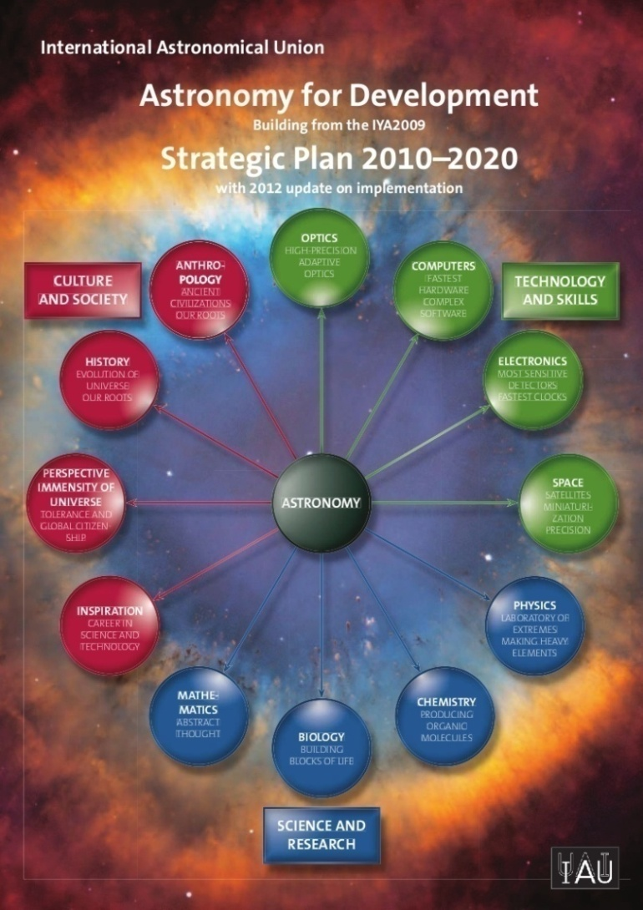
International Astronomical Union
Office of Astronomy for Development
SALT Board Meeting, June 2014
Contact: Kevin Govender
kg@astro4dev.org
www.astro4dev.org
Notes:
I’ll be happy to be contacted if anyone has any queries

Slide 2
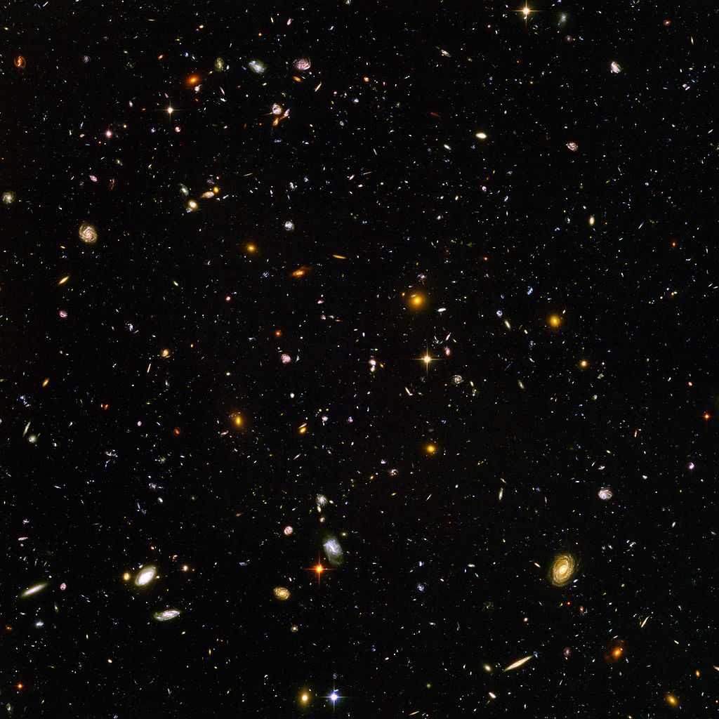
“Exploring the
Universe for the
benefit of
humankind”
Notes:
Reminder of the big picture – strategic plan is downloadable from the website

Slide 3
Milestones towards vision
Three Task Forces established and operational
Three regional nodes established, 4th imminent
One Language Expertise Centre
Six MOUs signed with partner organisations
>500 volunteers on database
Five Interns have passed through the OAD
Two calls for proposals have been implemented with:
18 projects in 2013 (191 applications)
23 projects in 2014 (230 applications)
Monitoring and Evaluation framework developed
OAD Funding Framework approved by Steering Committee
Several international workshops (e.g. Stakeholders in Cape Town, SpS at 2012 GA, Task force chairs workshop)
Glossy brochure (should be handed out - will refer to it)
Notes:
Overview of achievements – snapshot of what we’ve done

Slide 4
OAD Task Forces
Jean-Pierre de Grève (Belgium, C46)
Richard de Grijs (China)
Michèle Gerbaldi (France)
Edward Guinan (USA – Chair)
Roger Hajjar (Lebanon)
Edward Jurua (Uganda)
Katrien Kolenberg (USA - VC)
Hakim Malasan (Indonesia, Div C)
Shengbang Qian (China)
Nicole van der Bliek (Chile)
Rosa Doran (Portugal)
Edward Gomez (LCOGT,Cardiff - VC)
Mary Kay Hemmenway (USA, observer)
Robert Hollow (Australia)
Ofodum Chukwujekwu Nworah (Nigeria)
Rosa Maria Ros (Spain)
Pedro Russo (Leiden/UNAWE/C55, Chair)
Cecilia Scorza (Venezuela/Germany)
Linda Strubbe (Canada)
Akihiko Tomita (Japan)
Thilina Heenatigala (Sri Lanka)
Sarah Kendrew (UK - New Media)
Lars Lindberg Christensen (Germany, IAU C55)
Carolina Ödman (South Africa – VC)
German Puerta (Colombia)
Sze-leung Cheung (Japan, OAO)
Ian Robson (UK - Chair)
Komiko Usida (Japan)
Ziping Zhang (China)
1st Element: Foundations
Notes:
TFs established through open call for nominations as well as mix of experienced, new blood and ex-officio (e.g. Commissions 46, 55, OAO)

Slide 5
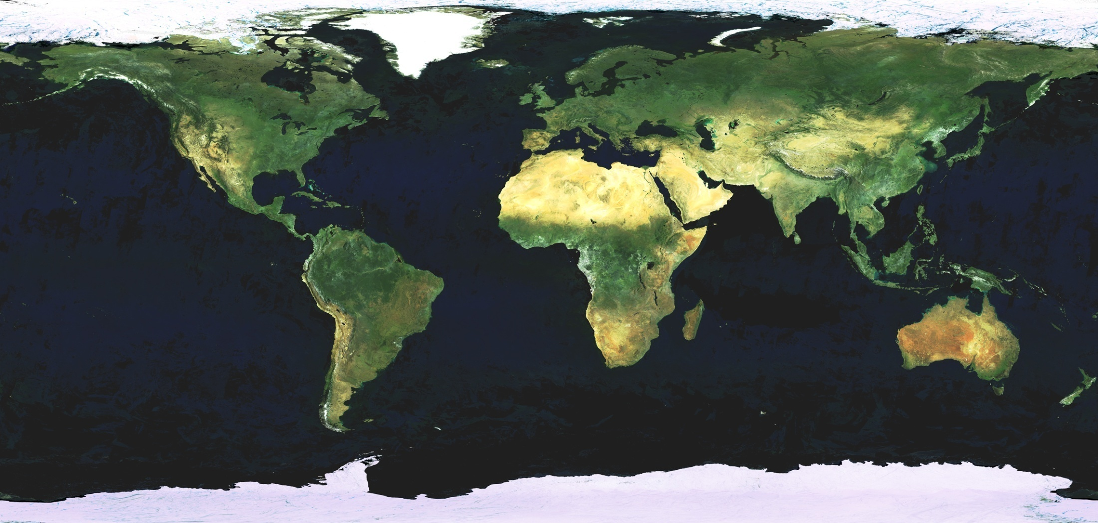
OAD Nodes
Eastern Europe,
Poland/Armenia
Lusophone,
Portugal
East Asia/Chinese,
China
Andean Region,
Colombia+partners
West Africa,
Nigeria
South East Asia,
Thailand
Gabon etc,
Francophone
East Africa,
Ethiopia
Brazil/Lusophone,
Brazil
Southern Africa,
Zambia
OAD
Global Office,
South Africa
White – established
Yellow – approved, awaiting signature
Blue – under discussion
1st Element: Foundations
2nd Element: Impact
Notes:
We are well underway for a global network!

Slide 6
OAD Partners
Royal Astronomical Society (GBP 5000 p.a)
Netherlands Organisation for Scientific Research (~€6000 p.a.)
International Centre for Theoretical Physics (~ €55000 p.a.)
Inter-University Centre for Astronomy and Astrophysics (local costs)
University of Central Lancashire (12 scholarships)
Haus der Astronomie (20% FTE)
More information: http://www.astro4dev.org/partners/
1st Element: Foundations
2nd Element: Impact
Notes:
Partners support wish list projects – we refer recommended projects to these opportunities.
RAS: visiting experts – soon to be both ways
NWO: visiting experts outwards from Netherlands
ICTP: workshops, associates, travel grants
IUCAA: hosting developing astronomers
UCLan: distance learning astronomy module
HdA: one day per week staff time to help with Latin America

Slide 7
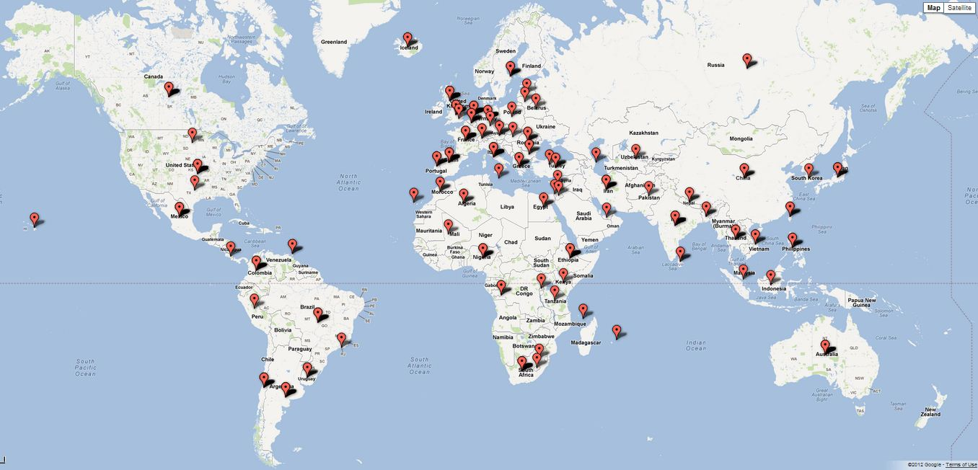
OAD Volunteers
IAU members, amateurs, professionals, teachers, students, public
Over 500 worldwide (on this map they are grouped by location)
1st Element: Foundations
2nd Element: Impact
Notes:
Volunteers register their skills and interests with the OAD.
We use this database whenever opportunities arise.
Example: Ethiopia needed astronomy and instrumentation skills for their new telescopes – over 20 feasible offers of assistance
Have a matching process with opportunities – need to automate this
With more funds can do more with volunteers
Use them to support wish list projects

Slide 8
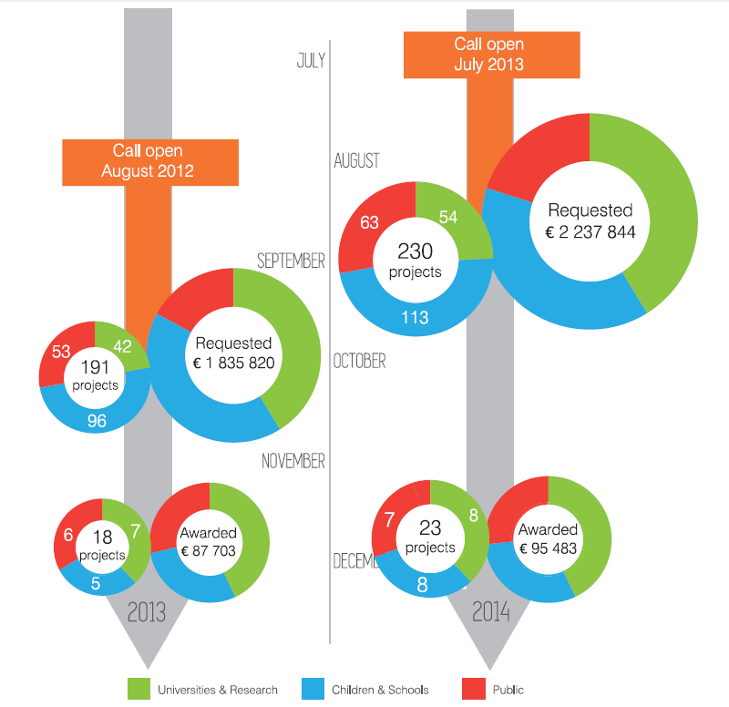
OAD Projects - Statistics
2nd Element: Impact
Notes:
20 % increase in demand
Funding only 10% by number
Importantly, the process is also a developmental one where proposers gain experience in writing proposals and conceptualising their projects. We have heard of projects that have been supported outside of the IAU funding simply because people now had a proposal they could put on their institutions’ tables or take to other funders. This is the benefit of the process.

Slide 9
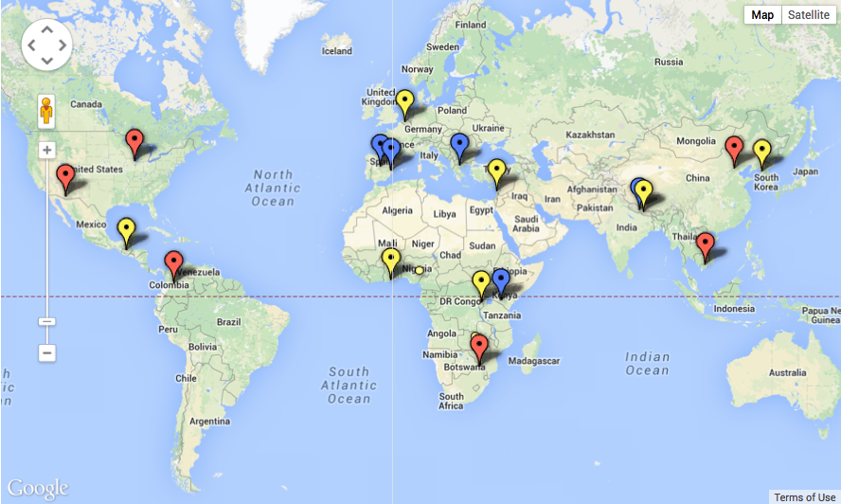
Overview of funded projects in 2013
Astronomy for Universities & Research
Astronomy for Children & Schools
Astronomy for the Public
2nd Element: Impact
www.astro4dev.org/funded-projects/
Notes:
Part of the selection process is geographical consideration
If someone asks why Nepal has more: Sometimes value for money is overwhelming – for 1000 EUR in Nepal can do what would cost 10 times as much elsewhere

Slide 10
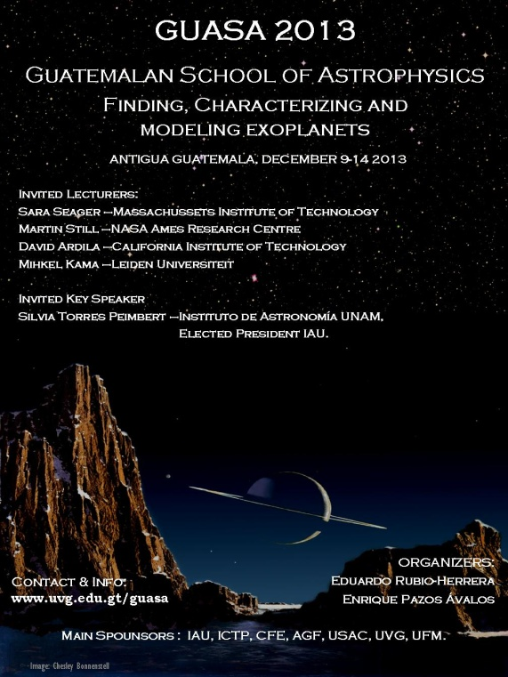
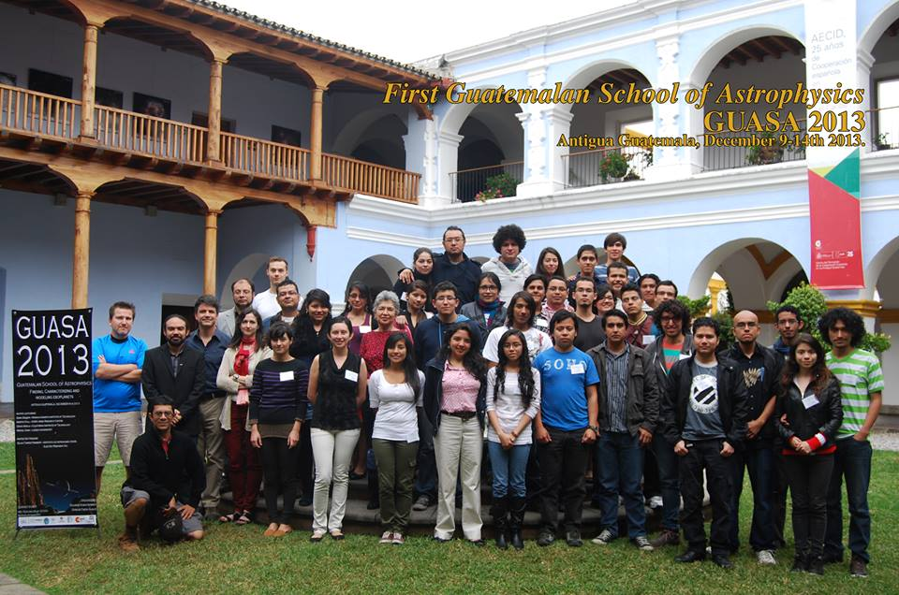
Astronomy for Universities and Research
Example: TF1 - funded projects
TF1G
The first “Guatemalan School of Astrophysics”, Guatemala
Project leader: Dr. Eduardo Rubio-Herrera
Launch of the first ever GUAtemalan School of Astrophysics (GUASA) to be held in a rural area of Guatemala every 2 years
33 students from local Central American/Caribbean undergraduate with experts from prestigious astronomical institutions from around the world
Martin Still (NASA Ames Research Centre), Sara Seager (MIT), David Ardila (Caltech), Mihkel Kama (Leiden University) and Silvia Torres-Peimbert, IAU President Elect, gave lectures on Exoplanets
2nd Element: Impact

Slide 11
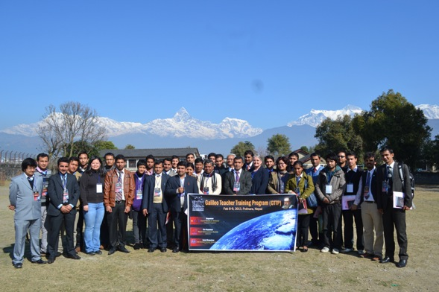
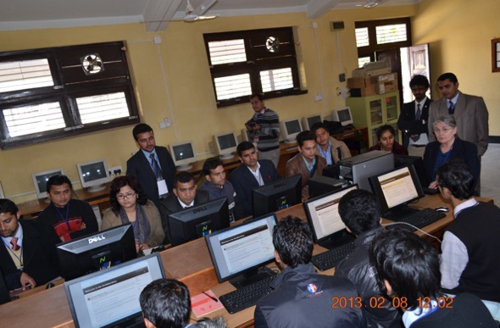
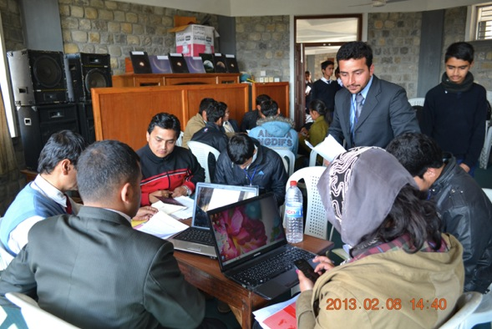
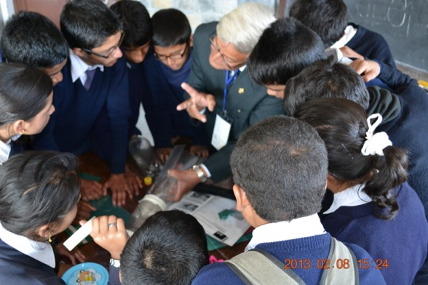
Astronomy for Children and Schools
Example: TF2 - funded projects
Galileo Teacher Training Program (GTTP), Nepal
Project leader: Mr. Sudeep Neupane
43 new Galileo teachers with the new hope of growing the community throughout the country.
8 lecturers
12 students (9th grade)
3 lectures, 4 workshops
Global impact in schools in Nepal
2nd Element: Impact
Notes:
Teacher training in Nepal – all this for 1000 Euro

Slide 12
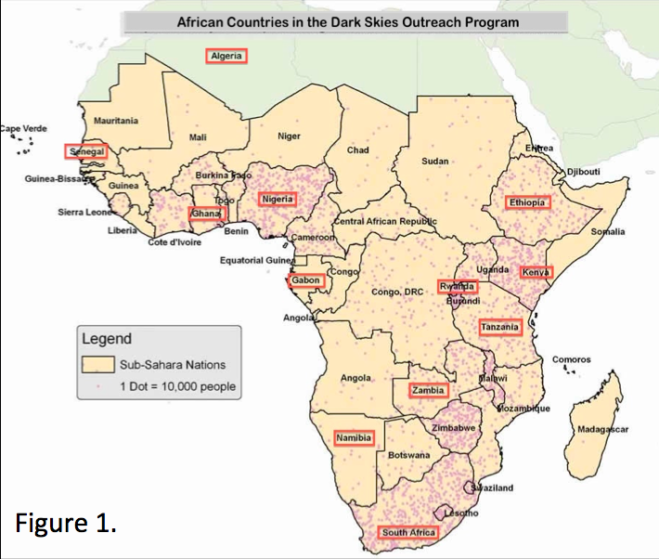
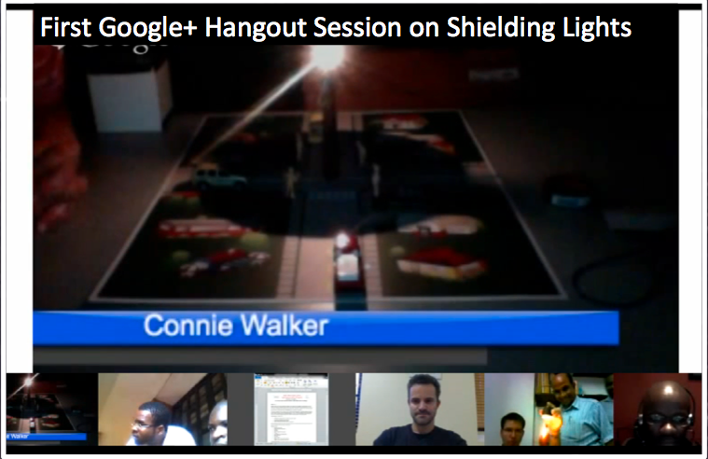
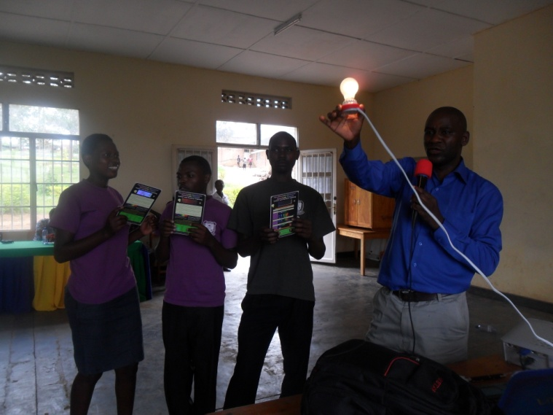
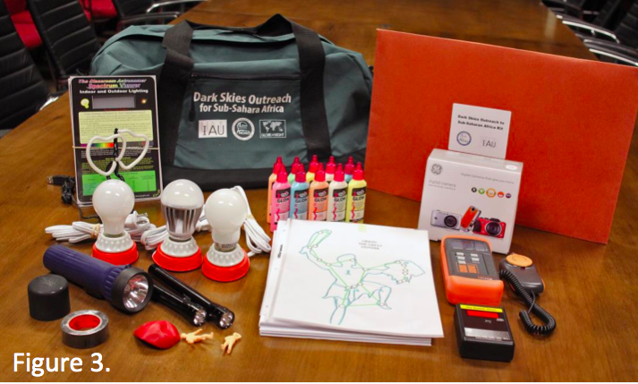
Example: TF3 - funded projects
Astronomy for the public
Dark Skies Outreach to Sub-Saharan Africa, USA/Africa
2nd Element: Impact
Notes:
Dark skies programme – this is the sort of activity that can be expanded for the IYL

Slide 13
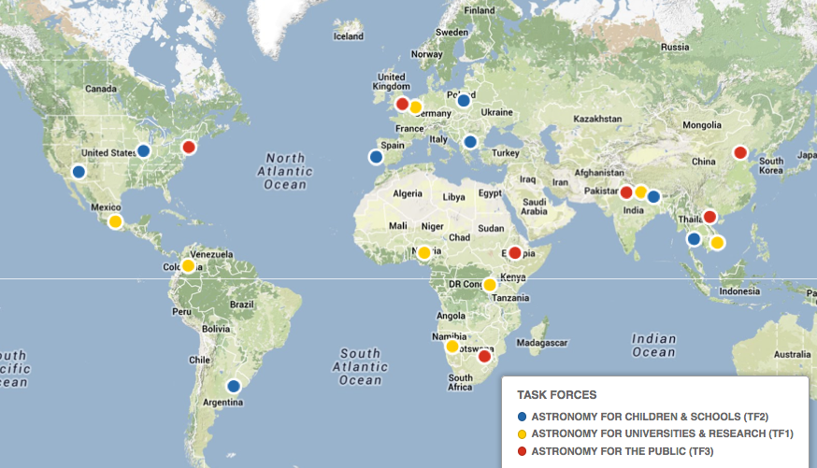
Overview of funded projects in 2014
http://www.astro4dev.org/funded-projects-2014/
2nd Element: Impact
Notes:
Good geographical spread – TFs rank projects then move down list looking at strategic aspects like geography and then test against proposal that was left out – done in a telecon and by email

Slide 14
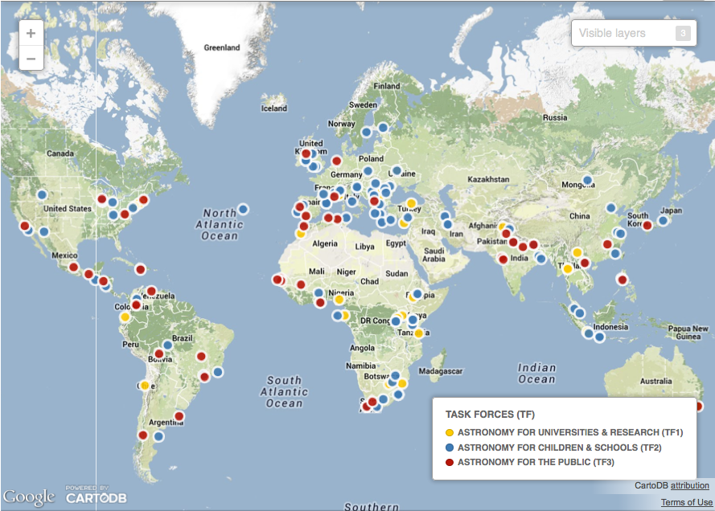
OAD wish list projects for 2014
2nd Element: Impact
www.astro4dev.org/2014-wish-list-projects/
Notes:
List comes about as an answer to the question: if you had unlimited funding would you fund this project? i.e. is it feasible/robust enough to be worthy of funding

Slide 15
Looking ahead: Activities for 2014
Fundraising
Communication – more publicity for OAD activities
New nodes – 6 key possibilities (West Africa, Francophone, Lusophone, Brazil, Andean region, Eastern Europe)
New partners – process needed to manage partners e.g. NASA Asteroid Grand Challenge
CFP2014 – release mid-2014
Method for managing projects e.g. online platform
Possible partnership with OpenUCT – open access journal for projects
1st Element: Foundations
2nd Element: Impact
3rd Element: Evaluating
4th Element: Sustainability
Notes:
Our experience and input from stakeholders informs our direction of efforts

Slide 16
Activities with Volunteers
Volunteer platform – match volunteers with opportunities
Volunteers forum
Using volunteers for OAD work
Volunteers assist with recommended projects
Hosting volunteers at OAD
Volunteers guest blogs
2nd Element: Impact
Notes:
This is a key resource that has been underutilised

Slide 17
Future of the OAD
The Strategic plan is for the decade 2010-2020
Much has been established and learned so far
Considerations for the future:
Host country (stay in SA or move?)
Looking back from 2020: what needs doing between now and then based on what we want achieved by 2020?
Does the OAD have the capacity to implement its mandate and achieve maximum impact?
Regional offices sustainability: reliance on OAD?
What happens after 2020?
4th Element: Sustainability
Notes:
This is the stuff that the SC and the IAU/NRF need to consider and what we hope can also be discussed at the FM

