Slide 1
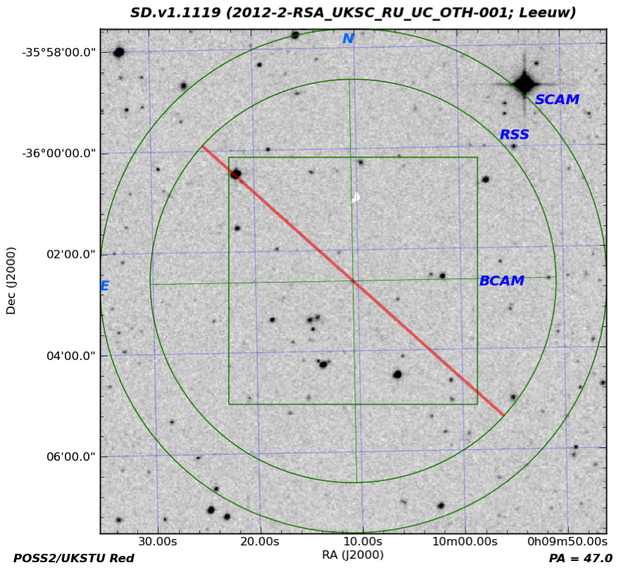
SALT Finding Chart and Detected Spectrum
of H-ATLAS Lens SDv1.1119 (V~20) at z = 0.443
Leeuw, Crawford, H-ATLAS-team et al. SAIP 2013

Slide 2
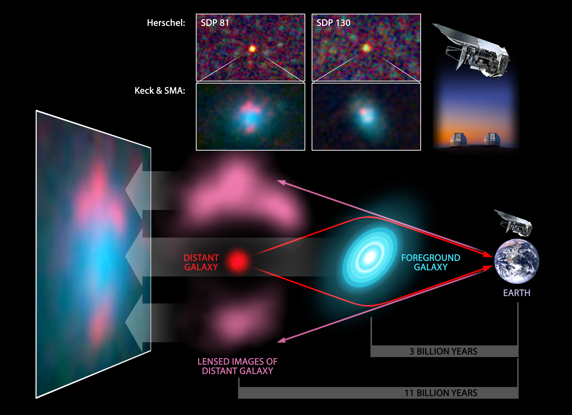
SALT (z of optical lens) &
MeerKAT / ALMA / SMA, SMG)
SALT, KecK (z of optical lens) &
MeerKAT / ALMA / SMA, SMG)
CREDITS: ESA/NASA/JPL--‐Caltech/Keck/SMA

