Slide 1
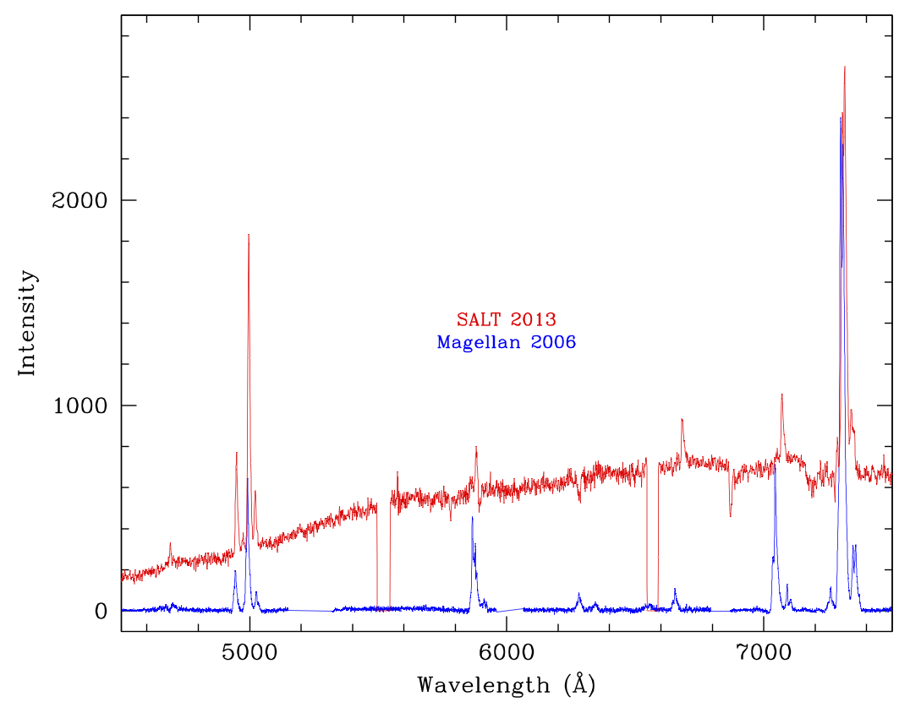
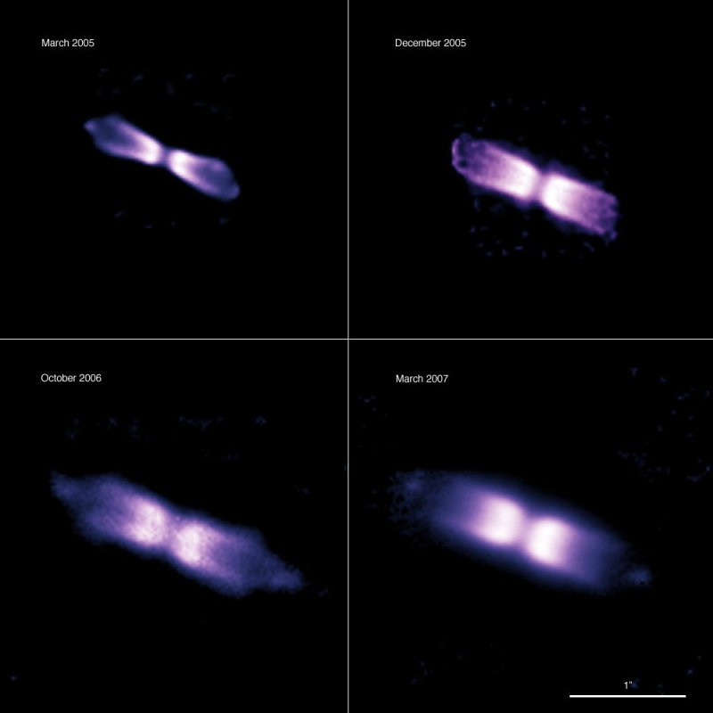
Spatio-kinematic modeling of the Helium nova V445 Puppis
2012-2-RSA_OTH-009 (PI: Woudt, University of Cape Town)
Bipolar outflow in the (only known)
helium nova V445 Puppis (note: arcsec scale)
(Woudt et al. 2009, ApJ, 706, 738)
SALT spectrum in 2013 revealed:
- re-emerging continuum source
- bipolar outflow in [OIII] and [OII] unchanged
- structure of HeI lines changed (at systematic velocity)

Slide 2
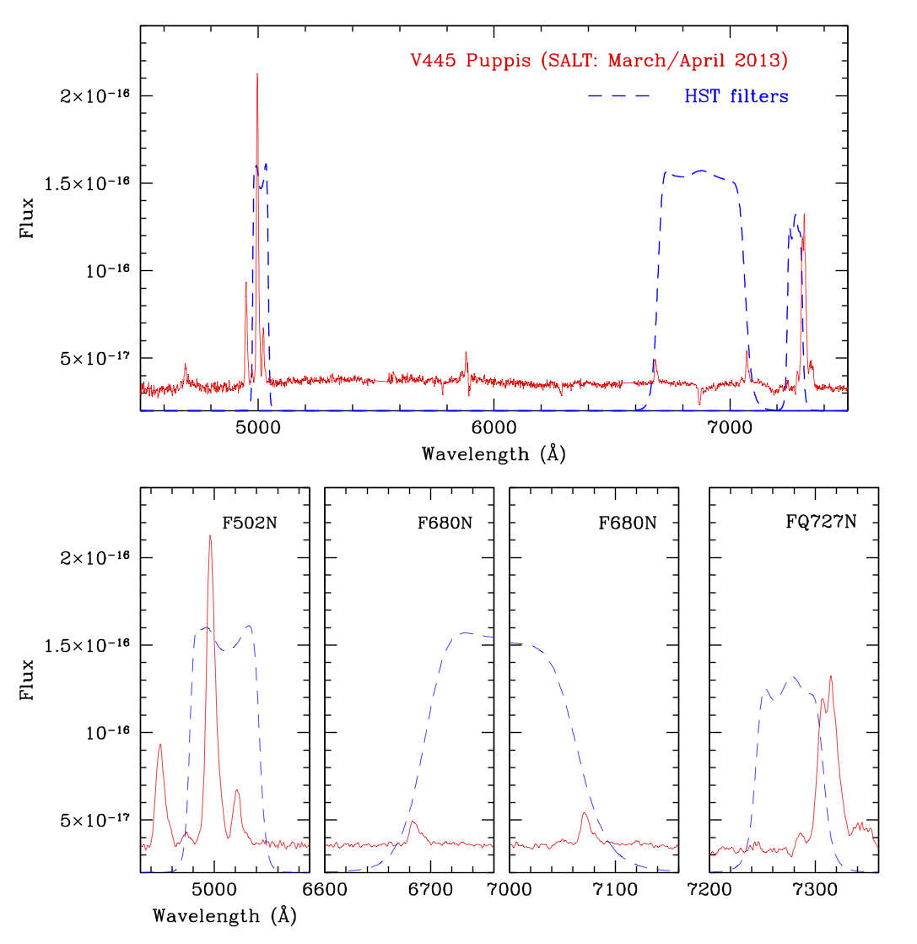
SALT spectra taken with PG0900 at March and April 2013 (along the major axis)
HST imaging (F502N, F680N and FQ727N) obtained on 16 April 2013
Improved spatio-kinematic model of V445 Puppis based on optical spectroscopy and optical imaging of the same lines (cf. optical spectroscopy and NIR imaging in 2005-2007)

