Slide 1
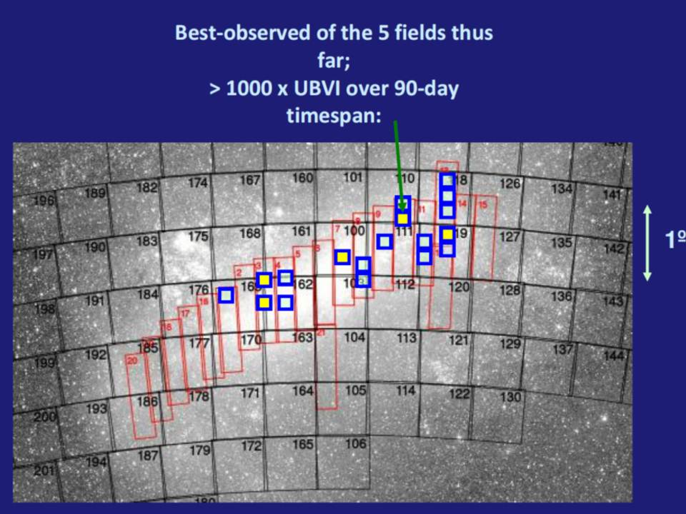
Long-term project to test effects of metallicity on pulsating B stars in the LMC (Engelbrecht, UJ):
UBVI photometry determines pulsation modes; MOS spectroscopy (with SALT) determines metallicity.
Squares show all fields select for study (5 yellow fields completed)

Slide 2
First fully-specced SALT MOS image taken March 2012 - 25 hot stars in one of the LMC fields just shown:

