Slide 1
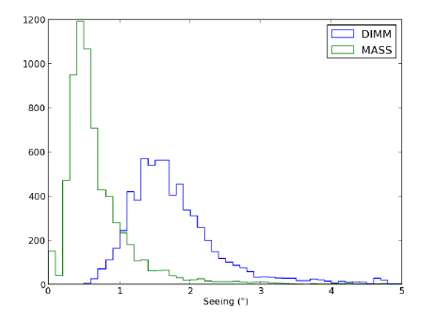
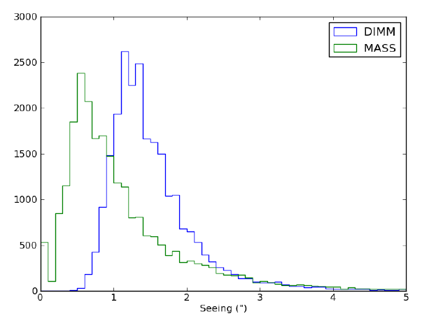
SALT 2012-1 Semester Report: seeing
2012-1:
1 May – 31 Oct
2011-2:
1 Sep – 30 Apr
Median = 1.66”
Median = 1.38”
Seeing values consistently worse than expected from long term DIMM measurements:
Old SAAO DIMM (1994-2000) gave median 0.9”
New DIMMs (Mar 2010 – Mar 2011) gave median 1.3” (53,938 measurements)
Difference partly attributed to different exp time (10 ms vs. 3 ms) coupled with mean
coherence time of the atmosphere at Sutherland (2.44 ms).

Slide 2
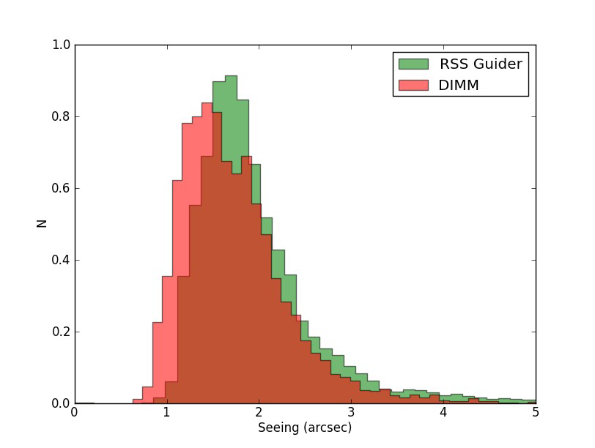
SALT 2012-1 Semester Report: seeing vs. telescope delivered image quality
Sep – Nov 2011
~1.2x degradation between ideal seeing limited images and real telescope images.
1.1 – 1.2 x degradation between zenith seeing and seeing at telescope airmass (1.2 – 1.4)
Rule of thumb: BEST expected IQ is ~1.4 x actual DIMM seeing value (for perfectly aligned primary mirror array)
For 2012-1, this implies expected median IQ is 2.3”. One reason why poor seeing programs
were more successful.

Slide 3
SALT 2012-1 Semester Report: observing statistics
Month | Median Night Length (h) | Fraction lost to weather | Fraction of engineering time | Fraction lost to faults | Fraction for Science
May2012 | 10.73 | 35% | 8% | 9% | 47%
Jun 2012 | 11.04 | 56% | 3% | 9% | 32%
Jul 2012 | 10.88 | 50% | 5% | 8% | 38%
Aug 2012 | 10.26 | 53% | 6% | 5% | 36%
Sep 2012 | 9.35 | 39% | 8% | 5% | 47%
Oct 2012 | 8.22 | 58% | 12% | 3% | 27%
Average | 10.08 | 49% | 7% | 6% | 38%
Spec |  | 25% | 7% | 3% | 65%
Previous semester 2011-2 (Sep 2011 – Apr 2012):
Average | 8.1 | 35% | 12% | 13% | 40%

Slide 4
SALT 2012-1 Semester Report: completion statistics
Number of accepted observing Proposals: |  |  |  | 153
Number of Proposals with any observations done: |  |  |  | 102
Number of Proposals with >95% completion: |  |  |  | 15
Number of Proposals with >50% completion: |  |  |  | 42
Total available: | 950.0 h | Total Charged*: | 408.3 h | Total Completion: | 43.0%
P0+1 available: | 190.0 h | P0+1 Charged*: | 92.3 h | P0+1 completion: | 48.6%
P2 available: | 285.0 h | P2 Charged*: | 114.1 h | P2 completion: | 40.0%
P3 available: | 475.0 h | P3 Charged*: | 201.9 h | P3 completion: | 42.5%
Expected total observed: 58% of 950h = 551 h
Actual total observed: 408 h
“Efficiency”: 74% (<100% due to overheads & rejected blocks)

Slide 5
SALT 2012-1 Semester Report: completion statistics
Partner Allocations
Partner | Allocated Time |  |  |  | Observed Time |  |  |  | Percent Completed |  |  |  | Allocated | Observed
 | P0+P1 | P2 | P3 | Total | P0+P1 | P2 | P3 | Total | P0+P1 | P2 | P3 | Total | Share | Share
GU | 33012 | 49500 | 165024 | 247536 | 8603 | 18379 | 36937 | 63919 | 26.1 | 37.1 | 22.4 | 38.7 | 4.8 | 4.3
UW | 94140 | 141192 | 470700 | 706032 | 71730 | 29038 | 29004 | 129772 | 76.2 | 20.6 | 6.2 | 27.6 | 13.8 | 8.8
RSA | 202860 | 304272 | 1014228 | 1521360 | 74621 | 174667 | 319371 | 568659 | 36.8 | 57.4 | 31.5 | 56.1 | 29.7 | 38.7
UNC | 16560 | 24840 | 82800 | 124200 | 18771 | 19396 | 28219 | 66386 | 113.4 | 78.1 | 34.1 | 80.2 | 2.4 | 4.5
UKSC | 25128 | 37656 | 125568 | 188352 | 16475 | 23619 | 50971 | 91065 | 65.6 | 62.7 | 40.6 | 72.5 | 3.7 | 6.2
DC | 57348 | 86040 | 286812 | 430236 | 41302 | 22679 | 43722 | 107703 | 72 | 26.4 | 15.2 | 37.6 | 8.4 | 7.3
RU | 60263 | 90432 | 301392 | 452088 | 37348 | 26875 | 28479 | 92702 | 62 | 29.7 | 9.4 | 30.8 | 8.8 | 6.3
POL | 58463 | 87732 | 292392 | 438588 | 22523 | 52440 | 107182 | 182145 | 38.5 | 59.8 | 36.7 | 62.3 | 8.5 | 12.4
CMU | 15768 | 23616 | 78768 | 118152 | 0 | 0 | 0 | 0 | 0 | 0 | 0 | 0 | 2.3 | 0
UC | 18720 | 28080 | 93636 | 140472 | 3794 | 4688 | 9376 | 17858 | 20.3 | 16.7 | 10 | 19.1 | 2.7 | 1.2
HET | 51876 | 77832 | 259416 | 389088 | 17500 | 10266 | 0 | 27766 | 33.7 | 13.2 | 0 | 10.7 | 7.6 | 1.9
AMNH | 10476 | 15732 | 52416 | 78588 | 0 | 0 | 12463 | 12463 | 0 | 0 | 23.8 | 23.8 | 1.5 | 0.8
IUCAA | 39384 | 59076 | 196884 | 295344 | 19552 | 28692 | 61099 | 109343 | 49.6 | 48.6 | 31 | 55.5 | 5.8 | 7.4

