Slide 1
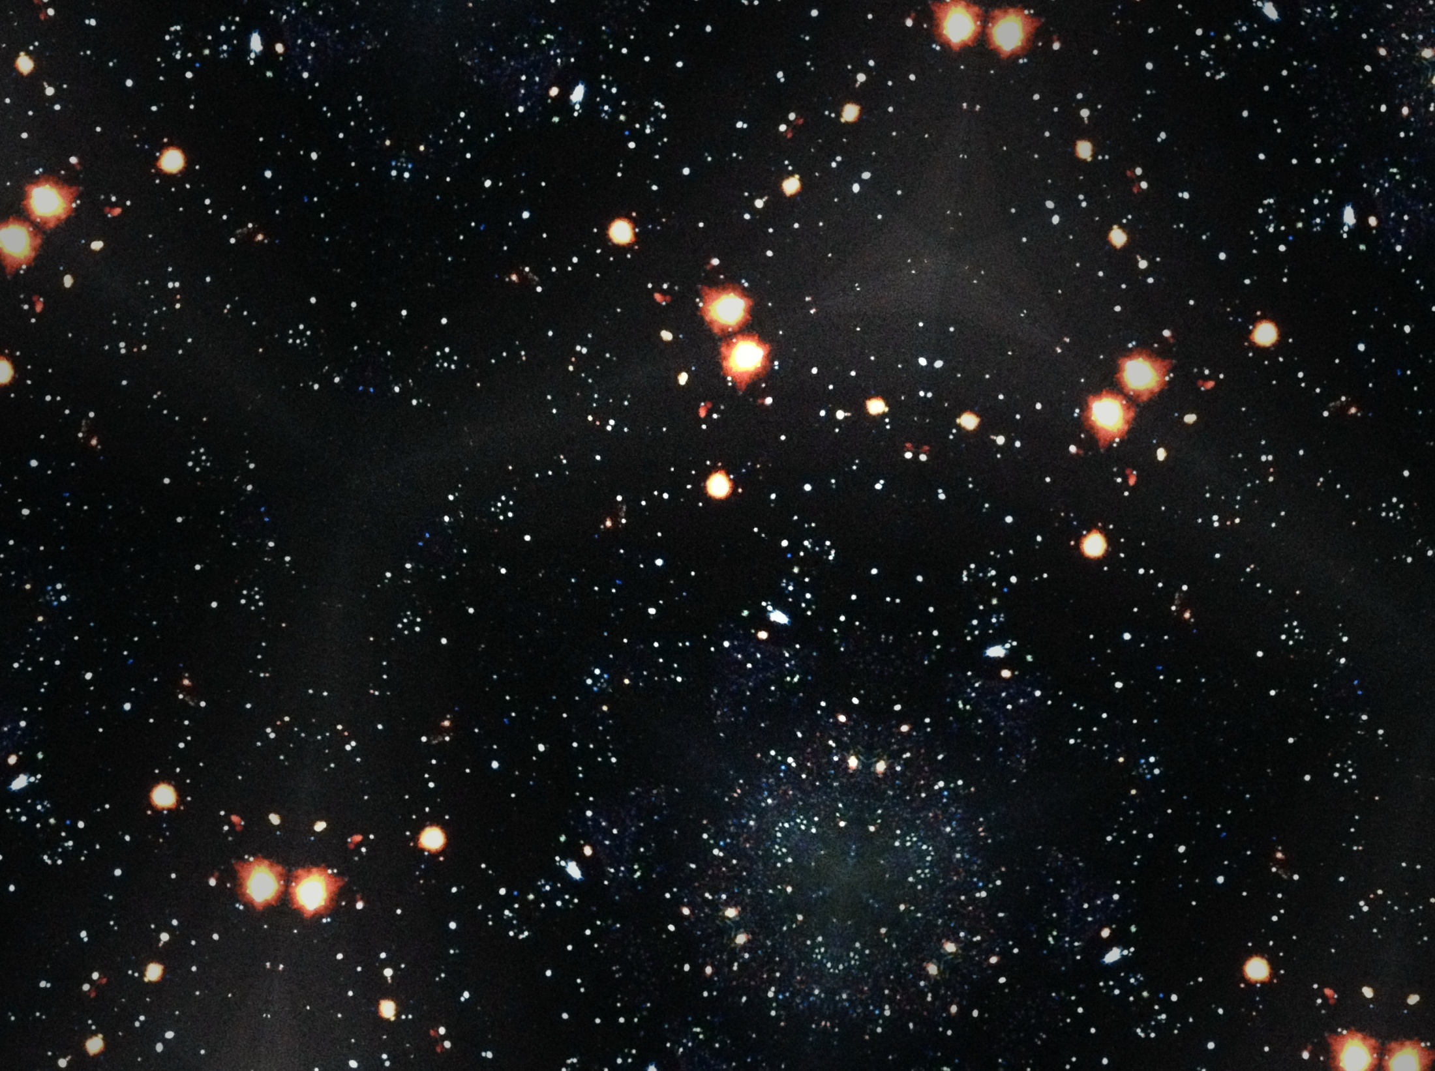
The XMM-Newton Survey of SMC a large collaboration involving the following:
F. Haberl, W. Pietsch, R. Sturm (MPE)
J. Ballet, D. A. H. Buckley, M. Coe, R. Corbet, M. Ehle, M. Filipovic, M. Gilfanov, D. Hatzidimitriou, N. La Palombara, S. Mereghetti, S. Snowden and A. Tiengo

Slide 2
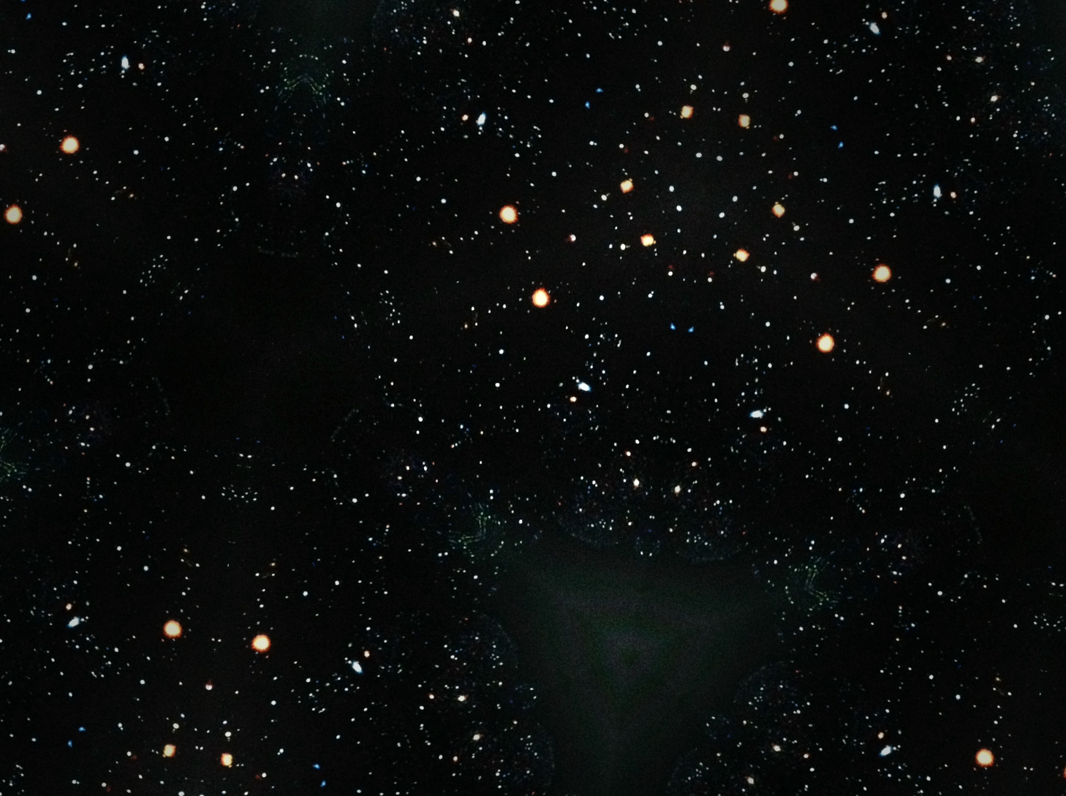
The XMM-Newton Survey of SMC
A survey to cover most of the SMC not already observed during XMM pointed observations
Conducted from May 2009 to March 2010
EPIC pn & MOS (0.2 – 12 keV)
Consisting of 33 observations of 30 fields not already in the XMM archive
A total of 1.1 Msec
Supplemented by 62 archival observations totalling 1.6 Msec; half of the calibration source 1E0102.2-7219 (SNR)
main survey field 5.6 square degrees (continuous over bar and wing), plus additional 6 archive pointings

Slide 3
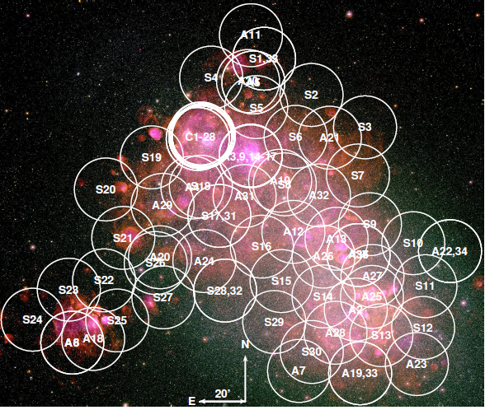
The Survey Pointings
(displayed on MCELS survey image
H-alpha/[S II]/[OIII] in red, green, and blue)

Slide 4
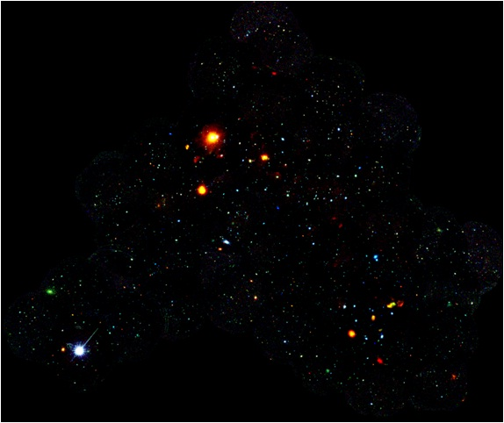
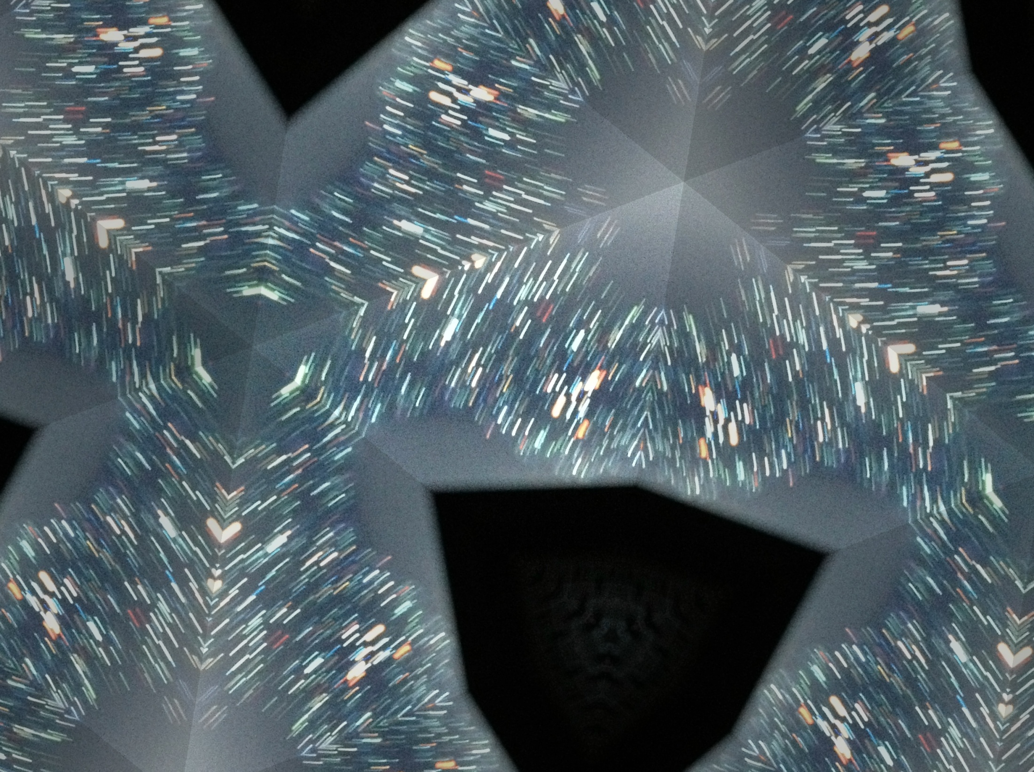
Mosaic of XMM Images
0.2 – 1.0 keV
1.0 – 2.0 keV
2.0 – 4.5 keV

Slide 5
Overview Of The Survey
91 pointings over 10 yrs (April 2000 to April 2010)
5.6 sq degrees covered with net exposure of ~2 Ms
A total of 5236 point-like sources (incl 207 moderately extended sources; 188 < 6” in size; 19 are 6 – 30”)
A total of 3053 unique point sources (Point Source Catalogue: Sturm et al. 2012, submitted)
2457 likely IDs (80%) of which 85% are AGN
Plus 23 SNR & 5 Galaxy Clusters (extended)

Slide 6
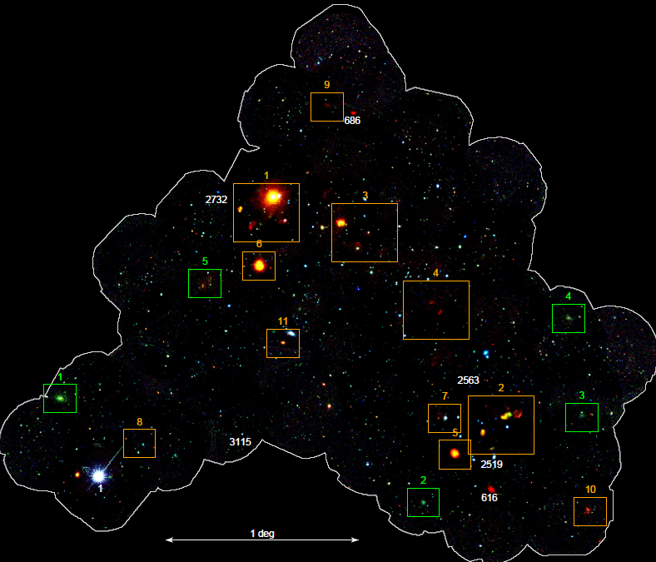
SNRs & Galaxy Clusters
Orange boxes: SNRs
Green boxes: galaxy clusters
Blue objects (with a number): new Be/X-ray binaries
Red objects: Super Soft Sources
PNe SMC22
SMC X-1
SMC 3

Slide 7
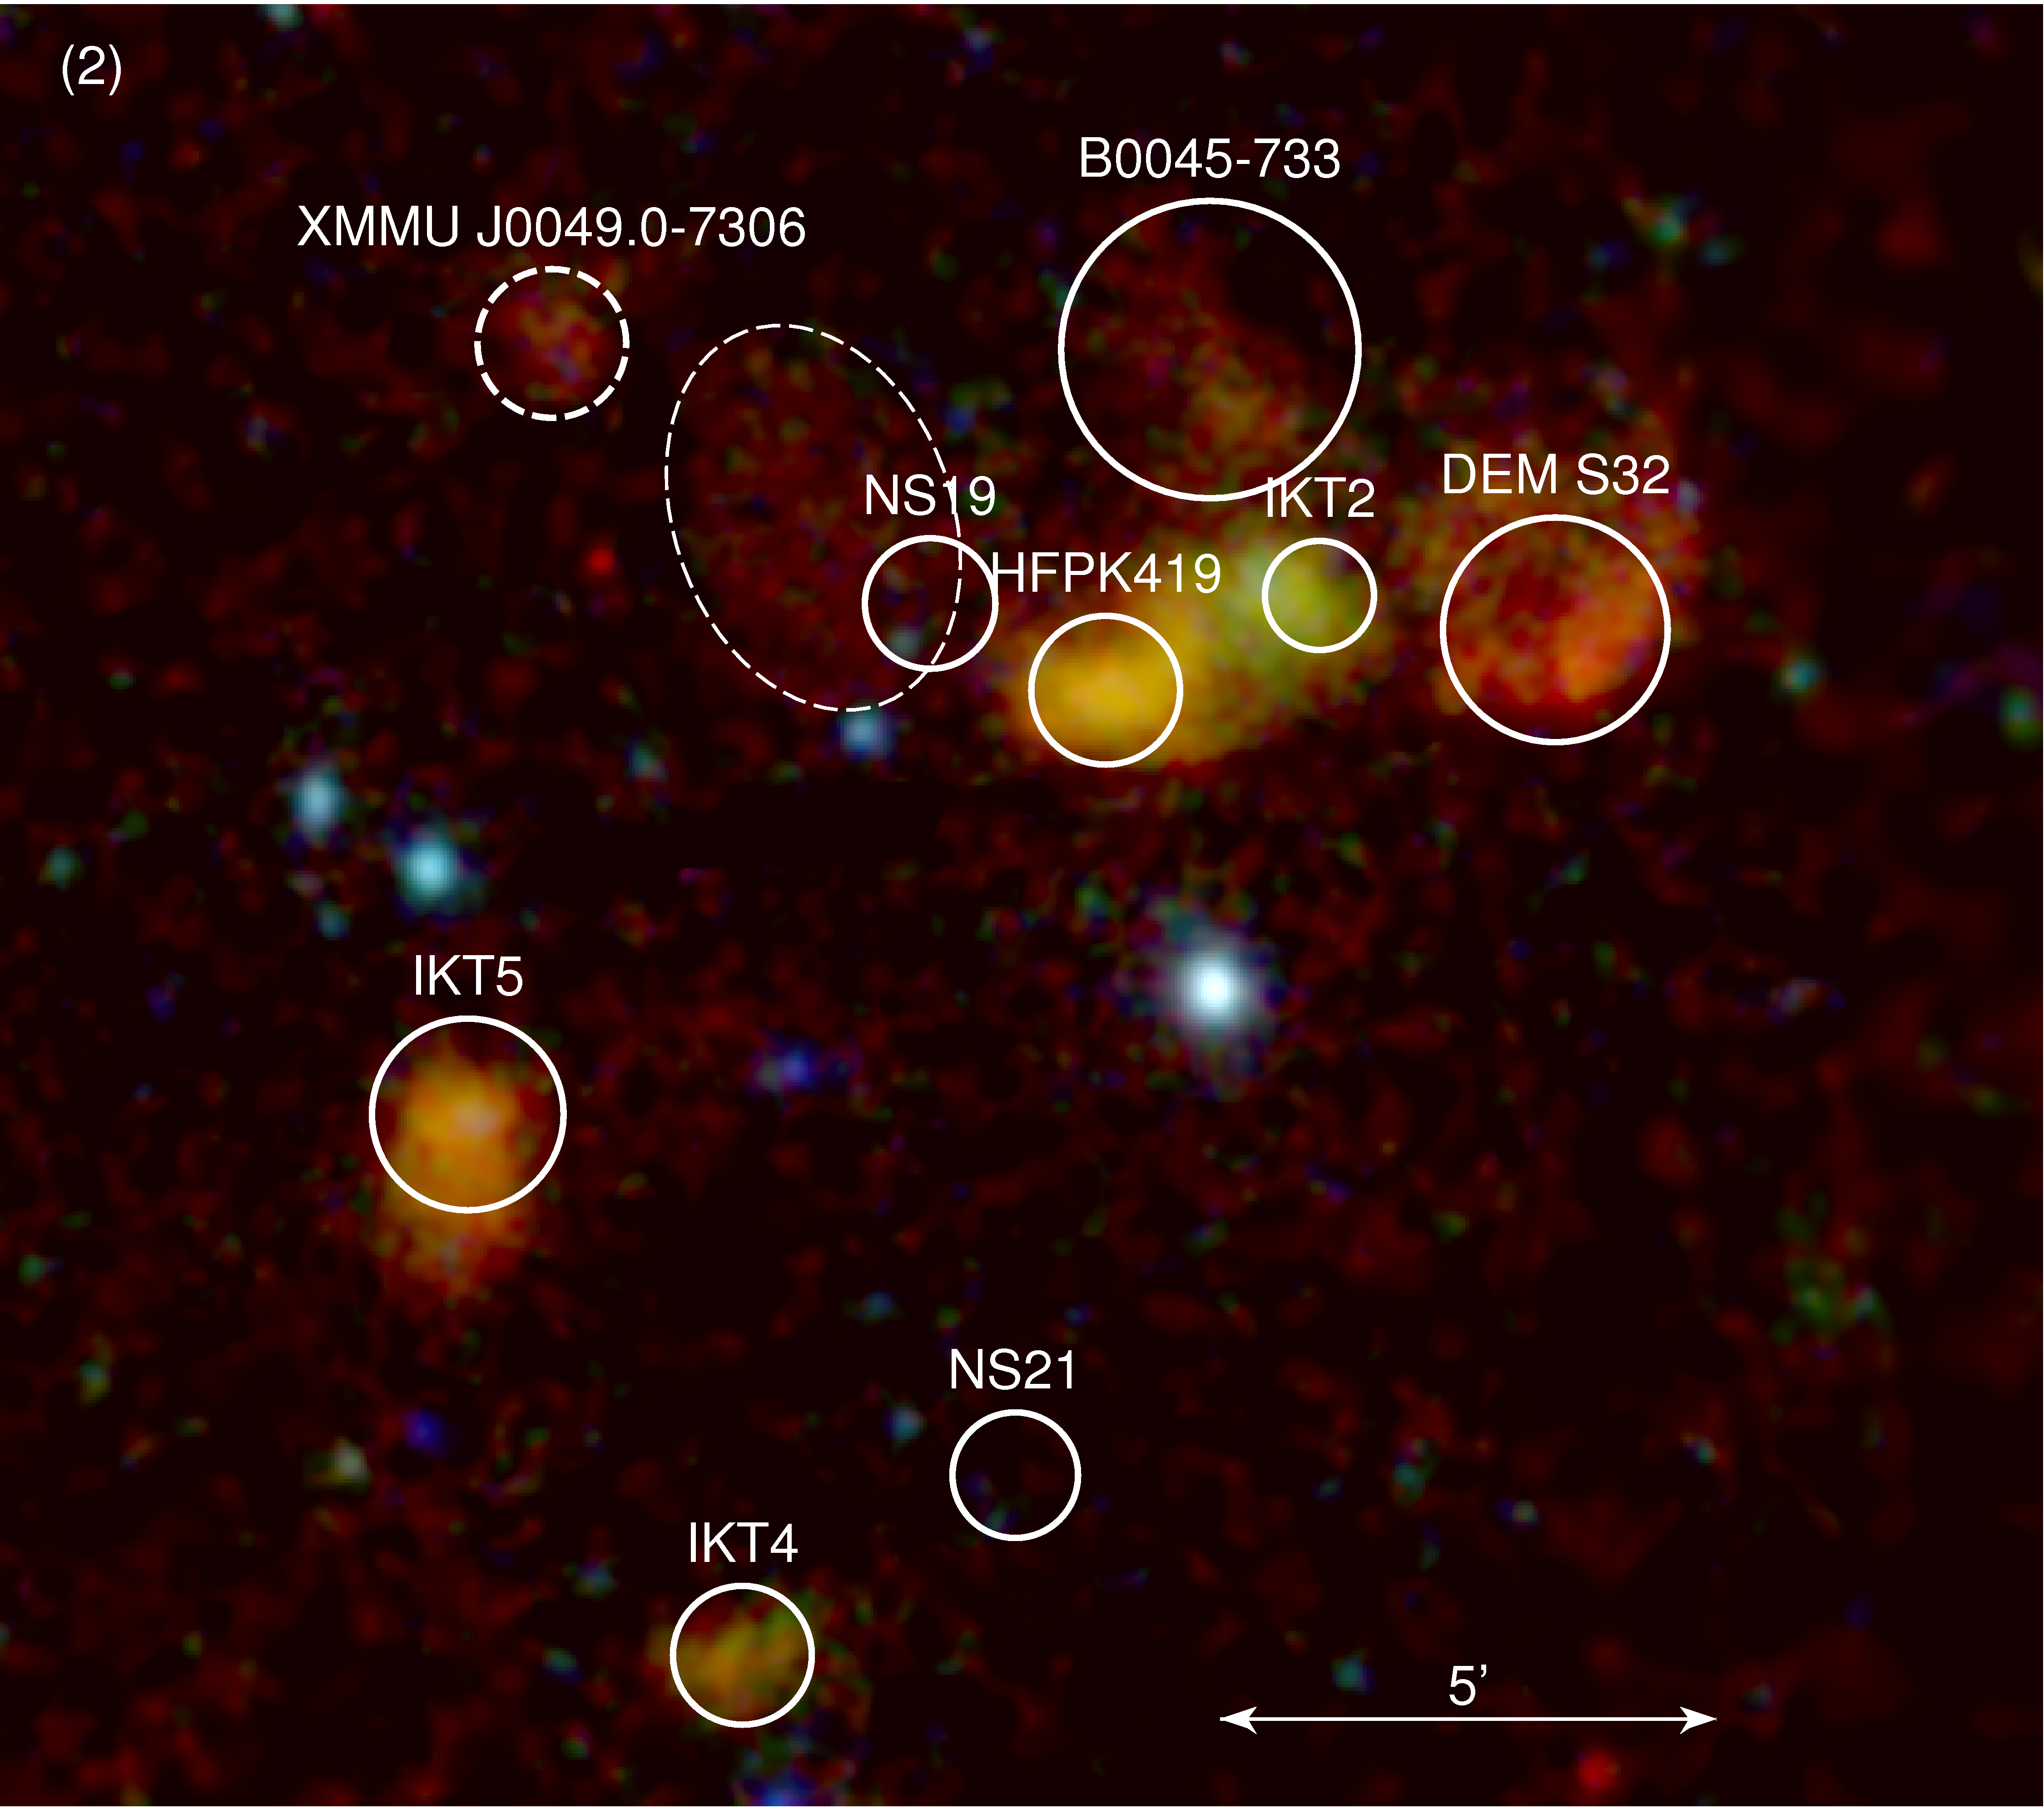
SNR Gallery
Most bright SNRs observed by XMM previously (van der Heyden et al. 2004)
20/23 previously catalogued SNRs (Badenes et al. 2010)
Concentrated in bar
3 new SNRs
5 show larger extent in EPIC images (age implications)
Spectra < 2keV

Slide 8
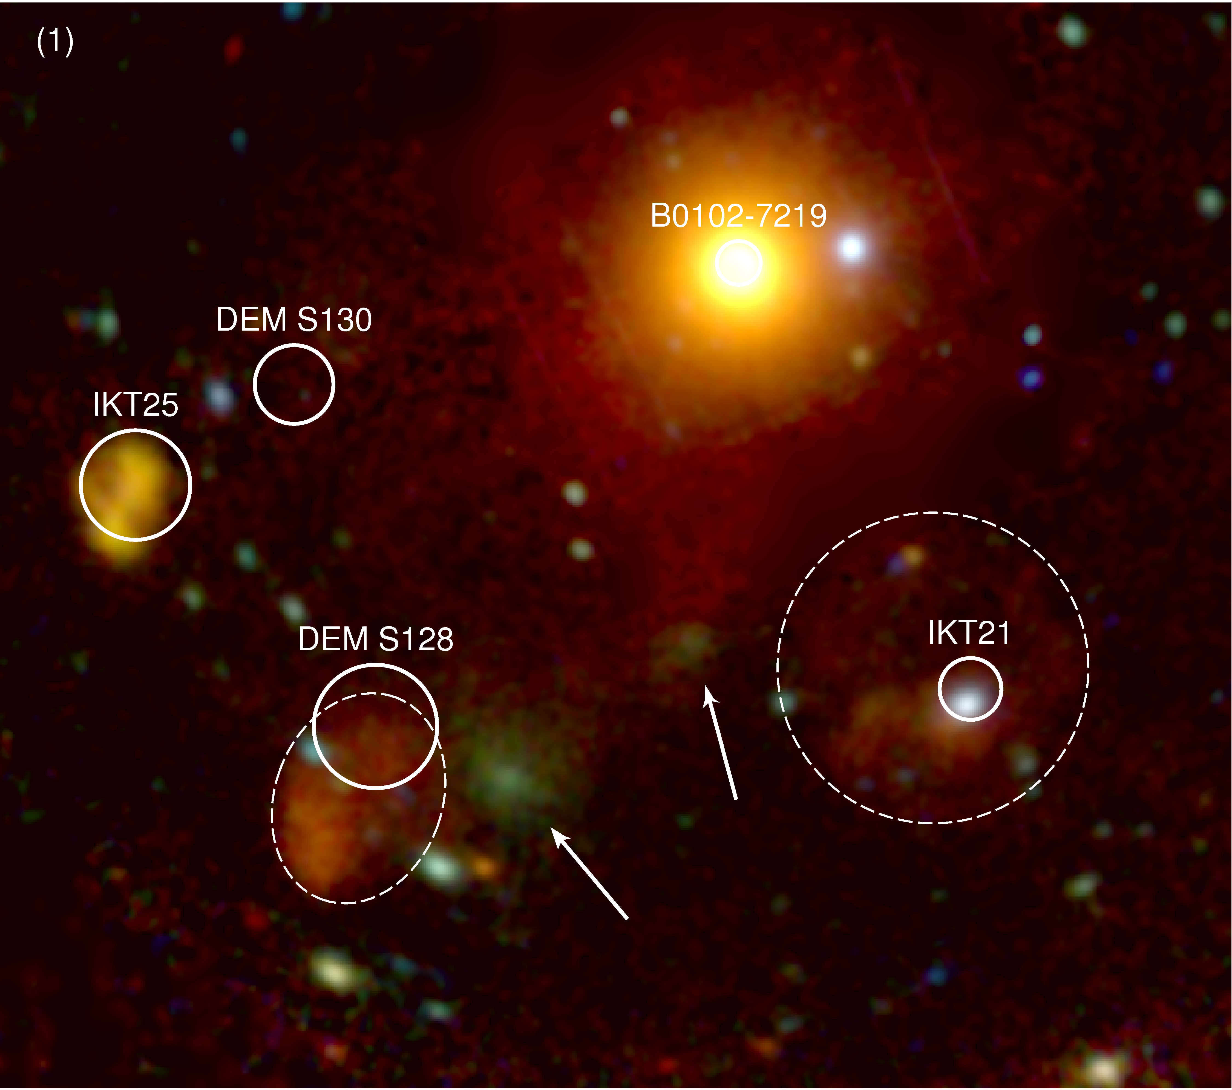
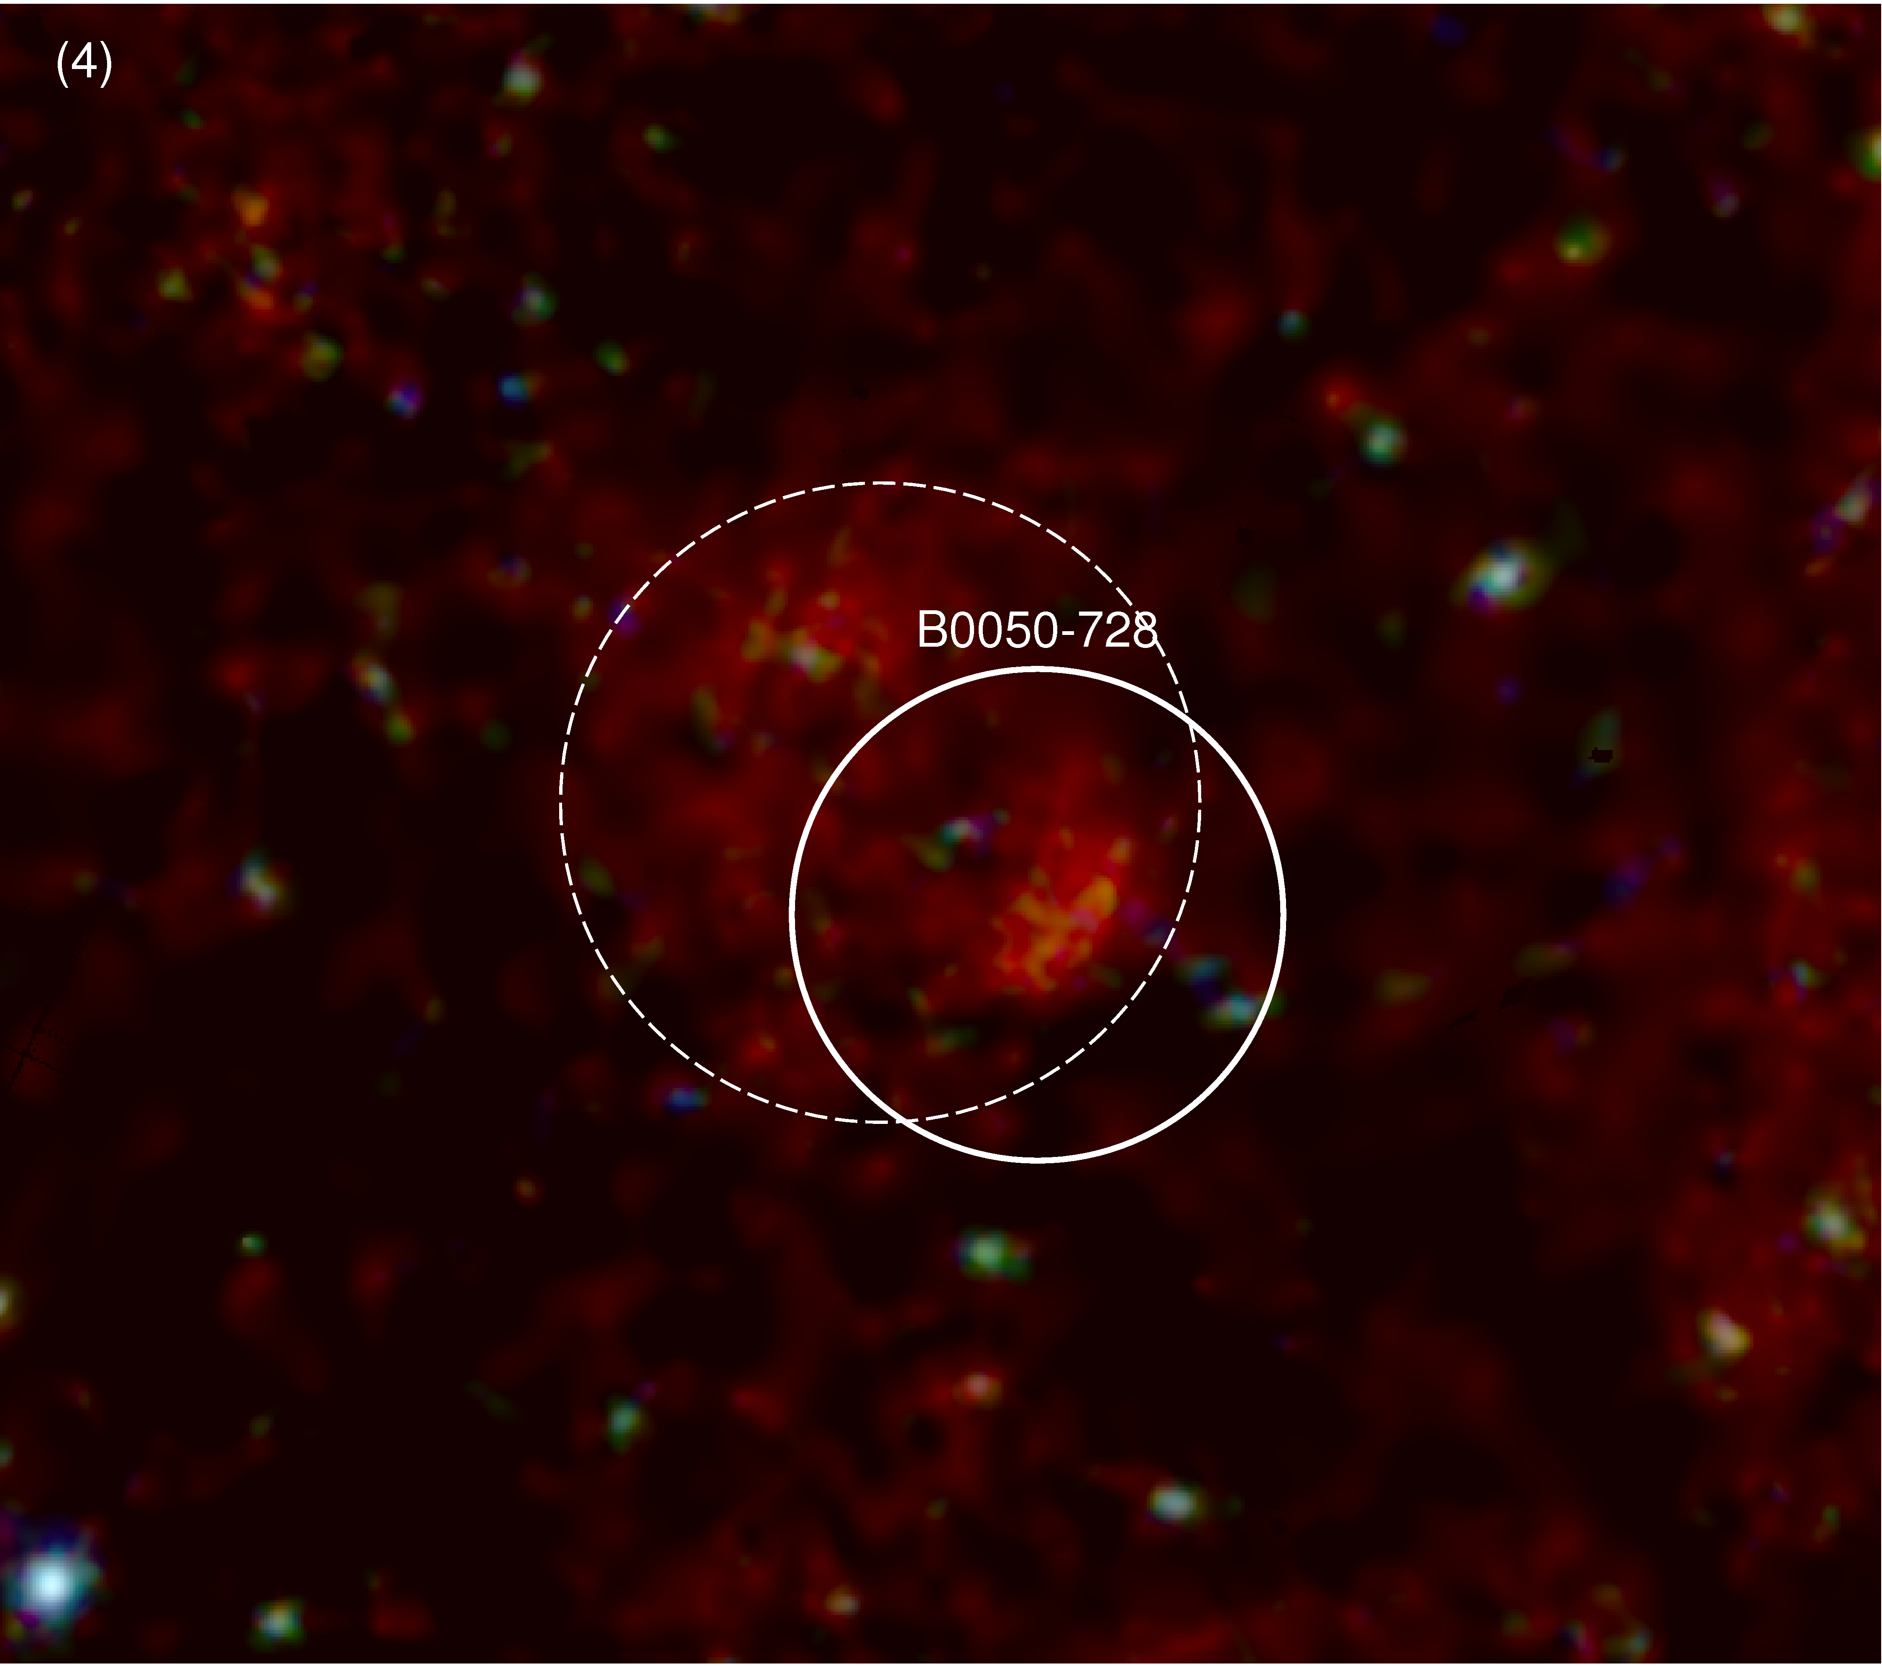
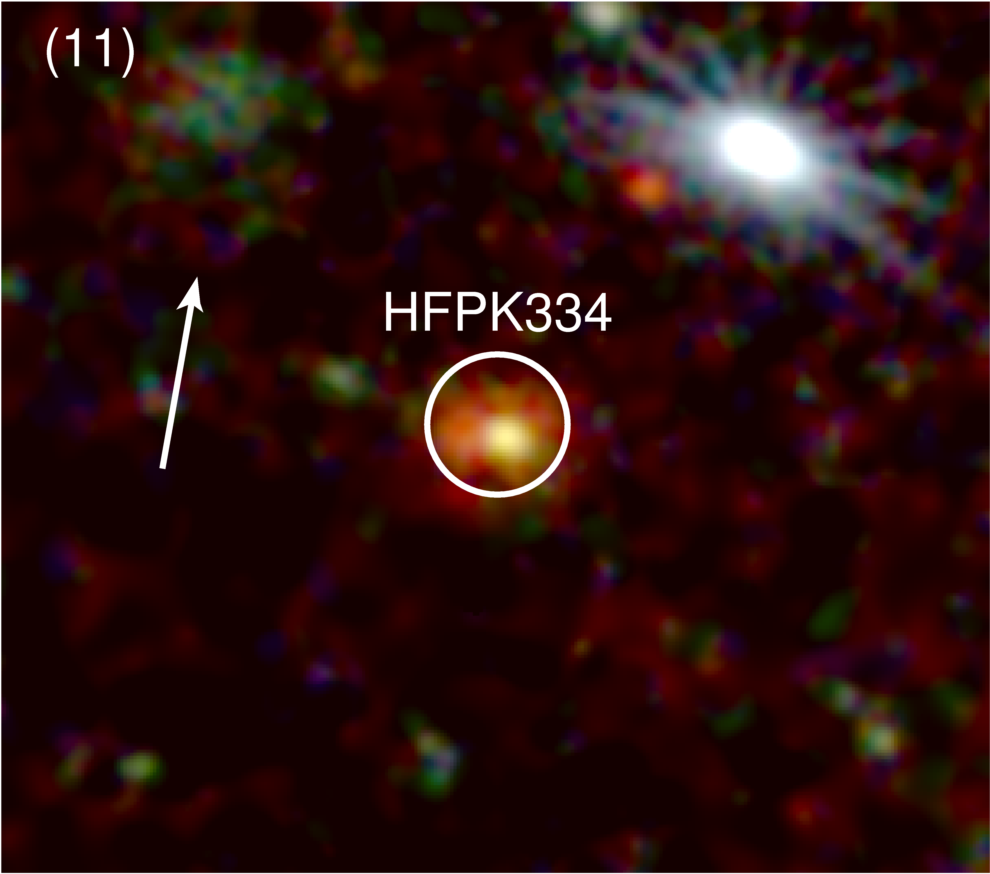
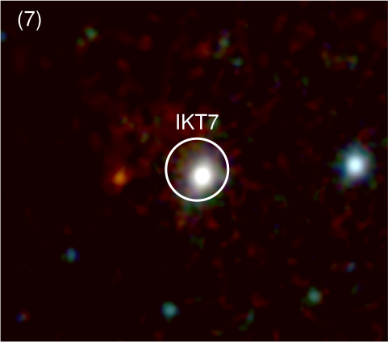
SNR Gallery (2)
3 previously catalogued not detected
  DEM S1300, NS21: nothing
  IKT7: hard172s Be/X-ray pulsar

Slide 9
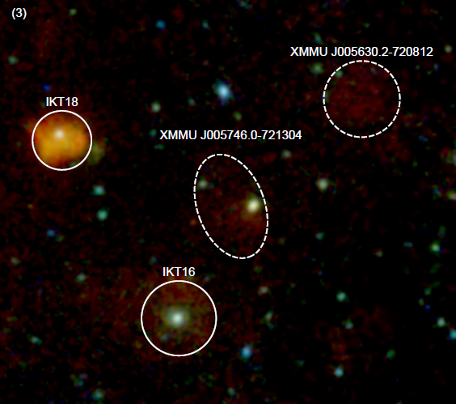
SNR Gallery (3)
2 new SNRS
One (XMMU J005630.2-720812) now has confirming SALT spectroscopy

Slide 10
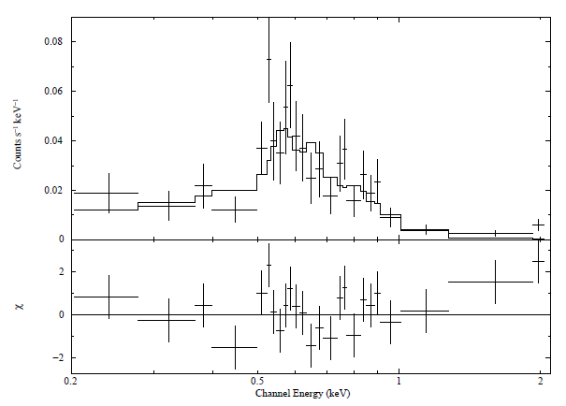
Examples of new SNR X-ray Spectra
XMMU J005630.2-720812
Sedov model
Derived age: ~21,000 yr

Slide 11
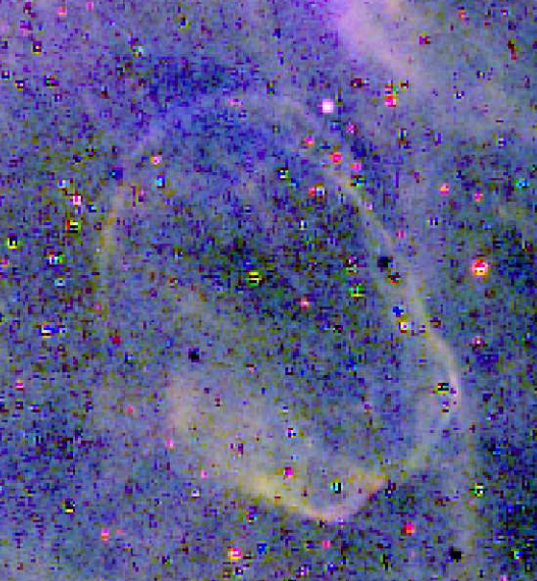
Multi-Wavelength Survey Followups
Example (XMMUJ005630.2−720812 =SNRC6):
SMC 13cm ATCA (Filipovic)
MC Em Line Survey (MCELS)
use radio & X-ray & optical (em. line) images to select regions for SALT optical spectroscopic followup

Slide 12

Optical Followup Studies with SALT
Use RSS to obtain spectra:
To confirm SNR properties
Use line diagnostics to obtain physical parameters
Identify candidates for more intensive followup (e.g. F-P)
Proposal 2012-2-RSA_OTH-013 (Buckley, Filipovic & van der Heyden) aimed to take LS spectra of 8 candidate SNRs (both from this survey andvATCA (radio) candidates and 2 “control” objects (i.e. know SNRs)
All observations (typically 1000-1270 s) completed and data being analyzed

Slide 13
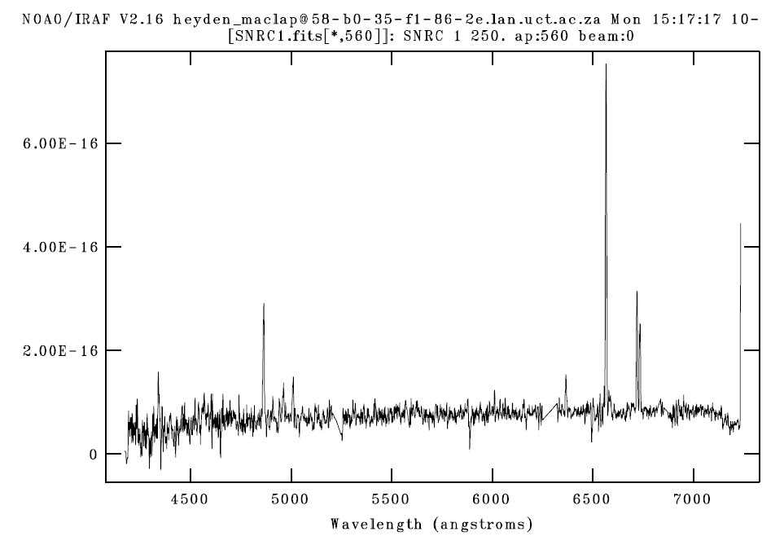
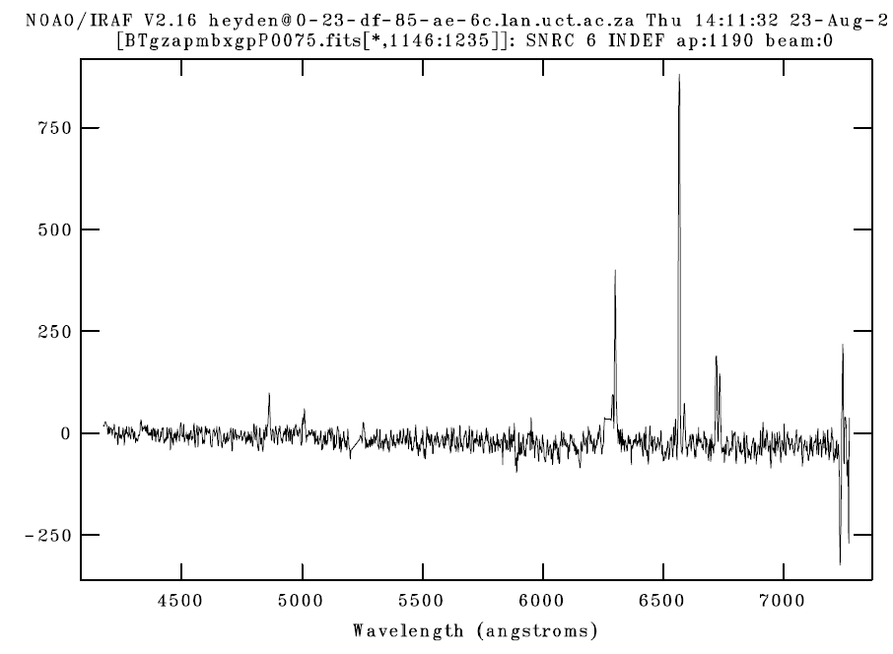
SALT Followup Spectroscopy of SNRs
RSS LS spectra: likely SNRs
SNRC1 = XMMUJ005630.2−720812
SNRC16 = ACTA candidate

Slide 14
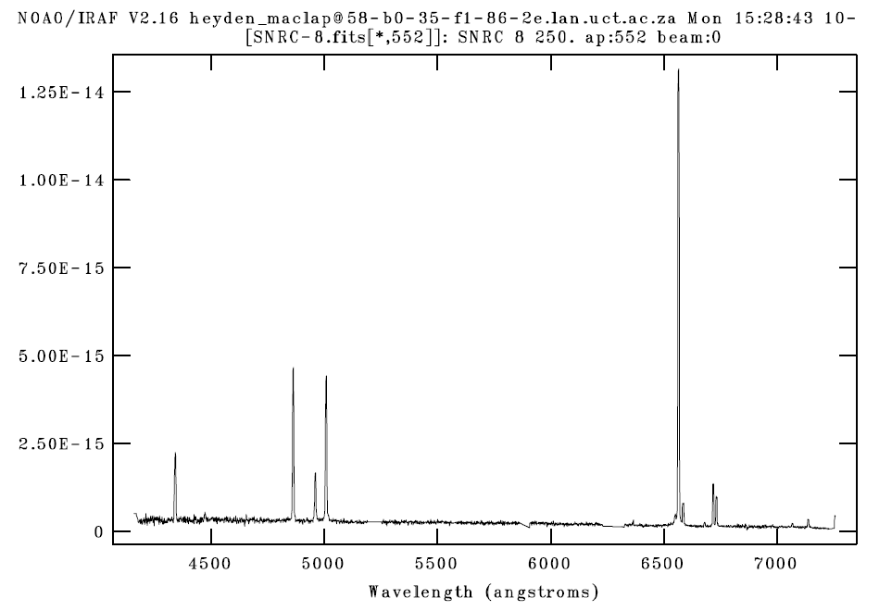
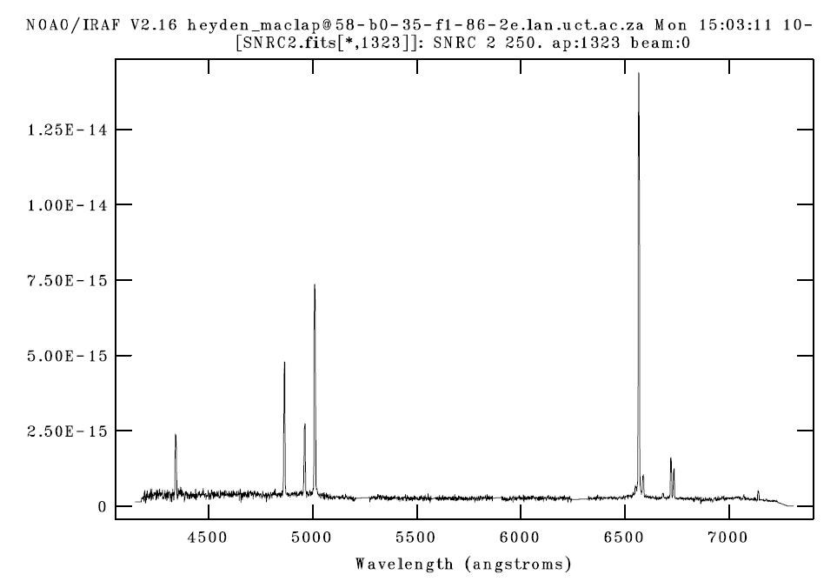
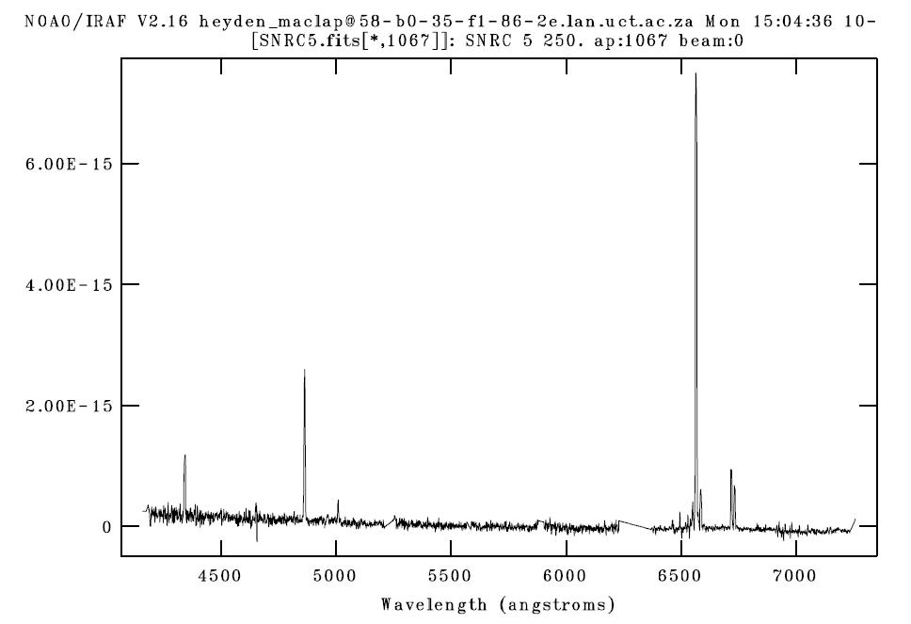
SALT Followup Spectroscopy of SNRs
RSS LS spectra: not SNRs (HII, PNe?

