Slide 1
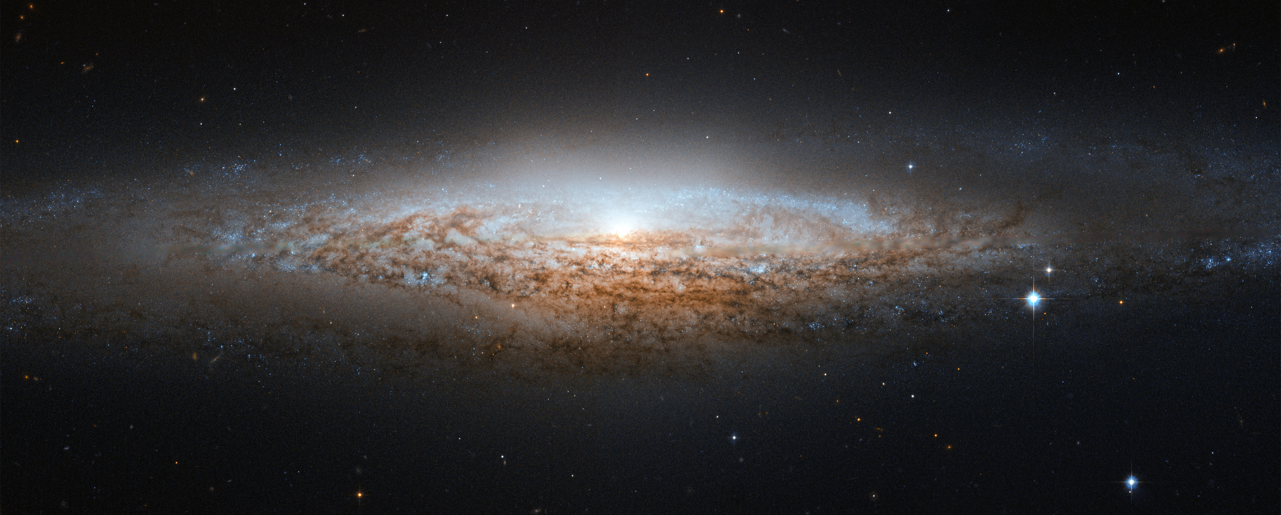


SALT-HRS
A New Spectrograph for the SALT Telescope
Luke Tyas
Notes:
Encourage people to interrupt, ask questions, apologize in case incorrectly pitched
Not just relating to the talk, but to astronomy in general (Big Bang, CMB, dark matter and energy, black holes, aliens, distance to Sun, why is sky blue, why spend money on science etc.)

Slide 2
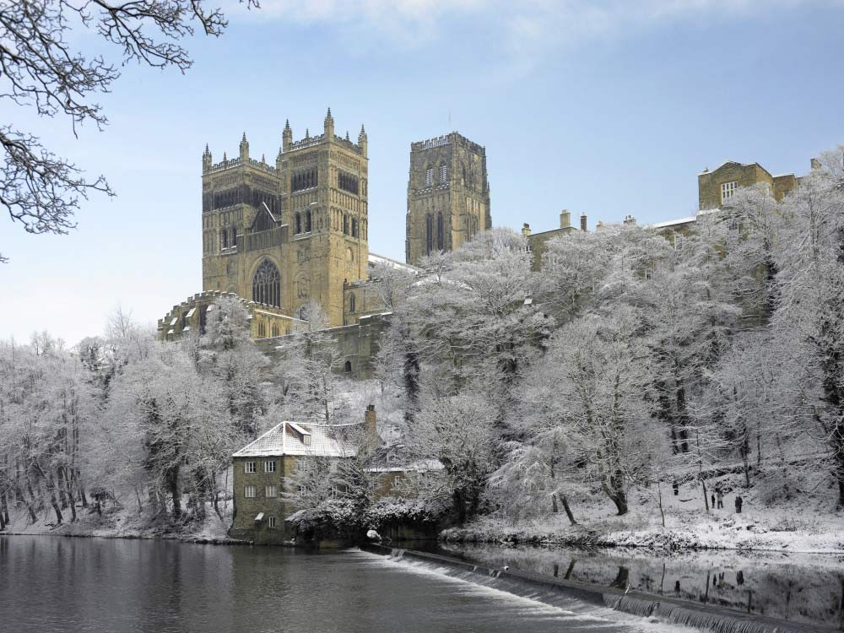
A plug for Durham…
‘A perfect little city’ & ‘If you haven’t been to Durham, you really should do at once’
– Bill Bryson, Notes from a Small Island
Notes:
- Mainline between London and Edinburgh, 1100 year old castle, 1000 year old Cathedral, Britain’s favourite building, Bill Bryson quote, Harry Potter filmed there, UNESCO World Heritage site

Slide 3
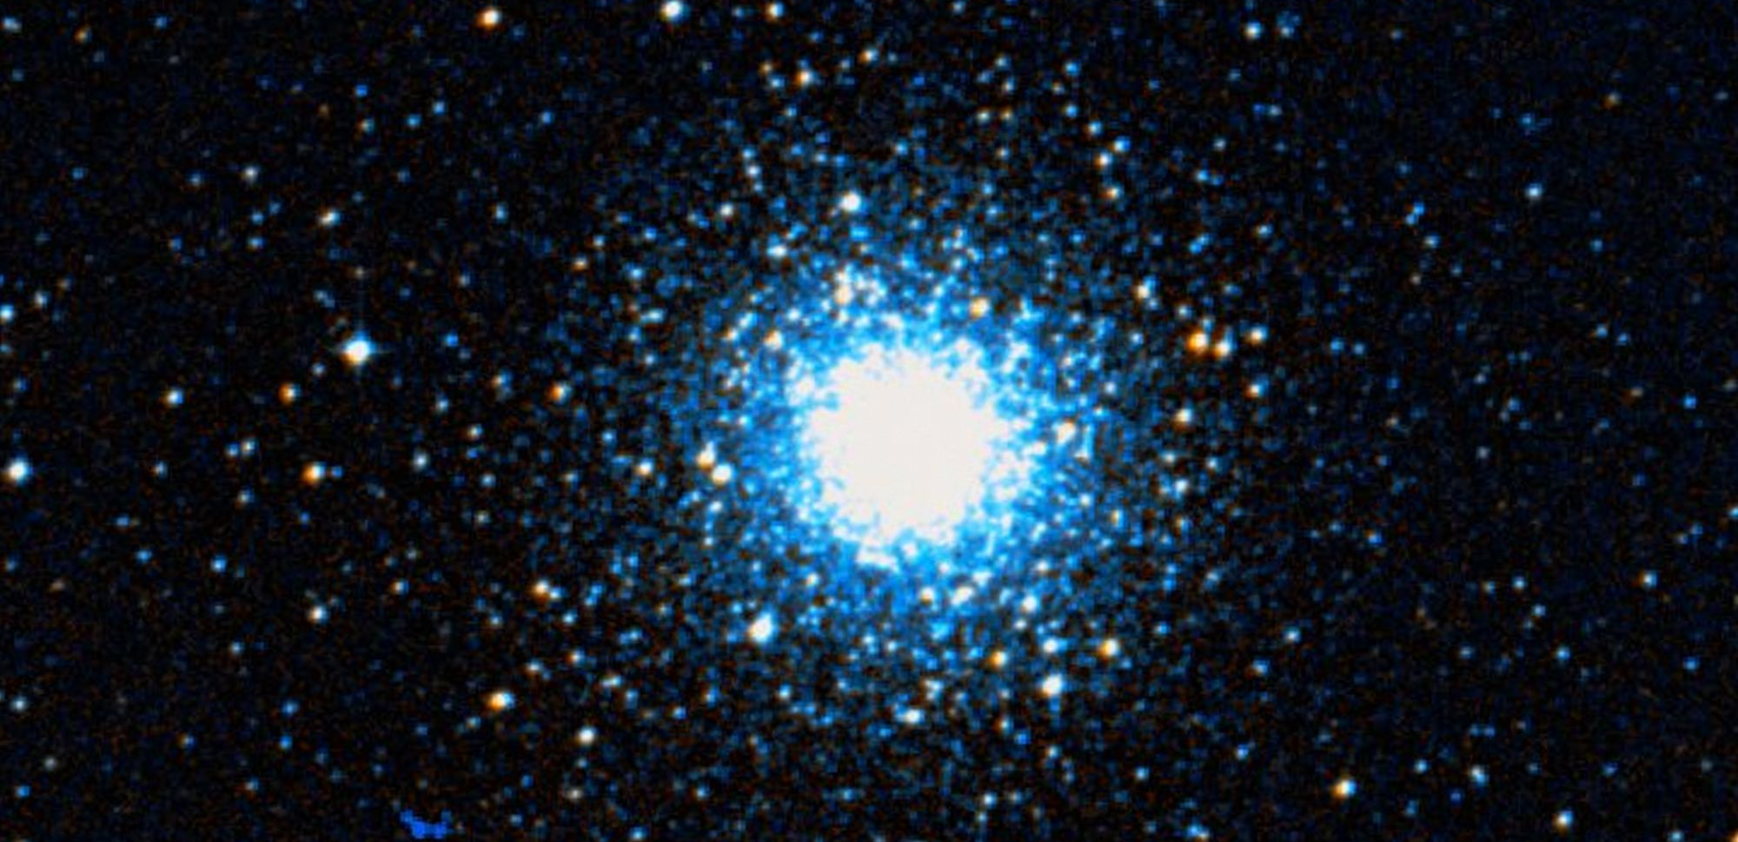
Types of astronomy
Notes:
As mentioned, telescope better with photographic plate, CCD, or instrument
Astrometry, photometry, polarimetry, spectroscopy
This is a globular cluster of stars by the way

Slide 4
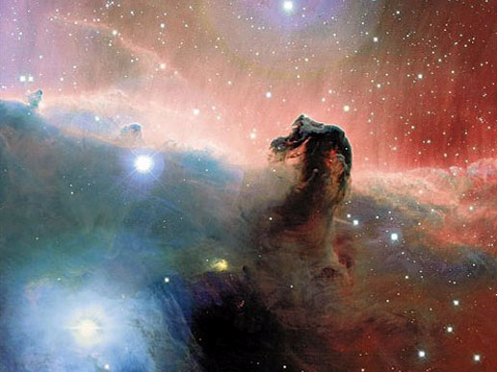
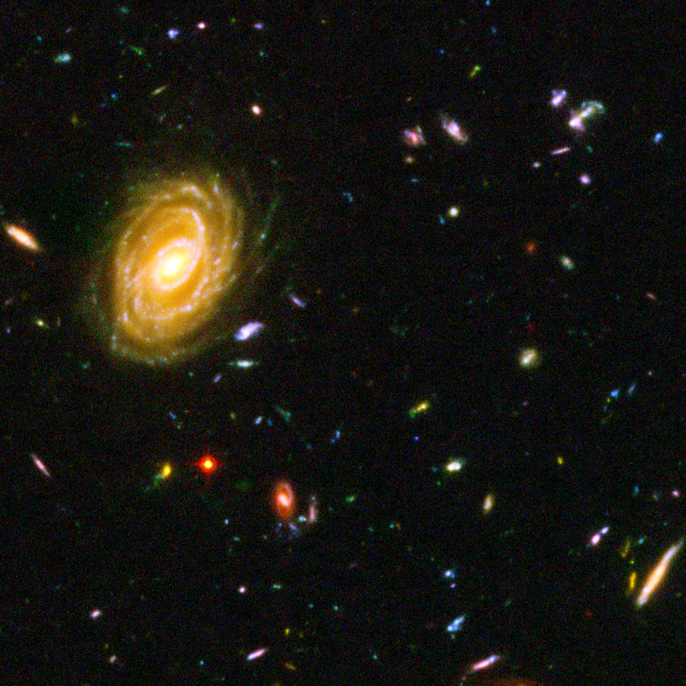
What do Astronomers measure?
Not just about the pretty pictures!
Horsehead nebula
Ultra Deep Field
Notes:
Horsehead: dark regions are dust, star forming regions. Spikes on stars are diffraction spikes. Pink areas are ionized hydrogen gas.
Ultra deep field: co-added exposures over long period in ‘empty’ region of space in Fornax near Orion. Area 1/10th size of moon. 10000 galaxies. 13.2bn years old.

Slide 5
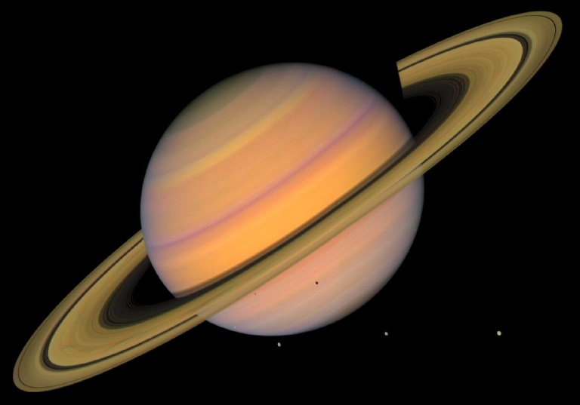
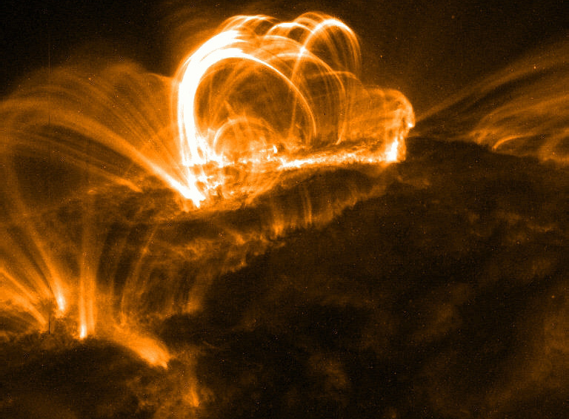
What do Astronomers measure?
Not just about the pretty pictures!
Saturn
Solar flare
Notes:
- Saturn – from 5.3million miles away from Voyager spacecraft
- Solar flare – from a satellite by NASA called TRACE, captured in X-ray

Slide 6
What do Astronomers measure?
Astrometry – the precision study of positions and movements of objects
Photometry – studying the brightness or change in brightness of an object
Polarimetry – measuring the polarization state of light
Spectrometry – studying the spectrum of an object

Slide 7
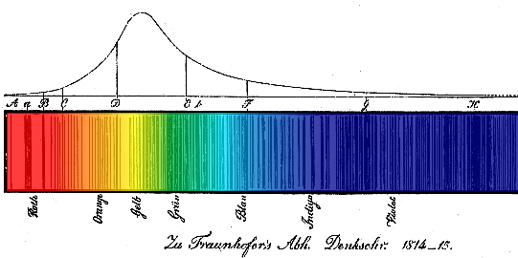
Spectra
Notes:
Solar spectrum from Fraunhofer who identified the sodium double D lines amongst others
Thomas Young first to discover that colour can be distinguished by wavelength (used as wavelength markers in his optics factory)

Slide 8
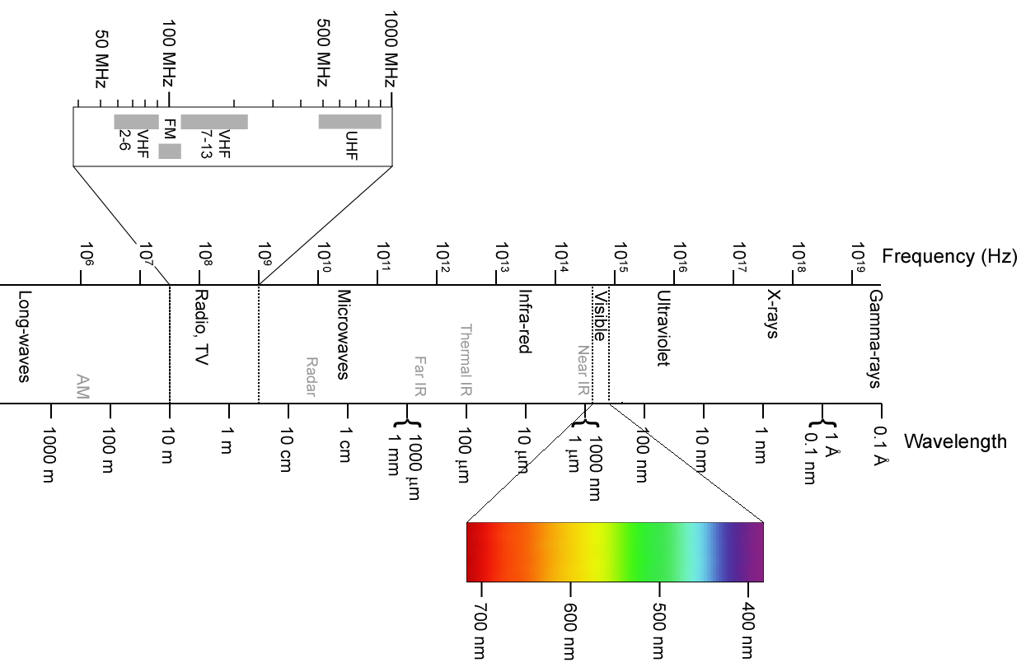
The Electromagnetic Spectrum
Notes:
Greeks knew light reflected, refracted, travelled in straight lines. Only knew of visible light.
Debate if light was a wave or particle through 1600/1700s, Newton thought particle.
Herschel discovered IR as ‘hottest’ out past red when using a prism, 1800.
1801, Ritter saw ‘chemical rays’ at UV
Faraday linked electricity and magnetism together (moving magnets, coils etc.), Maxwell theory of light

Slide 9
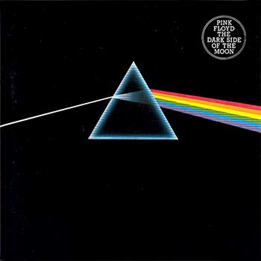
What is a spectrograph?
“Turning starlight into a rainbow and taking a picture!”
Notes:
Think of putting a straw in a glass of water, it seems to bend
Huygens principle – refraction – different wavelengths ‘bend’ by a different amount when light slows down in a medium (e.g. glass)
Different colours are different wavelengths

Slide 10
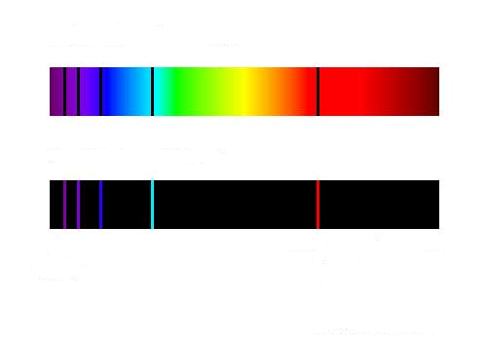
And why bother?
Astronomical spectra are more than just ‘a rainbow’ – they contain much of the information we know about the Universe we live in
Hydrogen Absorption Spectrum
Hydrogen Emission Spectrum
400nm
H_{α} line, 656nm
(N=3 to N=2 transition)

Slide 11
A cheeky bit of atomic physics…
Transition of an electron from one quantum state to another within an atom
Change causes emission or absorption of a photon of light
The energy gap of the jump or fall corresponds to the energy (wavelength, or colour) or the light photon
Photon
p+
e-
Photon
Notes:
A ‘quantum leap’ is spectacularly small!
Not to scale of atom!
Note small jump leads to read light, bigger jump to higher energy blue light
Line shown on previous page shows absorption promoting from 2nd to 3rd level in hydrogen gas

Slide 12
…cheeky bit of atomic physics II
Each element (hydrogen, helium, lithium etc.) has its own atomic structure (different number of electrons in different orbits) and therefore the electron transitions provide a unique ‘fingerprint’ for any element present
The width and depth of the spectral lines (are they ’spiky’ or broad and ‘bell shaped’, deep or shallow) tells us about the conditions of the elements present – pressure, surface gravity, density (higher pressures are broader)
Temperature of star correlates to mass (and lifecycle)
If we know how massive the star is, we can work out how bright it is
Comparison to how bright we see it to be tells us how far away it is
Metallicity (amount and ratio of elements heavier than hydrogen and helium) tells us age of star – first stars have low metallicity, more recent stars are higher
Zeeman splitting and of features into multiple spectral lines tell us about the magnetic conditions
Hyperfine splitting of spin states leads to 21cm line in the interstellar medium (although this is radio wavelength)
Forbidden lines in rarefied gas/plasma
Notes:
Temperature provides energy to excite electrons to higher energy levels, some transitions only possible in very hot stars
Electrons ‘prefer’ to stay at the lowest state possible
Helium was discovered on the Sun first (hence the name, helios)
The cooler atmosphere absorbs some light, creating the dark absorption bands we saw earlier
Some objects (hot rarefied gas) show emission lines, forbidden lines discovered in space, higher vacuum than lab, tiny probability of happening but can be seen due to low collision chances
Stellar classification based on line features, neutral metal lines in M type, HeII in O type, OBAFGKM
Mention ‘we are stardust’ bit about metallicity and age

Slide 13
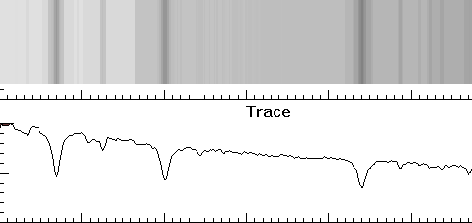
What do I mean, ‘line features’?
Recorded spectrum
Trace
Intensity
400nm (blue)
Wavelength
500nm (greenish)

Slide 14
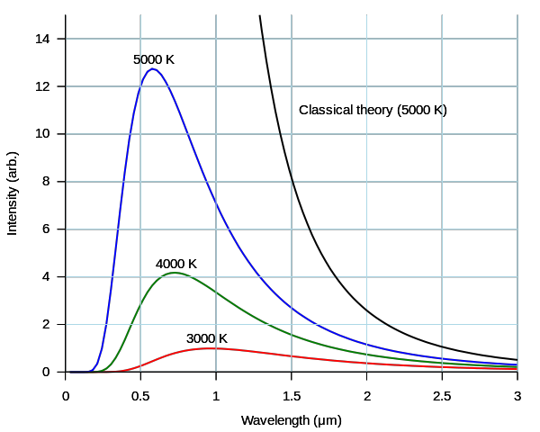
Blackbody radiation
Electron ‘jumps’ explain the spectral features – but what about the continuous rainbow part?
Everything with heat radiates according to the black body law – hot coals are red, even hotter molten steel is yellow, extremely large stars are blue
The peak of the distribution of the colour depends on the temperature
Intensity
Wavelength
Notes:
K means Kelvin, temperature – hotter 5000K object has peak further to blue
The blackbody continuum will come from the hot interior of the star
The cooler atmosphere adds the line features
Blackbody at room temperatures appears black as it absorbs visible light and emits in IR
Area under curve is total energy representation, hotter object also emits more radiation, as well as skewed to a different colour
Black holes closest to perfect blackbody, still emit Hawking radiation

Slide 15
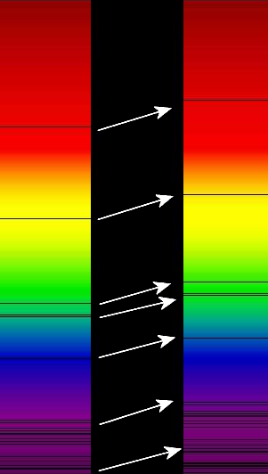
Doppler shift/redshift
Consider change in pitch as an F1 car races past
Waves behind a moving object are stretched out to longer wavelengths (lower pitch, or ‘more red’)
Waves in front of a moving object are compressed to shorter wavelengths (higher pitch, or ‘more blue’)
Light from astronomical objects also follows this effect – allows us to measure speed of object
Notes:
- Notice shift in position of lines
Each line still corresponds to the same element fingerprint, but indicates that the object emitting it is moving away from us
Faster an object is moving, the greater the effect

Slide 16
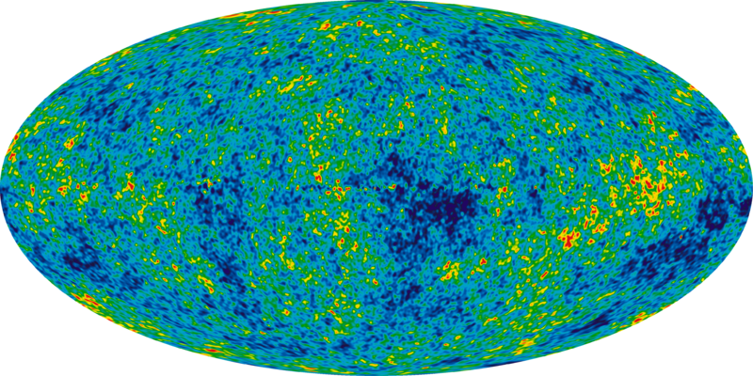
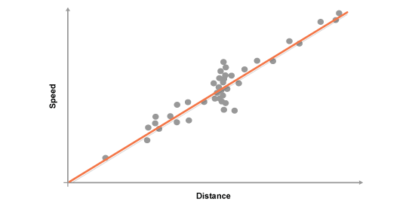
Hubble’s Law & The Big Bang
Recession of galaxies measured by Edwin Hubble in 1929
Doppler shift is proportional to the object’s distance from Earth
The further away a galaxy is, the faster we are moving away from it
Hence, the Universe is not static, but is in indeed expanding
Extrapolating back, the Universe was smaller and smaller at earlier times – and hence came from a Big Bang!
Speed
Distance
Cosmic Microwave Background
Notes:
Einstein predicted an expanding Universe but changed his fudge factor ‘cosmological constant’ in order to make it static – biggest blunder
Now have different proof… light left over from Big Bang when Universe cooled enough to be transparent to light, now redshifted so much that it is CMB
Small changes in CMB from WMAP, Planck etc. show us mass distribution in early Universe, structure formation, matter to anti-matter asymmetry

Slide 17
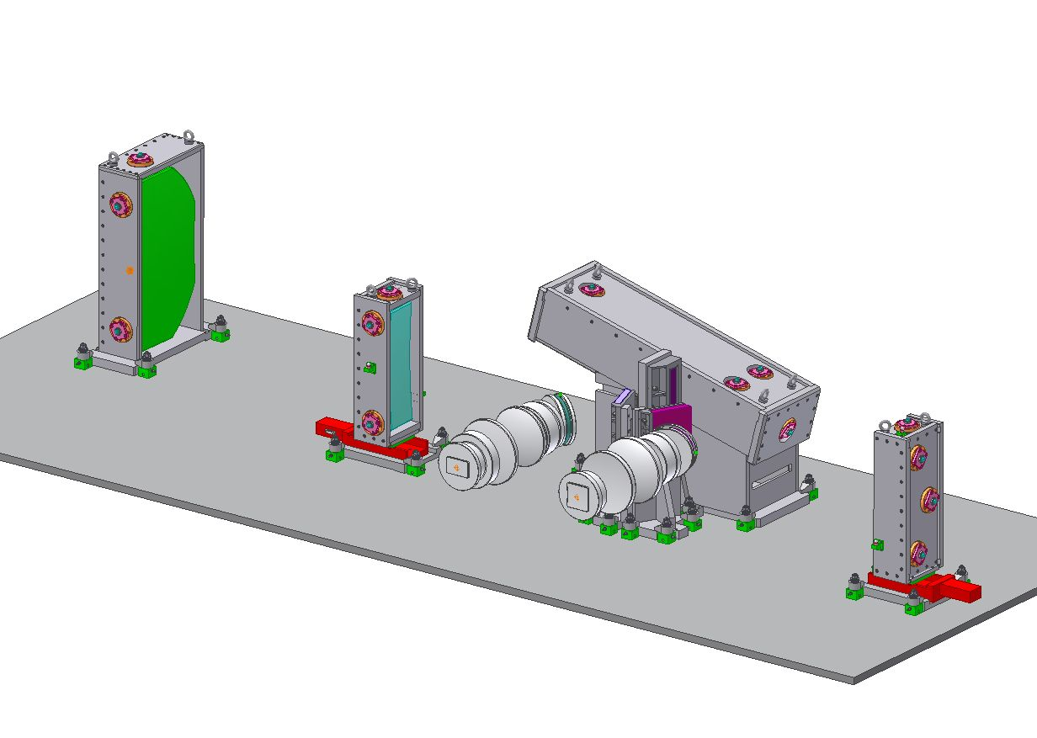
SALT-HRS
Notes:
- Construction details
How it works

Slide 18
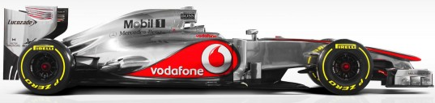

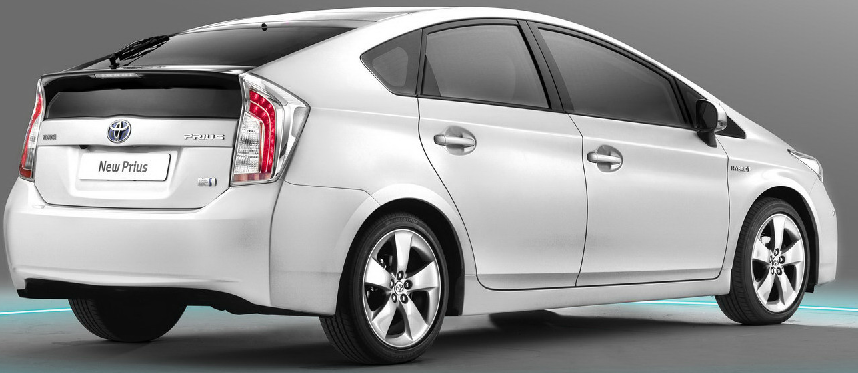
You can’t have your cake and eat it too!
Acceleration, cornering, top speed ✓
Efficiency, load carrying, durability, price ✗
Torque, grip, resilience ✓
Efficiency, load carrying, comfort, price ✗
Efficiency, comfort, practicality, reliability, price ✓
Acceleration, cornering, speed ✗

Slide 19
So what performance metrics do we use for spectrographs?
Throughput/efficiency
Spectral resolution
Wavelength coverage
Wavelength precision/stability
Image quality
Physical constraints
Downtime/engineering time
Cost
Construction time and risk
Notes:
Science specific, and engineering specific
Even though we record a ‘rainbow’ image quality still important
Wavelength range must be specific to type of science done – no point in an IR spectrum if the important lines are in the UV!
Telescope time extremely expensive
Only top bullet points are ‘interesting’
Find balance between pushing science envelope and actually delivering a working instrument!

Slide 20
SALT-HRS throughput
Notes:
As you can see, efficiency depends strongly on colour (very poor in UV)
Maximum efficiency still under 35% of light coming in from telescope
Different modes and arms will be mentioned later
No point in spending millions on your telescope only to have a crap instrument!

Slide 21
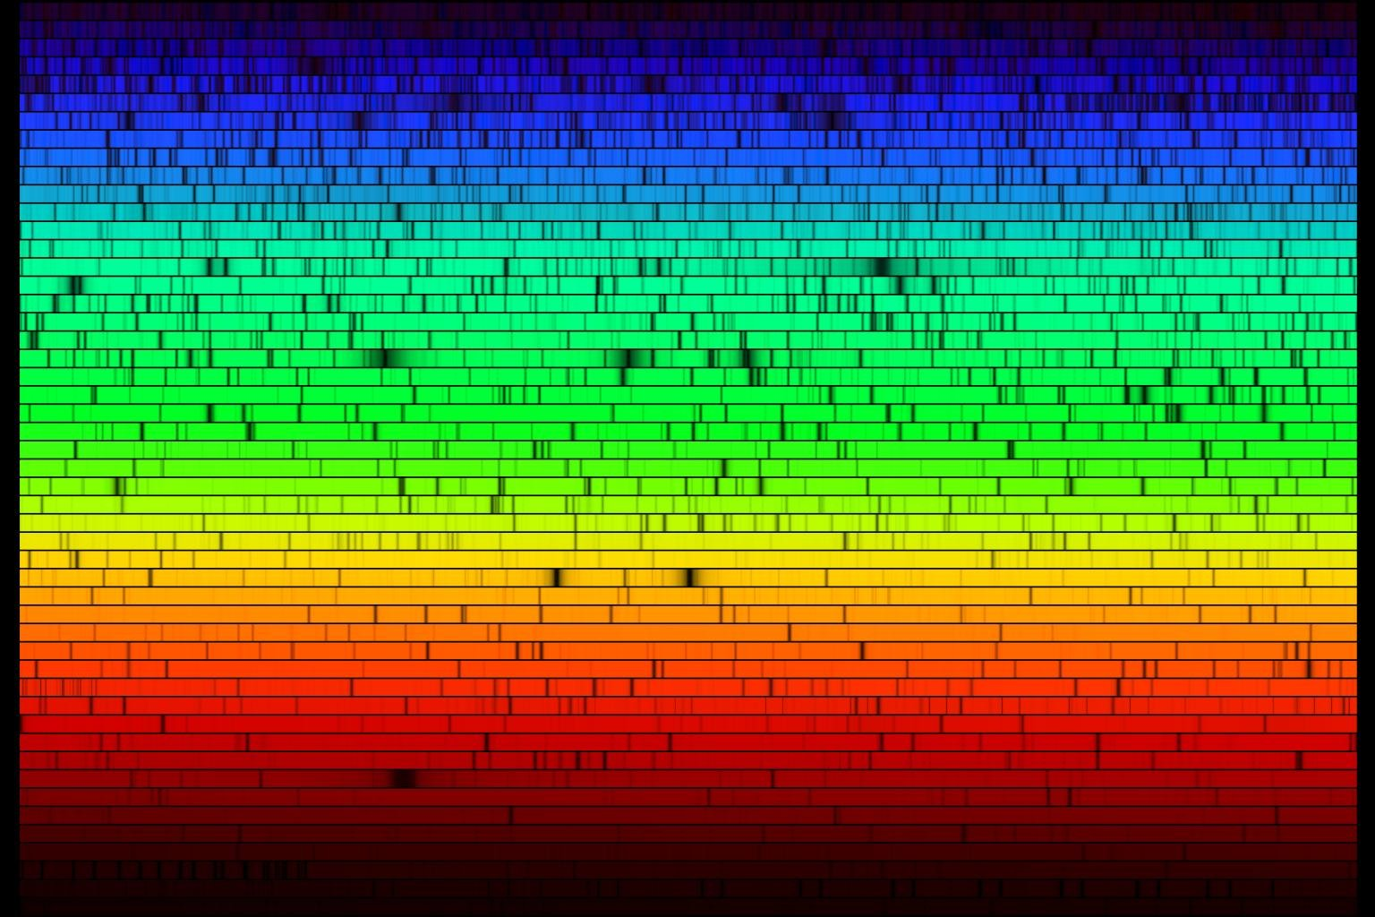
Spectral resolution
How do you know if your spectral feature is one broad feature or several narrower lines which happen to overlap?
Different SALT-HRS modes between R = 16000 to R = 67000 (bigger is better)
Two detector pixels
λ₁
λ₂
Notes:
- Will discuss how resolution is boosted SALT-HRS later
- Will discuss wavelength stability later, and image quality

Slide 22
SALT-HRS
SALT-HRS is the Southern African Large Telescope High Resolution Spectrograph
It prioritizes spectral resolution and wavelength stability most highly due to its specific science cases
The wavelength range is 370-890nm
Still offers four modes depending on usage
Notes:
370–890nm (just ‘blue’ of violet to just ‘red’ of red)
Modes trade off throughput for resolution

Slide 23
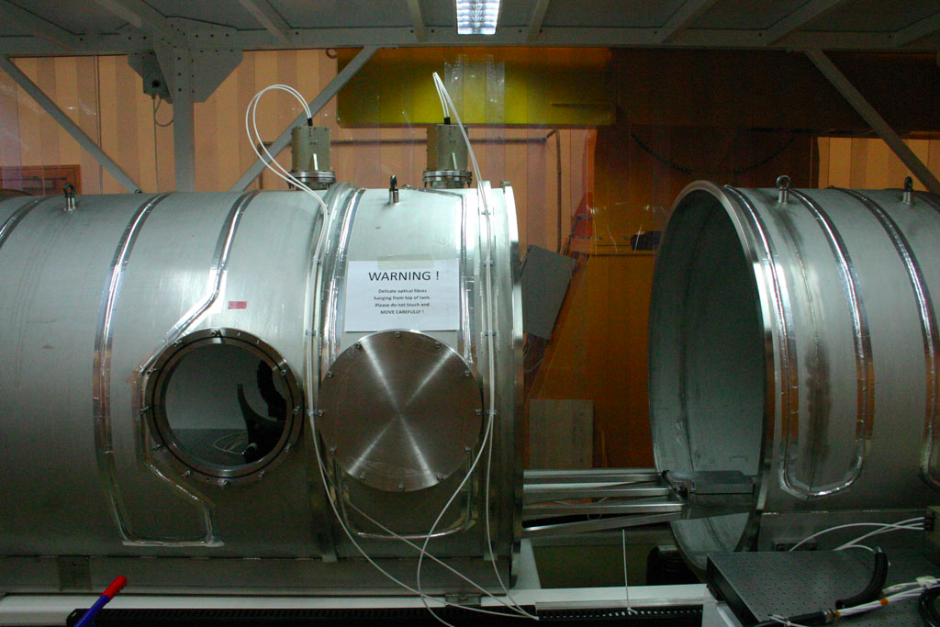
Spectrograph or submarine?
Notes:
Vacuum tank, temperature stability, aircon room
Special alloy Invar steel for low contraction/expansion, metal goes through thermal bake process after machining, also Zerodur glasses for mirrors
4m x 1.5m – too big to stick on telescope – notice fibre optic cables poking out the top – connects to telescope tracker (will discuss later)
Assembled inside clean tent, wear ‘space suits’/masks/sticky shoe mat/latex gloves, use CSI style UV torch for cleaning, ultrasonic bath
Mounted on damping feet
Heater cables on outside
Everything has to be vacuum compatible, cables, connectors, glues, lubricants – stuff has to be ‘baked out’
Everything is custom designed and manufactured

Slide 24
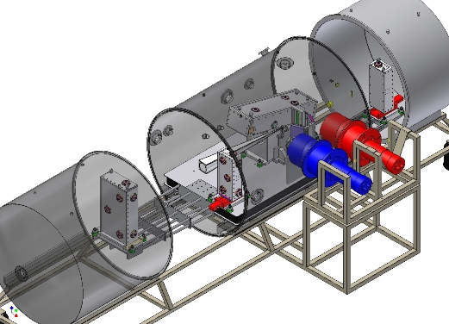
SALT-HRS CAD diagram
Notes:
CAD diagram of vacuum tank (opens for access)
Point out blue and red cameras and detectors
Mention division in to two arms, red and blue, and why (optimization of coatings, detector sizes etc.)

Slide 25
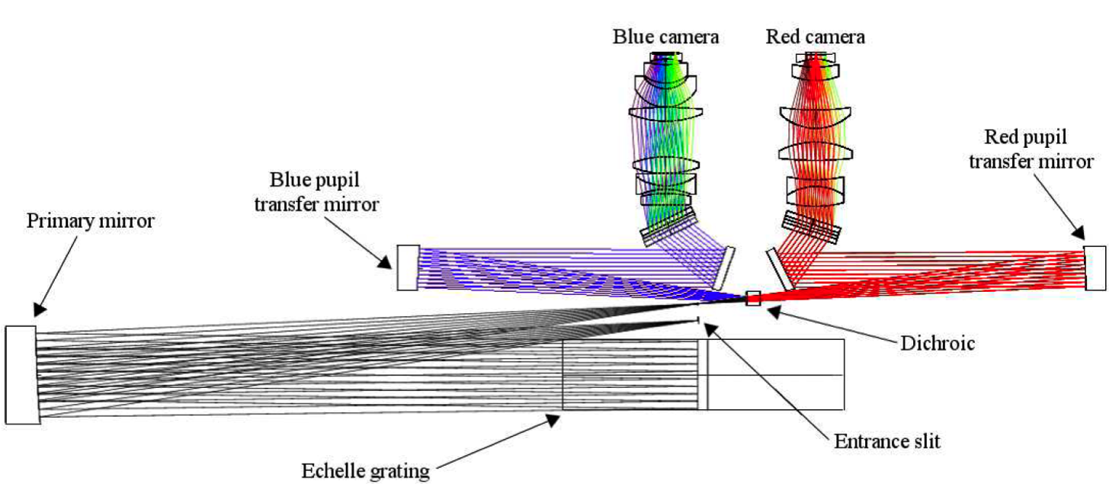
SALT-HRS – How it works (allegedly)
Blue camera and CCD
Red camera and CCD
Red volume-phase holographic grating
Blue volume-phase holographic grating
Blue pupil transfer mirror
Red pupil transfer mirror
Primary mirror
Dichroic beam-splitter
Entrance slit
Échelle grating
Notes:
Start at entrance slit, beam expands on to collimator
Collimated beam is parallel, like a ray gun
Expanding beam from fibre is like shining a torch to different distances

Slide 26
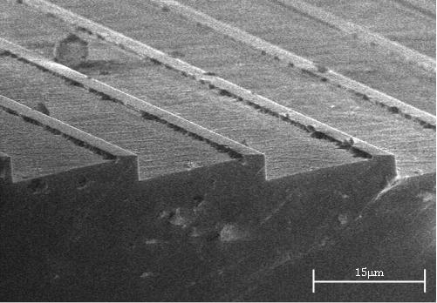
Échelle grating dispersion, not a prism
15μm
Notes:
Notice the scale… copied from master grating (limited to available grating types in design phase)
Our echelle is actually a mosaic of two, with a mirror in the gap for an exposure meter
Works more like the rainbow you see when looking at a CD
Scanning tunneling electron microscope image – notice the scale!

Slide 27
Échelle – where the magic happens!
A complicated diagram
y
N
x
θ_{B}
θ
γ
γ
θ
z
Notes:
Path difference between incoming and reflected light orchestrated such that light is dispersed
Don’t worry if this makes no sense

Slide 28
Fibre optic input (ideal)
Telescope
Optical fibre
Collimator mirror
‘White’ starlight
Dispersed spectrum
CCD Detector
(digital camera chip)
Camera lenses
(image spectrum)
Échelle (dispersed light)
Notes:
Fibre optics allows us to make a large spectrograph with all the vacuum stabilization we need
Useful for removing ‘memory’ of input beam which changes with atmosphere and telescope tracking
Light collected by telescope input into fibre, fibre carries light (TIR), collimator makes beam parallel, grating makes spectrum, camera onto detector (many images of star at different colours)

Slide 29
Fibre optic input (reality check)
Perfect star
Actual star
(PSF)
Wider fibre?
Narrower fibre?
Notes:
Presents its own problems – stellar PSF (plus another PSF from the telescope and instrument), more spread light means bigger fibre to maintain efficiency, which means lower resolution – oh no!
Solution is image slicing
SALT-HRS uses four modes with different sized fibres and image slicing to trade off efficiency and resolution - LR, MR, HR, HS (500micron, 350micron)

Slide 30
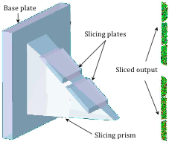
Solution - image slicing
Base plate
Slicing plates
Sliced
output
Slicing prism
Notes:
Slicer allows us to use larger fibres to capture all starlight but without resolution loss by imaging a fat image
Best of both worlds (although there is some light loss in the slicer optics, hence why we provide a full range of choices for the observer to fine tune)

Slide 31
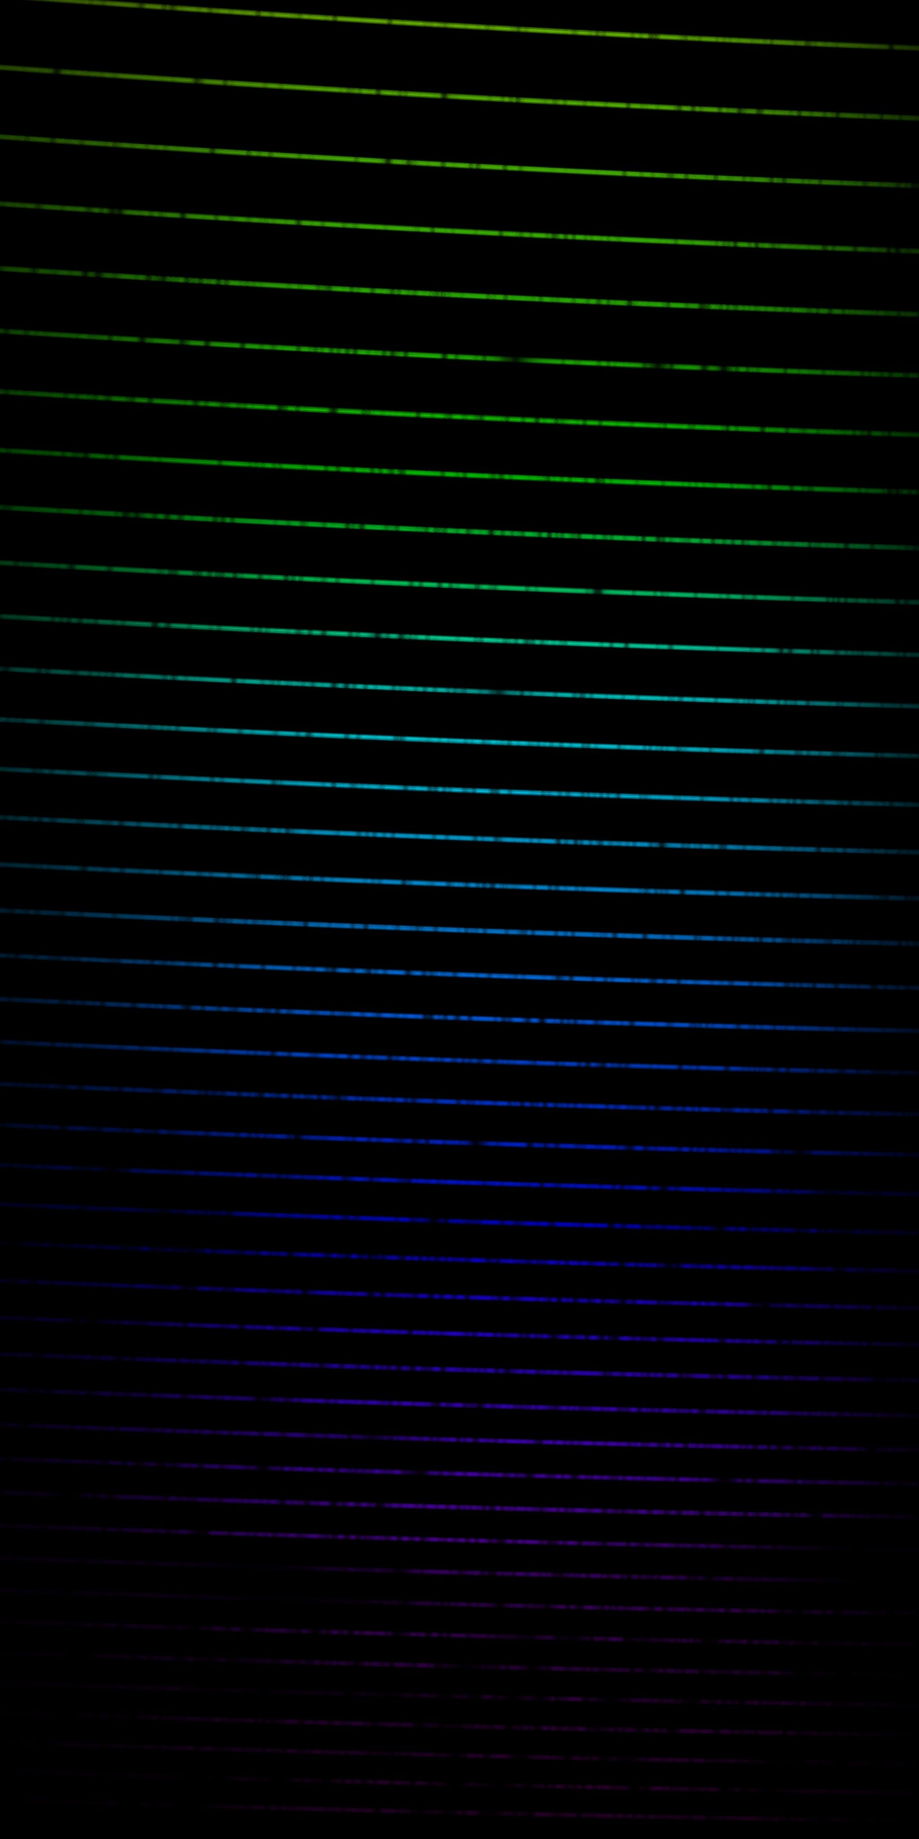
Example spectra
Order
λ_{B}
Δy
30
20
10
0
y-position (mm)
-10
-20
-30
-30
-20
-10
0
10
20
30
x-position (mm)
Notes:
Remember we have two cameras, a red and a blue channel
Our actual spectra are black and white, intensity map only, so colours are added, as are the spectral lines observers might look fo
This is what our CCD would record (but BW)
How do we calibrate our wavelengths? How do we know that a certain position on the CCD chip corresponds to a certain colour?
How do we calibrate for instrument efficiency? E.g. if a colour is dim, is it because the star is dim in that colour? Or because the telescope/instrument combination is inefficient in that wavelength?

Slide 32
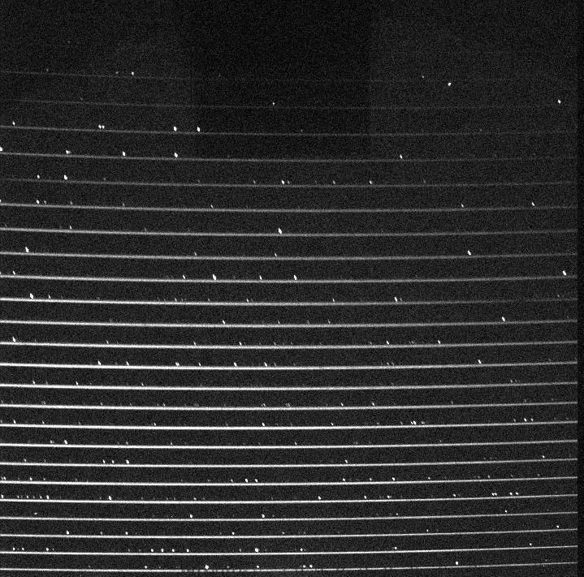
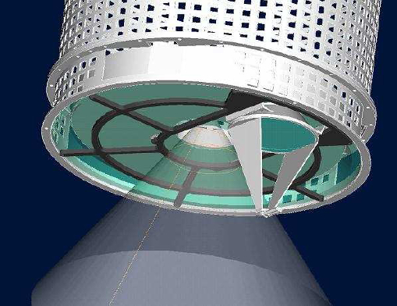
Wavelength and flat-field calibration
Inject light with a known spectrum into the instrument for wavelength calibration, compare
Inject white light from a calibrated source through the instrument and compare
Optionally may add Iodine cell
Notes:
HS mode add option to do this at the same time, in case the optics have moved slightly – yes, we have to be that precise!
(Also have to remove cosmic rays, radiation, bias from detectors etc.)
Iodine cell has forrest of lines which add ontop of the light signal – messy data, analysis, lost light, hence HS mode only, not useful over full wavelength range

Slide 33
SALT-HRS & Planet Detection
Indirect measurement
As planet orbits star, star ‘wobbles’ about common centre of gravity (barycentre)
Measure ‘wobble’ Doppler velocity shift
Notes:
Follows up from transit detection
Can only place limits on mass, not actual mass (complimentary method)
1m/s motion (South Easter is 10-12m/s) from an object moving at 100,000s km/s at a distance of billions of kms!
Higher the RV precision, the smaller the planet we can detect, further from its host star (i.e. swap super-Jupiters with 3 day orbits for new Earth’s around solar type stars)
Also stuff like secondary eclipse atmospheric measurement possible

Slide 34
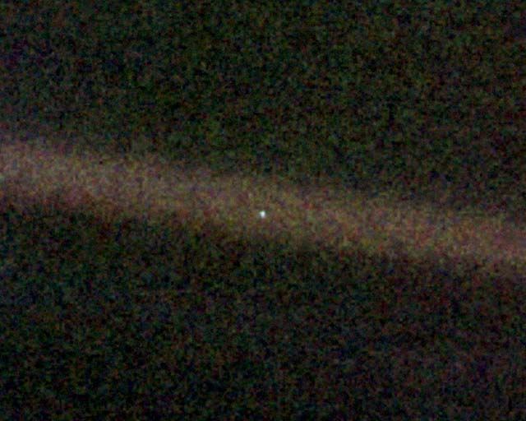
Thank you for listening…
Any questions?
Notes:
Not just relating to the talk, but to astronomy in general (Big Bang, CMB, dark matter and energy, black holes, aliens, distance to Sun, why is sky blue, why spend money on science etc.)
Pale blue dot is Voyager photo of Earth in 1990 from 7 billion km away
Voyager most distant human object at 18.5BN km (Carl Sagan poem small blue dot)
Mention outreach nights

