Slide 1
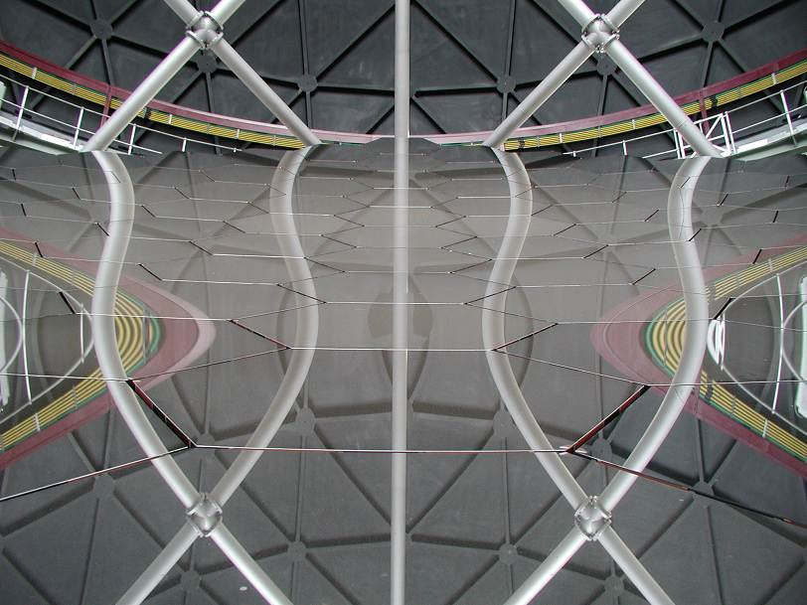
SAMS Project
David Buckley, Hitesh Gajjar & John Menzies
May 2014

Slide 2
System Overview : Requirements
Do we need it?
Improvement of the IQ delivered by the telescope through active control of the primary mirror
Approx 4 hours spent stacking during 5 day period
Primary mirror will maintain IQ over 5 day alignment cycle (0.1” TT RMS)
Challenges:
Piston resolution: 1nm
Control over lower order modes (focus)
Environmental conditions ( 15ºC temperature span/5days, severe temperature gradients, HIGH humidity)
No other edge sensor, in operation or development meets these requirements

Slide 3
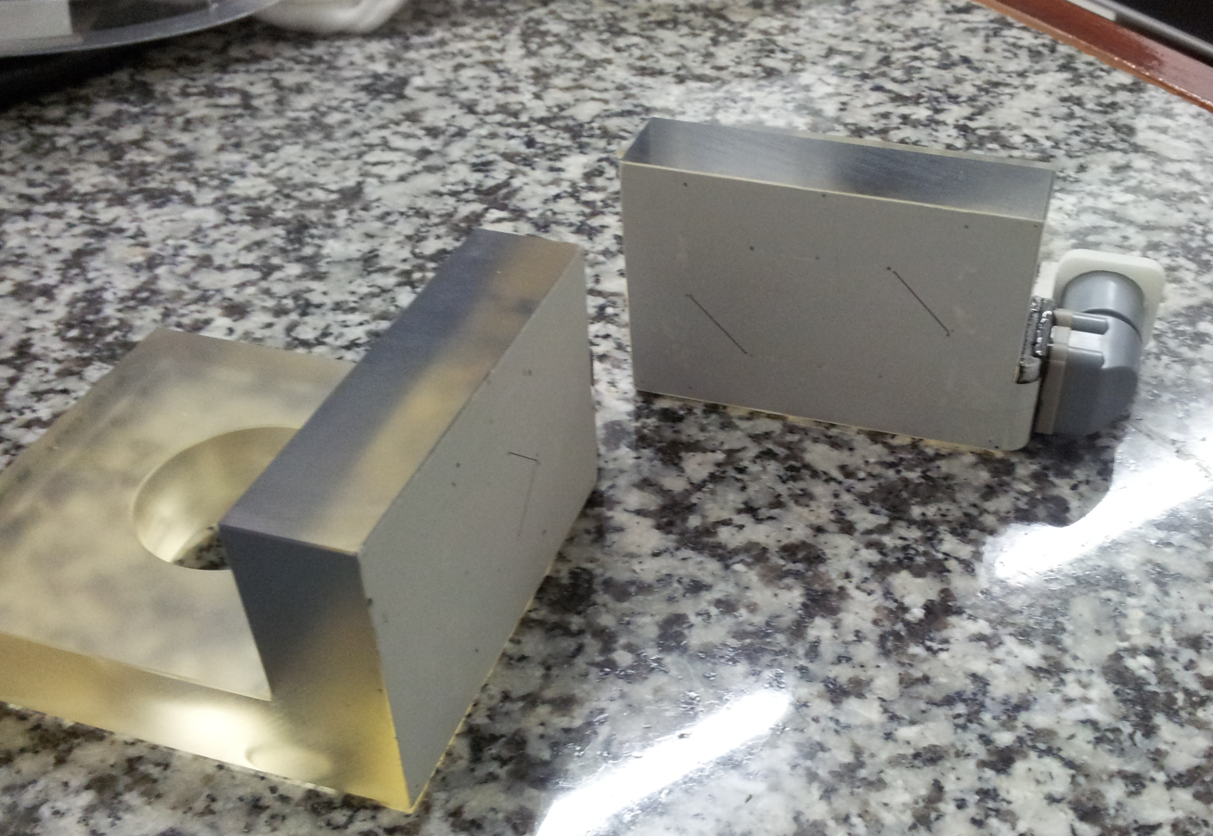
System Overview : Hardware

Slide 4
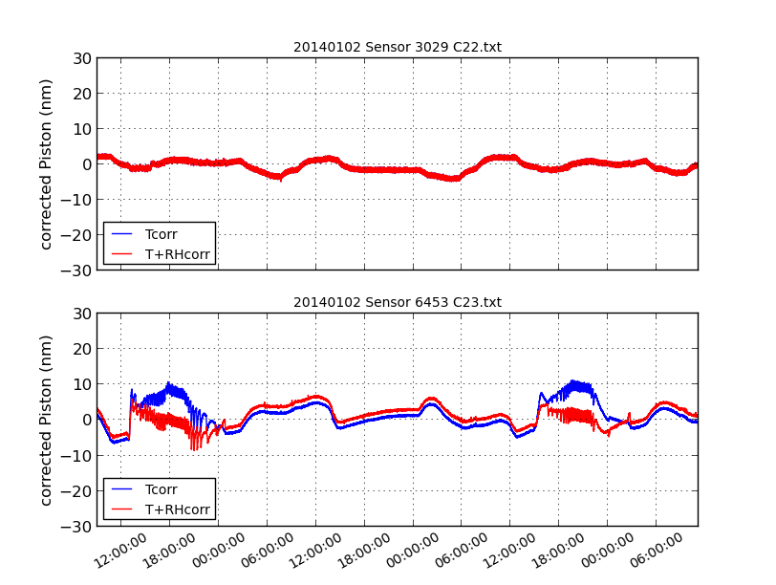
Performance Specification
Maximum cumulative error: 30nm over 5 days
Sensor Noise < 10nm rms
Temperature span 15°C
RH up 97%

Slide 5
Project Phases and Status
Project Phases
Phase 1: Central 7 segment sub-array
Phase 2: First 3 rings
Phase 3: Completion of entire array
Project Status
All hardware for Phase 1; 24 sensor pairs and supporting electronics delivered (early May)
Validation of 3 channel electronics, new cabling, and embedded software underway.
Environmental characterisation (temperature and RH characterisation) in progress
Additional software development of control software
Bug fixes to embedded rack software

Slide 6
Phase 1 Priorities
Task | Expected Completion
Button bonding | Early June’14
Sensor Characterisation/hardware validation | Mid June’14
On-telescope commissioning | July’14
Atp Phase 1 | July-August’14
Initiate Phase II | August’14
Manufacture, install and commission 156 sensors | August’14 – Jan’15
ATP Phase II | February ’15
Initiate Phase III | February ’15
Manufacture, install and commission 300 sensors | February ’15-August ’15
ATP Phase III | September ’15

Slide 7
SAMS Project Report
End

Slide 8
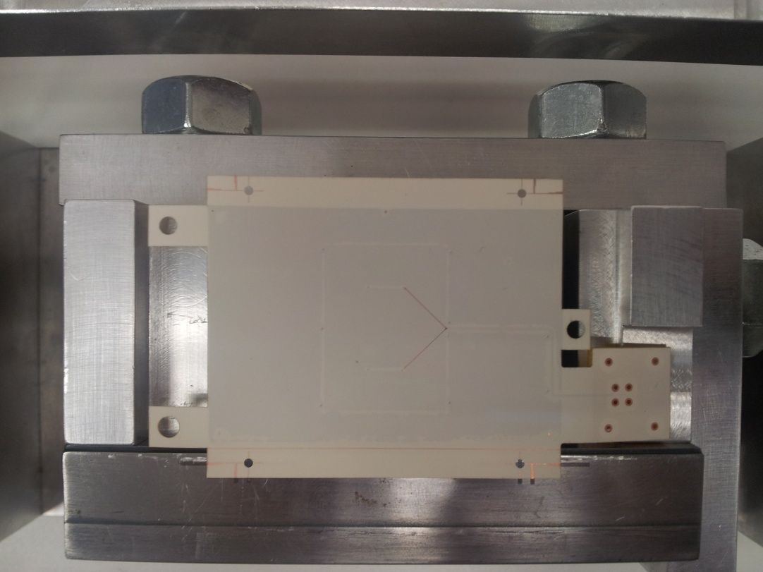
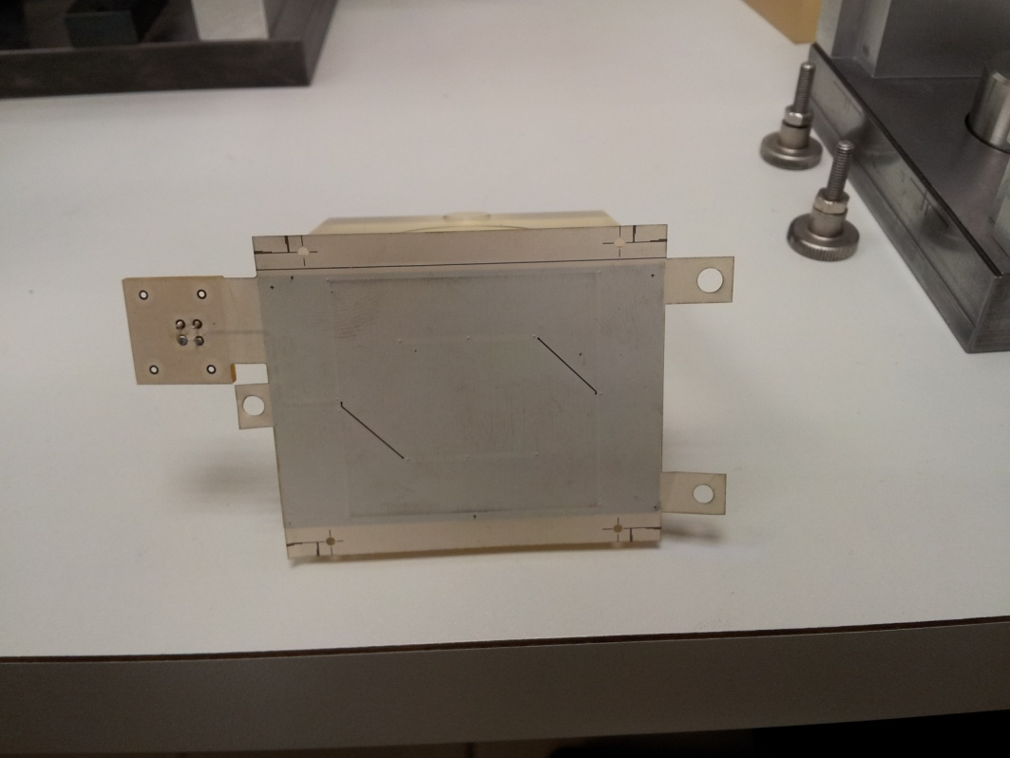
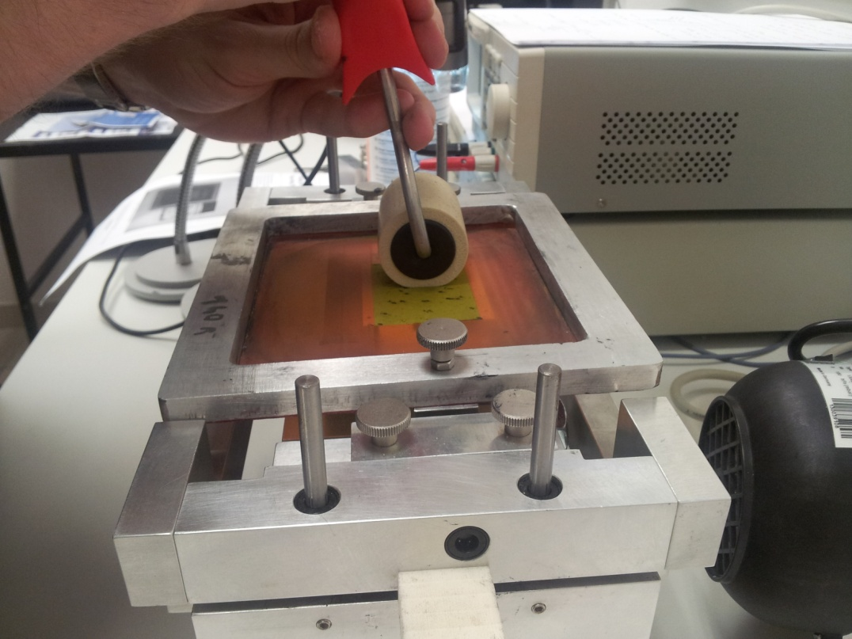

Slide 9
System Overview : GUI

