Slide 1
Team Building
SALT Tracker Upgrade Project
22nd May 2014
Raoul

Slide 2
Outline
Why are we doing the upgrade?
What are we hoping to achieve?
What is the status?
Conclusions

Slide 3
Why are we doing the upgrade?
The SALT Tracker was originally designed to carry a payload of 1000 kg. The current loading exceeds 1300 kg and more instrumentation, the NIR arm of the RSS, is being constructed for the telescope. In general provision also has to be made to expand the envelope of the tracker payload carrying capacity for future growth.
As part of the RSS-NIR development project it was decided to upgrade the SALT Tracker to be able to carry a payload on the Rho ring of 1875 kg. The NIR is being developed by the University of Wisconsin.
A pre-project study showed that in order for the SALT Tracker to carry this higher payload, upgrades are required on the following sub-systems of SALT:
Y-Drive, including a Runaway Brake and Anti-Gravity System
Rho-Drive, including Cable Wraps
Hexapod

Slide 4
What are we hoping to achieve?
Primary Objective:
The SALT Tracker Upgrade project will upgrade and install, in series, three subsystems of the Tracker called Y-Drive, Rho-Drive and Hexapod respectively, to accommodate a minimum Tracker payload of 1875 kg.
Secondary Objectives:
Establish a “process and procedural” environment for SALT on design/development, project management, configuration management, procurement and design quality.
Improve upgraded subsystem’s reliability and maintainability.
Establish configurable/auditable data packs for upgraded subsystems.

Slide 5
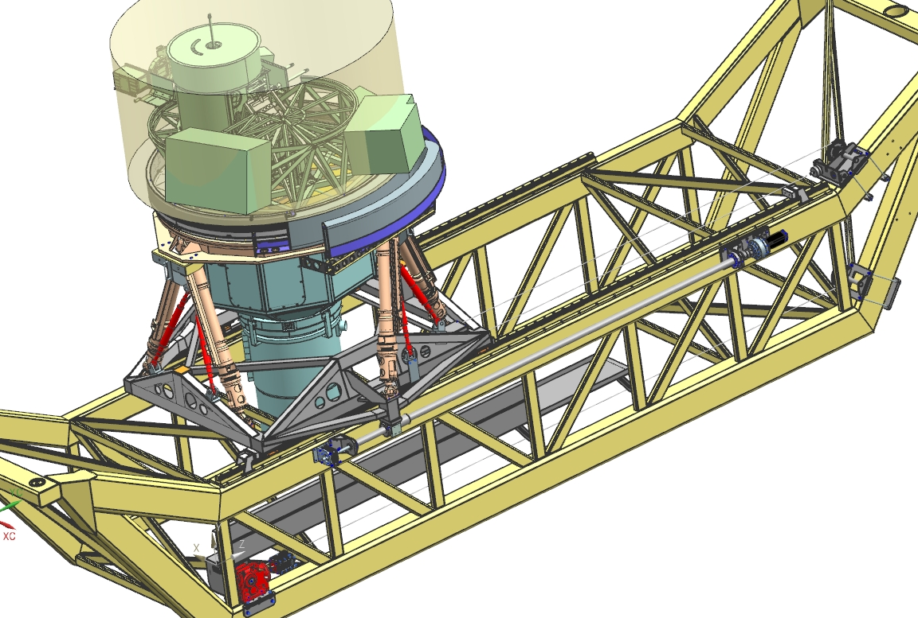
What is the status? Stage 1

Slide 6
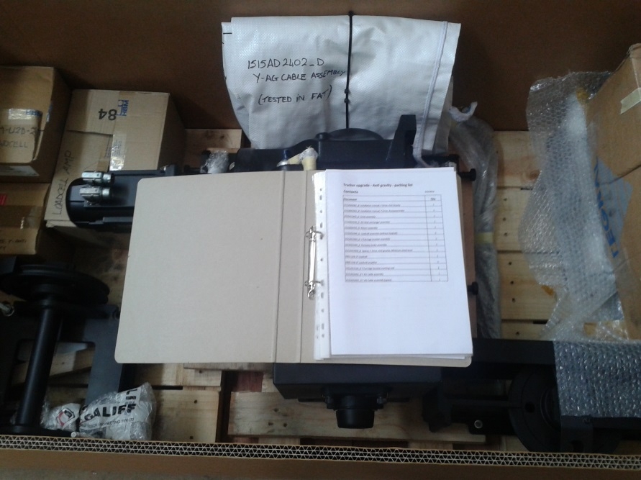
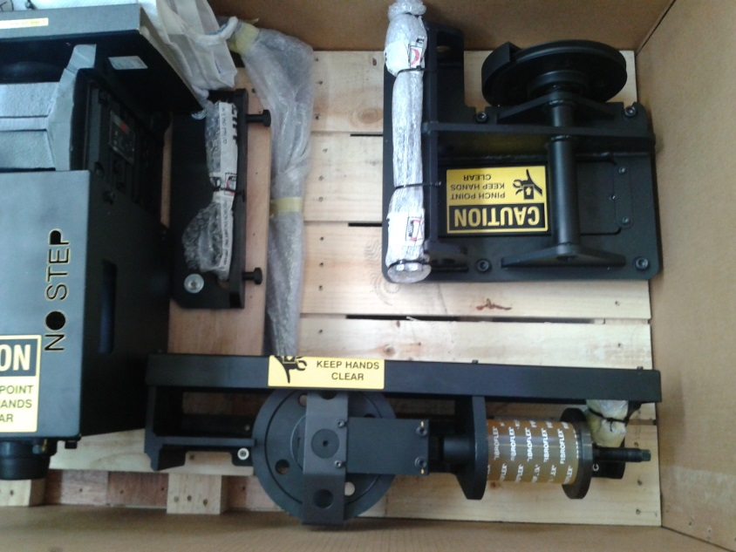
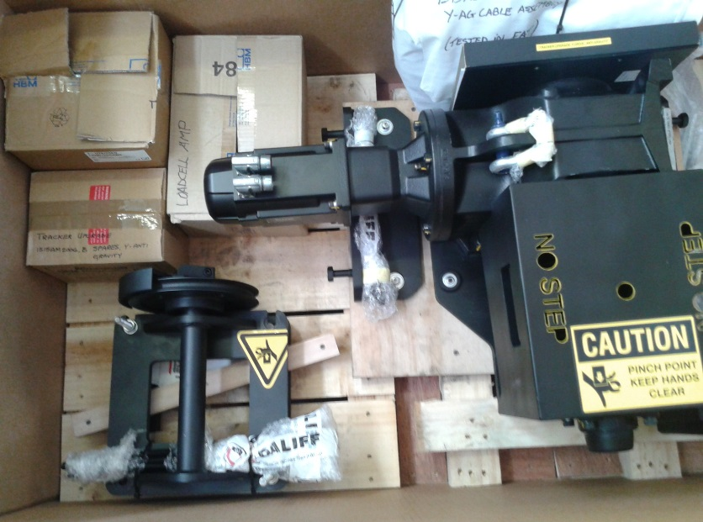
What is the status? Stage 1
Installation kit documentation
Drive, Load-Cell and Y-Carriage Assembly in Installation Kit
Drive, Return, Load-cell/Amp and Cable Assembly in Installation Kit

Slide 7
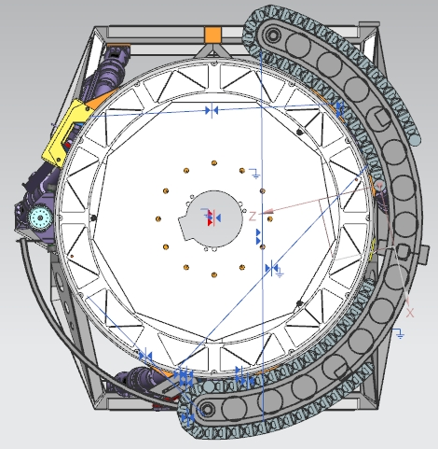
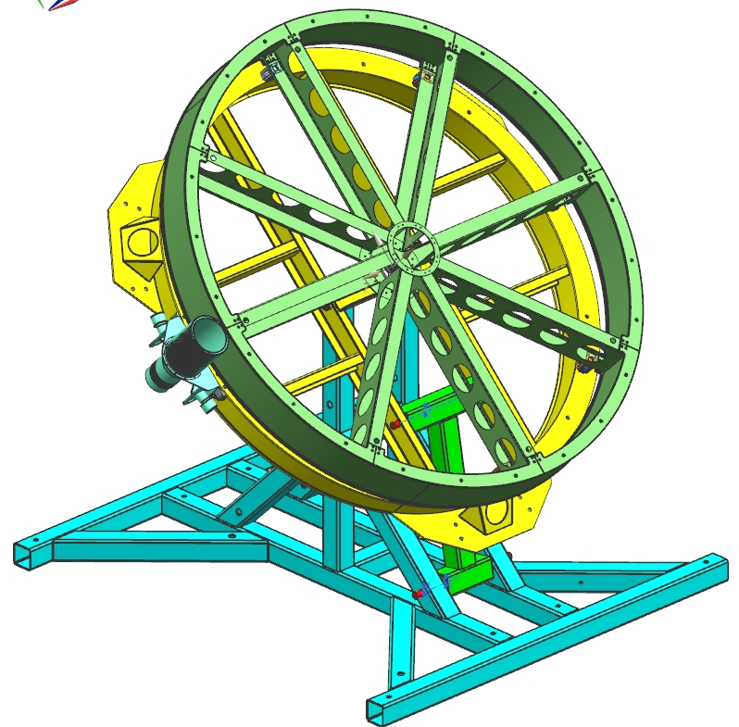
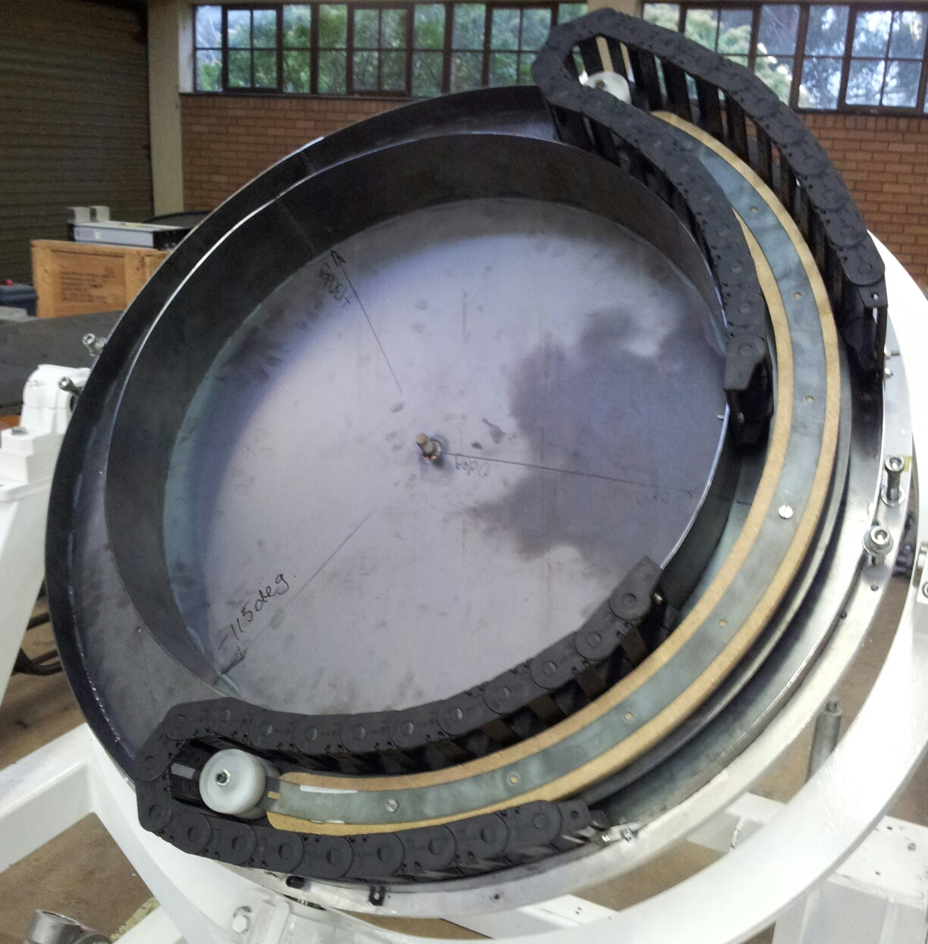
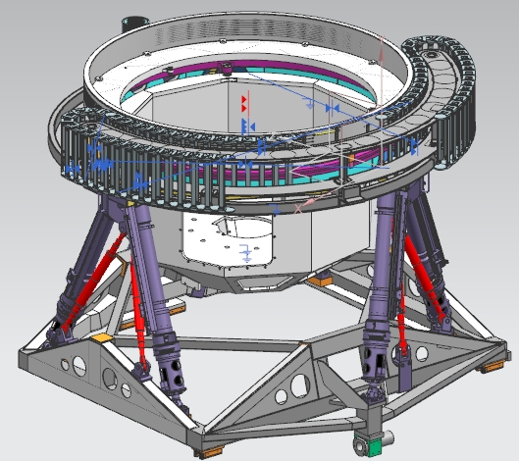
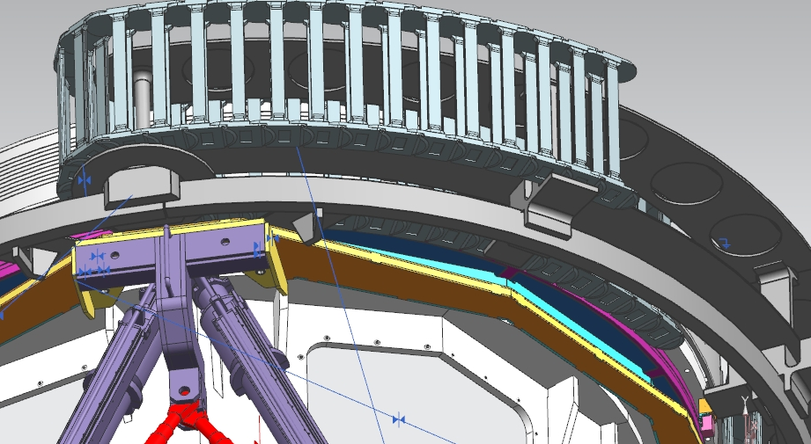
What is the status? Stage 2

Slide 8
Conclusions
Stage 1 of the Tracker Upgrade Project is complete awaiting installation.
Stage 2 of the Tracker Upgrade Project is in the detail design phase, currently within budget and 2 weeks behind schedule.
Stage 3 is planned for 2015

