Slide 1
SALT Astro and Tech Ops Teambuilding
22-23 May 2014
Sutherland
J C Coetzee

Slide 2
SALT Astro and Tech Ops Teambuilding Definition
Team building:
Is a philosophy of job design in which employees are viewed as members of interdependent teams instead of as individual workers [1].
Team building is pursued via a variety of practices:
Simple exercises
Complex simulations
Multi-day team building retreats designed to develop a team (including group assessment and group-dynamic games)
Usually falling somewhere in between
Team building is not to be confused with:
“Team recreation” ☹
[1] BusinessDictionary

Slide 3
SALT Astro and Tech Ops Teambuilding Definition
Can be seen in day-to-day operations
Team dynamics can be improved through successful leadership.
Benefits:
Self-development,
Positive communication,
Leadership skills
Ability to work closely together as a team to solve problems
Work environments tend to focus:
On individuals and personal goals,
Reward & recognition singling out the achievements of individual employees. (New Performance Contracting Model will help )
Wikipedia

Slide 4
SALT Astro and Tech Ops Teambuilding Team Dynamics
The team member:
Collection of effective individuals.
Experienced,
Have problem solving ability,
Are open to addressing the problem,
Action oriented.
Team relationships:
Must be able to give and receive feedback.
Team problem solving:
Effective team = focused and clear the goal of the team is.
A relaxed, comfortable and accepting environment
Open and honest communication are required.
Frank LaFasto

Slide 5
SALT Astro and Tech Ops Teambuilding Team Dynamics
Team leadership:
Effective team leadership depends on leadership competencies.
A competent leader is:
Focused on the goal,
Ensures a collaborative climate,
Builds confidence of team members,
Sets priorities,
Demonstrates sufficient “know-how” and manages performance through feedback.
Team relationships:
Must be able to give and receive feedback.
Organizational environment:
The climate and culture of the organization must be conductive to team behavior.
Competitiveness should be discouraged and uniformity should be encouraged - this will eliminate conflict and discord among team members

Slide 6
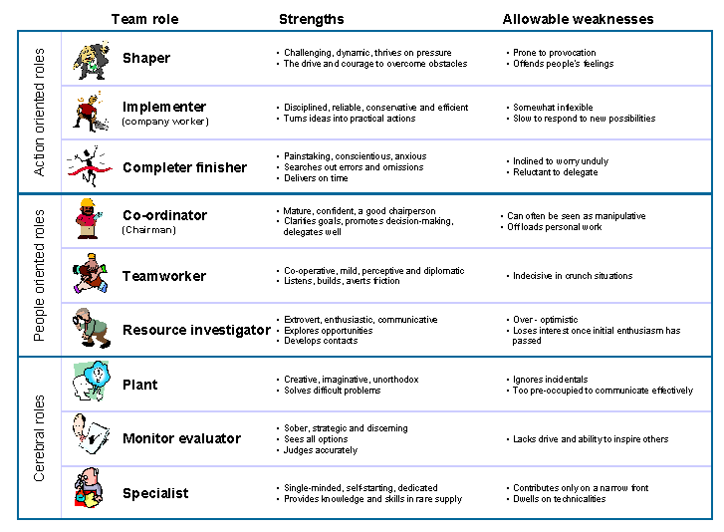
Notes:
Team role
Pattern of behavior that characterizes one person's behavior in relationship to another in facilitating the progress of a team.
Enables an individual or team to benefit from self-knowledge and adjust behavior according to the demands being made by the external situation
Use of the team roles
It is an individual's 'preferred' team roles and is designed to indicate how you would ideally operate in a team environment.
Strength in one team role is often at the expense of what might be seen as a weakness in another context.
An ideal team = healthy balance of all 9 team roles.
Strong teams normally have:
Strong co-ordinator,
Planter,
Monitor evaluator
One or more implementers, team workers, resource investigators or completer finishers.
A shaper should be an alternative to a co-ordinator rather than having both.
In practice, the ideal is rarely the case, and it can be beneficial for a team to know which of the team roles are either over represented or absent and to understand individual's secondary roles..

Slide 7
SALT Astro and Tech Ops Teambuilding Team Roles - Belbin
Team role
Pattern of behaviour that characterises one person's behaviour in relationship to another in facilitating the progress of a team.
Enables an individual or team to benefit from self-knowledge and adjust behaviour according to the demands being made by the external situation.
Notes:
Team role
Pattern of behaviour that characterises one person's behaviour in relationship to another in facilitating the progress of a team.
Enables an individual or team to benefit from self-knowledge and adjust behaviour according to the demands being made by the external situation

Slide 8
SALT Astro and Tech Ops Teambuilding Team Roles
Use of the team roles
It is an individual's 'preferred' team roles and is designed to indicate how you would ideally operate in a team environment.
Strength in one team role is often at the expense of what might be seen as a weakness in another context.
An ideal team = healthy balance of all 9 team roles.

Slide 9
SALT Astro and Tech Ops Teambuilding Team Roles
Strong teams normally have:
Strong co-ordinator,
Planter,
Monitor evaluator
One or more implementers, team workers, resource investigators or completer finishers.
A shaper should be an alternative to a co-ordinator rather than having both.
In practice, the ideal is rarely the case, and it can be beneficial for a team to know which of the team roles are either over represented or absent and to understand individual's secondary roles..

Slide 10
SALT Astro and Tech Ops Teambuilding Team Roles
Team roles tend to develop and mature and may change with experience and conscious attention.
If a role is absent from the team, then it is often filled by someone who has not recognised this role as a dominant one.
The team should share their team roles to increase understanding and enable mutual expectations to be met.

Slide 11
SALT Astro and Tech Ops Teambuilding Motivation - Hertzberg
.
Research done on 203 Engineers and Accountants in 1964 because of their growing importance in the business world
Motivators Factors for Satisfaction | Hygiene Factors Factors for Dissatisfaction
Achievement (Realizable goals and constant improvement) | Company policies (HR)
Recognition (Within SALT and SAAO, Publications, Conference Presentations, Special NRF bonuses) | Supervision (Leadership Development)
The work itself (Challenging and cutting edge) | Relationship with supervisor
Responsibility (Commensurate with education and training – stretch) | Relationship with peers (Selection)
Advancement (Flat structure – Limited promotion opportunities - Grading) | Work conditions (Sutherland specific)
Growth (More responsibilities and challenges) | Salary (50% of market)
 | Status (Career development)
Notes:
The conclusion he drew is that job satisfaction and job dissatisfaction are not opposites.
The opposite of Satisfaction is No Satisfaction.
The opposite of Dissatisfaction is No Dissatisfaction.

Slide 12
Tech Ops Master Strategy Aug 2009
MASTER STRATEGY PAPER
Optimized
Technical Operations
Offensive
Defensive
Temptations
F a c i l i t i e s and P r o c e s s e s
H u m a n C a p i t a l

Slide 13
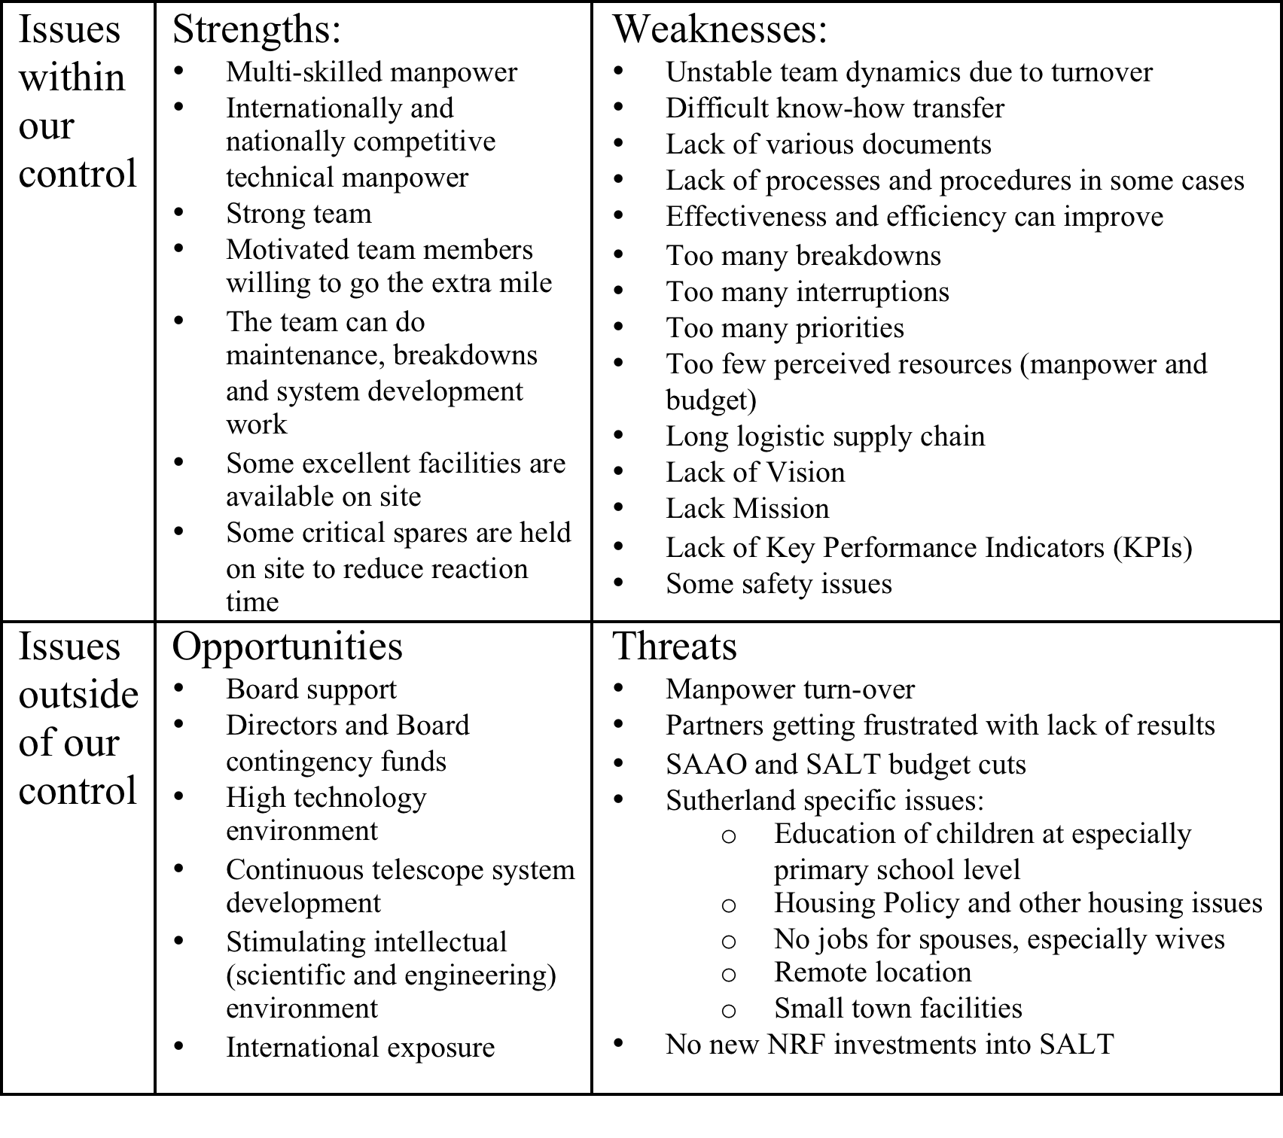

Slide 14
Tech Ops Master Strategy May 2014
Offensive Strategy (Apply Strengths to Opportunities)
Roadmap to take operations to a new level
Scientific Instrument engineering involvement
Maintain and extend International exposure
Maintain and strengthen Stakeholders’ support
Maintain and improve motivation
Herzberg model
Maintain and increase Multi-disciplinary skills
*Invest in manpower to achieve
the above
Manpower related
* Not fully under Tech Ops control

Slide 15
Tech Ops Master Strategy May 2014
Offensive Strategy (Apply Strengths to Opportunities)
Roadmap to take operations to a new level
Scientific Instrument engineering involvement
Maintain and extend International exposure
Maintain and strengthen Stakeholders’ support
Maintain and improve motivation
Herzberg model
Maintain and increase Multi-disciplinary skills
*Invest in manpower to achieve
the above
Manpower related
* Not fully under Tech Ops control

Slide 16
Tech Ops Master Strategy Aug 2009
Defensive Strategy
(Strengthening Weaknesses)
Alleviate cost pressure
Improve the Supply Chain
Job Definitions and PMS
Implement Critical Chain
Project Management
Implement Configuration Management
Improve Safety
*Manpower Retention
(Average Turnover/Year >30%)
*Manpower Strategy
* Not fully under Tech Ops control

Slide 17
Tech Ops Master Strategy May 2014
Defensive Strategy
(Counter Threats)
Mitigate cost pressure
Meet New Agreement’s KPI
Availability, Reliability, <7% Technical Down Time
Strengthen Project Management
Strengthen Supply Chain
Strengthen Configuration Management
Maintain and Improve Safety
Job Definitions and PMS
*Manpower Retention
Average Turnover =4%
*Manpower Strategy
* Not fully under Tech Ops control

Slide 18
Tech Ops Master Strategy May 2009
Temptations = No - No
Pair off Weak Points with Opportunities
Do not ask for more resources
without fully utilizing existing ones
Do not apply unproven or cutting
edge Technology to systems
required to operate reliably

Slide 19
Tech Ops Master Strategy Aug 2009
Temptations = No No
Pair off Weaknesses with Opportunities
Do not ask for more resources without fully utilizing (< 80%) existing ones
Motivation to Board for new human resources need Director’s and SA Director’s support & budget
Do not apply unproven or cutting edge technology to systems required to operate reliably:
Tracker Upgrade, SAMS, RSS Throughput Repair
Built TECHNOLOGY DEMONSTRATORS for future instruments before full-scale development begins

Slide 20
SALT Astro and Tech Ops Teambuilding Tech Ops Management Model
SALT Board
6 Monthly
NRF Bi-Annual Meeting
6 Monthly
SALT BEC
6 Weekly
SAAO Executive Meeting
6 Weekly
SALT Operations Meeting
Weekly
Project Meetings
Weekly
Night Operations
Morning Meeting
Daily
Individual Job List Progress Reviews

Slide 21
SALT Astro and Tech Ops Teambuilding
Recommendations:
Strategic Plan
Instrumentation development a key components
Optical and Opto Mechanical Qualifications
Product Development and or System Engineering
Project Office
Formal Leadership Development (Co-ordinaters & Shapers)
Focus on Team dynamics (Frank La Fasto)
Team roles (Belbin)
Motivational skills (People orientated roles and Monitor Evaluators)
Influencing skills (People orientated roles)
Negotiations skills (Resource Investigators & PM)
Assertiveness skills (Team Players and Celebral roles)
Conflict management skills (Shapers and Team Players)
Communication skills (Planters and Specialists)
Joint Team Meetings
Focus on implementation (Implementers and Completer Finishers to lead)
Devise plans to meet new Operations and Maintenance Contract Objectives and KPIs (Planters to lead)
Organizational Culture audit
Organization Development

