Slide 1
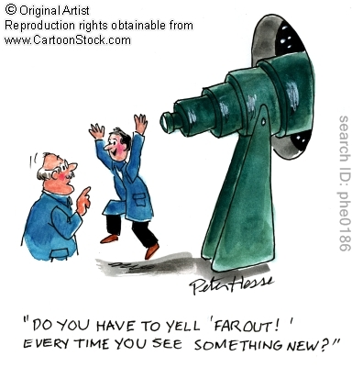
David Buckley, SALT Science Director

Slide 2
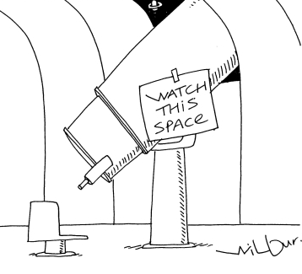
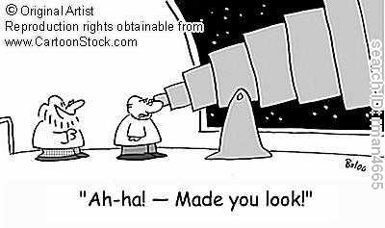
What Do Telescopes Do?
They collect light
They form images of distant objects
The images are analyzed by instruments & detectors
  The human eye
  Photographic plates/film
  Digital detectors (e.g. CCDs)

Slide 3
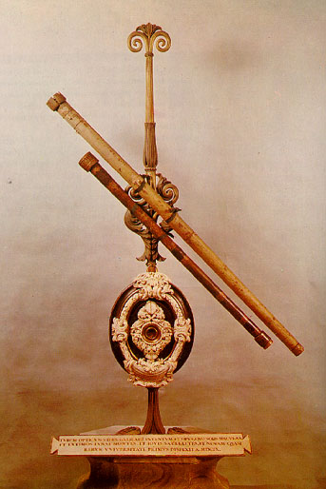
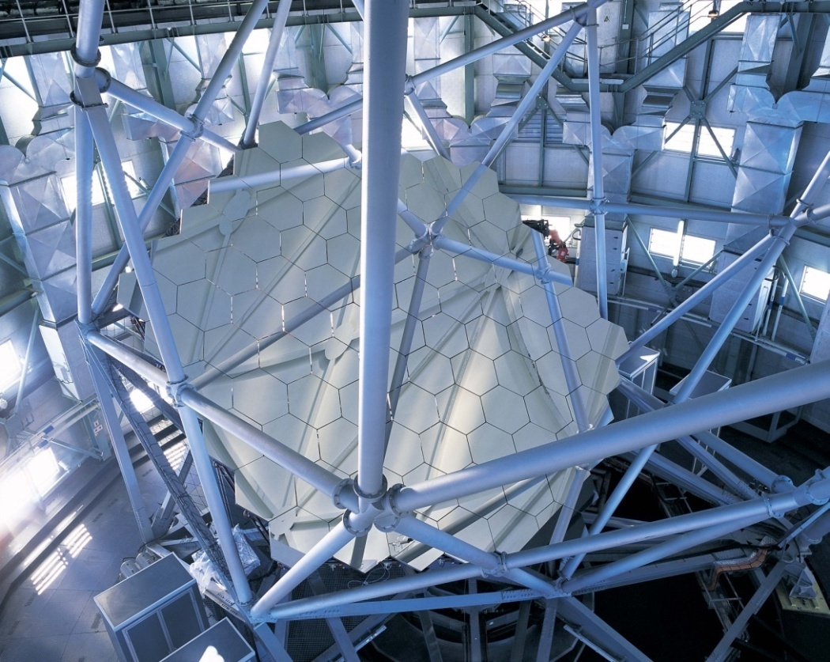
Giant Steps in Telescope Designs
Telescope invented in 1608
First astronomical observations by Galileo in July 1609
  37 mm diameter, f/26
  largest now 10,000 mm (in ~10y, 42,000)
  ~70,000 times larger collecting area
SALT primary mirror array: 91 x 1.2-m segments

Slide 4
Key parameters for an astronomical telescope:
Light gathering power
Determined by the area of the collecting element (objective lens of mirror)
∝ telescope diameter²
Resolution
Measure of the how much fine detail can be seen in an image
∝ telescope diameter (a)
  Defined by considering the wave nature of light
  Specifically diffraction at an aperture (Fraunhofer or Fresnel)
  Typically telescope apertures are circular
  From interference, a diffraction pattern is produced

Slide 5

Resolution
θ
Diffraction pattern for perfect optics
Central peak called the Airy disk
the larger the aperture, the smaller the Airy disk and the better the resolution
for typical astronomical telescopes Airy disk < arcsec
for the eye more like arcmin (100s – 1000s times larger)
Examples:
D = 0.13 m, 0.50 m, 2.5m
& 5 m diameter telescopes

Slide 6
Intrinsic image quality
Determined by the figure of the individual optical elements (how close they are to their ideal shape) and how well they are aligned.
Field of view (FoV)
Determined by the optical design. Usually expressed as field diameter. Information content ∝ area of FoV ∝ diameter of FoV²
Throughput
How efficiently photons are delivered to a focus. Determined by the transmissiveness of lenses and the reflectivity of mirrors.
Tracking & pointing capability
This determines overall performance in terms of observational efficiency and how well image quality is retained during an observation.

Slide 7
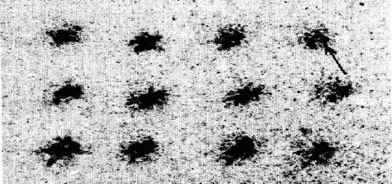
Atmospheric seeing:
Because of the atmosphere, telescope optics usually don’t deliver diffraction limited images, so often its not necessary for them to be diffraction limited
  Can be expensive & unnecessary, unless the atmosphere (“seeing”)
  can be corrected with adaptive optics

Slide 8
Telescope Systems for Different Assumptions
Geometric Optics Wave Optics Real Atmosphere
Ideal

Slide 9
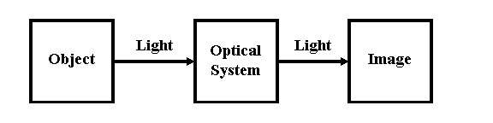
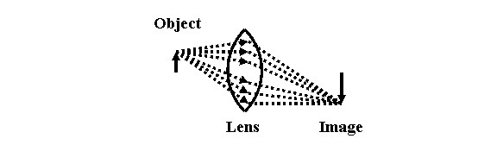
Telescope Optics
What is a telescope system? With optics (lenses or mirrors) it produces an image of an object at a distance.

Slide 10

Optical Aberrations
Departures from ideal image caused by optical aberrations (imperfections).
Can describe them using a simple ray tracing approach derived from considering simple reflection or refraction (e.g. Snell’s law)
For lenses (transmitting light) allow for angles of incidence to real lens surface and refractive indices.
First order, or Gaussian theory, applies for small angle so approximation sin θ = θ and cos θ = 1 is valid.
Next level of complexity uses better approximation for sin θ:
This is used in defining the Seidel aberrations

Slide 11
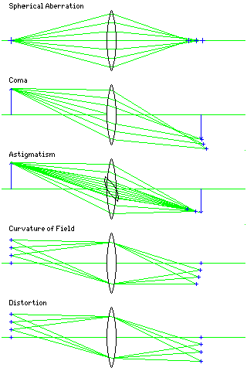
The Seidel aberrations:

Slide 12
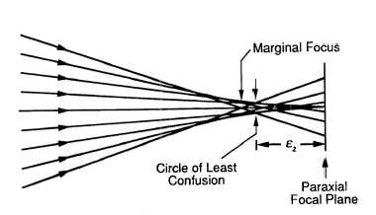
Optical Aberrations
Example: Spherical Aberration
Spherical because a sphere images just like this.
perfect image only of centre of curvature
any optic (spherical or not) can show exhibit it
ideal mirror to image on-axis object at ∞ is a paraboloid (as used in most telescope primary mirrors).
SALT
Since SALT is deliberately designed to have
a spherical primary mirror it suffers from
severe spherical aberration
circle of least confusion ~10 arcmin (1/3rd Lunar diameter)

Slide 13
Example of an aberration (de-focus)
What is this aberration commonly know as?

Slide 14
Optical Aberrations: Zernike polynomials
Can describe optical aberrations using the wave nature of light as a wavefront perturbations retarding or advancing the phase
Consider the entrance pupil (e.g. objective lens in a refractor) and the imperfections of this surface
Can describe aberrations as phase changes that change with position over such a pupil

Slide 15
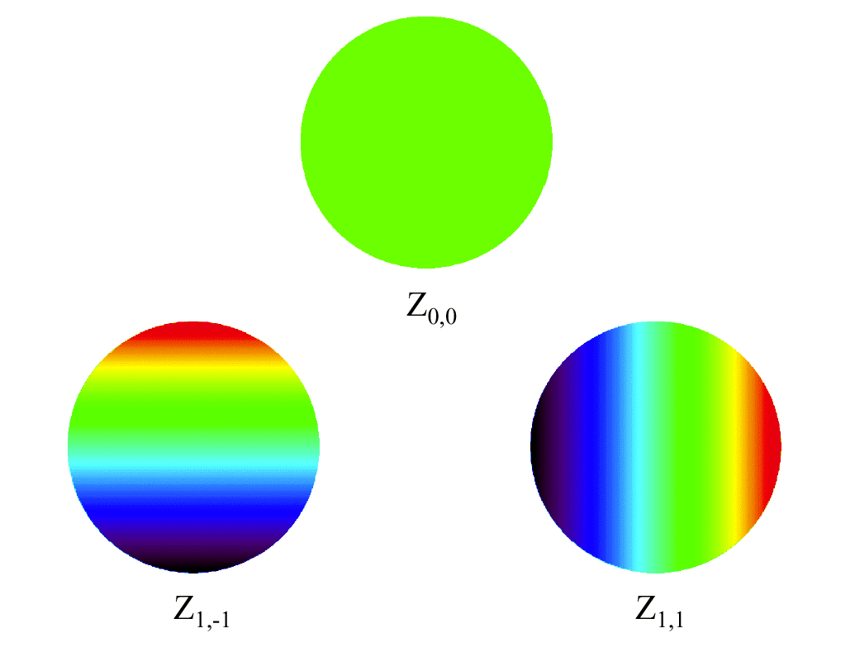
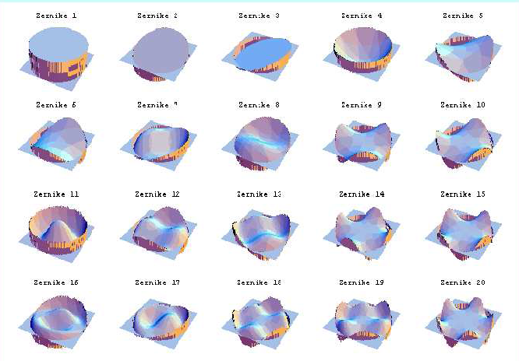
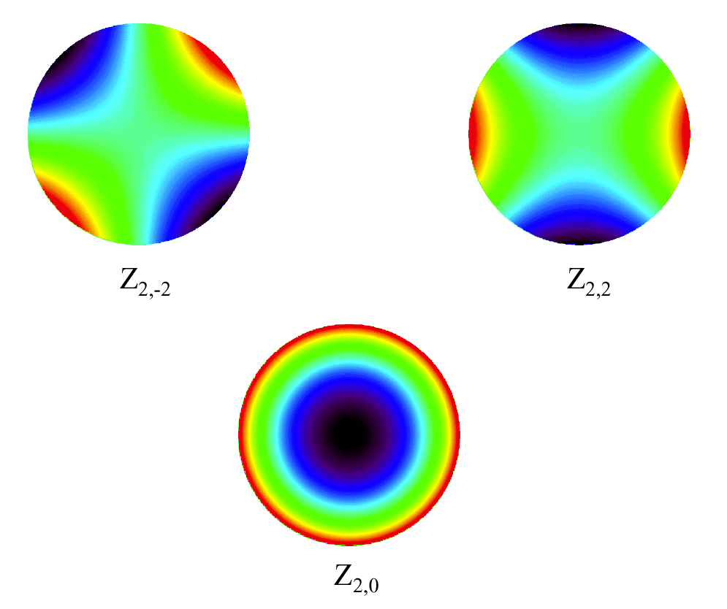
Pupil variations
Piston
Wavefront perturbations result in phase changes over the pupil
These can be characterized by Zernike polynomials in the circular pupil plane
Tip & tilt
Astigmatism
Defocus

Slide 16
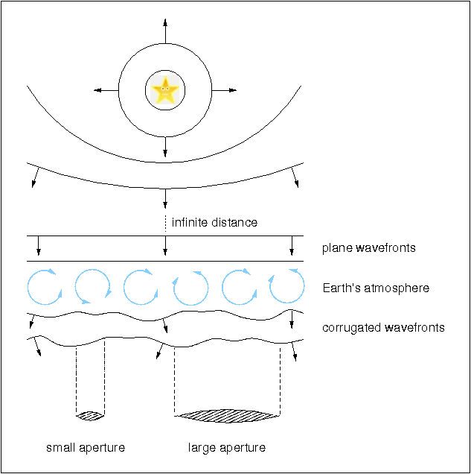
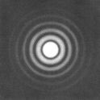
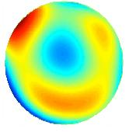
Wavefront Perturbations
Turbulent cells of varying index of refraction distort the wavefront
Phase changes occur
Introduces aberrations which distort the ideal image (‘near field’), the point spread function (PSF)
aberrations
In the pupil plane (‘far field’), phase variations can be deconvolved into the Zernike terms.
Ideal pupil aberrated pupil
aberrations
pupil deconvolved into Zernike terms
=
+
+
+
+
+ …

Slide 17
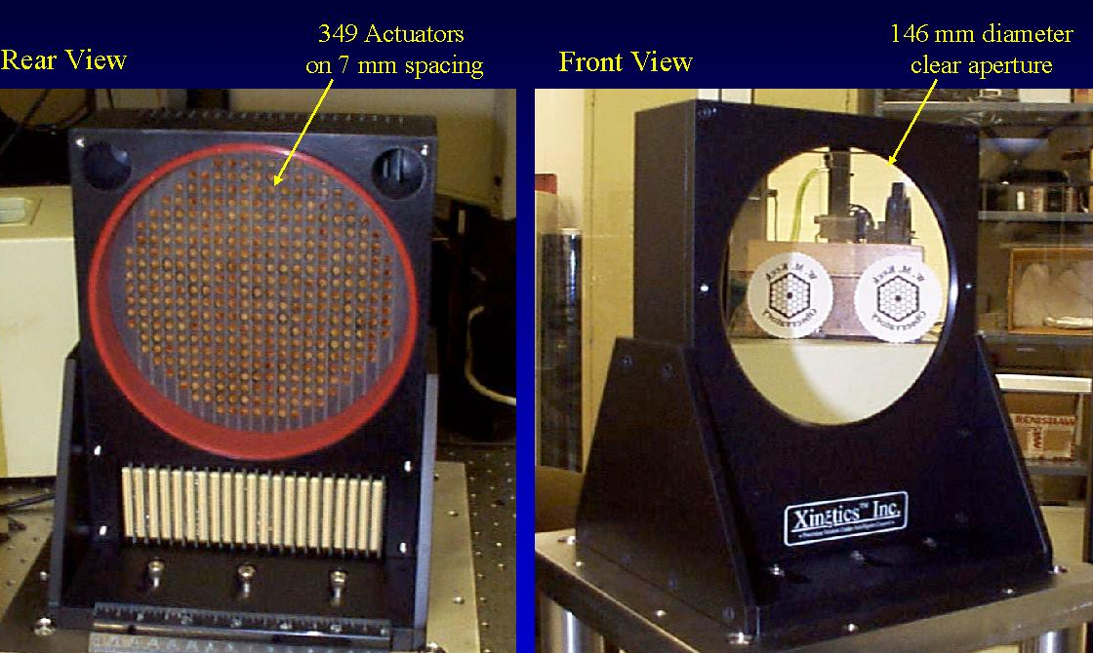
How Adaptive Optics (A-O) works
Determine the Zernike terms of the wavefront perturbations
  Fast exposures & fast analysis
Use these terms to perturb a deformable mirror in the opposite sense
Remove the phase variations
  Fully corrected image

Slide 18
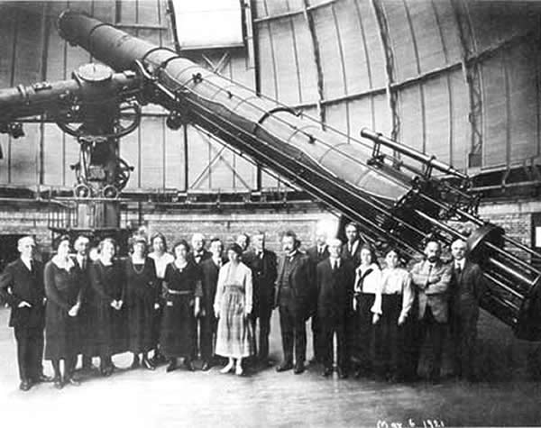
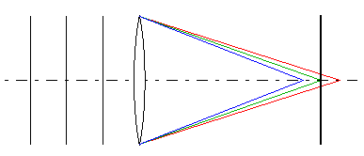
Telescope Optics
1. Refractors:
The lens has to be supported around the edge (like spectacles)
As lenses become bigger (light grasp ∝ d²), the mass increased as the cube of the size (m ∝ d³)
Supporting the lens became harder (bigger and more complex)
Flexure (bending) of the lens itself cause ‘figure’ to change, resulting in optical aberrations
Largest refractor ever made is the Yerkes telescope in the US (1 m diameter)
All refractors suffer from chromatic aberrations
Yerkes refractor in 1895

Slide 19
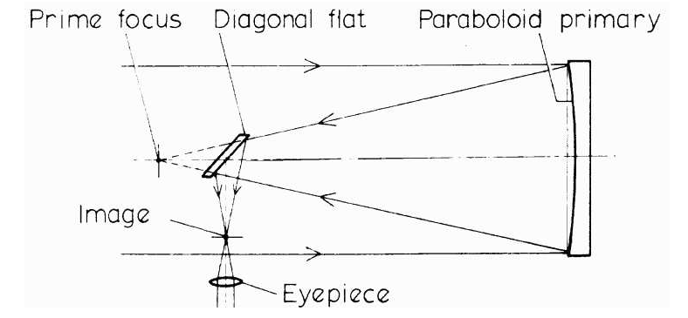
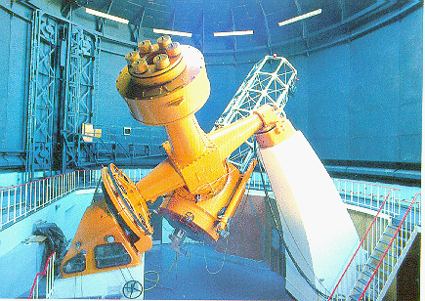
Telescope Configurations
Reflectors avoid many of these problems
Newtonian reflector Cassegrain reflector

Slide 20
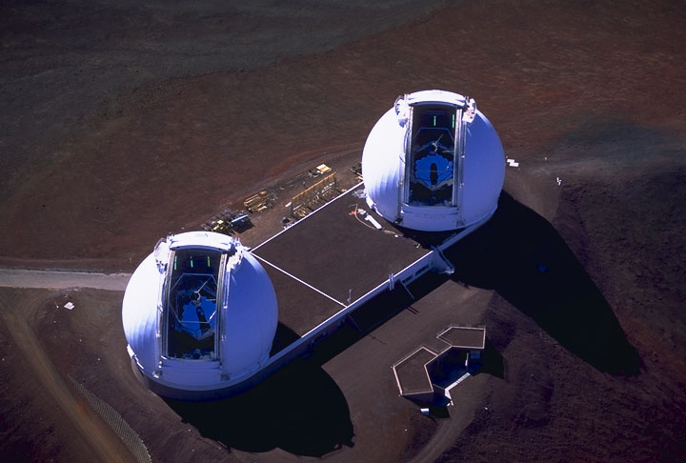
Telescope Configurations
Nasmyth focus
For any reflector, can add a third mirror (tertiary flat) to deflect the beam perpendicular to optical axis
Allows for heavy instrumentation to be easily supported
Keck Telescopes (10m) on Hawaii (first segmented mirror telescopes

Slide 21
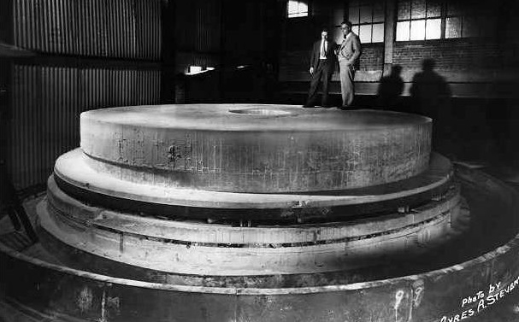
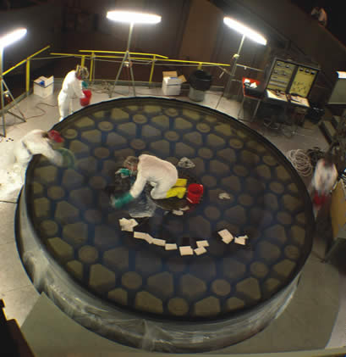
Telescope Mirrors
Originally mirrors had to be made thick in order for them not to sag
  Thickness-to-diameter ratio of typically 1:6
  Mirrors relatively heavy
    Hale telescope mirror weighs over 20 tons
  Sometimes mirrors were cast with ceramic inserts to decrease the amount of glass
  Mirrors could take literally years to cool after being cast to avoid stresses

Slide 22
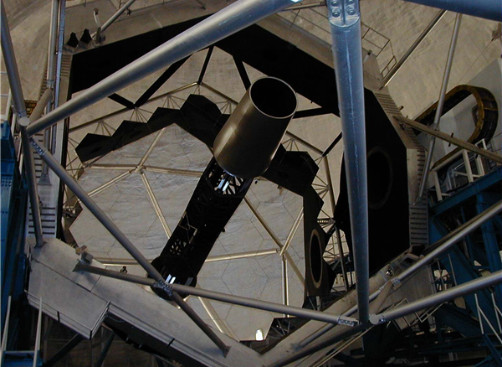
VLT
New innovations in telescope mirrors
Meniscus mirrors
Spun-cast mirrors
Segmented mirrors
LBT
Keck

Slide 23
Supporting Thin Mirrors
Thin mirrors bend due to gravity and temperature:
Correct with active optics
Allows distortions to be removed locally on surface
Uses push-pull actuators
Correction done dynamically using a reference
Subaru telescope

Slide 24
Mirror Costs
New technologies developed in the 1980s to allow thinner mirrors to be made
  Less material, so cheaper and quicker to make
  But more sophisticated support mechanisms required
SALT
SALT total
SALT figuring
SALT blank

Slide 25
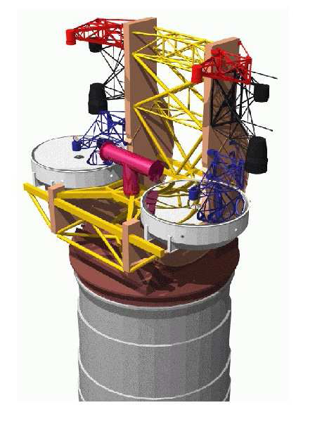
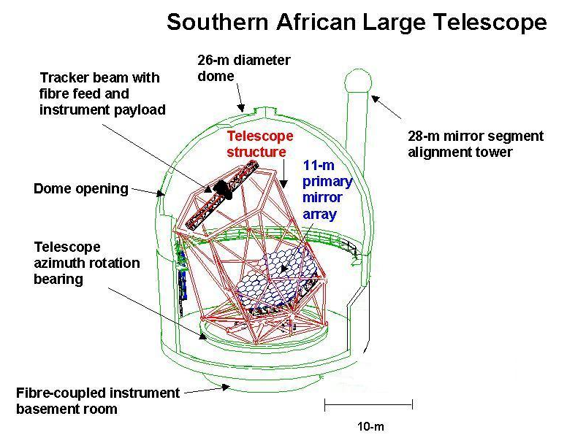
Novel Telescope Mounts
New types of Alt-Az mounts
Large Binocular Telescope (LBT)
SALT & HET
Twin 8.4-m LBT (2006)
SALT (2005)

Slide 26
Telescope Mirror Sizes
#6
(2000)
#8=
(1999)
#7=
(1998)
#7=
HET
#3=
(1993)
#3=
(1996)
#5
(1997)
#4
(2005)
#7=
#7=
(2001)
GTC
#2
(2009?)
#8=
(2000)
#1
(2009?)
Those >8-m in red (+ year)

Slide 27
The “Big Five”: Segmented Mirror Telescopes
Keck I (1993) & Keck II (1996): Hawaii, USA
HET (1999): Texas, USA
SALT (2005): South Africa
GRANTECAN (2009:) Canary Islands, Spain
These telescopes have the largest light grasp
Some also use adaptive optics to get sharper images, particularly at longer wavelengths (IR)

Slide 28
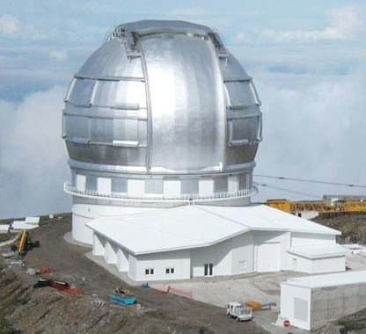
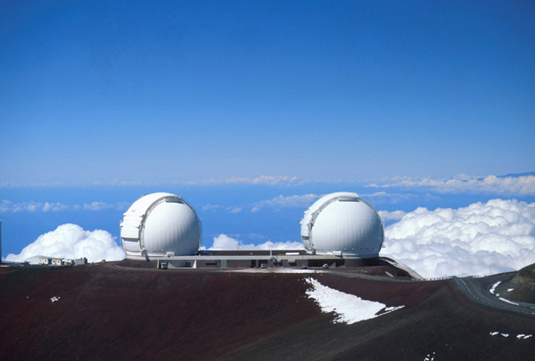
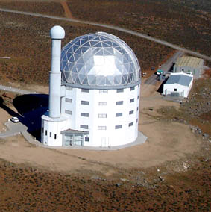
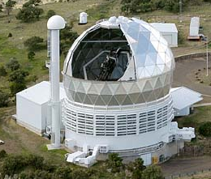
The 10-m Club
2 x 9.8-m Keck Telescope: Hawaii (N)
10.4-m GTC: La Palma (N)
9.0-m SALT (S)
9.0-m HET: Texas (N)

Slide 29
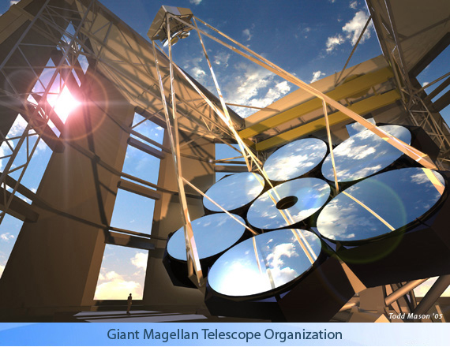
Giants of the Future:
Extremely Large Telescopes
The Giant Magellan Telescope (USA/Australia/Korea consortium)
[to be built in Chile]

Slide 30
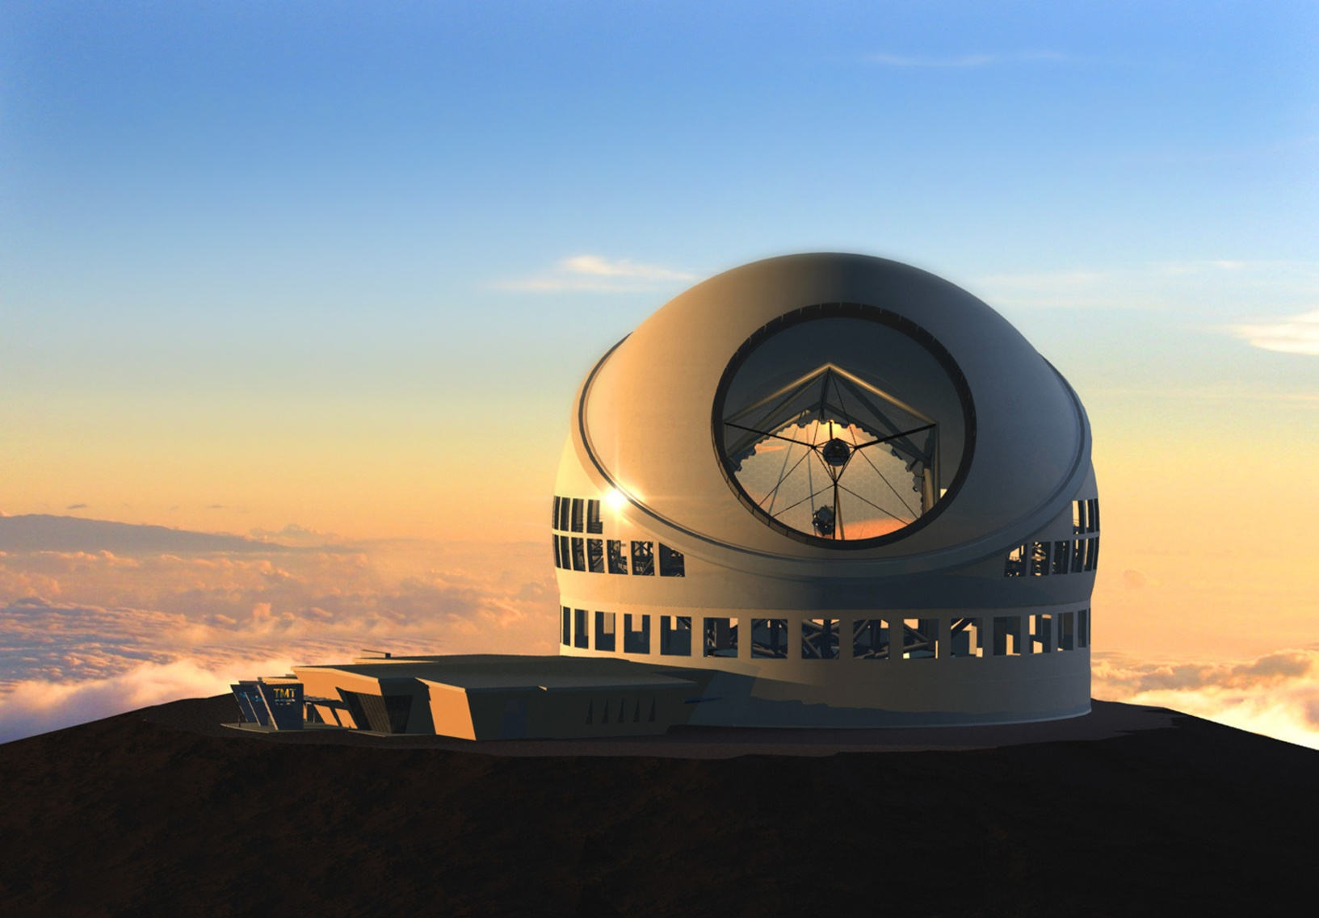
Giants of the Future:
Extremely Large Telescopes
TMT: Thirty Meter Telescope (US-Canada-India) 30-m

Slide 31
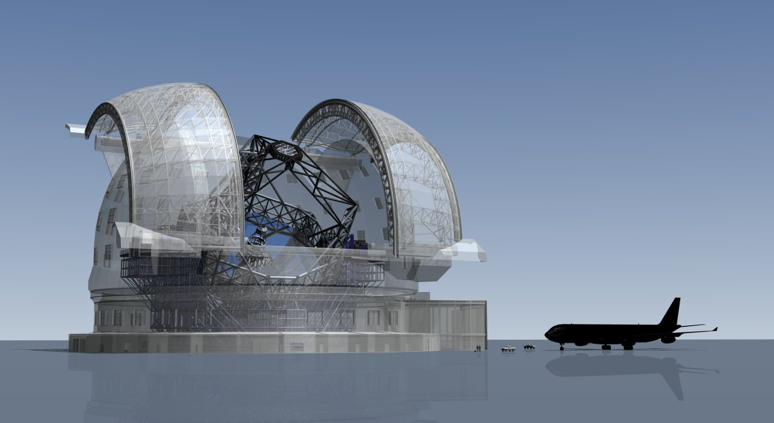
Extremely Large Telescopes
E-ELT: European Extremely Large Telescope (39-m)
(moved from 100m -> 42m ->39m)
Airbus A-340

