Slide 1
MeerKAT
Large Survey Projects
SAAO Board, Roy Booth (SA SKA Project)

Slide 2
The MeerKAT Large Survey Proposals (MLS)
MeerKAT (64 x 13.5m offset Gregorian antennas) will be the most powerful centimetre-wave radio telescope in the Southern Hemisphere until it is eventually merged with more (circa 180) SKA project 15m diameter antennas to form the SKA1.
MeerKAT will support scientific investigations within and beyond the MLS
MLS proposals will occupy 70% of the observing time
The other 30% is for PI proposals and ‘Targets of Opportunity’ at the Director’s discretion

Slide 3
MeerKAT Large Surveys
Community response
22 countries

Slide 4
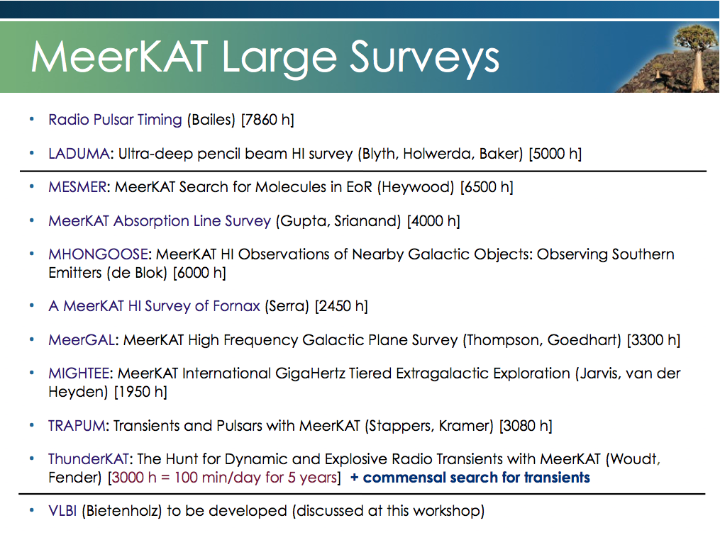
Includes magnetic fields in galaxies (polarization and Faraday rotation) and Faraday rotation)
= place holder for VLBI with MeerKAT

Slide 5
1. HI (OH) Galaxy Surveys
Distant Universe (LADUMA) z=1.4 (580 MHz) – Extended Chandra Deep Field South (Blythe, Baker and Holweda)
ABSORPTION LINE SURVEY– HI (+OH) detection at high red-shifts and also investigation of magnetic fields (Zeeman splitting) and constancy of Fundamental constants as a function of z using OH lines and their different dependencies on the fine structure constant and the electron/proton mass ratio. Also millimetre and optical follow-up (Gupta and Srianand)
Nearby galaxies of different types (MHONGOOSE) –Cosmic web, dark matter (de Blok)
Galaxy Clustering (FORNAX cluster) Effects of galaxy-galaxy interaction, tidal stripping, galaxy formation in clusters,…. (Serra)

Slide 6
LADUMA
Galaxies form from gas that cools and condenses in dark matter halos. In the local Universe (z < 0.5) HI is the easily detectable manifestation of this process (Guinevere Kaufman). Laduma will study H1 to z=1.2!
High-z HI (even OH) in galaxies in a single field (ECDFS) in two phases (z= 0.58 and z> 1.2 (according to the receiver roll-out of MeerKAT).
Goals
Measurement of integrated HI masses in relation to environment, to halo mass, Stellar mass.
HI emission v. absorption
For the first time to investigate the HI galaxy content out to z=1.2
(Probably rely on optical red shifts – and may need more?)

Slide 7
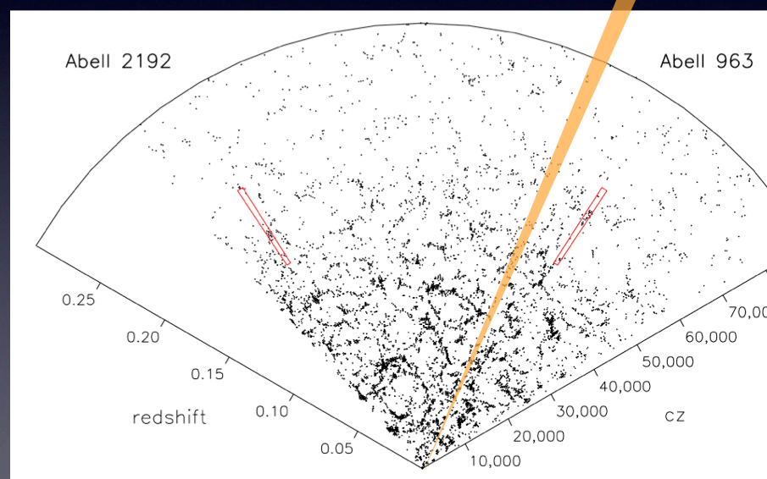
LADUMA a deep HI survey to z=1.2
Mark Verheijen

Slide 8
HI Observations of the FORNAX Cluster
PI Serra
Fornax is the second most massive cluster within 20 Mpc form us and the largest cluster in the southern hemisphere. Its low X-ray luminosity makes it representative of the environment where most galaxies live. Furthermore, Fornax’ ongoing growth makes it an excellent laboratory for the study of structure formation. Ideally located for MeerKAT observation, it provides an excellent opportunity to study the assembly of clusters, the physics of the accretion and stripping of gas in galaxies falling in the cluster, and to probe for the first time the connection between these processes and the neutral medium in the cosmic web.

Slide 9
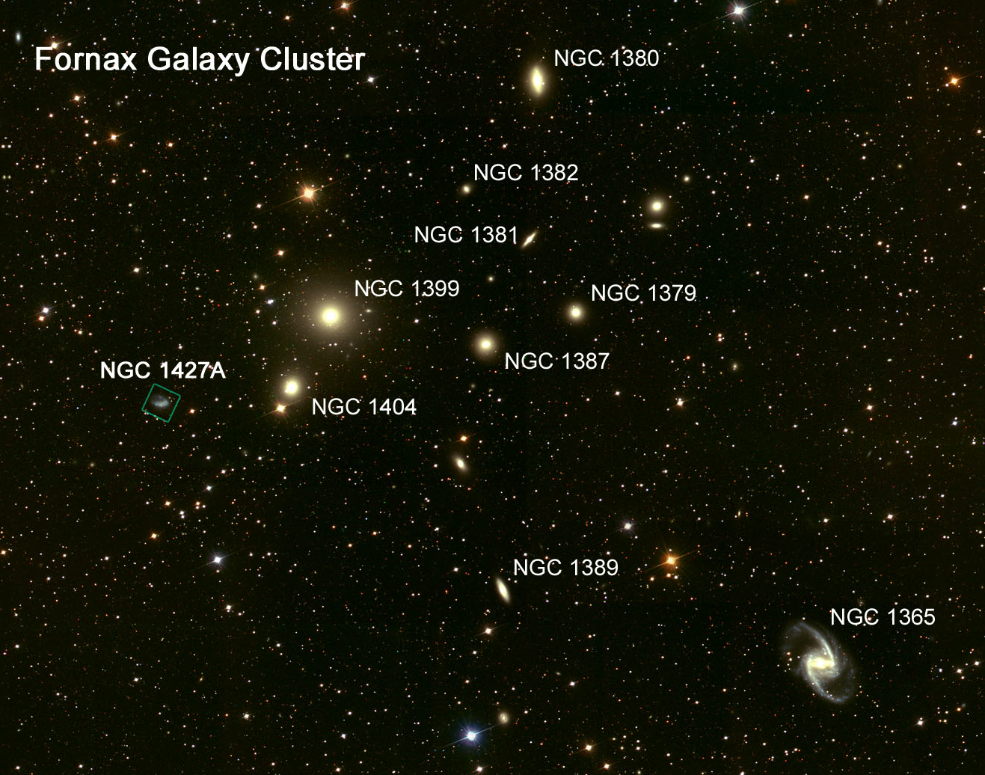
HST heritage image

Slide 10
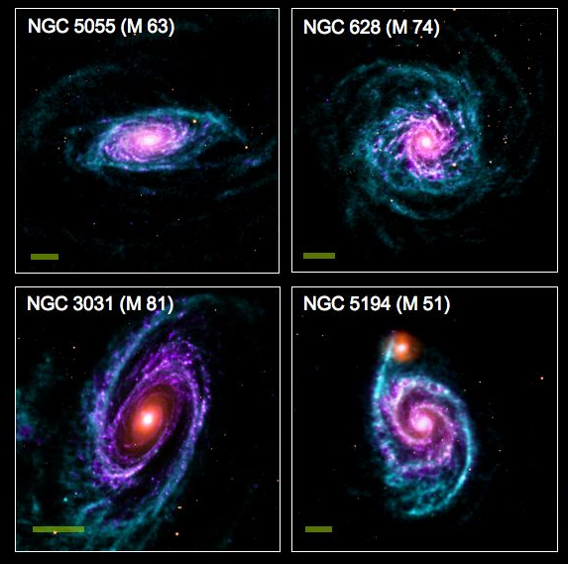
Mhongoose - Galaxy Assembly & Evolution – de Blok

Slide 11
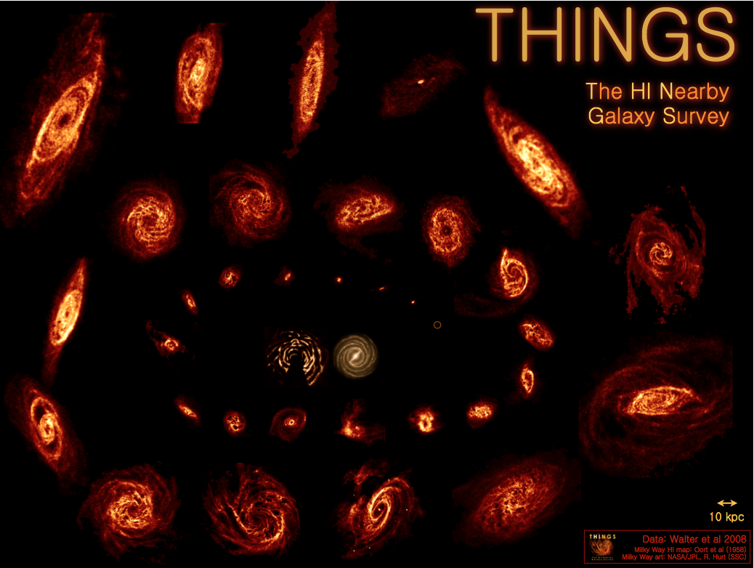
/tmp/PreviewPasteboardItems/NWONRF_deblok.pdf

Slide 12
Follow-up to ‘THINGS’ survey with VLA
Studying relatively local galaxies and the connection between star formation and HI dynamics and accretion
Outer discs of galaxies and the cosmic web
Comparison of Spitzer data,
Relationship to molecular gas fn(radius)

Slide 13
The Velocity Field of M31 and the Dark Matter
No dark halo
Radio observations of the neutral hydrogen line in nearby galaxies showed that the speed of rotation of the gas is constant far beyond the optical image. The optical image suggests that the galaxy must be embedded in a huge dark matter halo.

Slide 14
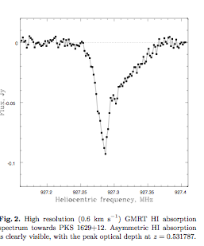
HI Absorption lines – Gupta and Srianand
HI may be detected more easily in absorption against a background continuum source
Pks 1629 + 12
Z = 0.531787
Kanekar and Chengalur
GMRT

Slide 15
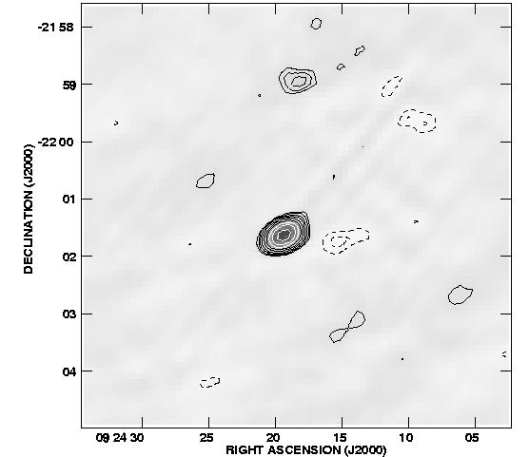
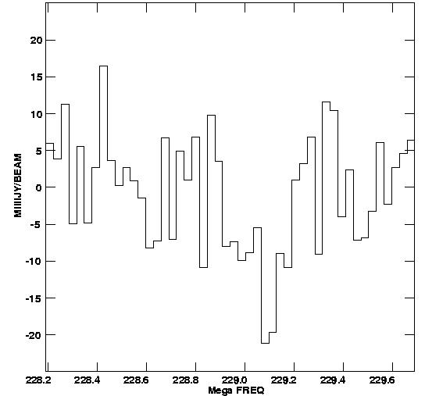
GMRT 230 MHz 0924-220 z=5.2?
Continuum point source = 0.55 Jy
Noise limited spectra: s=5.5 mJy/channel
HI 21cm absorption at z=5.200? t = 4%, Dv = 130 km/s N(HI) = 9e20 (Ts/100K) cm^-2

Slide 16
Goals
Blind search for 21cm and OH absorbers at z<1.8:
using 580- 1750 MHz frequency band(s).
Detect more than ~600 intervening 21-cm absorbers:
20 times the number of absorbers known.
3) Measure the evolution of cold atomic and molecular gas at z<1.8:
the z-range where most of the evolution in SFRD takes place.
4) Time variation of the fundamental constants of physics:
using OH lines, and 21-cm and optical/UV absorption lines
(SALT + VLT + ALMA).
5) Probe the magnetic field in absorbing galaxies:
using rotation measure and Zeeman splitting.
6) Synergy with ALMA, EVLA, SALT, VLBA and VLT.
.
.... all the data will be public.
Chile - 2011

Slide 17
FUNDAMENTAL CONSTANTS
Basic Idea:
Measure the apparent redshifts of two spectral lines whose frequencies have different dependences on fundamental constants (eg OH lines)
From the observed redshift difference determine rate of change of relevant constants (or get upper limits)
Fine structure constant
Electron/proto mass ratio
Proton g-factor
Rydberg constant

Slide 18
Hydroxyl (OH)
The OH rotational line is split:
First by an interaction between the electronic angular momentum and the molecular rotation
Then, each energy level is split again through the interaction of the nuclear magnetic moment with the magnetic moment of the orbiting electron
Different dependences on alpha and
on the electron – proton mass ratio
2
1
2
1
Frequencies and LTE line ratios
F=1-2 1612 MHz 1
F=1-1 1665 MHz 5
F=2-2 1667 MHz 9
F=2-1 1720 MHz 1
In normal OH, spectra in all 4 lines give info on excitation conditions.
Could be important for MeerKAT

Slide 19
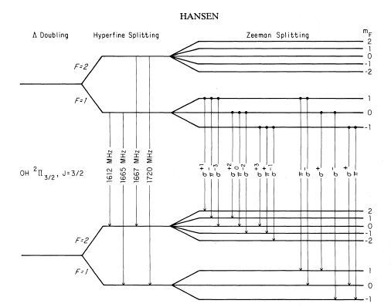

OH ²Π_{3/2} ground-state transitions
Λ doubling: Interaction of electronic angular momentum with molecular rotation
hfs splitting: Interaction of nuclear magnetic moment of with magnetic moment of orbiting electron
Different dependences
on α and y = m_{e}/m_{p}
Fundamental treatment:

Slide 20
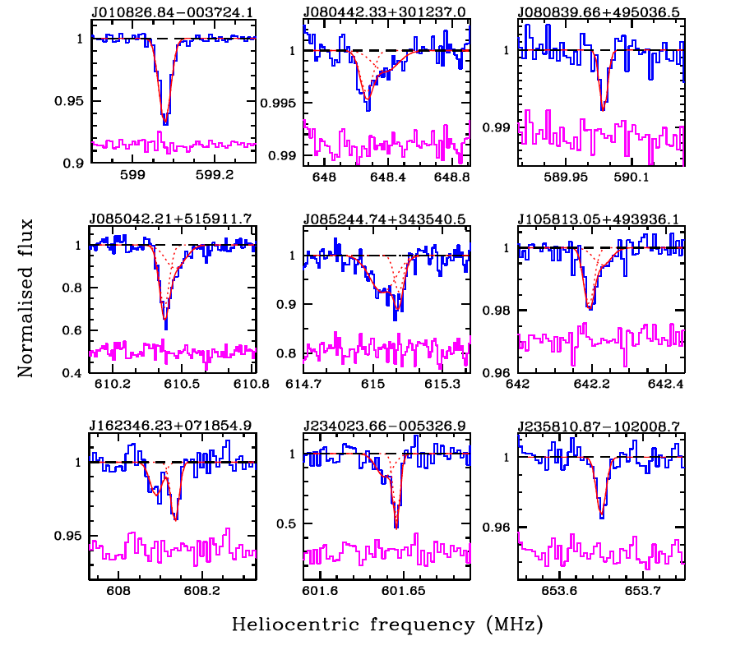
21-cm absorbers for the fundamental constant studies
What is a good system for fundamental constant studies ?
Gupta et al. 2009
CapeTown - 2012

Slide 21
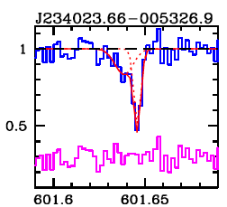
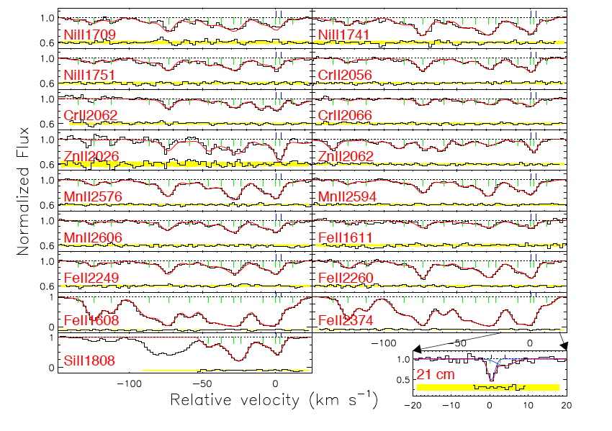
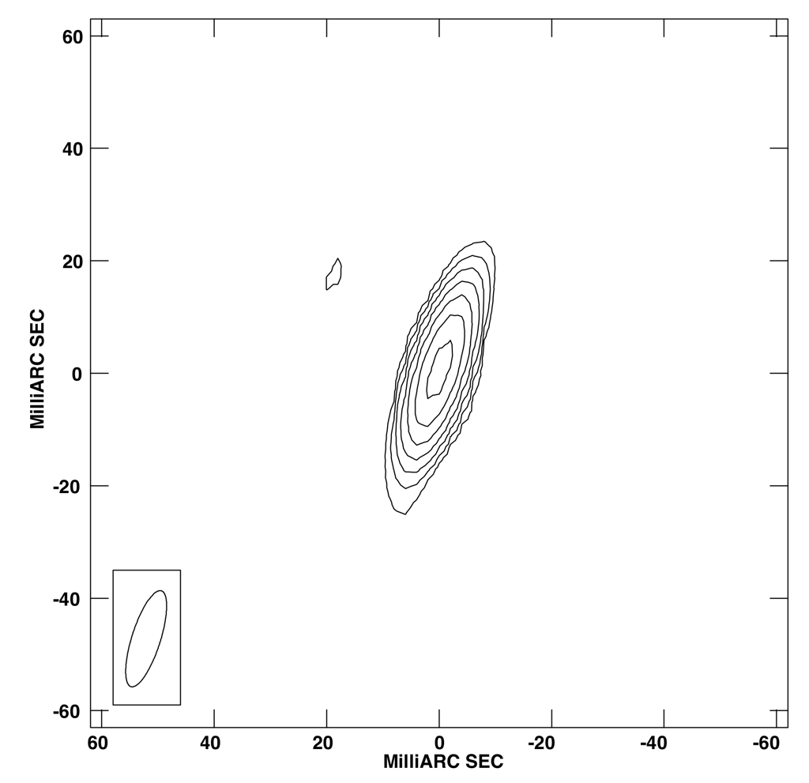
Case of J2340-0053 (z=1.3603)
Case of J2340-0053 (z=1.3603)
Compact at VLBI scales
Compact at VLBI scales
Rahmani et al. 2012
CapeTown - 2012

Slide 22
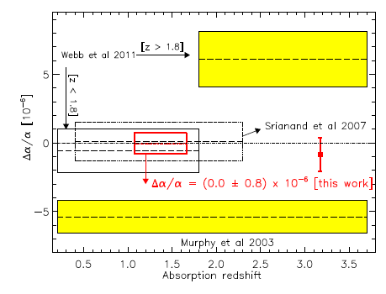
Discrepancies in the variation? of the Fine structure constant
Rahmani et al. 2012
CapeTown - 2012
Rahmani et al used optical spectra taken with the UVES Echelle Spectrograph at the VLT and 21 cm absorption data from the GMRT

Slide 23
2. High frequency spectroscopy nb high frequency receiver 8 – 15 GHz
High-z CO (MESMER) – PI – Ian Heywood
(MeerKAT Search for Molecules in the epoch of reionisation)
CO is a surrogate for H₂ which has no dipole moment and so no rotational spectrum
CO already detected in two galaxies at z + 6.4 (even greater) - and commonly at z=4 and less
Evidence that molecular hydrogen more abundant than atomic hydrogen in the early Universe, where galaxies more tightly bound (pressure/gas density higher)
How common is high-z CO?
This study was one of the drivers for a high frequency band on MeerKAT

Slide 24
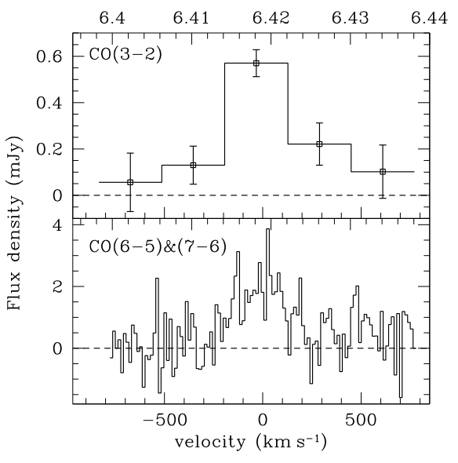
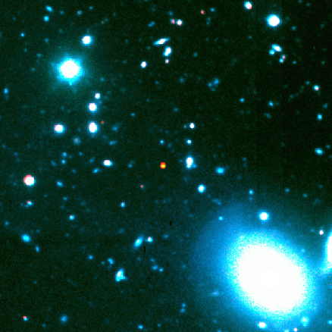
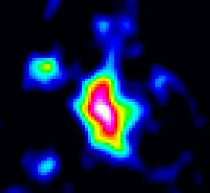
CO and dust detected at z=6.42, already close to EoR
VLA
PdBI
Fuel for Galaxy Formation
Size ~ 5.5 kpc
Radio-FIR SED follows star forming galaxy
SFR ~ 3000 M/yr
SDSS J1148+52: Gas detection
z = 6.42 (t = 0.87 Gyr)
L_{bol} = 10¹⁴ L
SMBH ~ 3 × 10⁹ M
M(H2) ~ 2 × 10¹⁰ M
Carilli et al.

Slide 25
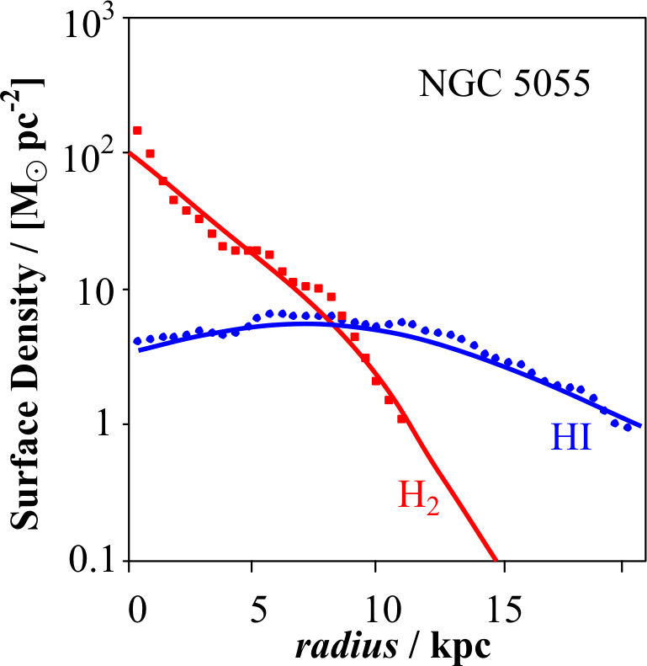
Theory for HI and H2 in Galaxies
Properties of HI and H2 in a normal galaxy
Molecular hydrogen/atomic hydrogen ratio depends on Pressure,
which builds up towards the centre of normal galaxies
Obreschkow et al., 2009, ApJ

Slide 26
Three stage observational scheme:
Stage 1: Target fields containing lensing clusters, (A370, A 1689 and MACS 2129) chosen because they have no bright radio sources) thereby taking advantage of the lensing magnification in source brightness, angular extents and source counts that lensing affords. (3 x 600 hrs)
Sensitivity in a 1 MHz bandwidth is about 10 microjansky in 250 hrs
Stage 2: High-z quasars and some blank fields (9 x 300 hrs)
Stage 3: One square degree survey centred on a prominent field already targeted by other surveys eg ECDFS (250 x 8 hrs)

Slide 27
MeerGAL – High-frequency survey of the Milky Way Galaxy (and Magellanic Clouds)
Mark Thompson and Sharmila Goedhart
Unique to MeerKAT and another reason for 8-14.5 GHz
Stellar formation and evolution - HII Regions,
Recombination lines and Galactic Rotation Curve,
interstellar molecules,
Astrobiology - new molecules, molecules of life….
MASERS throughout the Galaxy - astrometry follow-up with VLBI

Slide 28
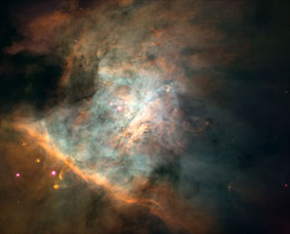
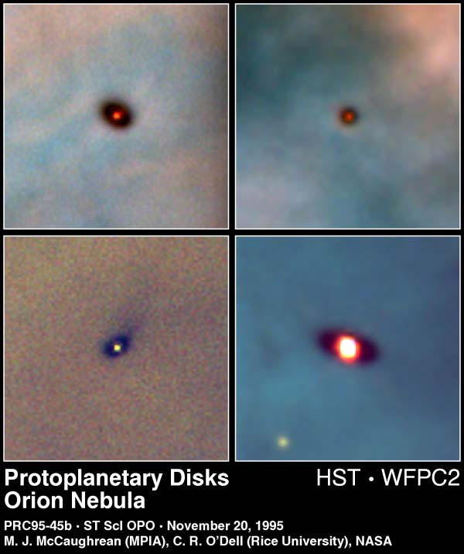
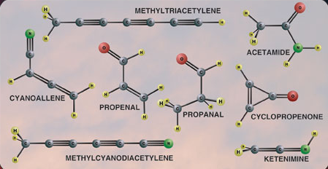
Astrobiology at Long Wavelengths
Origins
  First Light
  Galaxy Evolution
  Astrobiology
λ > 1 cm
Not affected by dust
Complex molecules have transitions at longer wavelengths
“Waterhole” (1.4–1.7 GHz)
Leakage emissions from extrasolar planets!

Slide 29
3: Deep Continuum studies (Mightee) van der Heyden and Jarvis
Long integrations of selected regions in order to reach micro-Jansky sensitivity levels
Will integrate on the same field as Laduma
Synergy with the wider field ASKAP-EMU survey
Mightee is so sensitive that it is very likely to detect new types of radio sources – showing the way the radio galaxy population evolved

Slide 30

Approach to major radio surveys
The wedding-cake approach

Slide 31
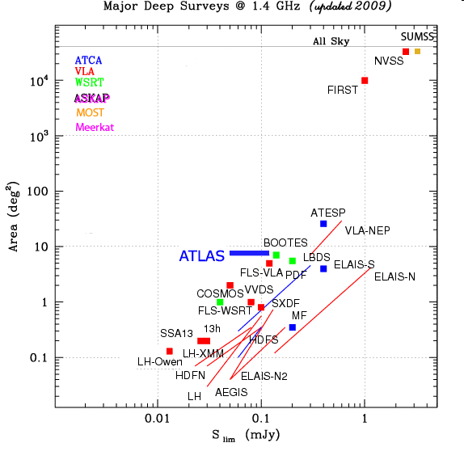
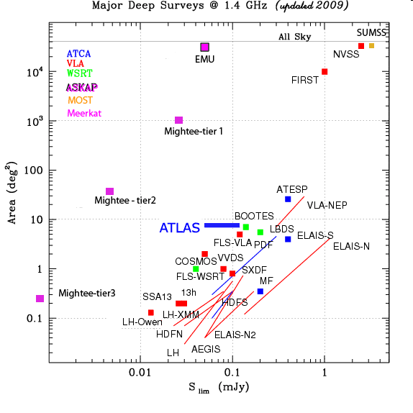
Current major 20cm surveys
EMU
75% of sky
rms=10μJy
NVSS
75% of sky
rms=450μJy
SKA pathfinders
SKA pathfinders
Limit of conventional radio-telescopes
Diagram courtesy of Isabella Prandoni

Slide 32
Current major 20cm surveys
SKA pathfinders
Limit of conventional radio-telescopes
Diagram courtesy of Isabella Prandoni

Slide 33
–
Pulsars
Pulsar Timing (Bailes), Trapum (Stappers and Kramer)
Pulsar timing – gravitational waves
Pulsar timing – variations in period may indicate gravitational waves pervading the medium
Pulsar Searches – looking for new types of Pulsar some switch on and off – why? how?

Slide 34
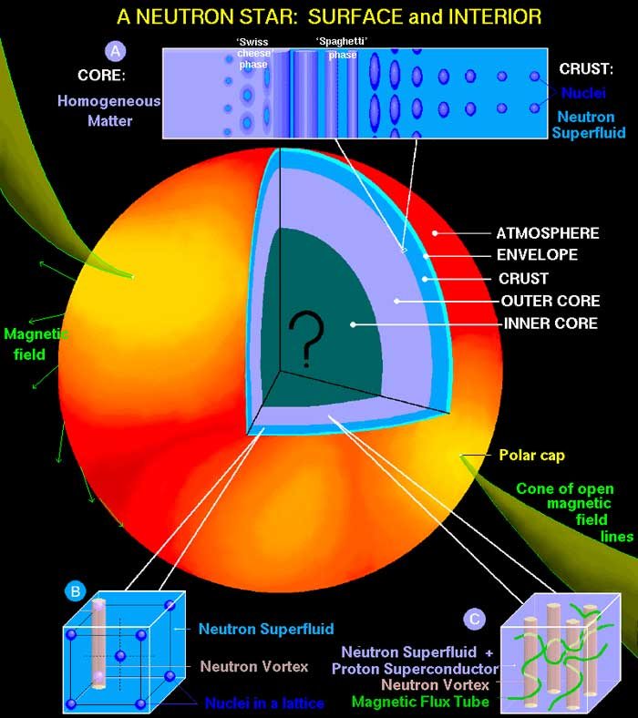
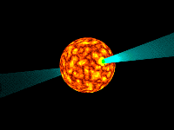
Pulsars are rotating neutron stars
Mass 1.4 Mo
Radius 10 km
Surface – crystalline solid, density 10^6 gm/cc
Outer core – solid with free neutrons
Inner core – neutron superfluid, d=10^14
Popssible solid central core;
Central density 10^15 g/cc

Slide 35
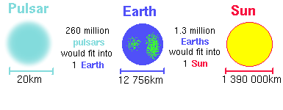
Pulsar size

Slide 36
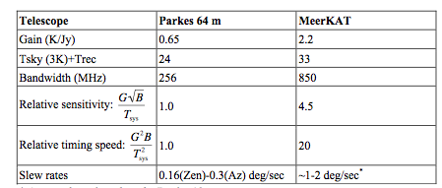
Pulsar timing
MeerKAT 4.5 times as sensitive as Parkes
(Matthew Bailes, PI Pulsar timing at X-band)

Slide 37
High frequency Pulsar observations
Exploration of Central region of the Galaxy to conduct precision Pulsar timing with the aim of detecting the gravitational wave background using an array of millisecond pulsars.
Rigorously test General Relativity and alternative theories of gravity using the double pulsar and other relativistic binaries.
determine the distribution of neutron star masses,
precisely map the orbits of the binary pulsars to trace their origin and evolution, study pulsar planetary systems, determine the origin and evolution of the globular cluster pulsars.
study the internal structure of neutron stars via glitch monitoring, explore the radio pulsar emission mechanism and its relation to gamma-ray and x-ray emission.
understand the magnetars,
determine a large number of pulsar parallaxes and proper motions, rigorously map the interstellar medium,
study the single pulses of a large ensemble of pulsars, determine the pulsar birthrate and population and determine the true nature of the rotating radio transients (RRATs).

Slide 38
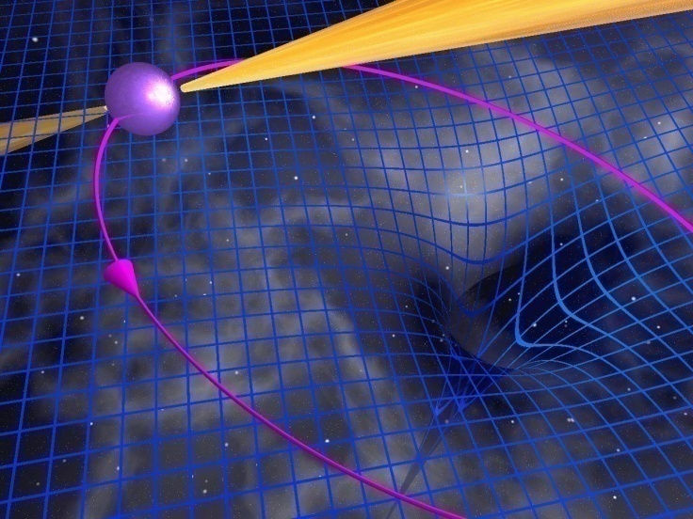
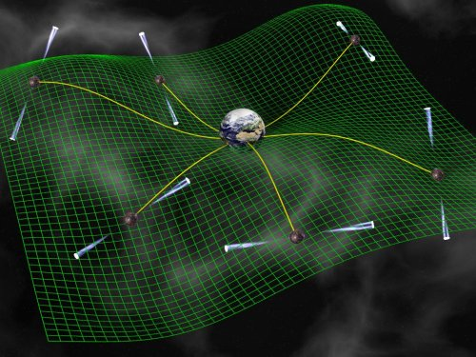
PULSARS and Tests of General Relativity and Search for Gravitational Waves
Huge pulsar surveys will discover pulsar black hole binaries, providing direct tests of gravity in the strong field limit.
Huge numbers of pulsars provide an array of very stable “clocks” which can be used to detect a background of grav waves.

Slide 39
ThunderKAT – Extreme Physics
(Woudt and Fender)
Slow radio transients (several seconds and longer in duration) are relatively rare. eg Supernovae, Novae and even more exotic objects. But rather few studies have been undertaken.
Gamma ray bursts from AGN and other compact radio sources are observed occasionally, but have not been well studied or fully understood.
ThunderKAT aims to monitor a wide field with MeerKAT in the hope of finding transient events.
Other instruments will be ready to follow up on those events.
The essence of the project is the high sensitivity of MeerKAT, a spigot from the correlator permanently connected to the transient detector system and the ability to marshal other instruments to follow through in the radio and other wavelengths.
Optical follow-up is of great interest.

Slide 40
The way forward

Slide 41
From Bernies letter to Successful PIs
The MeerKAT organization is anxious to ensure that the successful Survey Teams shall work with us to ensure a coherent approach to issues like Project Development, Special Software, Data Format (we propose VO compatibility), Team Organisation and Dynamics (working groups), Publication/Data Release Policy and Outreach.
Large Survey Oversight Team set up to conduct regular (quarterly) meetings of PIs and request that the Project teams conduct annual meetings with our scientific/technical liaison personnel, Roy Booth and Justin Jonas (in the first instance), to report progress, problems and possible changes in scientific priorities as other projects progress.
The project will adapt HR policy towards special postdocs and PhD positions in fields related to the accepted Large Survey Programmes, and request that a reciprocal policy is adopted by the team leaders.

Slide 42
Supporting the MLS
Regular interactions with PIs
Persuading surveys to set up working groups to interact directly with appropriate engineering teams – software (pipeline), digital (correlator)….system eng. (specs)
Involvement of PIs in KAT-7 commissioning
Annual MLS progress meetings with project reps.

Slide 43
ASKAP and Meerkat are different from conventional telescopes
They will both be dominated by large survey projects
Nobody will go to the telescope to observe
Observations will be orchestrated by the Ops team - often two projects simultaneously
Observers won’t reduce their data
  It will all be reduced in real-time in a pipeline
  Producing images, cubes, source catalogs., etc
PIs will mine the data on the web
  Using VO tools

Slide 44
Common scientific questions/requirements across the pathfinders
Exploiting synergies G. Kaufman
The balance between wide/shallow (ASKAP) and narrow/deep (MeerKAT) surveys and cooperation on location of fields
Ancillary data – familiarity with optical, IR and other data, sources, spectra, etc
Critical tools – Pipelines, source extraction, (source extraction in the presence of a strong source - peeling), polarisation measurement, data analysis tools (eg automatic extraction of rotation curves using model fitting and other techniques), non circular motions, radial flow analysis
Tools for interpretation – simulations of galaxy/AGN systems, source counts, source evolution, constraints by large scale structure (cosmic web), predictions of source/galaxy populations in cosmological volumes, N-body simulations

Slide 45
Moving forward
Networking among the pathfinder survey groups
Using existing telescopes (eg KAT-7 but also other telescopes) to obtain pilot data sets that can be used by everyone for tuning source extraction algorithms, data analysis pipelines…
A forum for sharing expertise in software – perhaps leading to more uniformity across the surveys
Public data base of simulations
Data bases of ancillary data- Optical/IR imaging, spectroscopy, X-ray data,…
Some of these collaborations already exist in eg the Pulsar community but we should become part of them, and participate in setting up others

