Slide 1
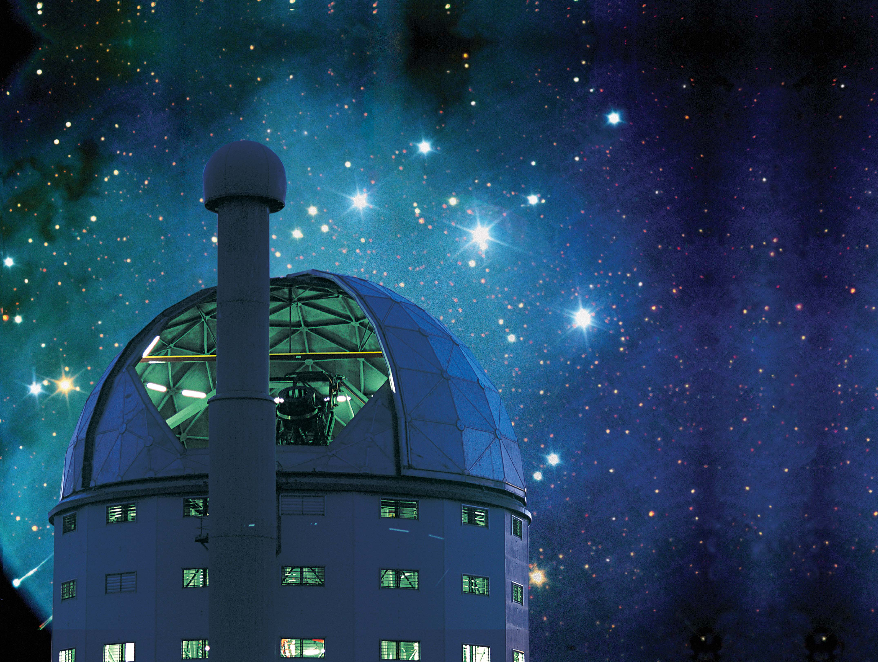
David Buckley
SALT Science Director
SALT’s Present Facilities:
First Generation Instrumentation

Slide 2
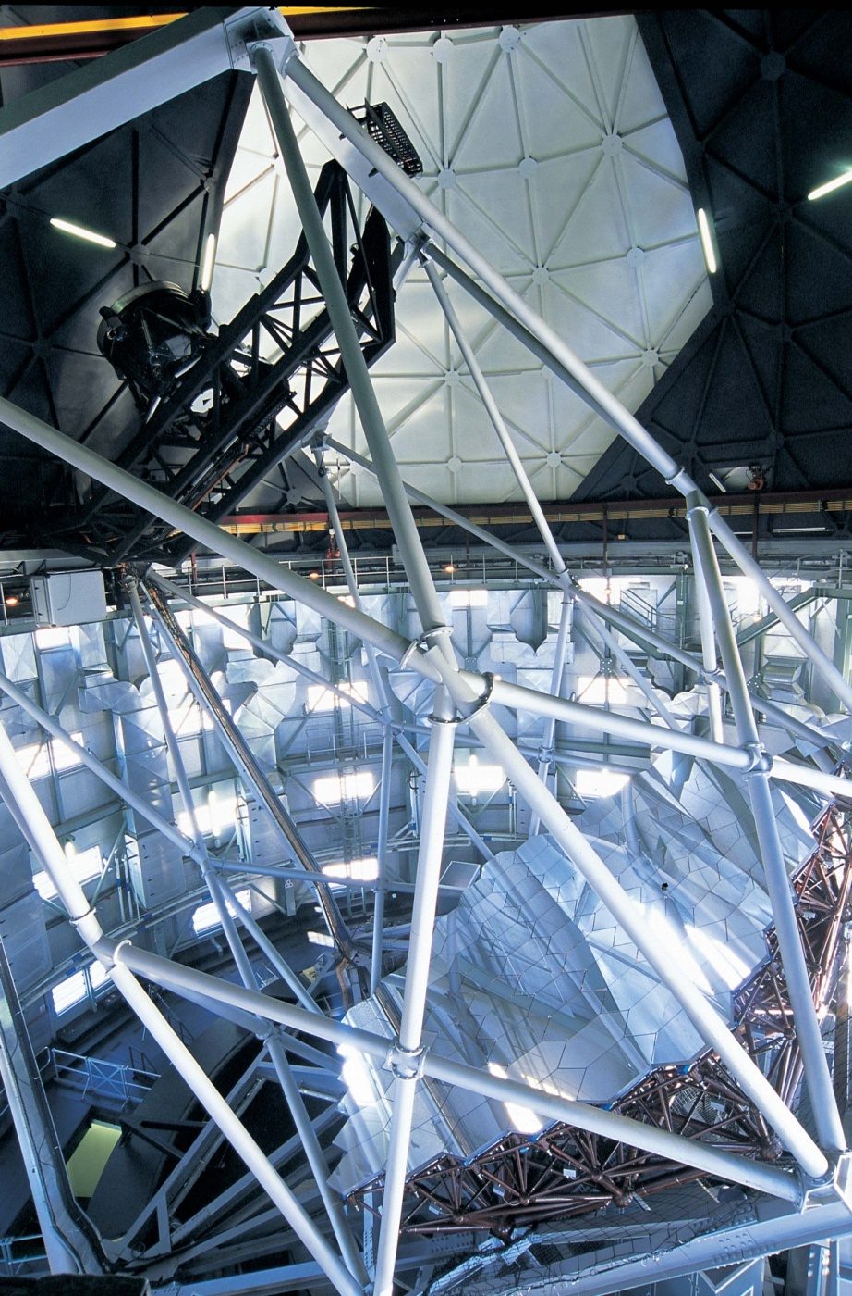
BASIC ATTRIBUTES
SALT: A Tilted Arecibo-like Optical-IR Telescope modelled on the Hobby-Eberly Telescope (HET)
PRIMARY MIRROR ARRAY
  Spherical Figure
  91 identical hexagonal segments
  Unphased (i.e. not diffraction limited 10-m, just 1-m)
  Mirrors (Sitall: low expansion ceramic) supported on a steel structure
TELESCOPE TILTED AT FIXED 37º
  Declination Coverage +10º < δ < -75º
  Azimuth rotation for pointing only
OBJECTS TRACKED OVER 12º FOCAL SURFACE
  Tracker executes all precision motions (6 d.o.f.)
  Tracker contains Spherical Aberration Corrector (SAC) with 8 arcminute FoV (Prime Focus)
IMAGE QUALITY
  Telescope error budget of ~0.7 arc-second FWHM
  Designed to be seeing limited (median = 0.9 arcsec)

Slide 3
SALT Science
SALT IDEALLY SUITED TO THE FOLLOWING TYPES OF PROGRAMS:
Survey Spectroscopy Followups: Where astronomical targets are uniformly distributed on the sky and have sky surface densities of a few per square degree OR are clustered on a scale of a few arc minutes
  Tracker window (12 x 12 deg) / field of view of SALT (8 x 8 arcmin)
Time variability studies: on time scales of ~0.08 sec up to a few hours, or > a day (photometry, spectroscopy, polarimetry)
Multi-wavelength studies: Ideal suite of UV-visible instruments plus large telescope aperture and flexible scheduling
Unique capabilities: Highly competitive spectroscopy & polarimetry from UV (320 nm to 900 nm initially, extending eventually to J & H (RSS-NIR).
  Wide range of parameter space & multiplex advantage (R = 370 – 10,000; MOS of ~50 objects; F-P spectroscopy of 1000’s of objects.
Queue scheduling will give the SALT a unique ability for flexible scheduling allowing for time sampled programs & targets of opportunity.
SALT Science has so far exploited high-speed imaging , longslit & MOS spectroscopy & Fabry-Perot imaging spectroscopy

Slide 4
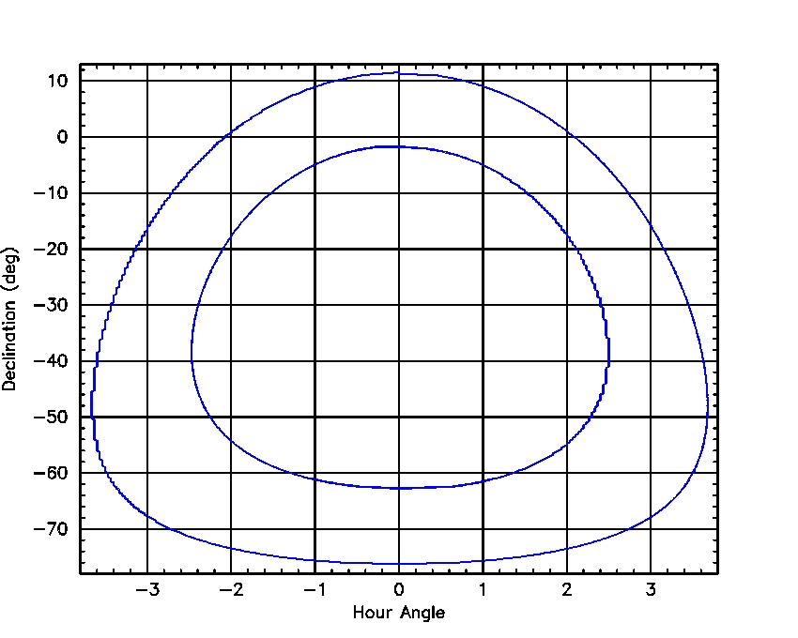
How SALT Observes: Restricted Viewing Window
Annulus of visibility
for SALT:
Annulus represents
12.5% of visible sky
Declination range:
+10º to -75º
Observation time available = time taken to cross annulus
But tracker only has limited range ⇒
Additional azimuth moves needed to achieve full obs. time
Implies that all SALT observations have to be queue-scheduled

Slide 5
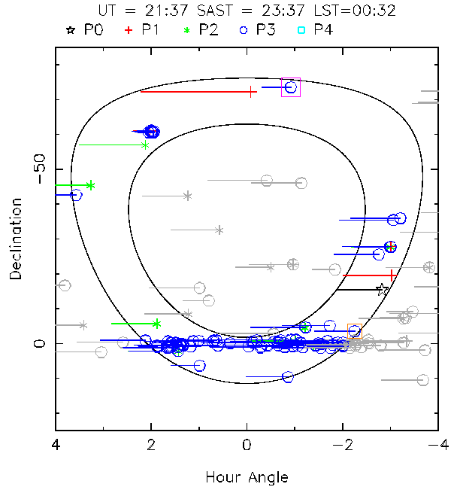
SALT Scheduling & Planning Tool:

Slide 6
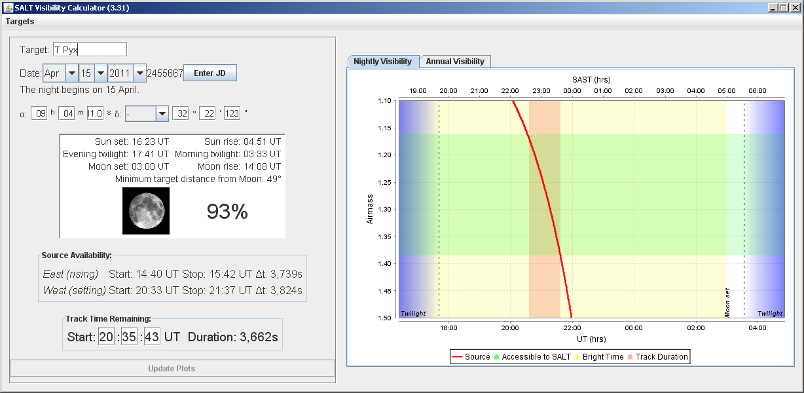
The SALT Visibility Tool:
How to determine when a particular object is visible
to SALT

Slide 7
SALT’s Current Science Instruments
First Generation Instruments chosen to give SALT a wide range of capabilities in UV-VIS range (320 – 900 nm)
Ensure competitiveness with niche operational modes
  UV, Fabry-Perot, high-speed, polarimetry, precision RV
Take advantage of SALT design and modus operandii
  100% queue scheduled telescope
  Capability to react quickly to events, but restricted viewing window
Initially budgeted for 3 “first generation” instruments
  But initially only enough $’s for 2
First two completed & installed from 2005 (“First Light” instruments)
  SALTICAM: a UV-VIS sensitive “video camera” (up to ~15 Hz)
  Robert Stobie Spectrograph (RSS): a UV-VIS versatile imaging spectrograph
Third is the fibre-fed High Resolution Spectrograph (HRS)
  Design completed 2005 by UC. Construction by Durham University began in 2007
  Commissioning due to begin April 20
Auxillary instruments: for small (<50 kg, <0.3m³) niche instruments
  Currently Berkeley Visible Image Tube (for 2 years)

Slide 8
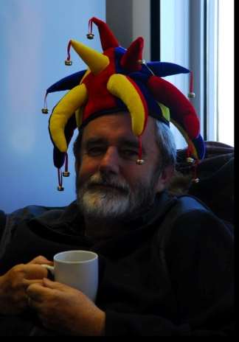
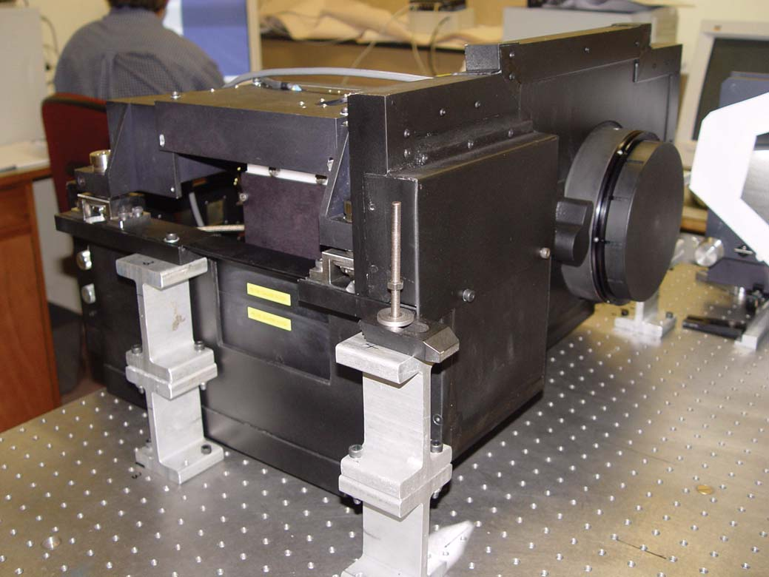
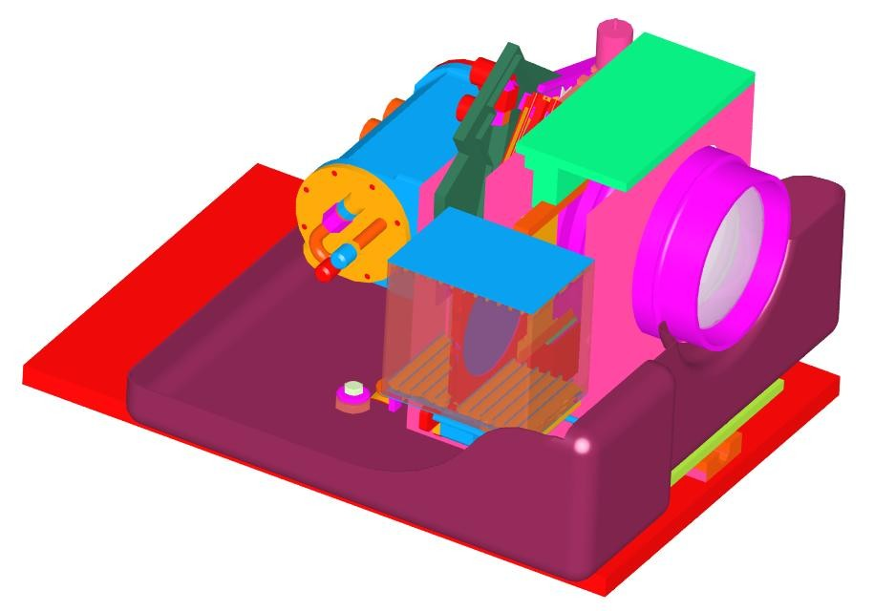
The SALTICAM PI
SALTICAM (built at SAAO)
An efficient “video” camera over entire science FoV (8 arcmin).
Efficient in the UV/blue (capable down to atmospheric cutoff at 320nm (sun-burn territory!).
Capable of broad and intermediate-band imaging and high time-resolution (to ~80 ms) photometry.
Fulfills role as both an acquisition camera and science imager.
Optics
Cryostat &
detector
Filter jukebox
SALTICAM

Slide 9
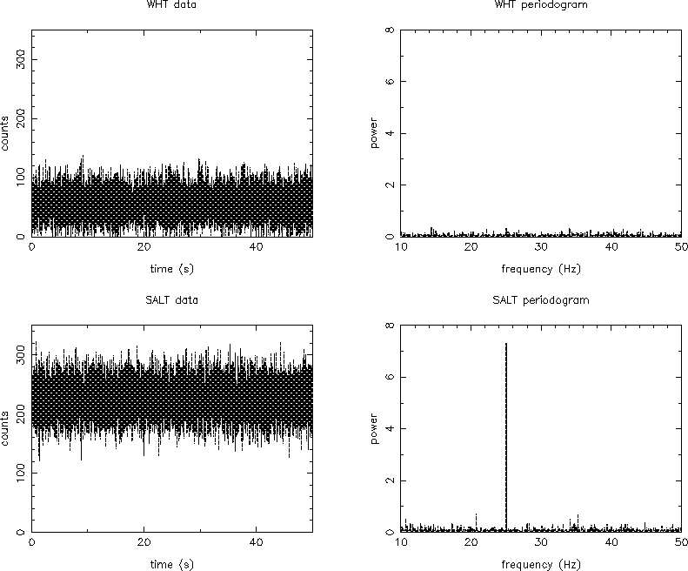
Aperture advantage: searching for weak periodicities
This shows simulated light-curves and periodograms obtained with ULTRACAM on the WHT and SALT. The source is an R =16 variable star observed during bright time in 1 arcsecond seeing using 5 millisecond exposures. The source is varying with an amplitude of 2.5% and a period of 40 milliseconds.
(courtesy of Vik Dhillon)
Detection of periodic signals greatly benefits from increased aperture
power ∝ aperture⁴

Slide 10
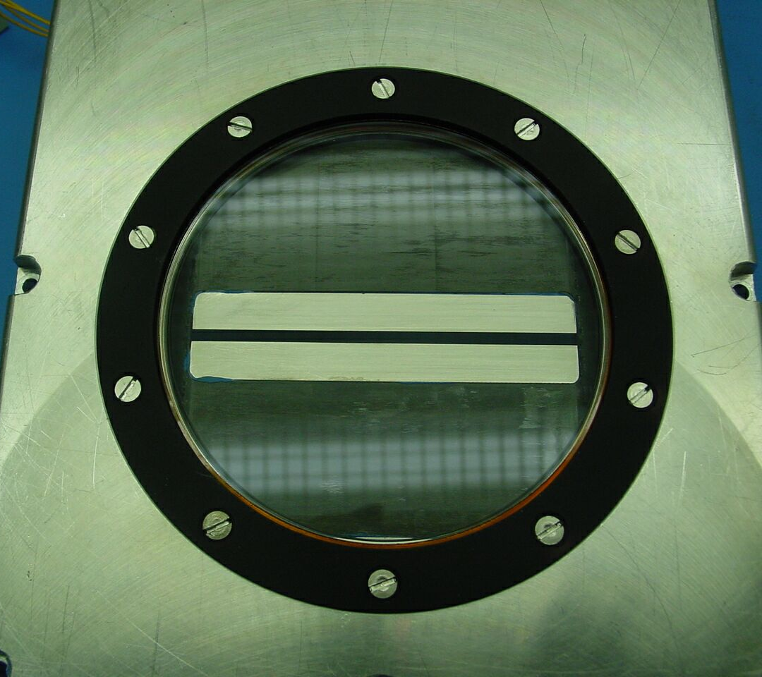
SALTICAM Frame Transfer Mask in High Speed ‘Slot Mode’
Slot ~11 arcsec wide
Image/store area split
Serial Readout Registers
Notes:
SLOT AREA MOVED DOWN INTO STORE AREA, ~4MM = 250 ROWS, TAKES 12mS INSTEAD OF 205mS. To read out the full “slot area”
(250x50uS)+ (250x1074x0.8uS)+ (250x1074x2.2uS) = 0.82 sec, however this readout can be done binned and windowed

Slide 11
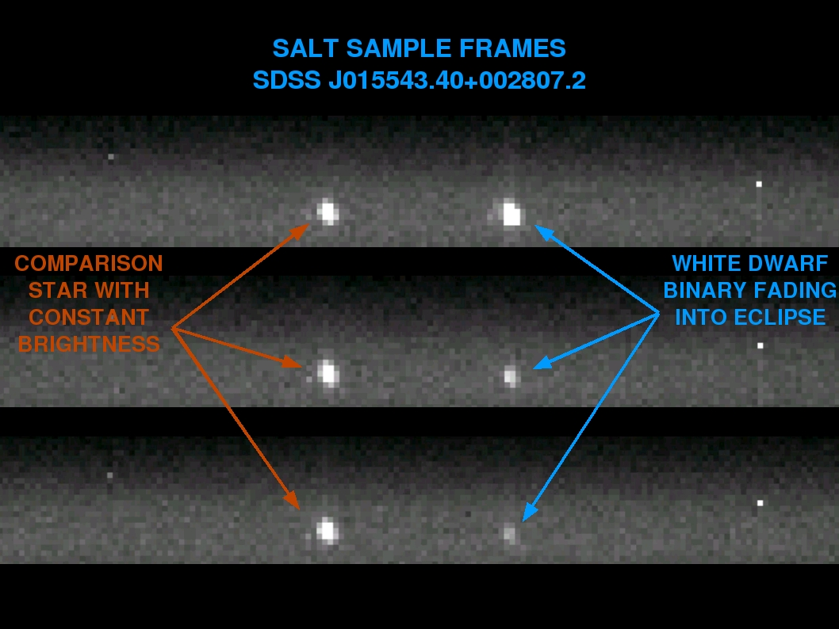

Slide 12
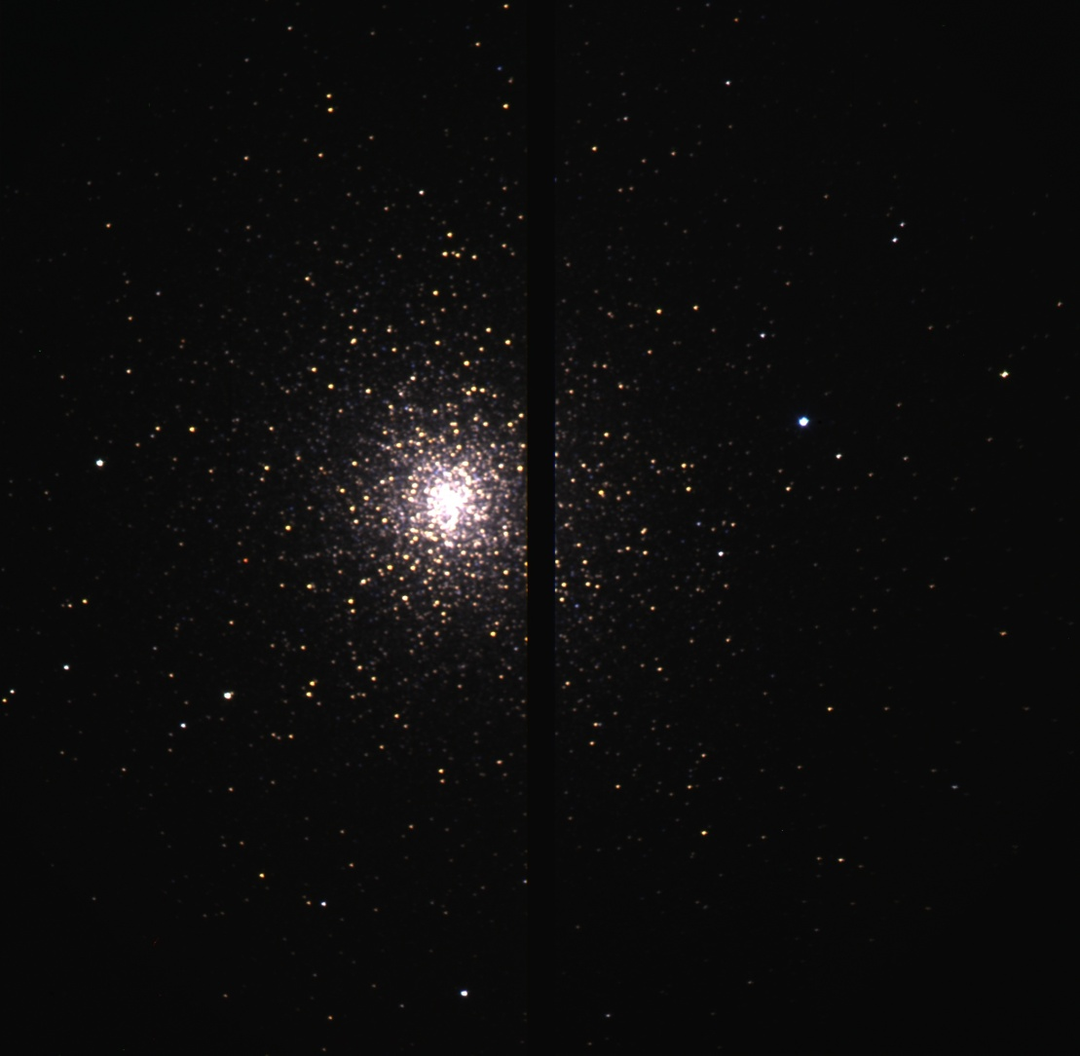
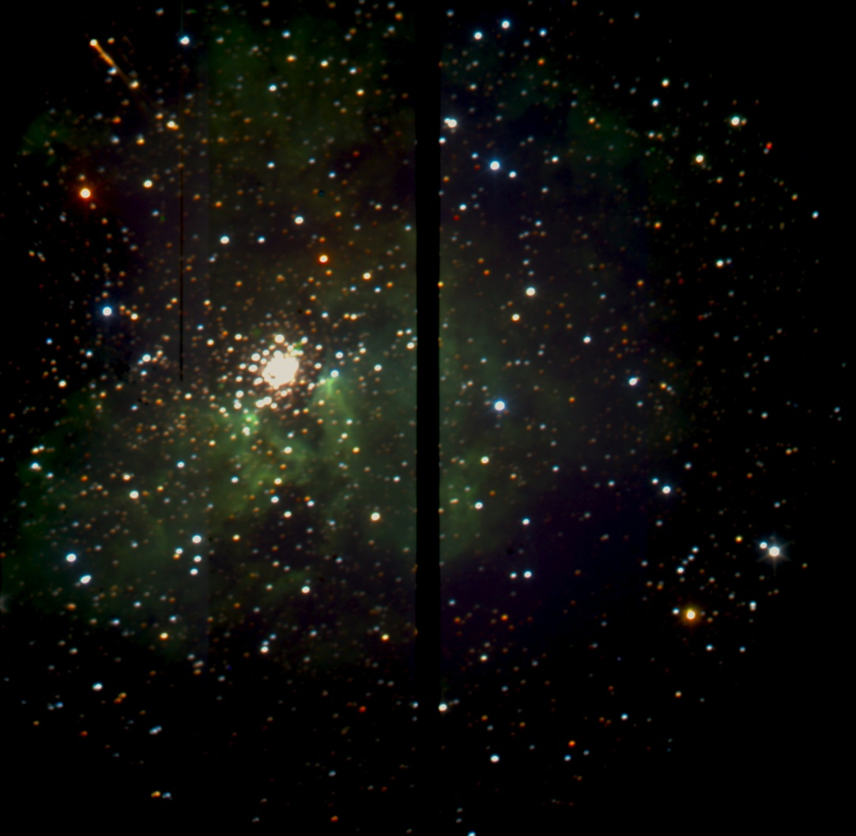
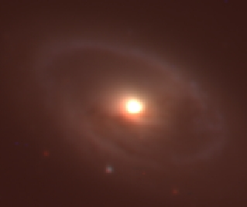
SALTICAM Recommissioning:
Following telescope image quality fix April 2011

Slide 13

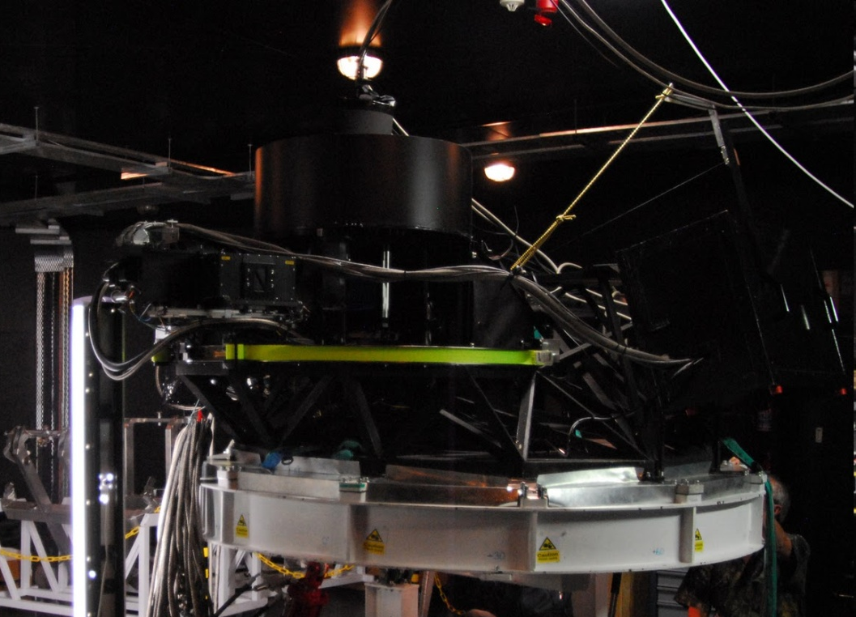
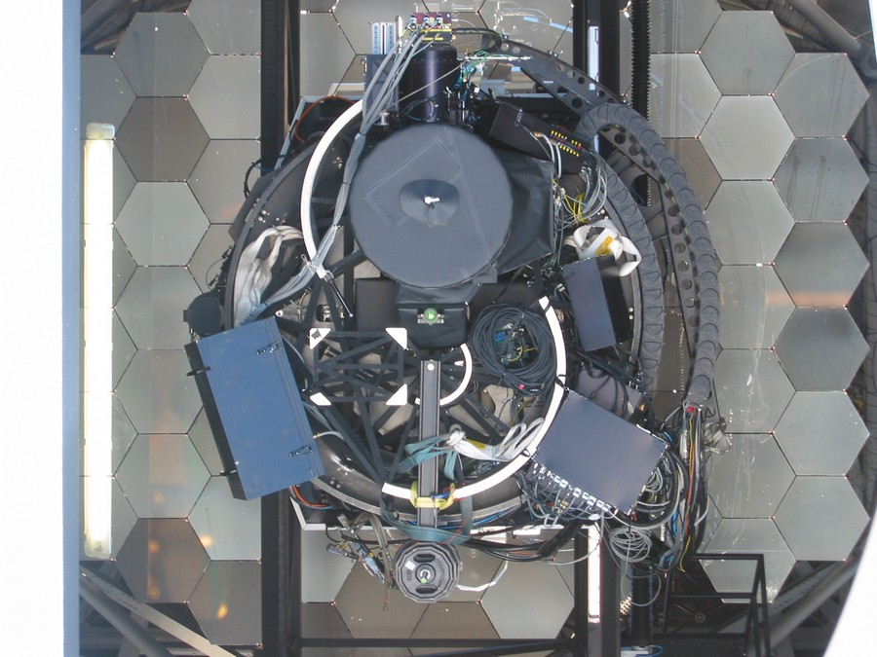
The Robert Stobie Spectrograph (RSS)
(built at Wisconsin, Rutgers & SAAO)
PI: Ken Nordsieck
An efficient and versatile Imaging Spectrograph
capable of UV-vis spectroscopy (VPHGs)
high time resolution ablility
polarimetry capability
Fabry Perot imaging (many narrow filters)
multiple object spectroscopy
  Can observe ~50 objects at once
The RSS PI
RSS installed on SALT (Oct 2005)
RSS being refurbished and tested in SALT
spectrometer room (Mar 2011)

Slide 14
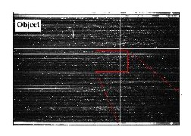
RSS Spectroscopy
MOS ~ 100 spectra
Combined with a small telescope ‘nod’ and CCD charge shuffle, background subtraction of v. faint objects possible (~0.05% errors in sky subtraction).

Slide 15
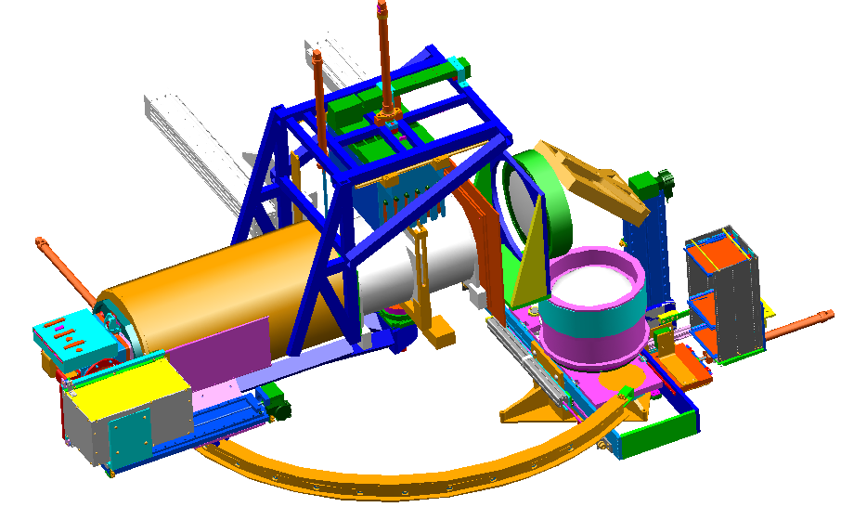
RSS Mechanisms
Polarizing Beamsplitter(slide)
6-Grating Magazine
2 Fabry-Perot Etalons (slides)
40-Slitmask Magazine
3 CCD Mosaic Detector
Shutter
Camera Articulation 0 - 100°
20-Filter Magazine
2 Polarimeter Waveplates (slides)

Slide 16
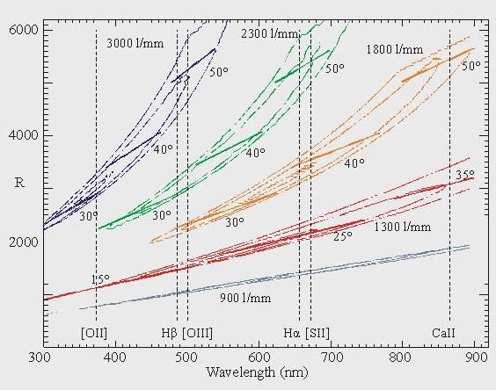
RSS complement of VPHGs

Slide 17
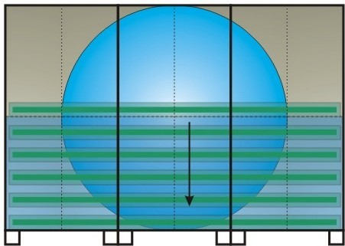
RSS High Speed Spectroscopy mode: like SALTICAM slot mode
Fast spectroscopy
Fast spectropolarimetry
Fast imaging polarimetry

Slide 18
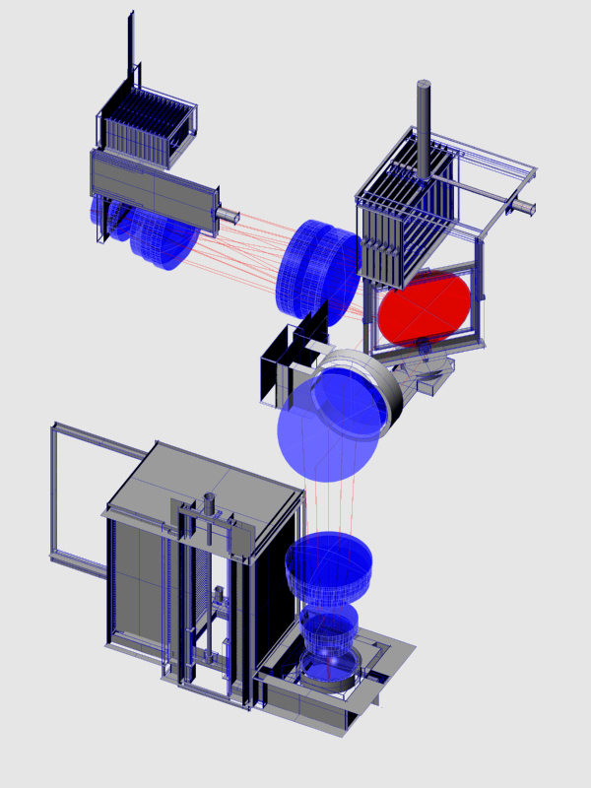
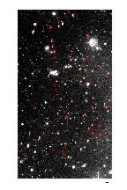
RSS Multi-Object Grating Spectroscopy
Filters
"VPH" Grating disperses wavelengths
Up to 100 Spectra
Hubble Deep Field (South)
Slitmasks
selects objects

Slide 19
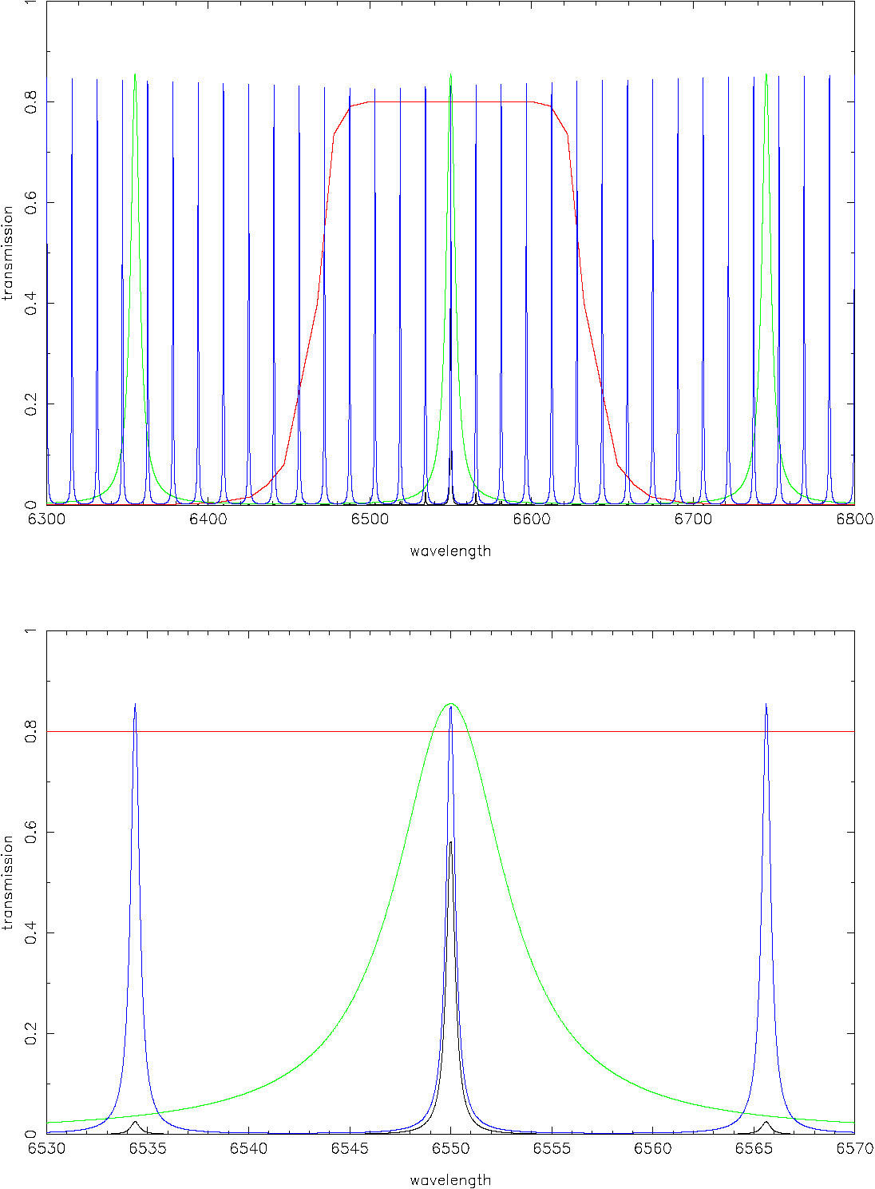
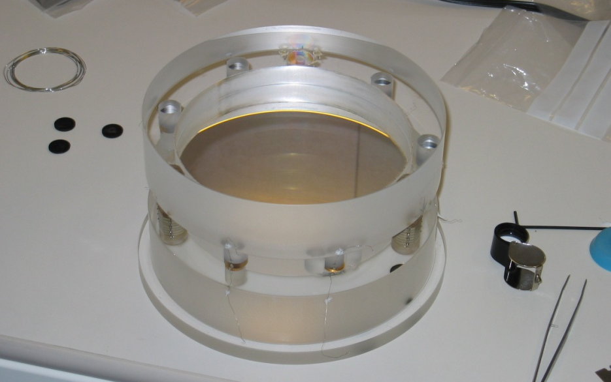
RSS: Fabry-Perot mode
3 resolution modes:
low (R = 320-770) ‘tuneable filter’ (full field)
medium (R = 1250 – 1650 ) bullseye 3.8’ – 3.3’
high (R ~ 9,000) bullseye ~1’
Using 150mm diameter Queensgate etalons
Finesse ~30, implying 75-80% throughput
Using ~30 R = 50 interference filters (latter
can also be used on their own for narrow
band imagery).
Filter
R=1000 etalon
R = 9,000 etalon

Slide 20
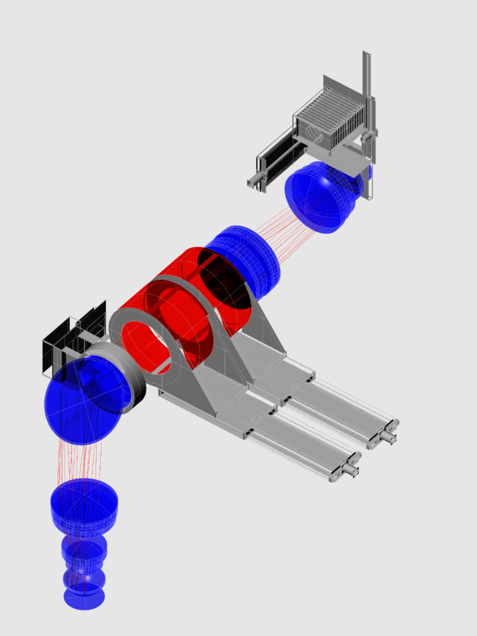
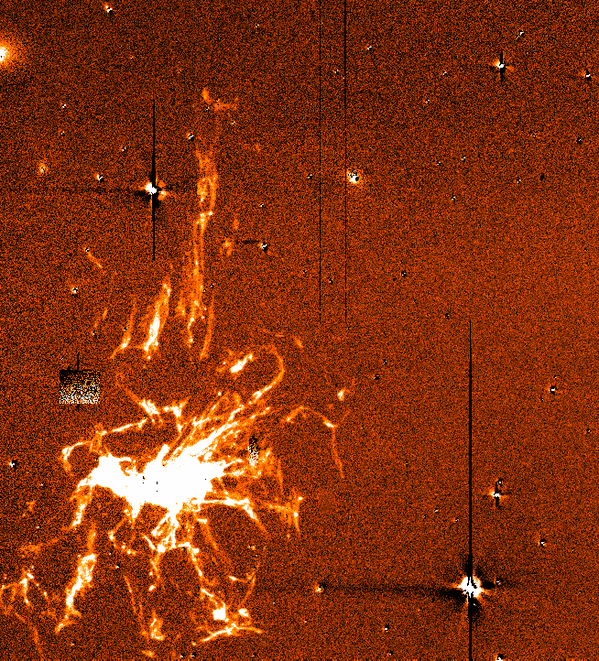
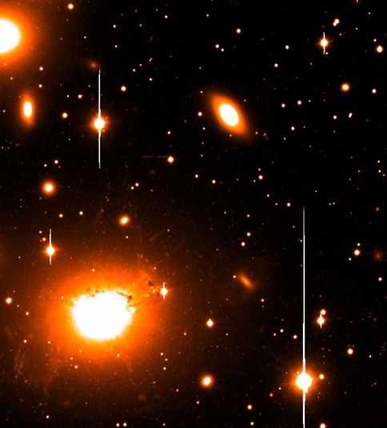
Fabry-Perot Imaging Spectroscopy
Filters
Fabry-Perot etalons
(scans wavelength)
Many
wavelengths
Perseus A in Hα
Perseus Cluster of Galaxies

Slide 21
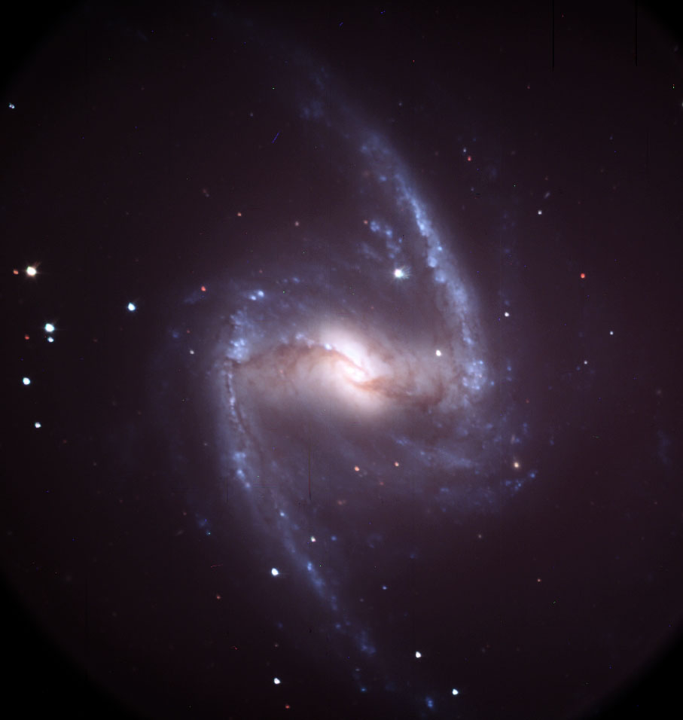
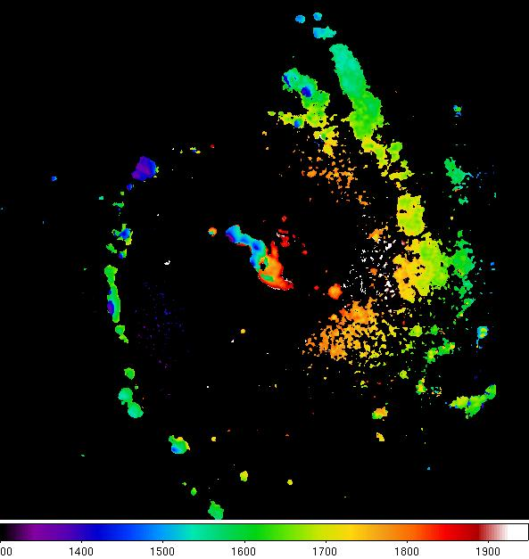
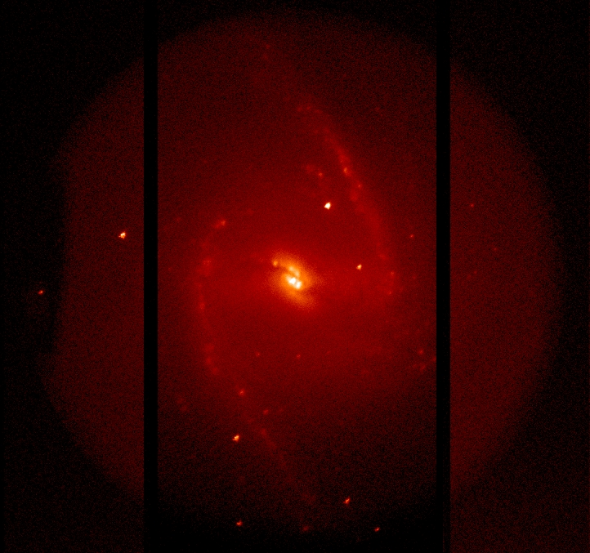
Fabry-Perot Commissioning Observations:
NGC 1365
SALTICAM
image
H-alpha image Velocity Map

Slide 22
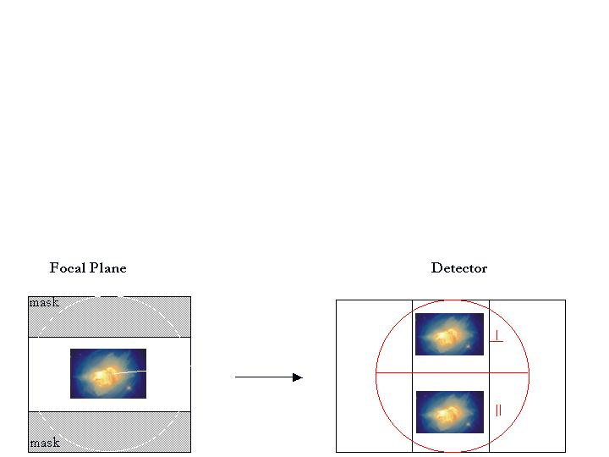
RSS Polarimetry
Imaging polarimetry

Slide 23
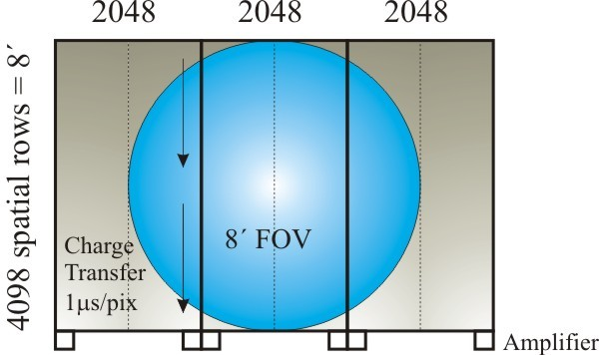
Focal Plane Configuration for
imaging/ long slit spectropolarimetry
2048 2048 2048
Focal plane
Mask
O-ray
image
4’
4’ x 8’ FoV
E-ray
image

Slide 24
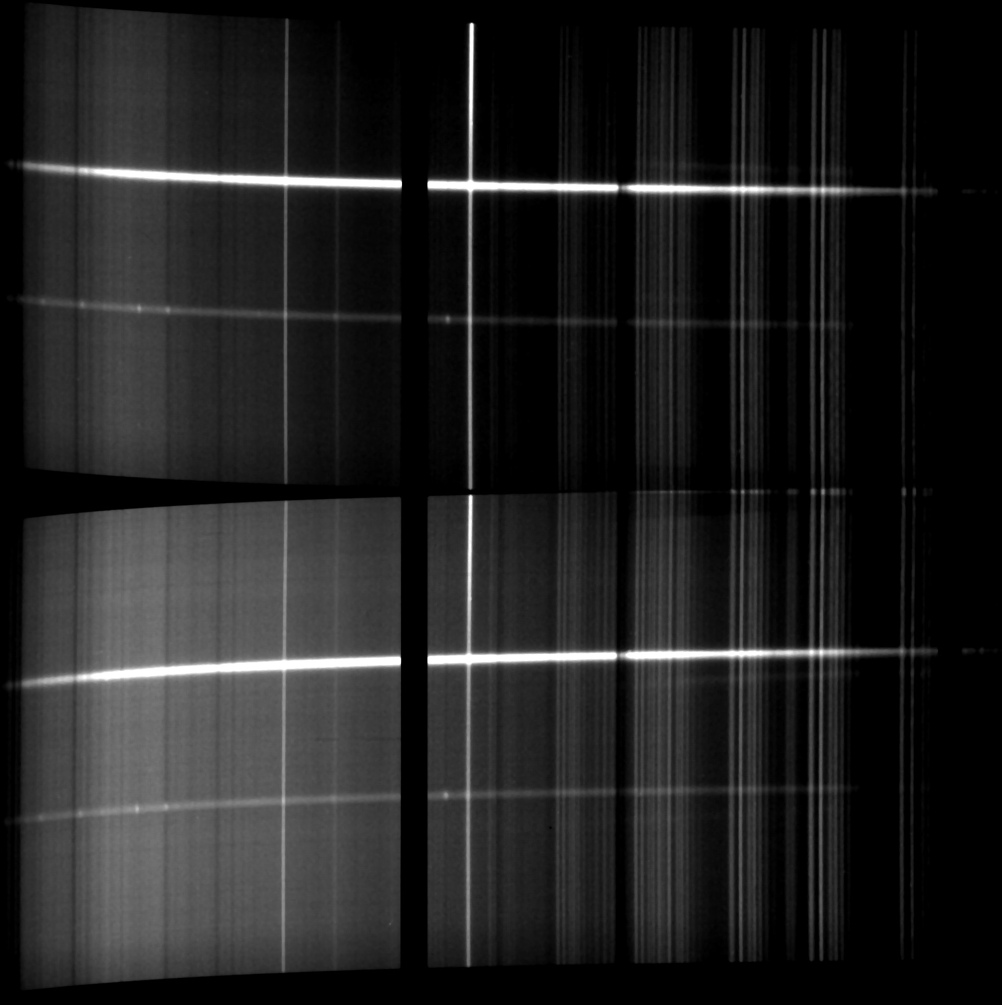
Spectropolarimetry Commissioning
Began in Oct 2006, just weeks before RSS was removed to fix UV throughput
Observation of new polar RX J2316-0527

Slide 25
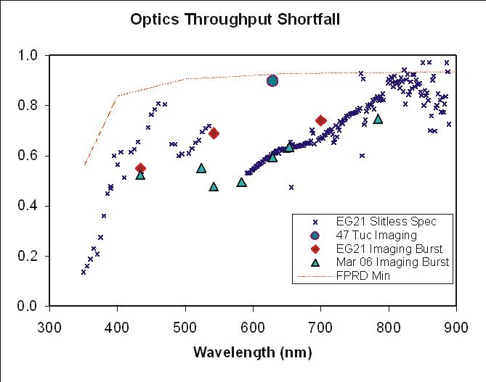
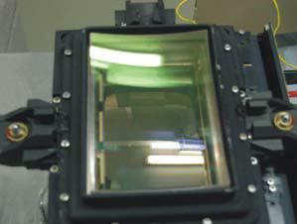
RSS Throughput Problems
From 2005-2006 commissioning
UV (<400 nm) precipitous drop-off
Other throughput ‘dips’
Ghost seen in F-P interference filters
  Image of pupil
  Worse at ~550 nm
Attributed two main causes:
1. Lens fluid issues
2. poor multi-layer A-R
coating on camera field flattener
Following recommissioning from Apr 2011, throughput still found to be lower than expected

Slide 26
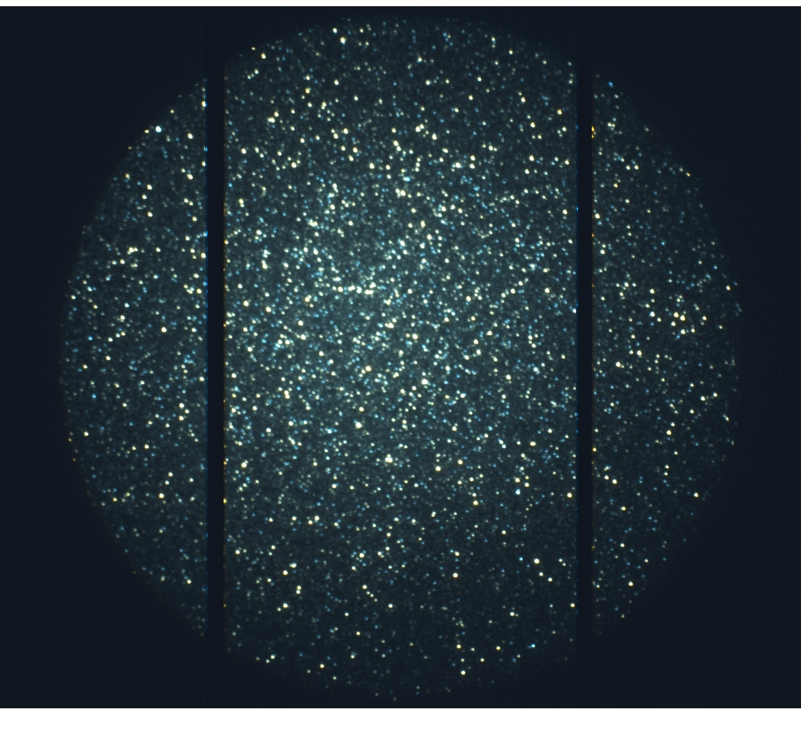
RSS image: following Apr 2011 reinstallation

Slide 27
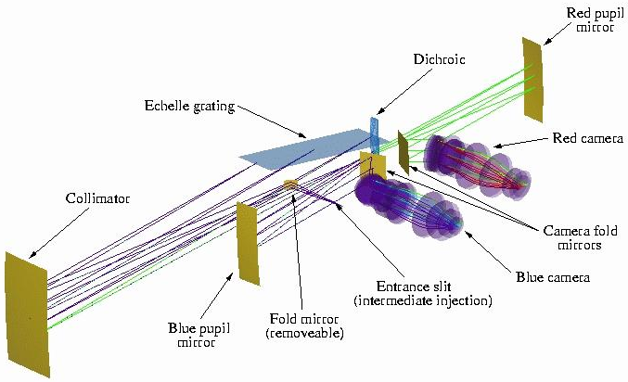
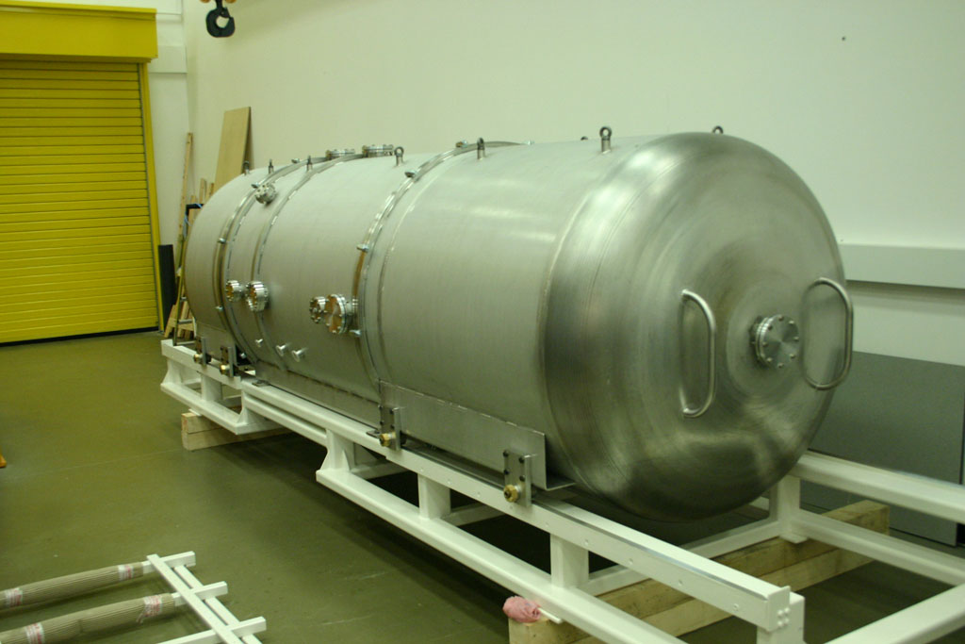
SALT High Resolution Spectrograph (HRS):
3rd “First Gen” SALT Instrument
Fibre-fed with dual fibres for sky subtraction and nod/shuffle.
R ~ 16,000 – 70,000
λ ~ 380 – 890 nm
Designed for very high stability
Housed in vacuum tank
Temperature stabilized
Minimize air index effects
Minimize dimension changes
Precision radial velocities (m/s)
- extra-solar planets
Under construction at Centre for Advanced Instrumentation, Durham University (UK)
Started in late 2007, assembly begun; commissioning early-2012
Based on University of Canterbury CDR level design

Slide 28
SALT’s Third First-Gen Instrument:
High Resolution Spectrograph
SALT will utilize fibre-fed high-resolution spectroscopy of point
sources (<2 arcsec) plus background (fibre pairs)
A high precision mode is also possible
- incorporating iodine cell and double scrambler and simultaneous ThAr (as in Harps)

Slide 29
SALT High Resolution Spectrograph (HRS)
Blue echellogram

Slide 30
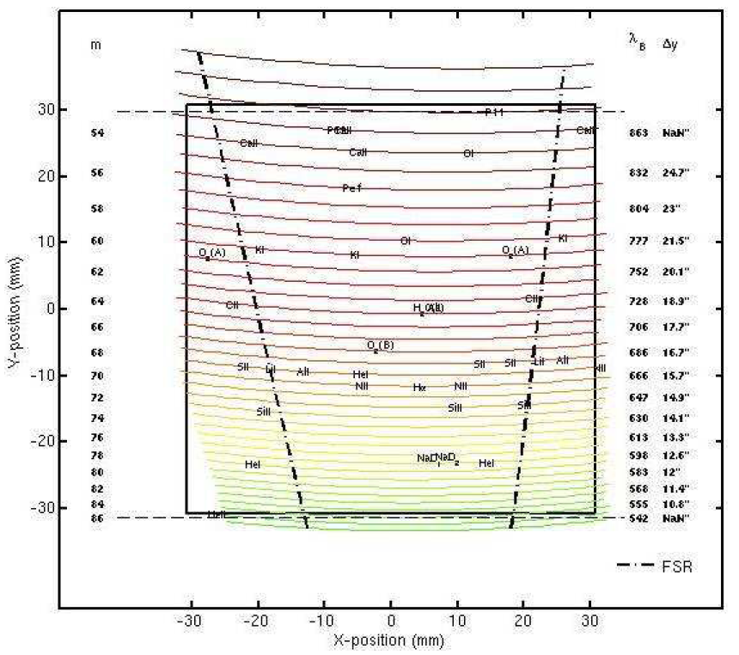
SALT High Resolution Spectrograph (HRS)
Red echellogram

Slide 31
NIR extension to RSS: a “Gen 1.5” instrument
RSS NIR:
CDR passed Oct 2010
Now in construction
Commissioning: 2014?
RSS VIS:
Completed in 2005
“Repaired” Nov 2006 – Jul 2009
Reinstalled on SALT in Apr 2011
Science operations from Sep 2011
NIR upgrade path: simultaneous 3200 Ǻ – 1.7 μ (e.g. X-Shooter)
“Tuneable” Volume Phase Holographic transmission gratings
Fabry-Perot capability
Polarimetric capability

Slide 32
Science Drivers for RSS NIR
Many diverse requirements from the SALT user community.
Sample from questionnaire:

Slide 33
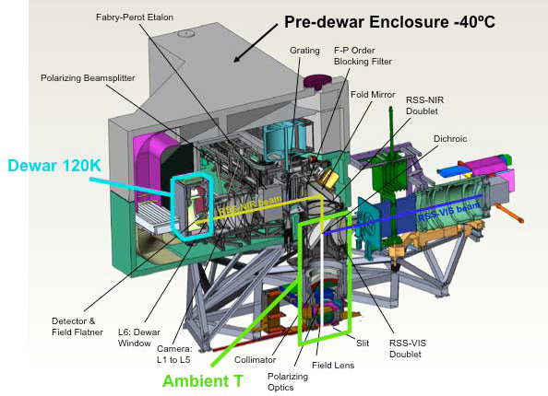
RSS VIS-NIR Schematic

Slide 34
Predicted Spectroscopic Performance
Resolution – Wavelength coverage achieved with 4 VPHGs + 1 grism
Efficiency contours at 75% (solid), 50% (dashed) & 25% (dotted)

Slide 35
Predicted Sensitivity
Limiting magnitude predictions
Includes slit cooling effect

Slide 36

RSS UV-VIS-NIR: an ideal astronomers tool!

Slide 37
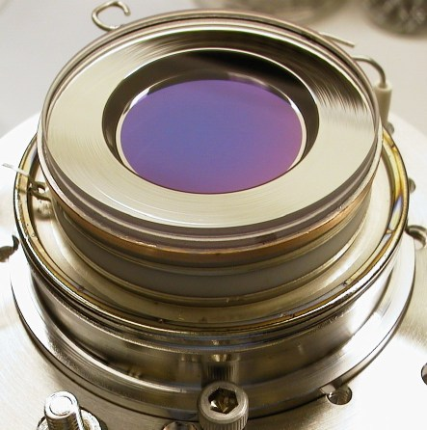
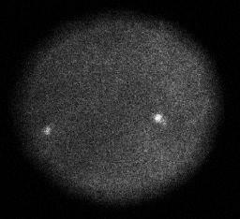
Auxilliary Port Instruments:
Recent SALT experiments with a photon counting camera
The Berkeley Visible Image Tube (BVIT) installed at SALT Auxiliary Focus as a visitor instrument
A very high time resolution imaging photometer.
  Enables a new time domain for astronomical observations with full imaging capability
    Time resolution (time stamping for each photon) to ~microsecond
    BVIT is a simple instrument with minimal observational setup requirements
Based on Microchannel Plate & strip anode detector (50 ns time tagging of photons)
Prototype built with low QE S20 photocathode (peak of ~10% QE peaking at ~400nm)
Now upgraded to Super GenII, with ~20x improvement in count rate
Undergoing recommissioning from Nov 2012. Community access from 2013-1 (~2 yr)
UZ For (Polar)

Slide 38
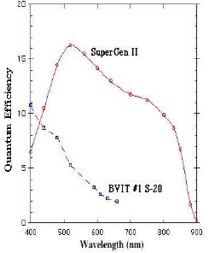
BVIT upgrade
BVIT mounted at SALT Aux Port
Expected improvement in BVIT
sensitivity

Slide 39
SALT Second Generation Instruments
Already proceeding with a “Gen 1.5” instrument: a NIR (to 1.7µm) extension to RSS (giving simultaneous 320nm – 1.7µm coverage)
A White Paper on future instrumentation has been produced
  Beginning to discuss new instruments for SALT
Small “niche” instruments have/are being developed/considered
  A high-speed photon-counting camera from SSL Berkeley (BVIT)
  A low-order Adaptive Optics demonstrator experiment (SADCAM)
    Currently in process of characterizing Sutherland atmosphere for Ground Layer A-O

Slide 40
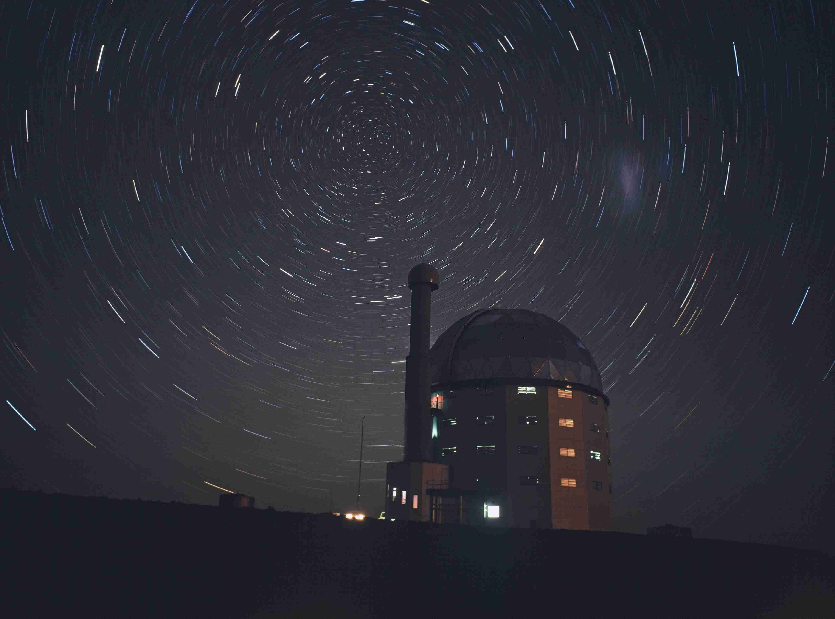
SUMMARY
SALT has a current suite of 2 facility instruments + 1 visitor instrument
  » SALTICAM: fast, efficient imager (UBVRI, u’g’r’I’z’, uvby, H-beta, H-alpha, specialized red extension to Stromgren) & high speed
  » RSS: multi-mode imaging spectrograph (MOS, F-P, pol, high speed)
  » BVIT: specialized very high time res. photon counting camera
New instruments on the horizon:
» HRS (mid-2012): fibre-fed high stability echelle spectrograph
» RSS-NIR (2014?): near IR extension (background limited to 1.7µm) to RSS. Simultaneous UV-VIS-NIR.
Potential UV-VIS-NIR observations supporting multiwavelngth programs (e.g. MeerKAT, HESS, ASTROSAT, space missions… SKA)
Second Gen. instruments still under consideration should focus on SALT strengths and potential synergies
» see Darragh’s talk

