Slide 1


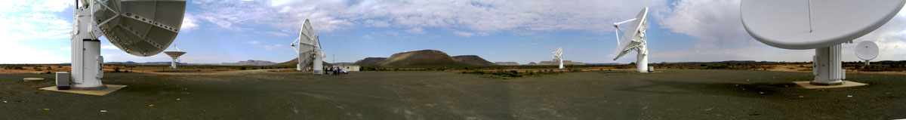
MHONGOOSE
MeerKAT HI Observations of Nearby Galactic Objects: Observing Southern Emitters
MeerKAT Deep Nearby Galaxies HI Survey
Claude Carignan (UCT) & Erwin de Blok (ASTRON)
SALT/MeerKAT collaborations Workshop, November 2012

Slide 2
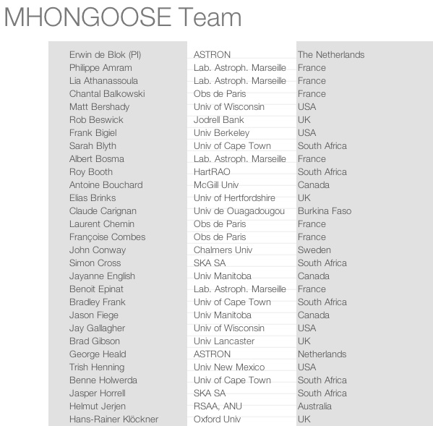
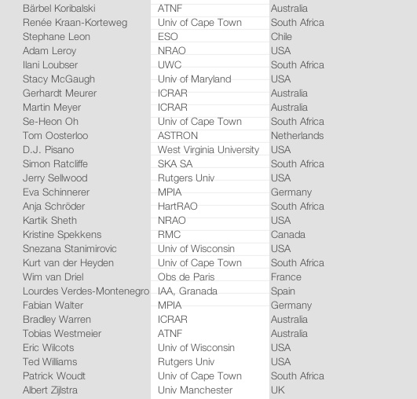
MHONGOOSE
MeerKAT HI Observations of Nearby Galactic Objects: Observing Southern Emitters

Slide 3
HI: what’s left to do nearby ?
The connection, over time, between star formation, HI dynamics and accretion, is one of the main issues to address in the coming years through large deep surveys of the HI in the local and distant Universe
How do galaxies get their gas ?
How is star formation regulated ?
How are outer disks and cosmic web linked ?

Slide 4
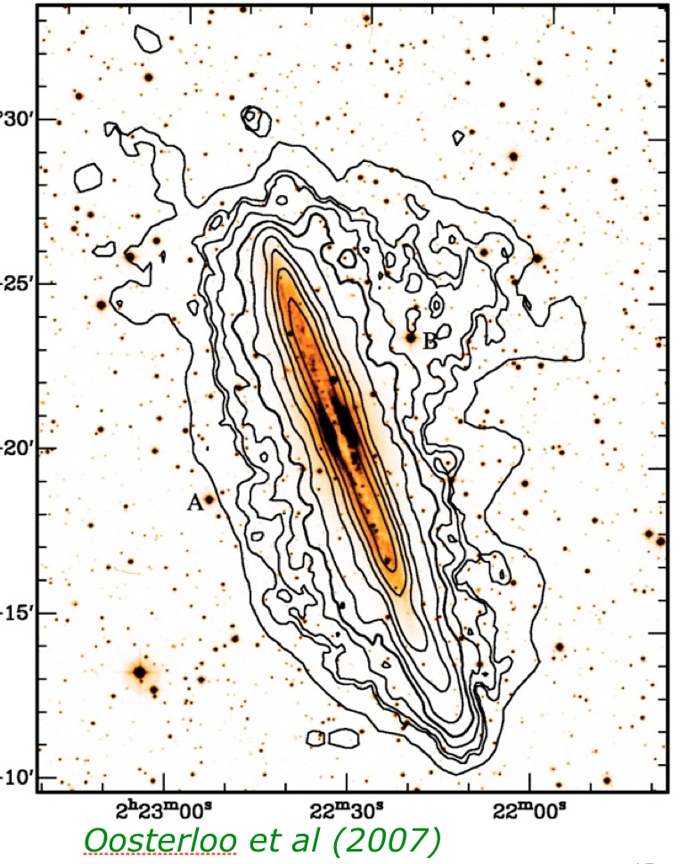
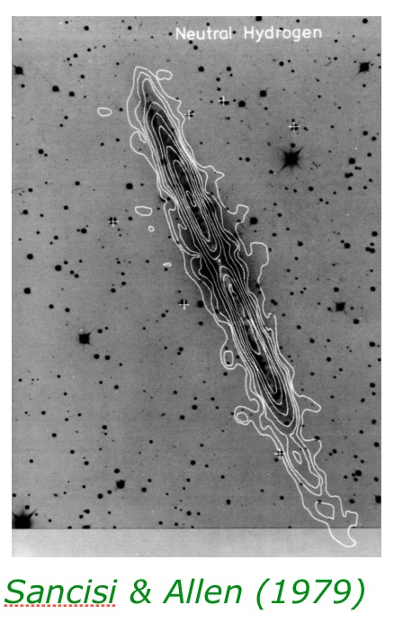
HI: what’s left to do nearby ?
σ_{HI} = 1 x 10¹⁹ cm⁻²
σ_{HI} = 1 x 10²⁰ cm⁻²
σ_{HI} = 5 x 10²⁰ cm⁻²

Slide 5
HI: what’s left to do nearby ?
Two components
Galactic fountains
Accretion (HVC)
Ultra-deep HI observations
reveal significant amount
of extra-planar gas

Slide 6
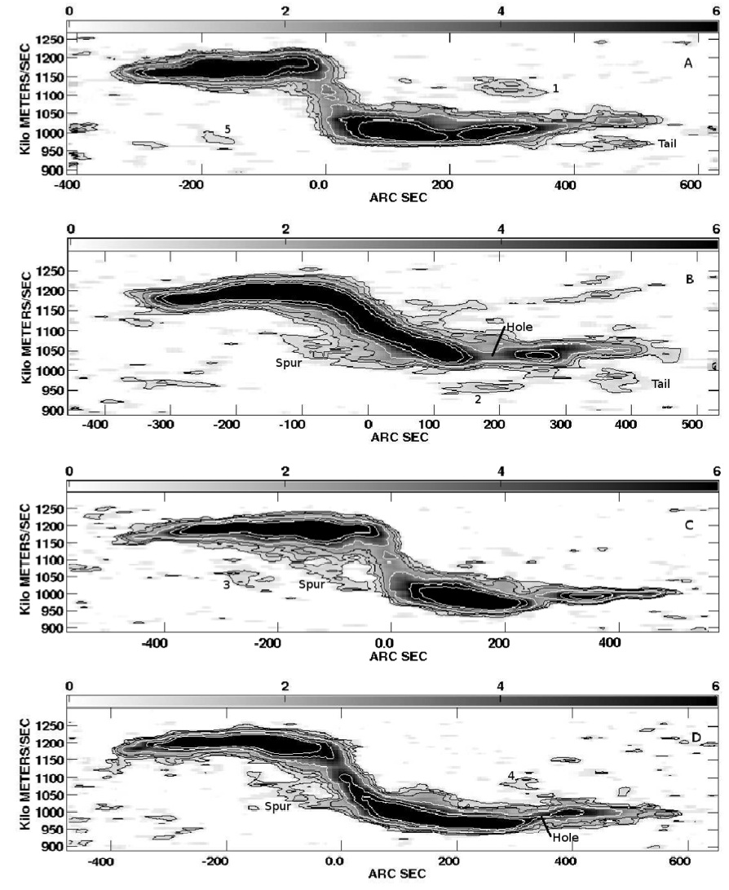
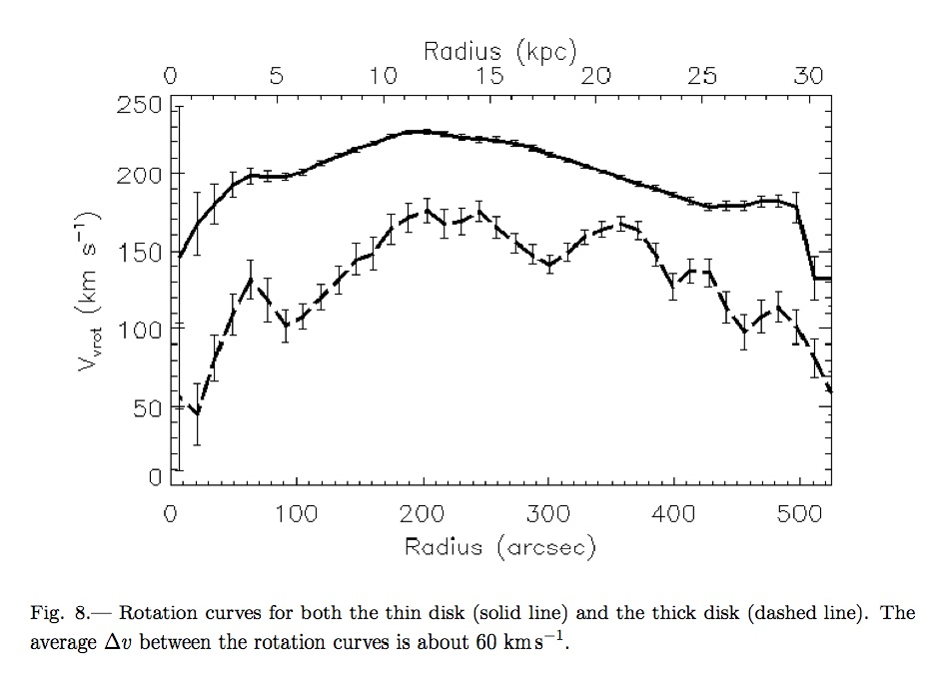
HI: what’s left to do nearby ?
ATCA - σ_{HI} = 1 x 10²⁰ cm⁻²
NGC 2995: Hess, K. et al. 2009
Study of galactic fountain & accretion gas

Slide 7
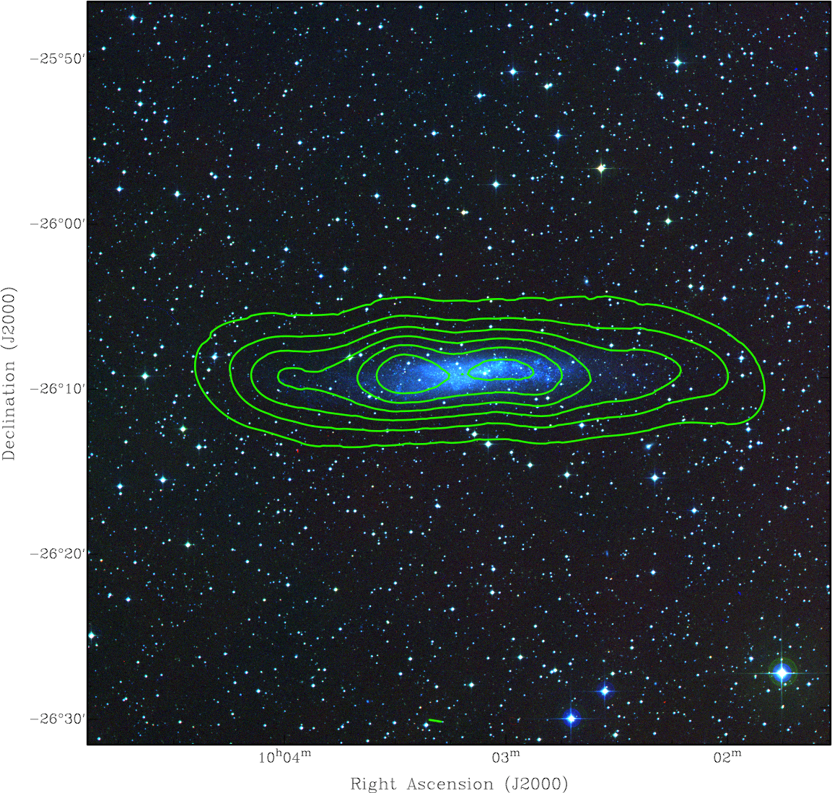
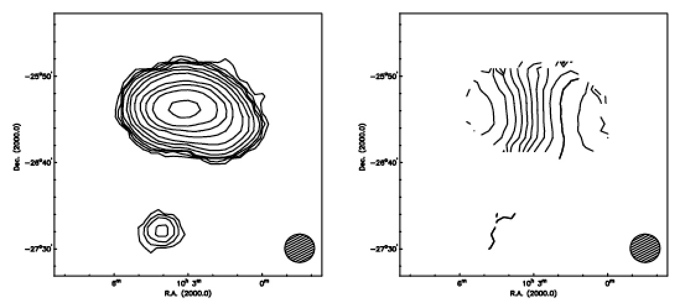
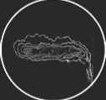
HI: what’s left to do nearby ?
KAT 7: march 2012
VLA: Jobin & Carignan 1990
HIPASS: Barnes & de Blok 2001

Slide 8
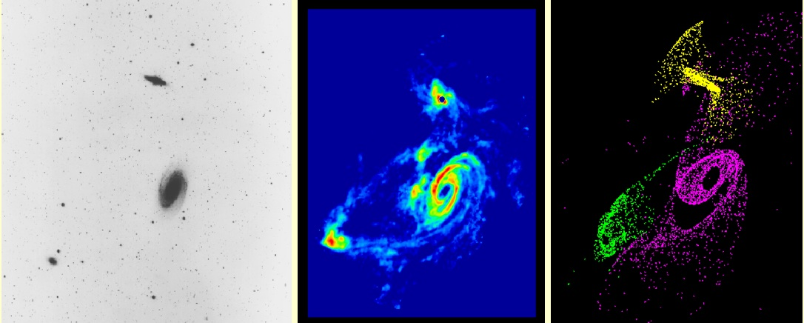
HI: what’s left to do nearby ?
M81 group: grav. interaction

Slide 9
ATLAS^{3D}
166 early-type galaxies, ~2000 hrs Westerbork
sensitivity: N(HI)~10¹⁹ cm⁻², M(HI)~10⁷ M⨀
40% detection rate outside Virgo
1/4 of all ETGs host HI discs (10⁷-10¹⁰ M⨀)
show the importance of environment
Serra et al. 2012
low density
high density (groups)

Slide 10
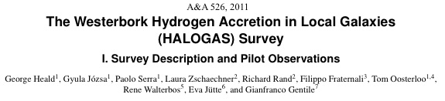
HALOGAS
10x12 hrs per target, to reach typical column density sensitivity of N_{HI} = 1x10¹⁹ cm⁻² (3σ) at 30” resolution (cf. THINGS: 5x10¹⁹ cm⁻²)
Survey sample includes 24 galaxies
WSRT observations are complete as of mid-2011 ... !
Advantage of deep WSRT observations seen at start of survey:

Slide 11
MHONGOOSE history
Deadline for MeerKAT Large Programs: March 2010
MHONGOOSE proposal:
  300 nearby galaxies for 8h each over uniform range in log(M_{HI}) 2500 hours (“shallow”)
  30 of these ultra-deep for 200h each 6000 hours (“deep”)

Slide 12
MHONGOOSE history
Outcome of MeerKAT Large Programs TAC meeting: October 2010
MHONGOOSE project:
  30 ultra-deep for 200h 6000 hours (“deep”)
  Defining a deep sample

Slide 13
Deep Survey
Observed 25 times longer than THINGS (200 hours per galaxy)
Accretion, cosmic web, dynamics beyond disk
Equivalent to HALOGAS but different parameter range
5σ = 1.25 . 10¹⁹ cm⁻² at 30” for 16 km s⁻¹ FWHM HI line at 5 km s⁻¹ channel spacing or 5 . 10¹⁷ - 10¹⁸ cm⁻² at 90”
The sensitivity numbers assume the canonical MeerKAT design with 64 dishes of 13.5m, a T_{sys} of 30 K and an overall efficiency of 0.7

Slide 14
Selection of the sample
Criteria for the MHONGOOSE sample:
  HI detection
  Extended
  Sub-kpc resolution
  No inclination selection

Slide 15
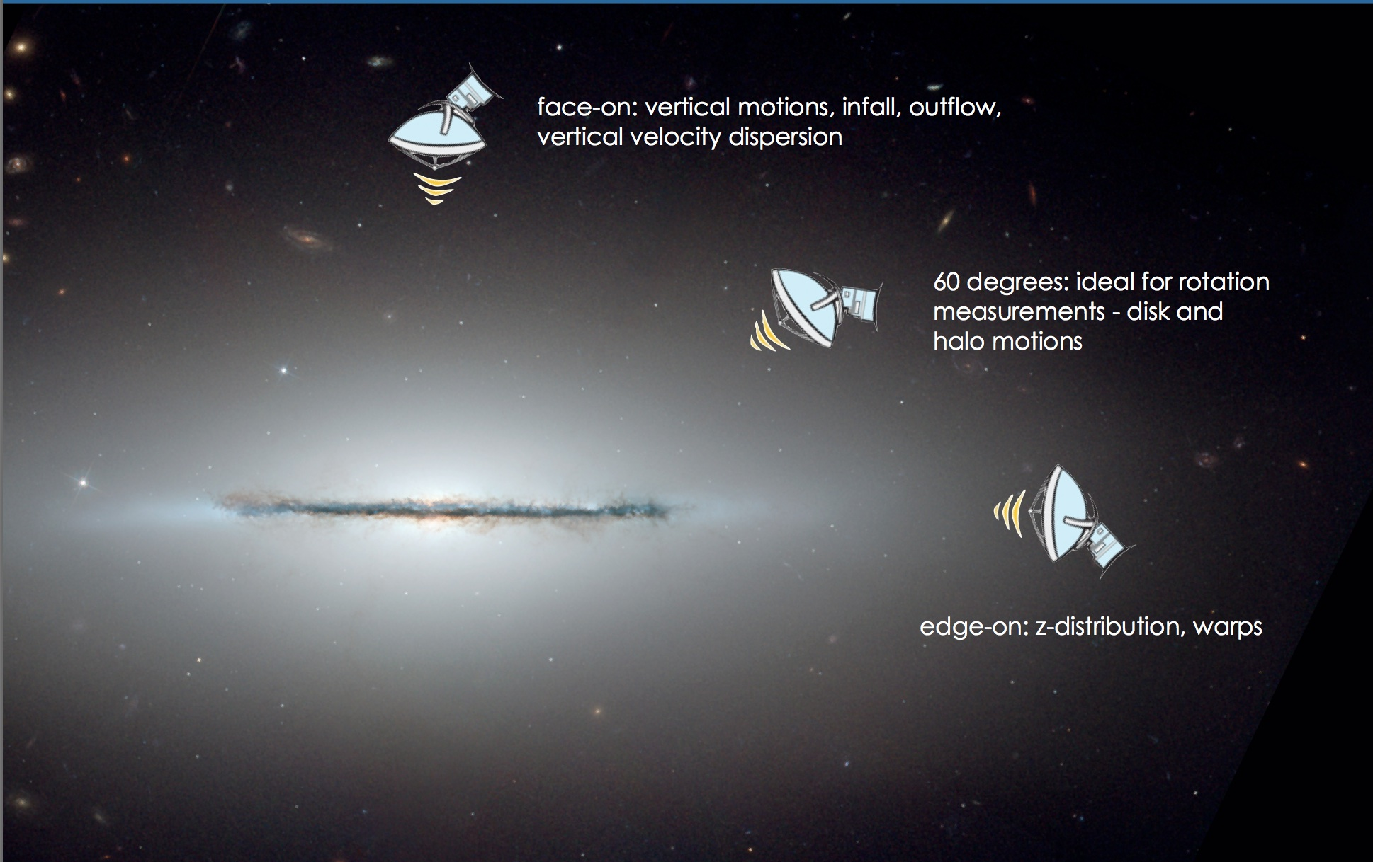
Selection of the sample

Slide 16
Selection of the sample
Criteria for the MHONGOOSE sample:
  HI detection
  Extended
  Sub-kpc resolution
  No inclination selection
  Ensure log(M_{HI}) coverage
  Little foreground extinction
  Other wavelength data (to be) available

Slide 17
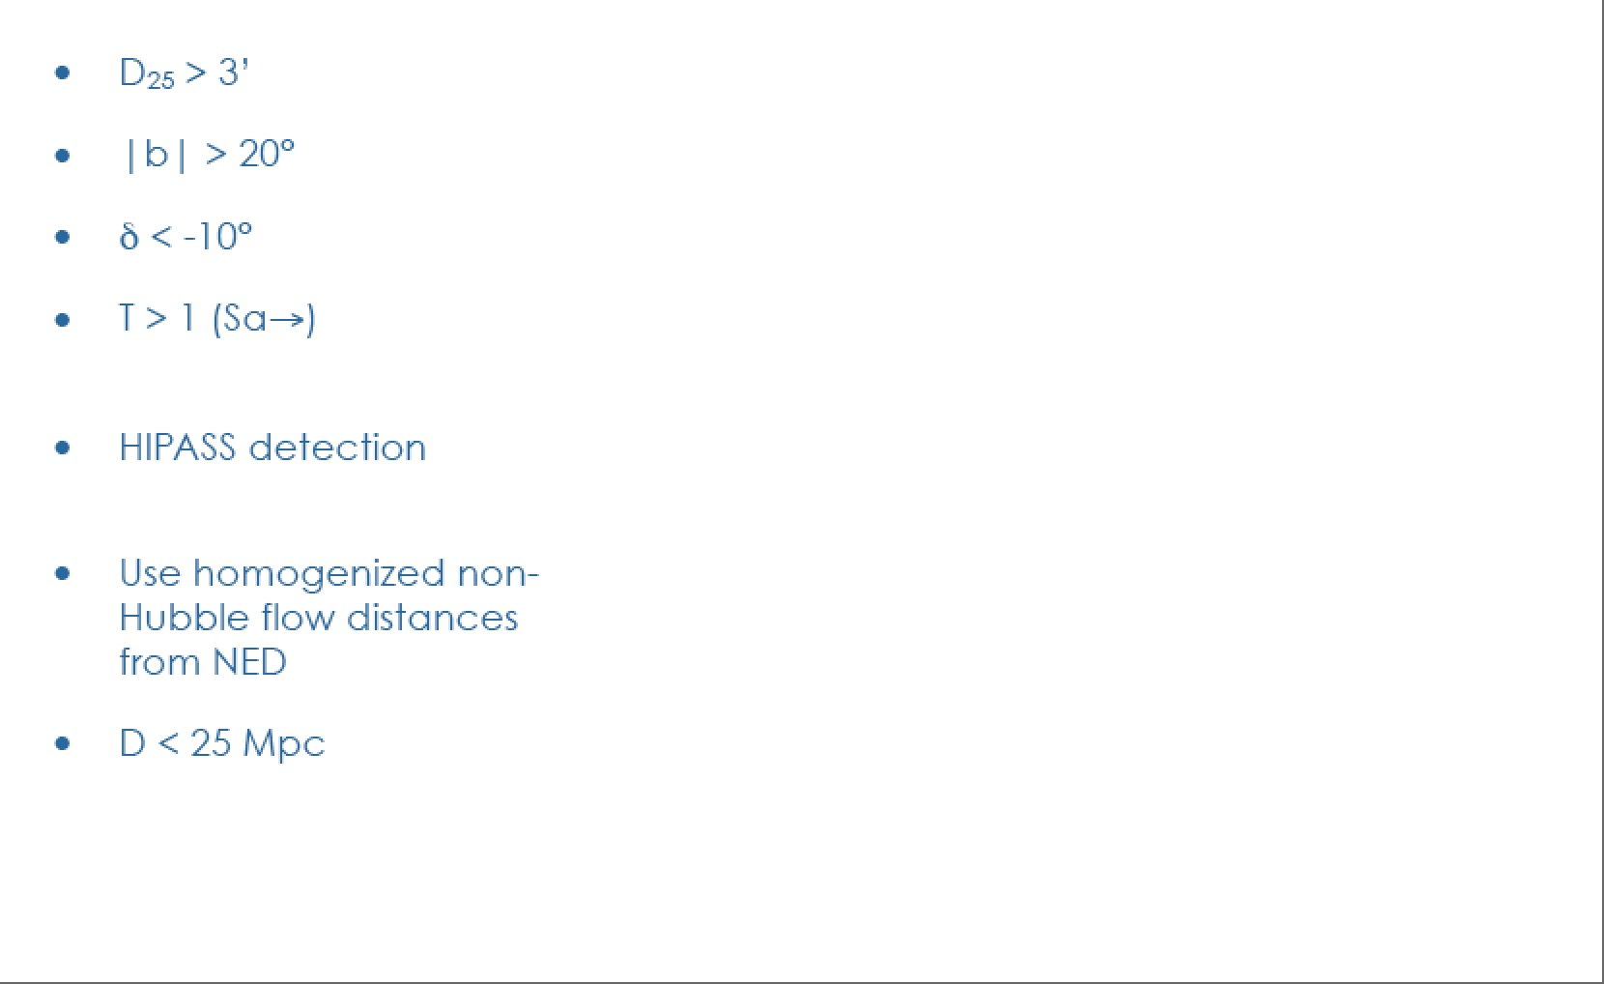
Selection of the sample

Slide 18
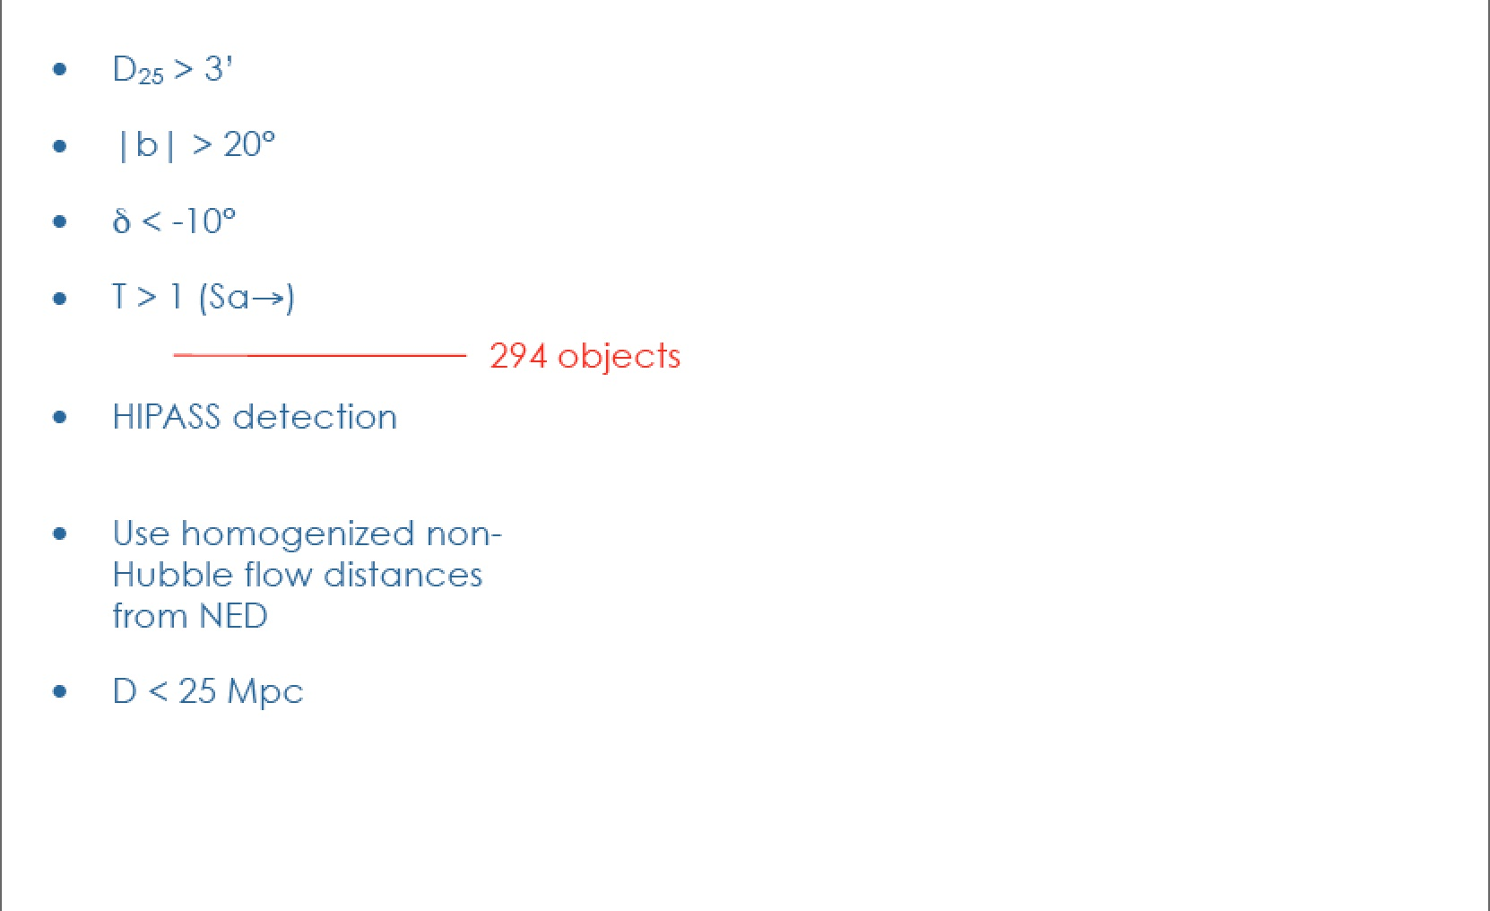
Selection of the sample

Slide 19
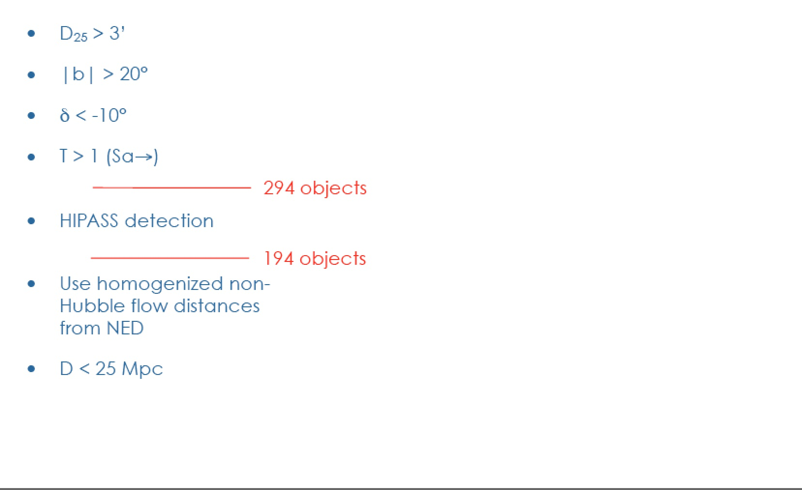
Selection of the sample

Slide 20
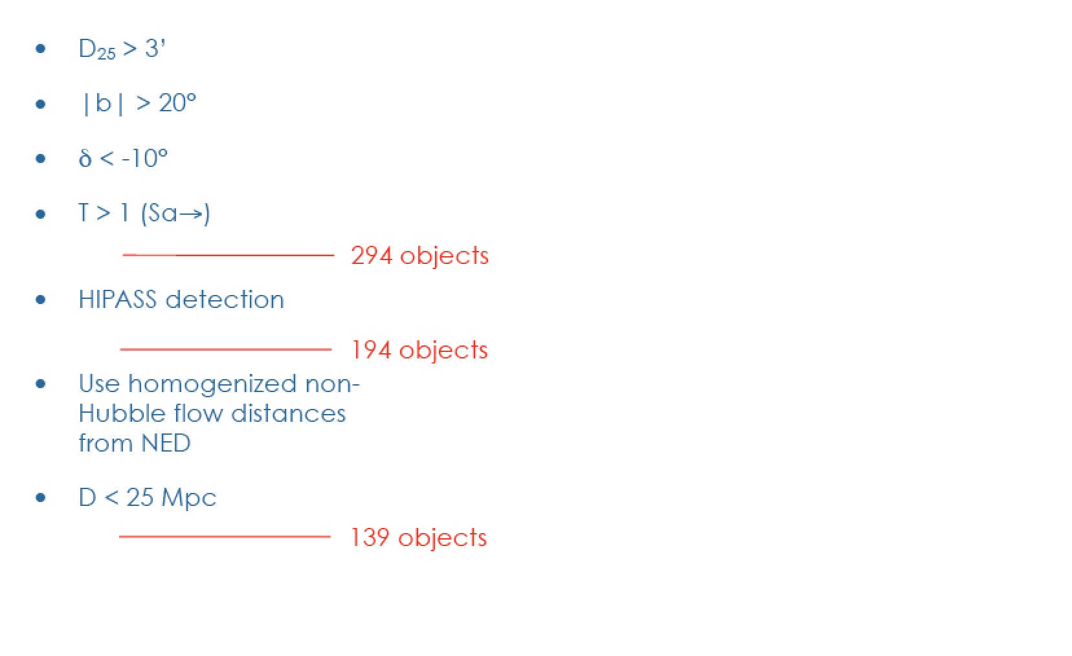
Selection of the sample

Slide 21
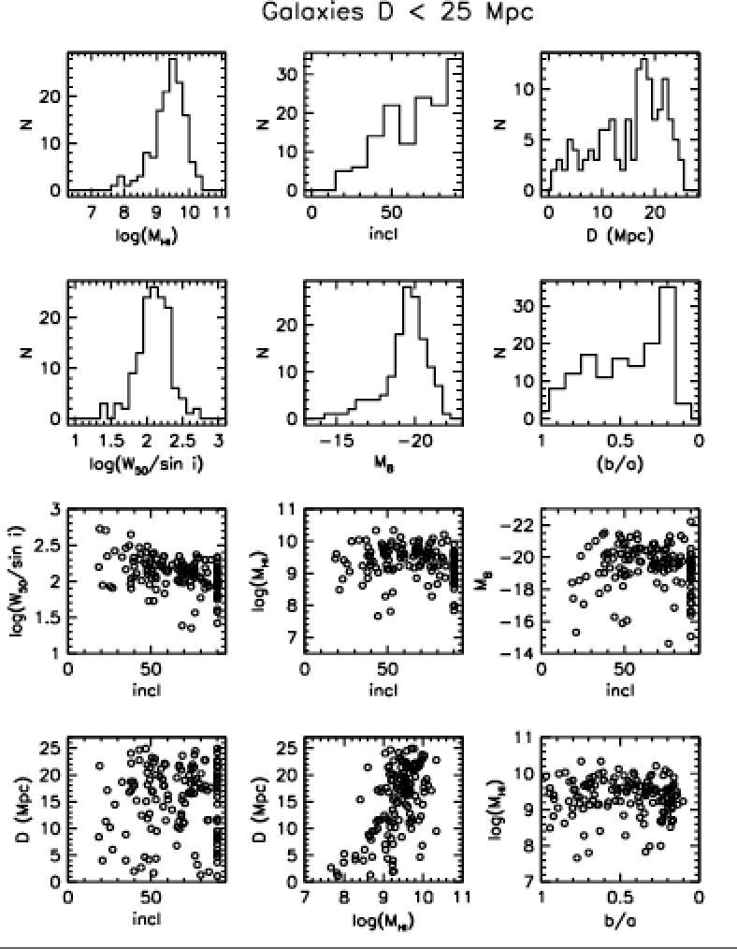
Selection of the sample

Slide 22
Selection of the sample
How to get to 30 objects ?

Slide 23
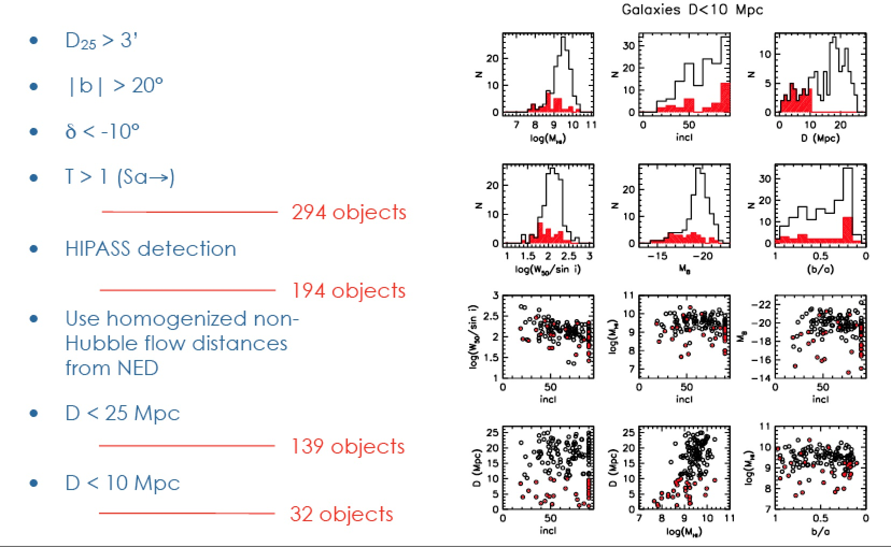
Selection of the sample

Slide 24
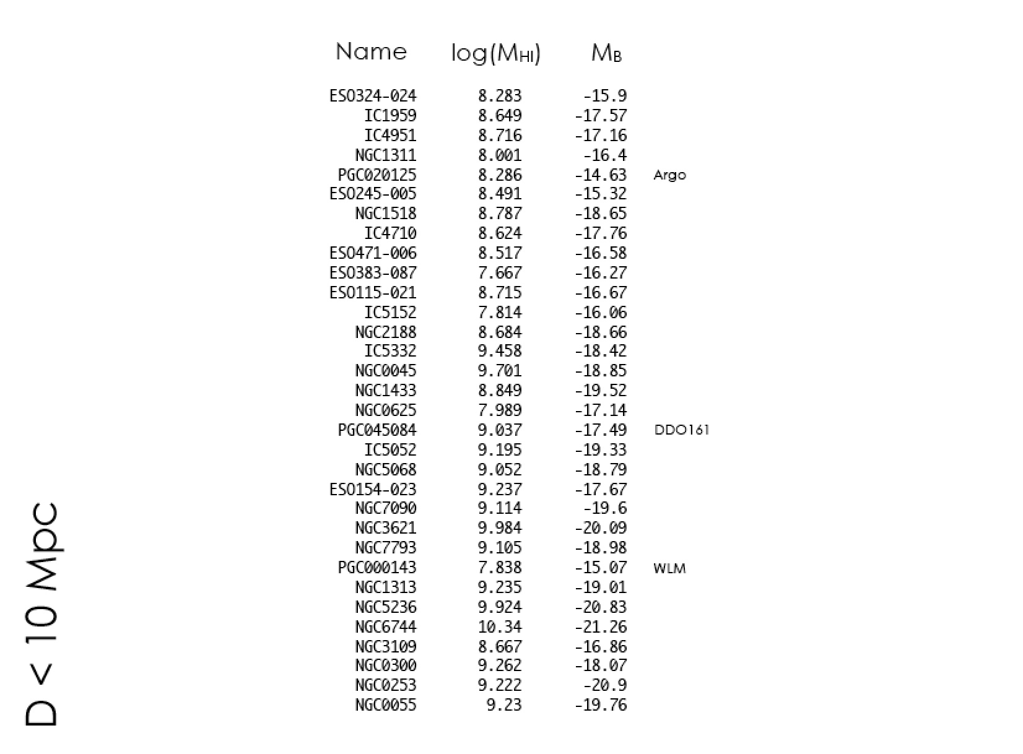

Slide 25
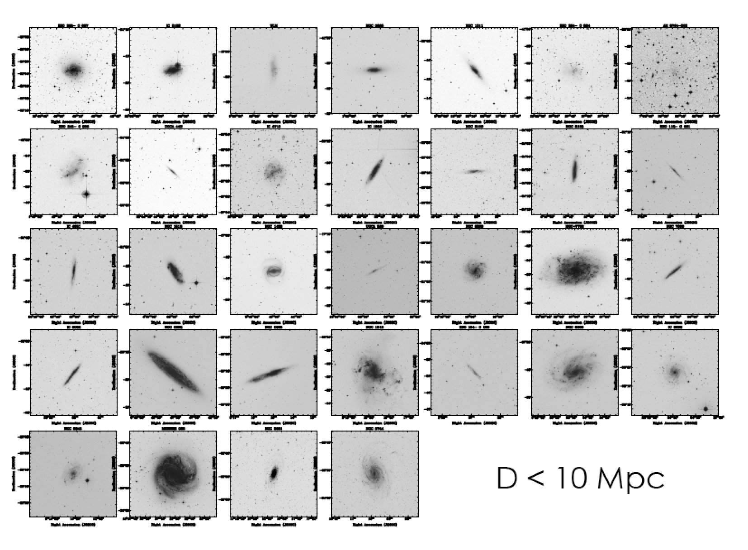

Slide 26
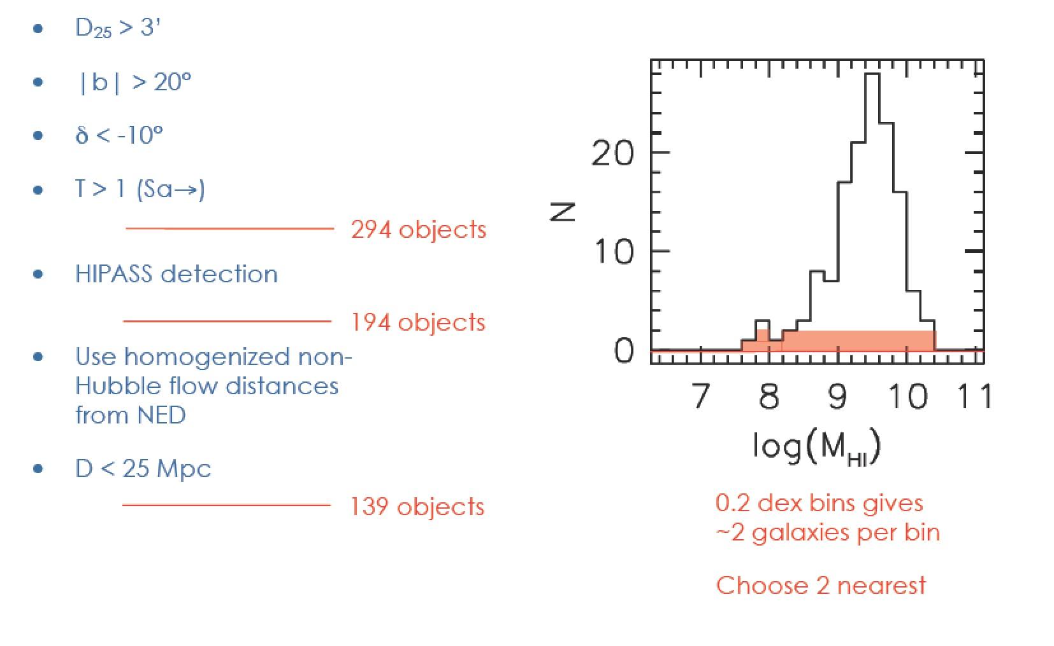
Selection of the sample

Slide 27
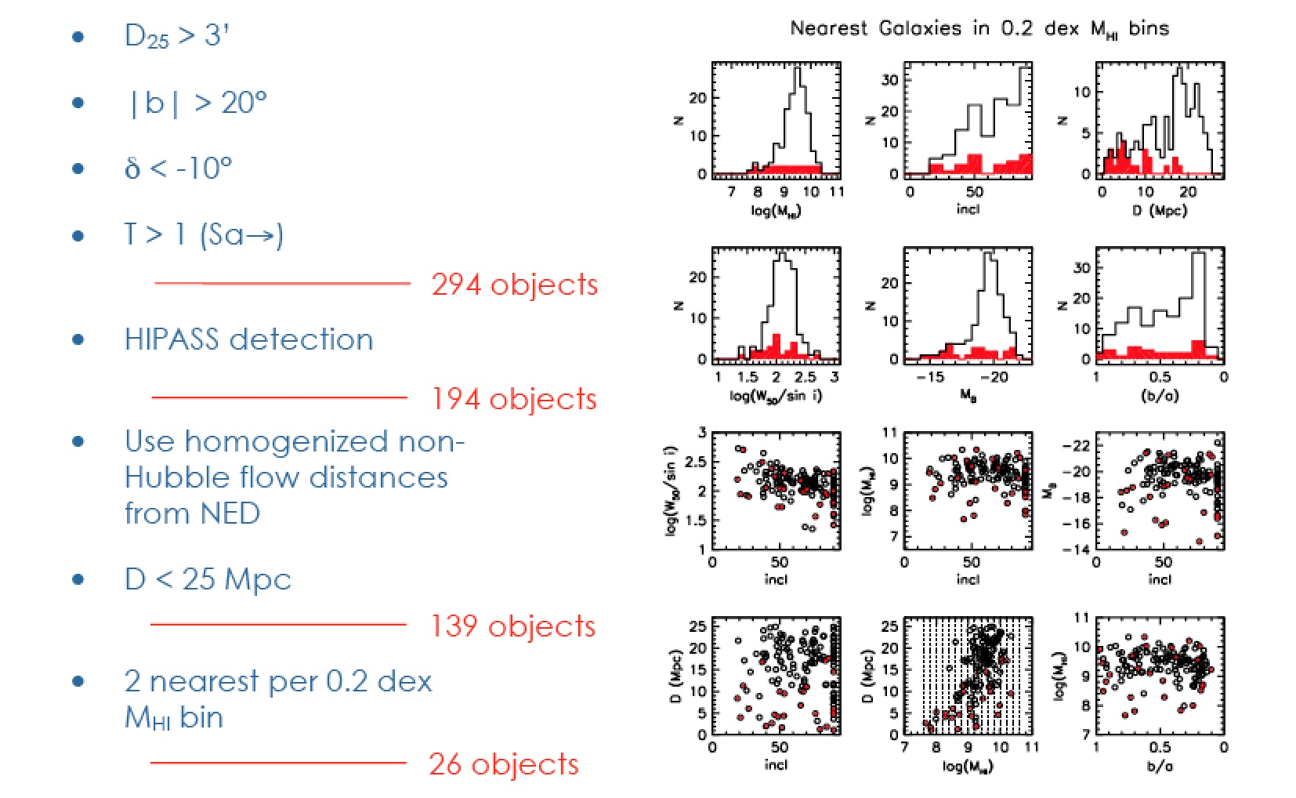
Selection of the sample

Slide 28
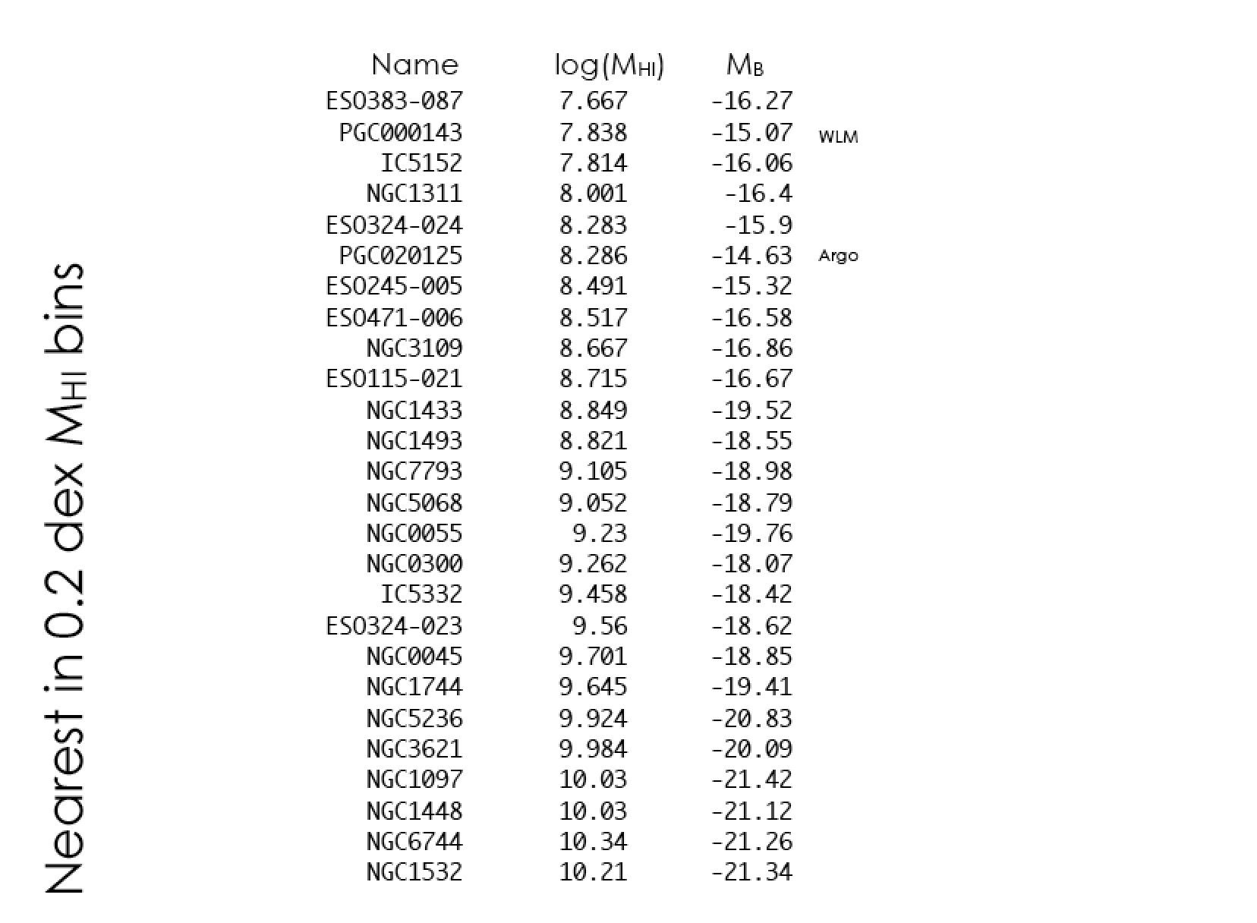

Slide 29
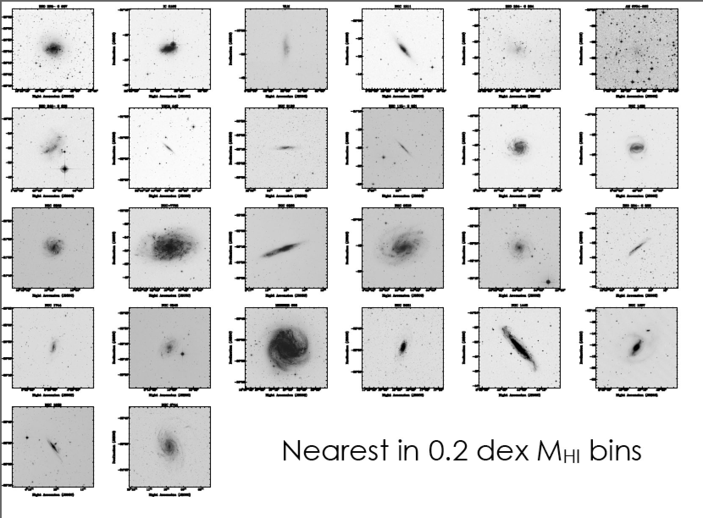

Slide 30
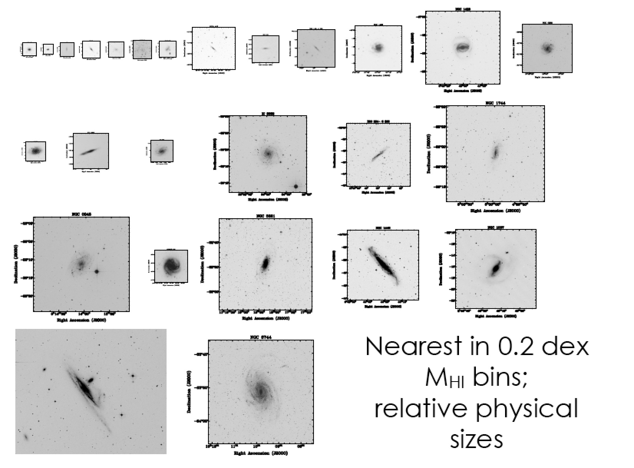

Slide 31
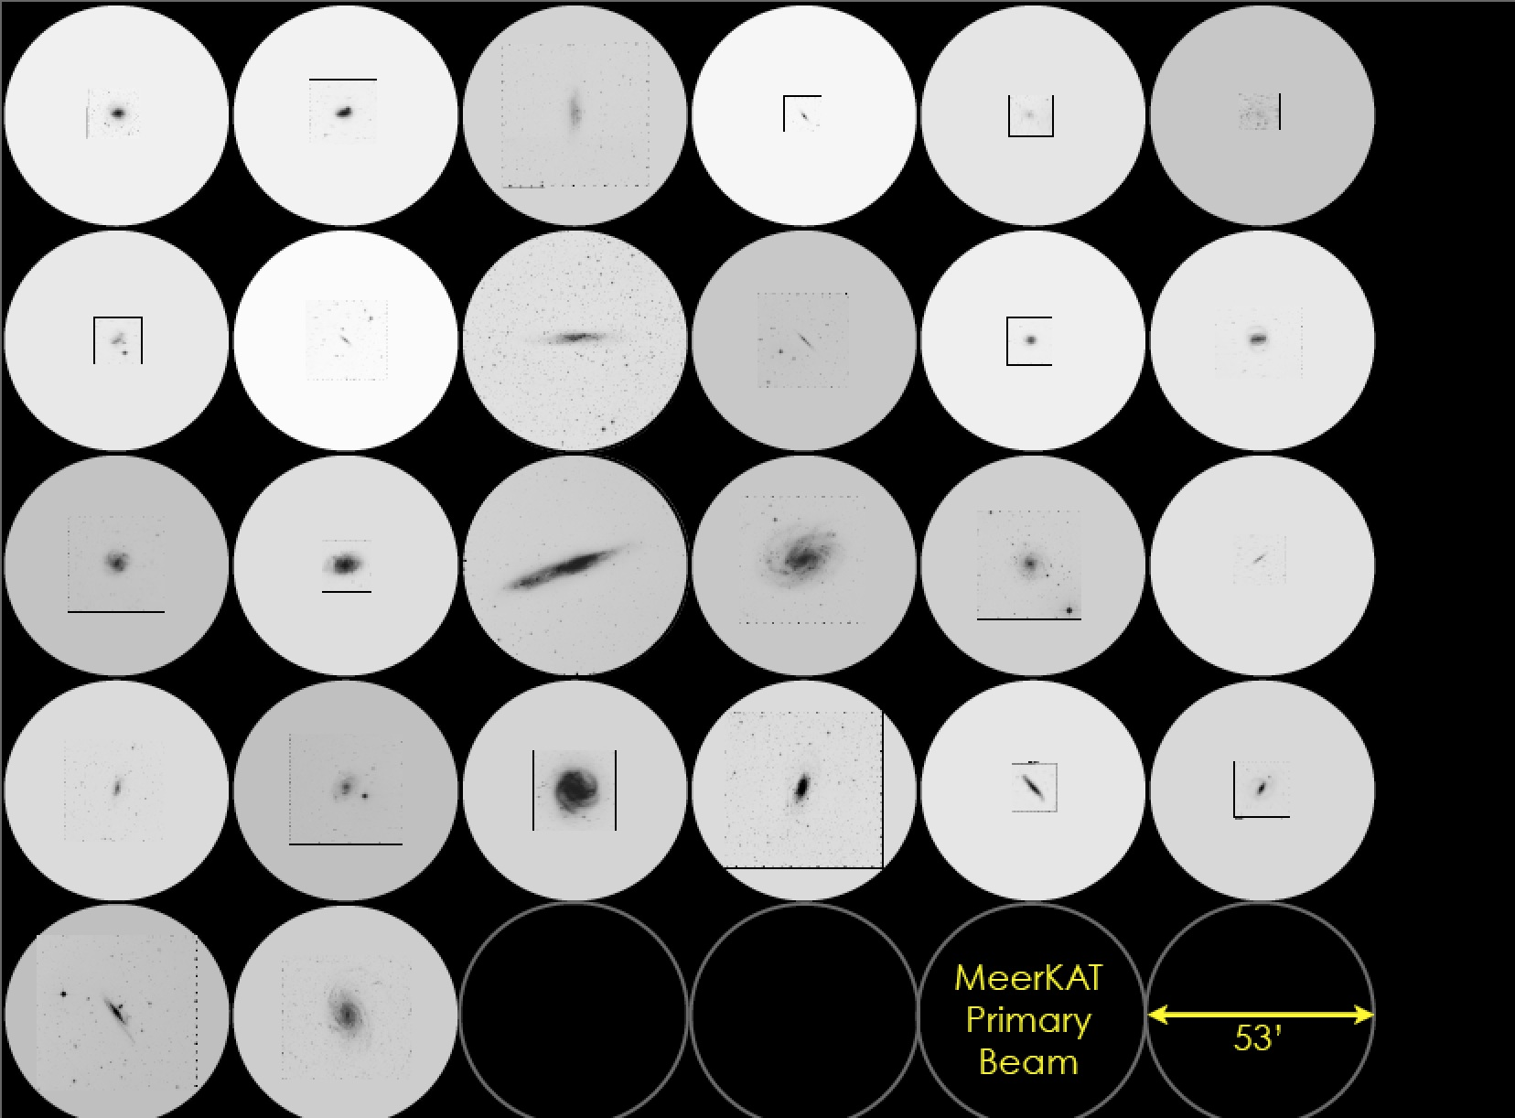

Slide 32
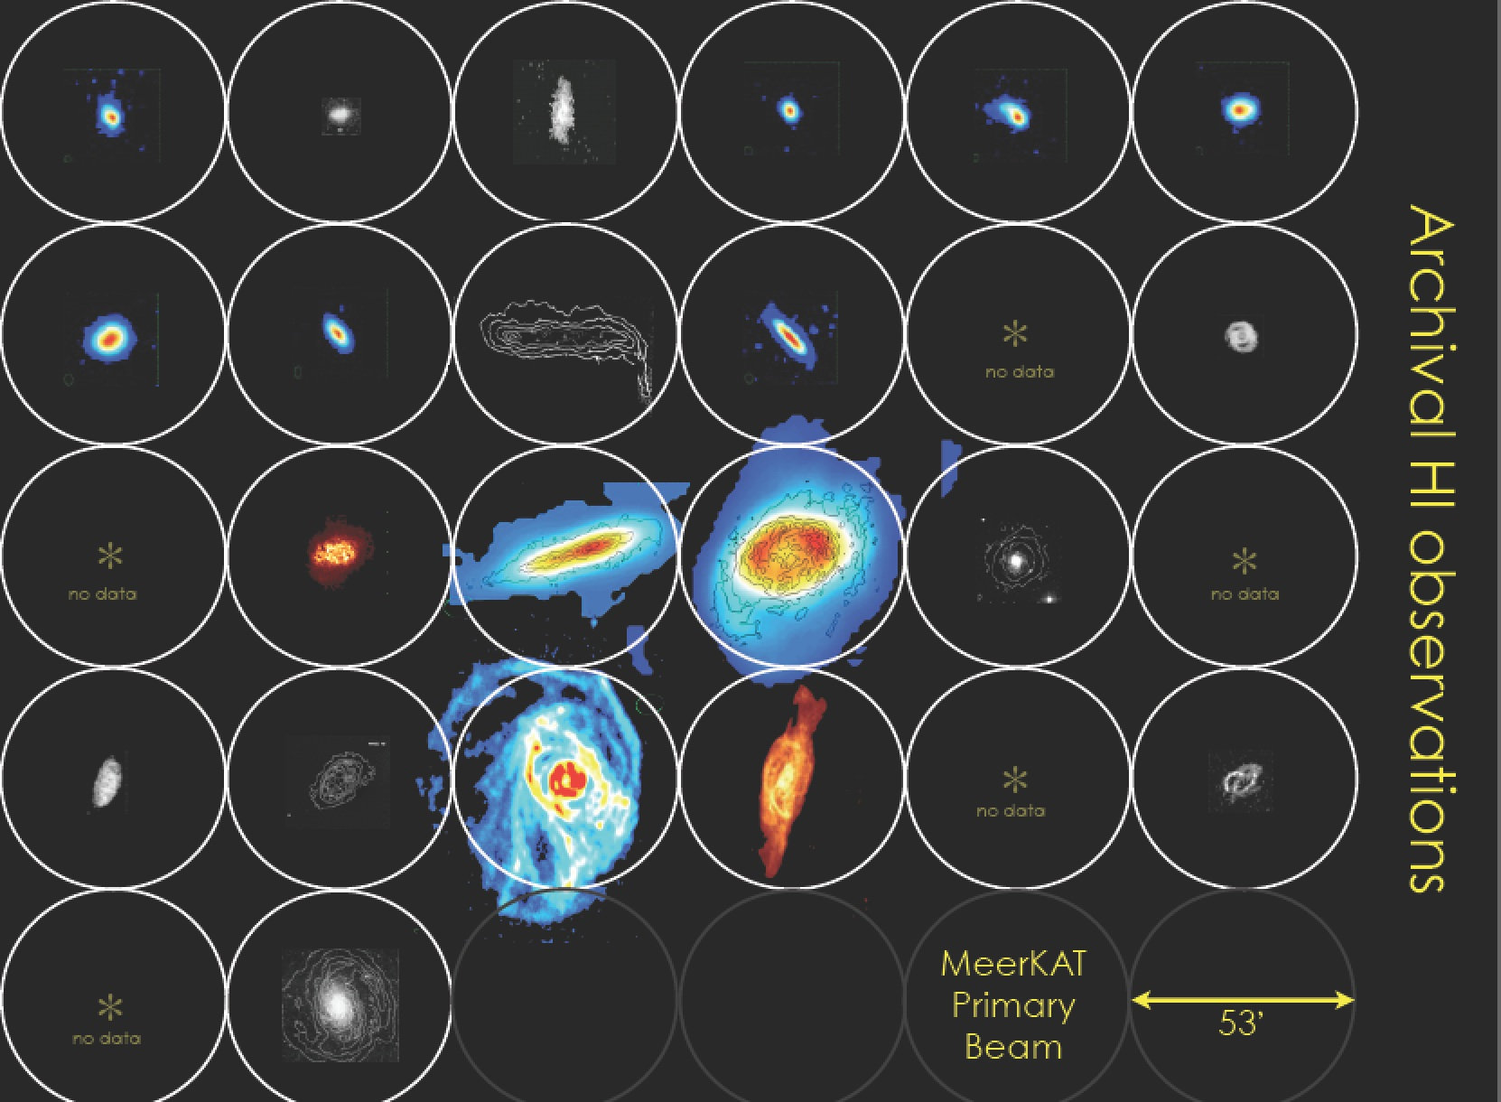

Slide 33
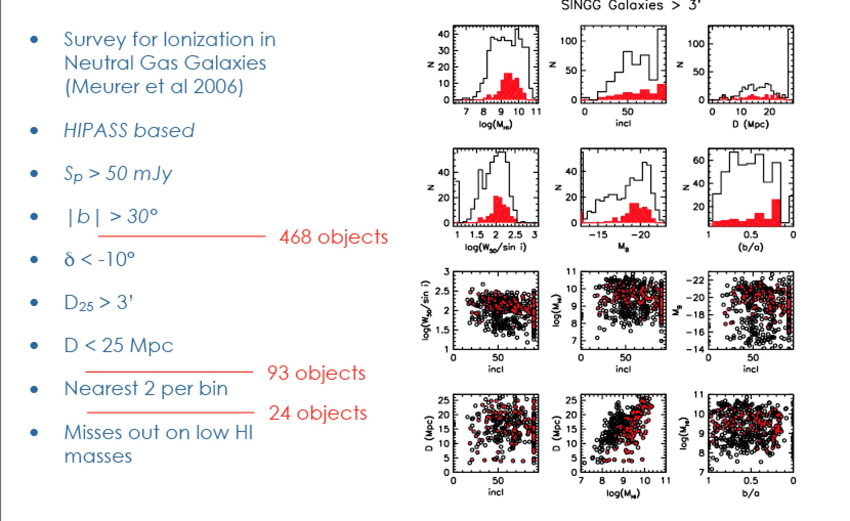
SINGG sample

Slide 34
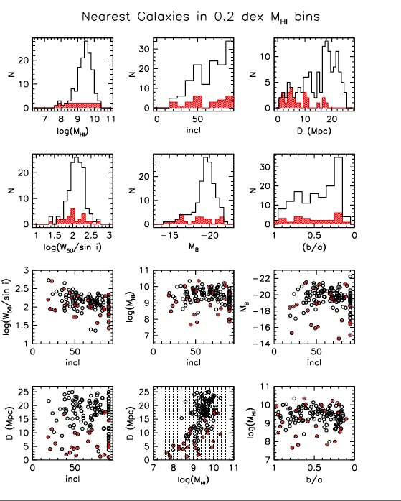
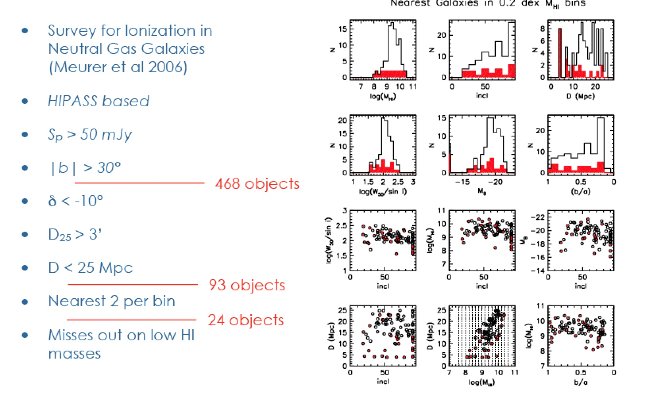
SINGG sample

Slide 35
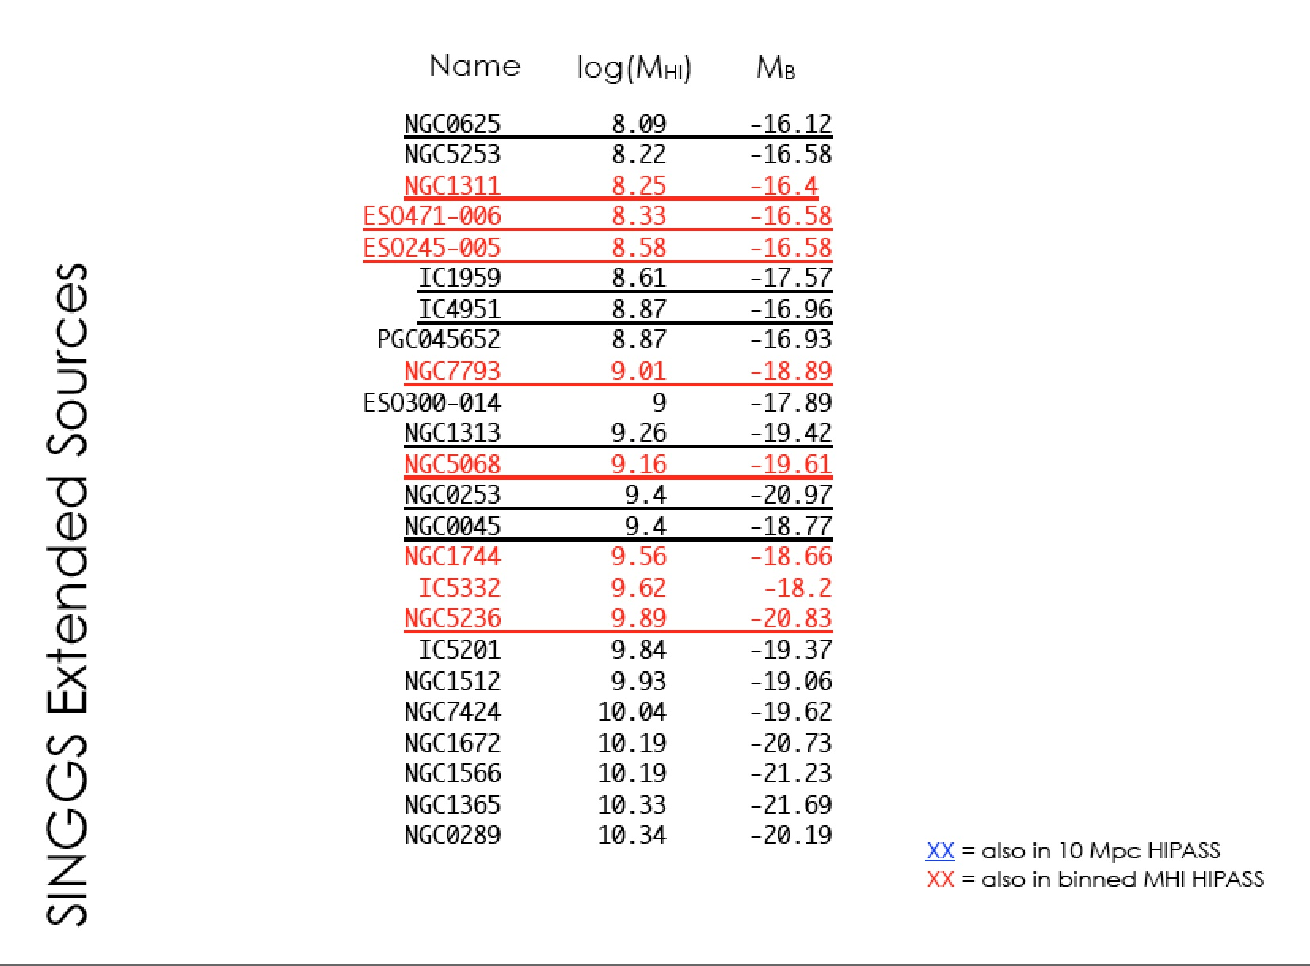

Slide 36
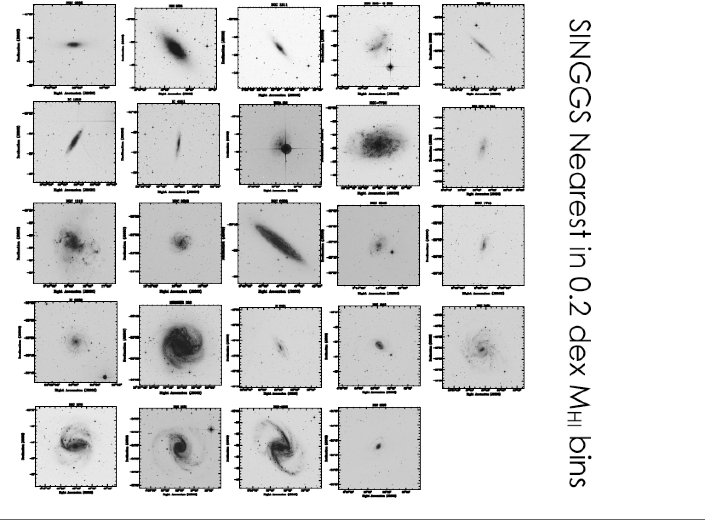
More early-types
Less dwarfs

Slide 37
Overall strategy
Collaboration with SINGG/SUNGG/Wallaby
  Shallow observations of ~200 galaxies
  Deeper follow-up of ~60 galaxies with ATCA/GMRT
  Select 30 galaxies for MeerKAT deep survey
    200 hours corresponds to ~M_{HI}* at z = 0.1

Slide 38
MHONGOOSE update
Work in the past year has concentrated on defining a precursor sample for MHONGOOSE
Sample of 90 galaxies has been defined using SINGG/SUNGG database (PI: Gerhardt Meurer)
SINGG/SUNGG were drawn from HIPASS in a similar manner as MHONGOOSE
Advantage is that multi-wavelength observations are readily available
First HI data cube obtained by KAT 7 (NGC 3109)

Slide 39
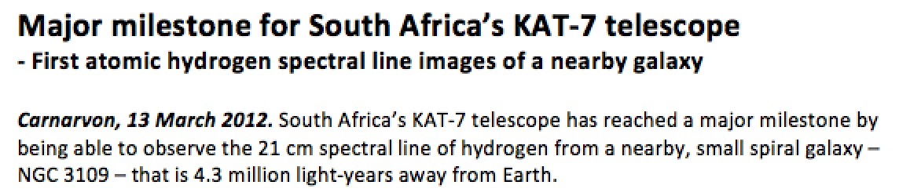
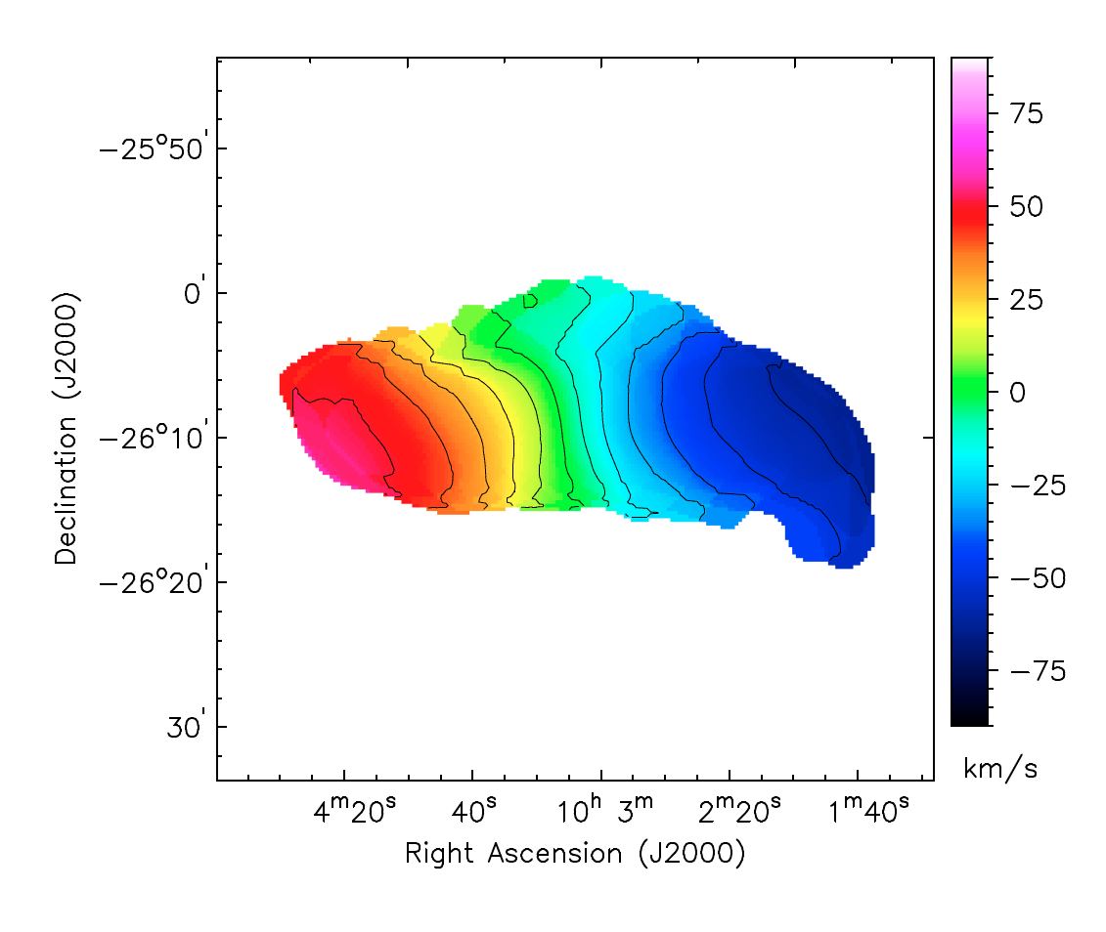
HI with KAT 7

Slide 40
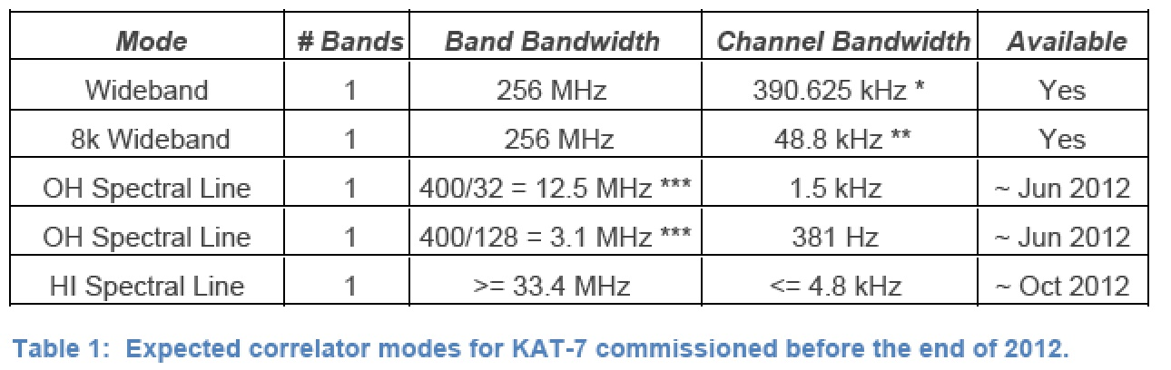
HI with KAT 7

Slide 41
Hα Fabry-Perot on SALT
SALT FP
Medium
Resolution
Data
September 2012
NGC 7424
NGC 7793

Slide 42
MHONGOOSE update
First HI data cube obtained by KAT 7 (NGC 3109)
Commissioning of HI line mode – KAT 7 commissioning team in collaboration with B. Frank (PhD, UCT) & D. Lucero (post-doc, UCT)
SALT Hα Fabry-Perot follow-up of MHOGOOSE deep survey candidates (medium resolution)
ANU 2.3m (WIFES – 38” x 25” IFS) observations of candidates - PI: G. Meurer, in coll. with M. Mogotsi (PhD, UCT)

Slide 43
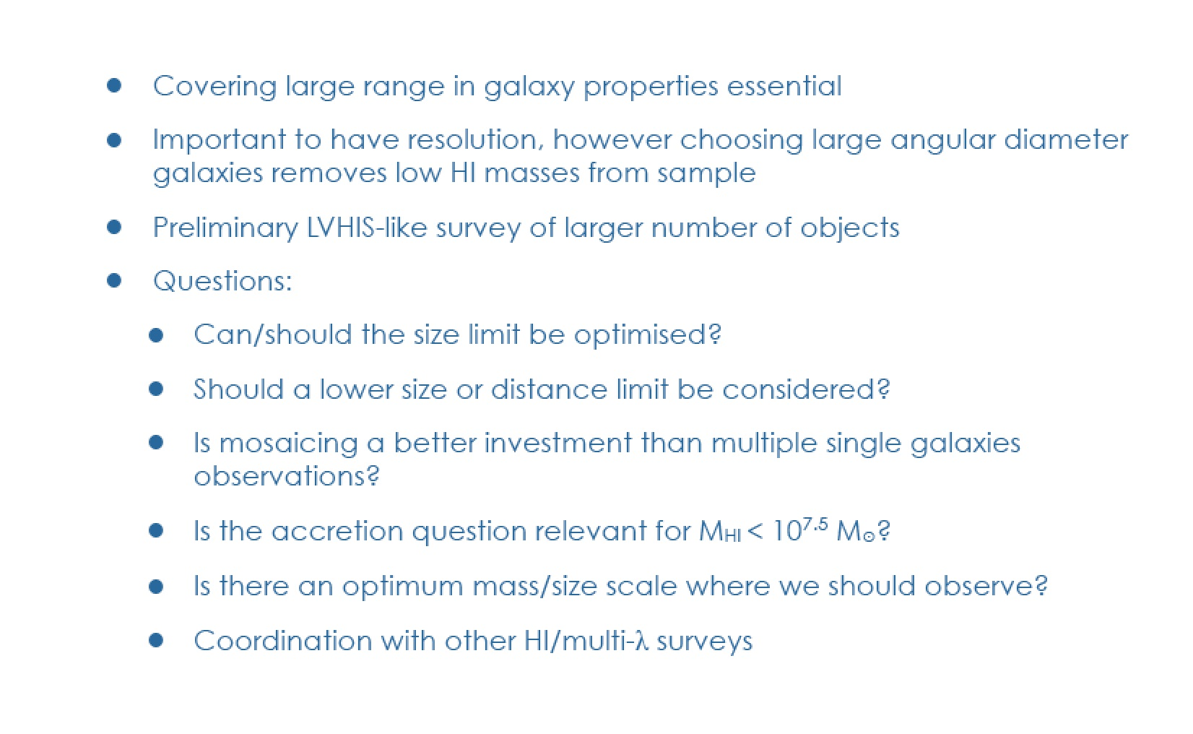
MHONGOOSE sample questions

Slide 44
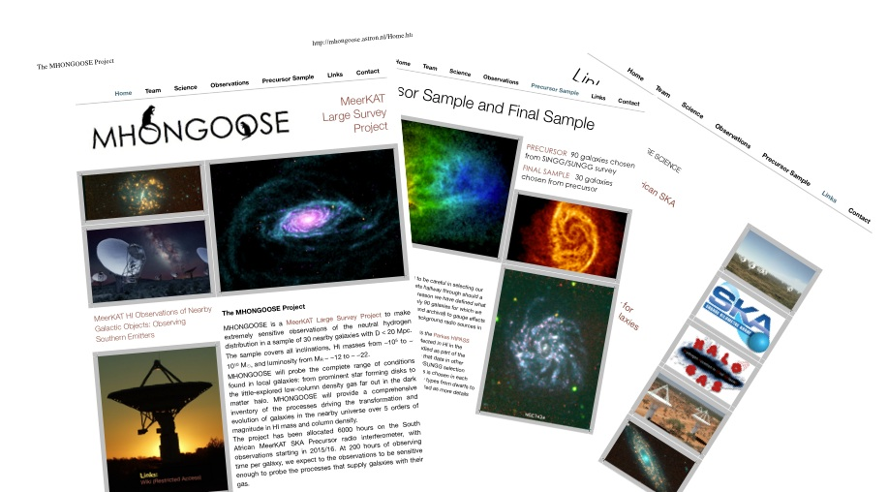


website: mhongoose.astron.nl

