Slide 1
MeerGAL a high frequency survey of the Southern Galaxy
Mark Thompson, Sharmila Goedhart
and
The MeerGAL Consortium

Slide 2
Introduction
The high frequency optically thick, variable Galaxy is relatively unexplored
Survey cost scales as ν^{2.2} to ν^{3.4} (for non-thermal or optically thin emission)
However, low frequency GHz surveys select against rising spectra
~10 GHz surveys of the Galaxy that have been done to date all have arcmin resolution or sensitivities measured in Jy (AT20G, Langston, Nobeyama, Ryle 10C…)
Hints of variability from Langston survey
Many small dishes & sensitive feed design of MeerKAT cuts the survey cost at 14 GHz to ~ the same as the EVLA at 5 GHz
MeerGAL will be the first high frequency sub-arcsec sub-mJy multi-epoch survey of the Galaxy

Slide 3
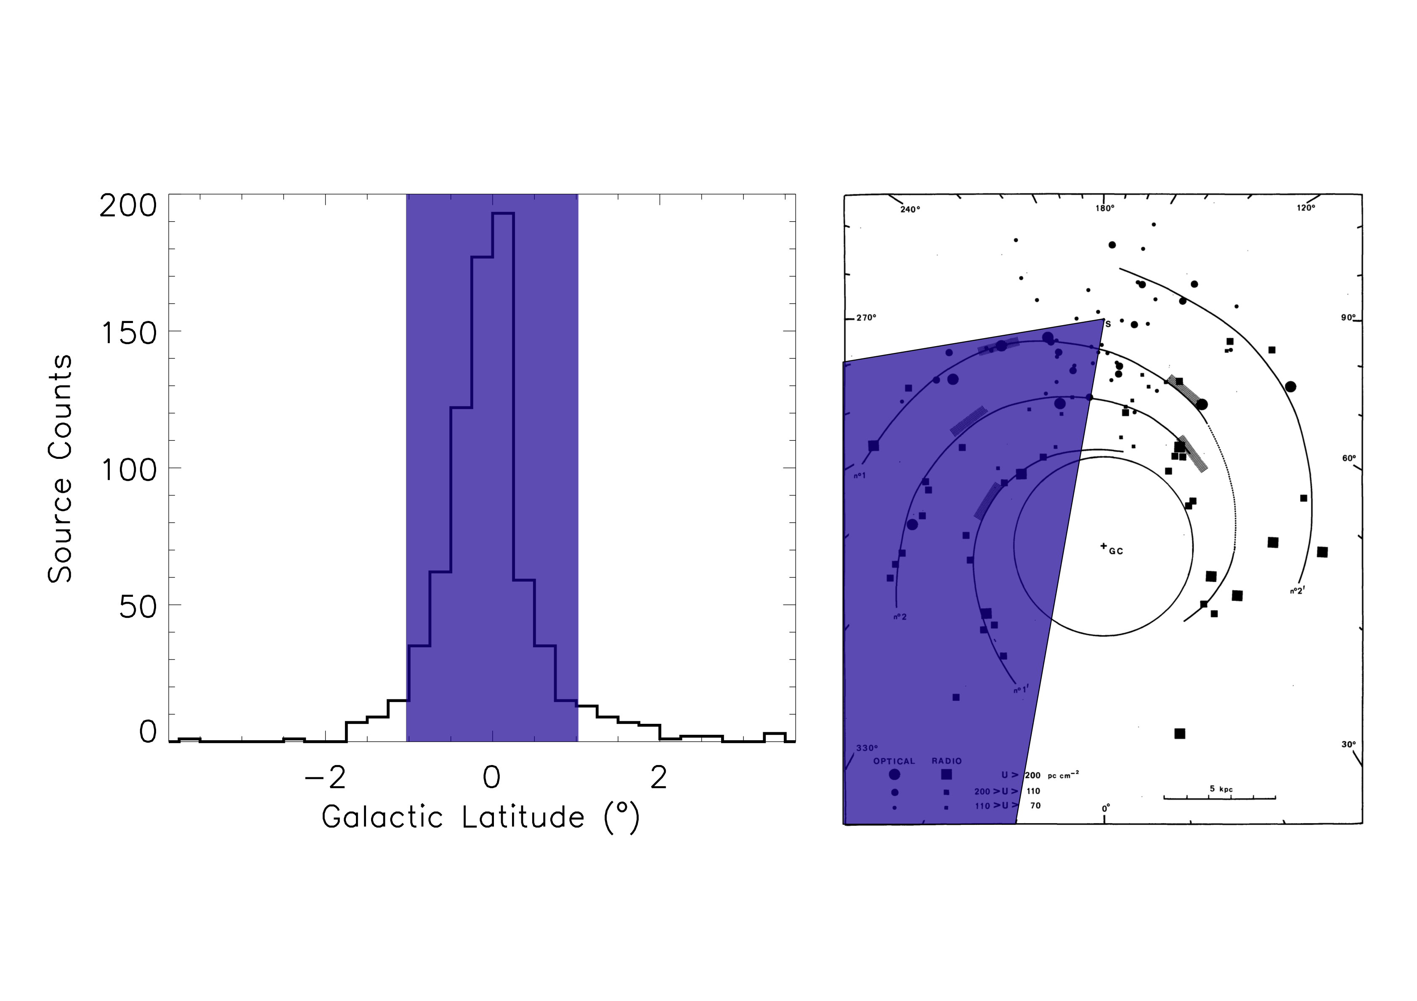
MeerGAL Survey Design
3300 hours of MeerKAT time awarded
Survey the Carina, Crux & Norma Arms (280 < l < 350 and |b| <1)
3 epochs with 1 year cadence
Single epoch 5σ: 60 µJy/bm (cont) 7 mJy/bm (line)
Three epochs 5σ: 30 µJy/bm (cont) 4 mJy/bm (line)
Stacking of RRLs in passband to improve S/N
Deeper RRL follow-up of selected faint HII regions to maintain uniform longitude velocity coverage

Slide 4
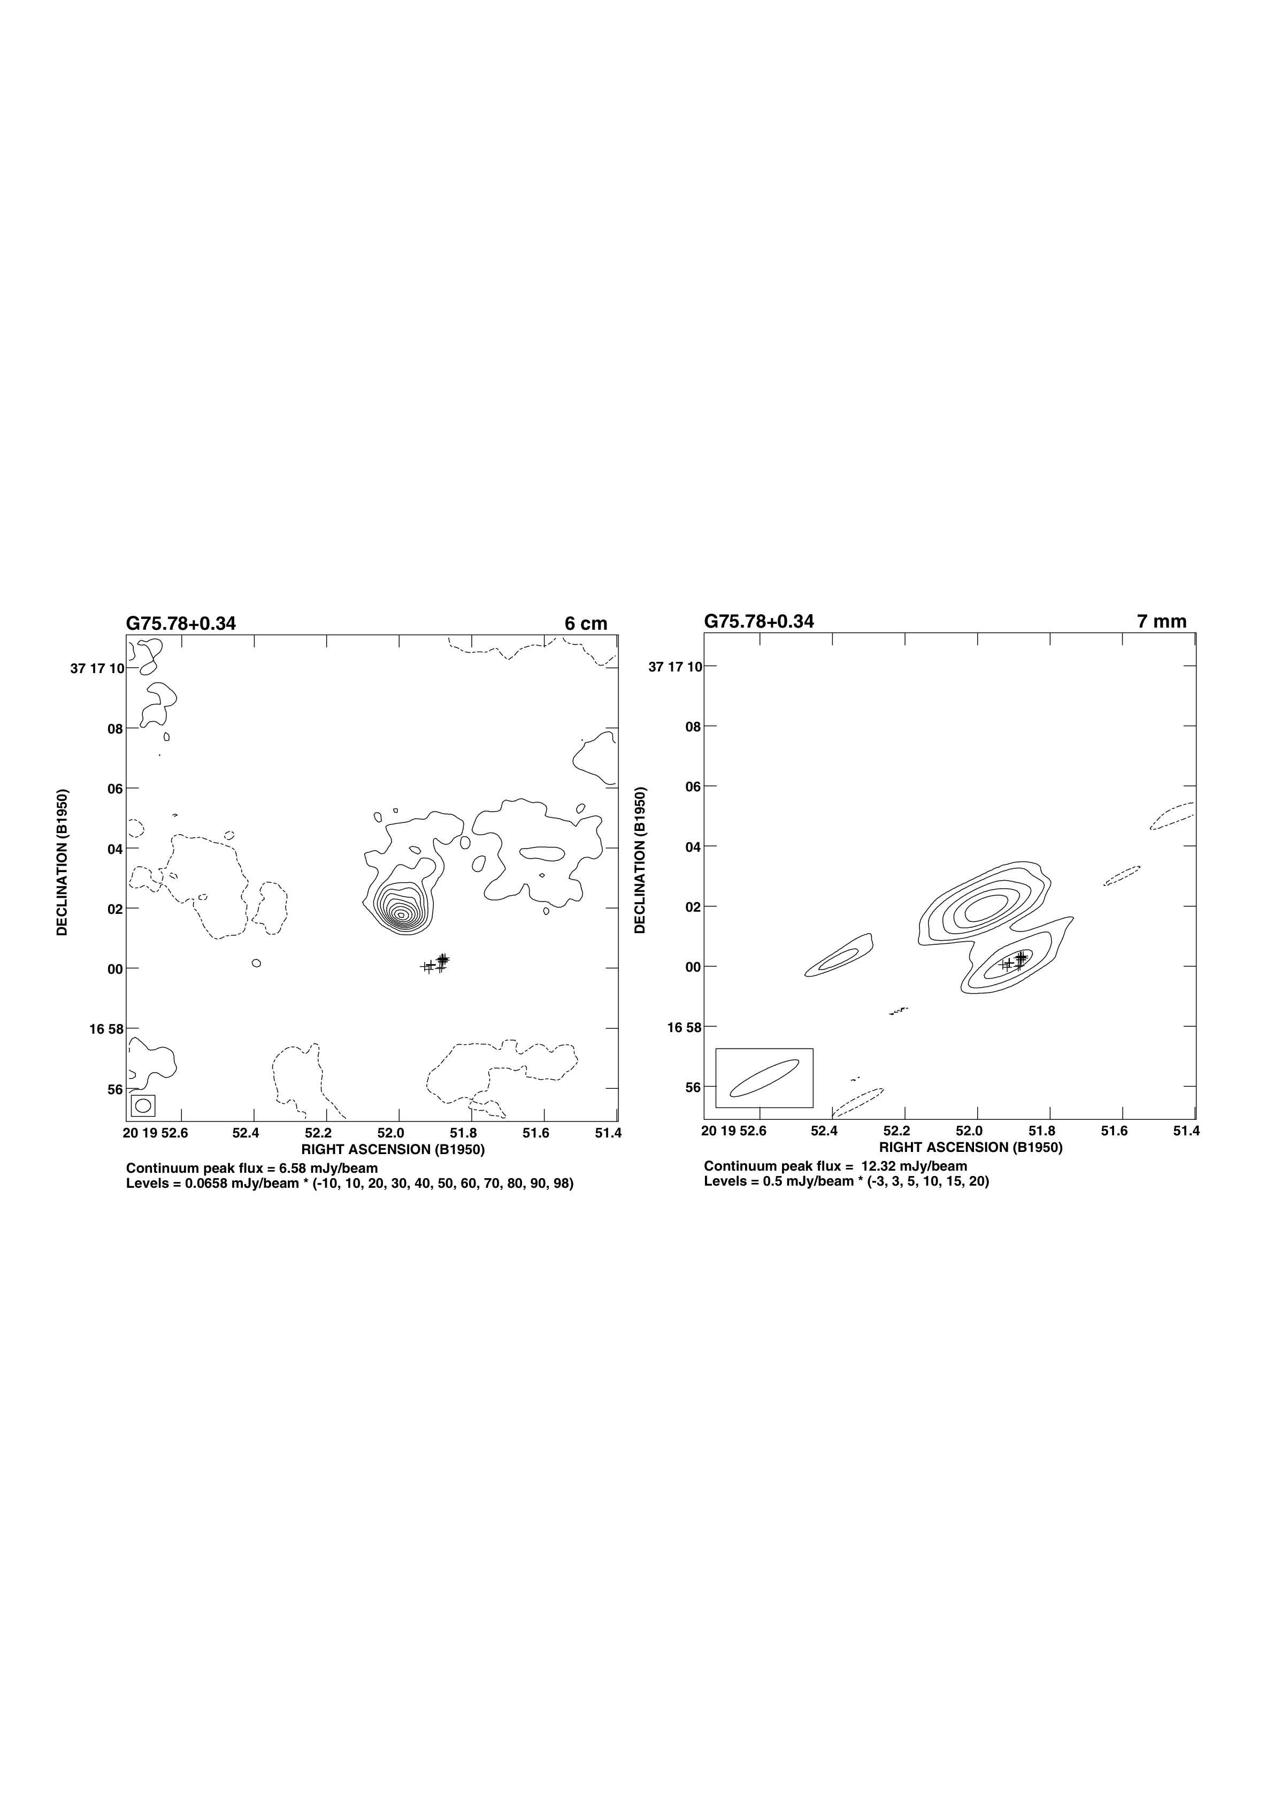
Science Goal: the birth of HII regions
Hypercompact HII regions
Completely missed at 5 GHz
Only good examples are serendipitously detected
Earliest stage in development of HII region

Slide 5
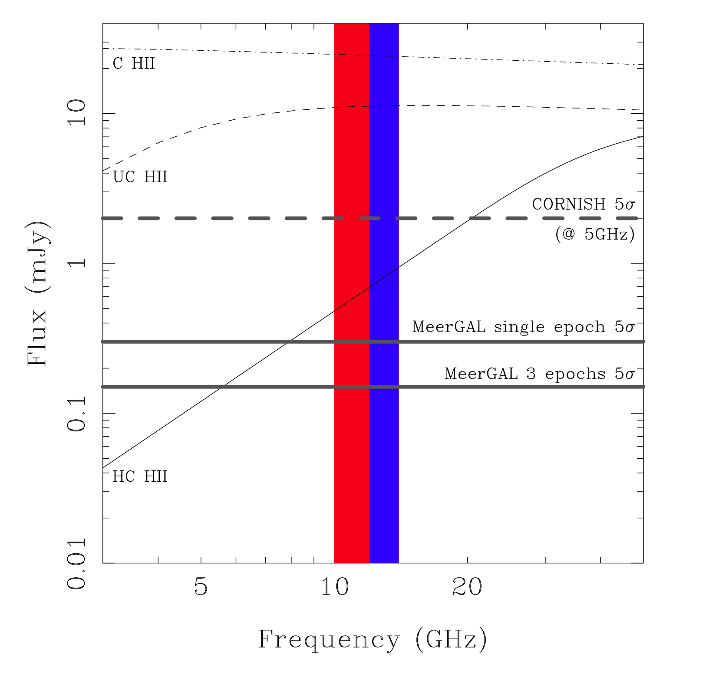
Science Goal: the birth of HII regions
MeerGAL complete to edge of Galaxy for all HII regions (compact, ultracompact, hypercompact), whether optically thin or thick
Can isolate thermal vs non-thermal emission using supporting infrared data & CORNISH-S
Study the variability of large sample of HII regions for the first time
Variability gives clues to accretion physics (~10% year-on-year for a handful of objects)
Statistical lifetimes, luminosity functions…

Slide 6
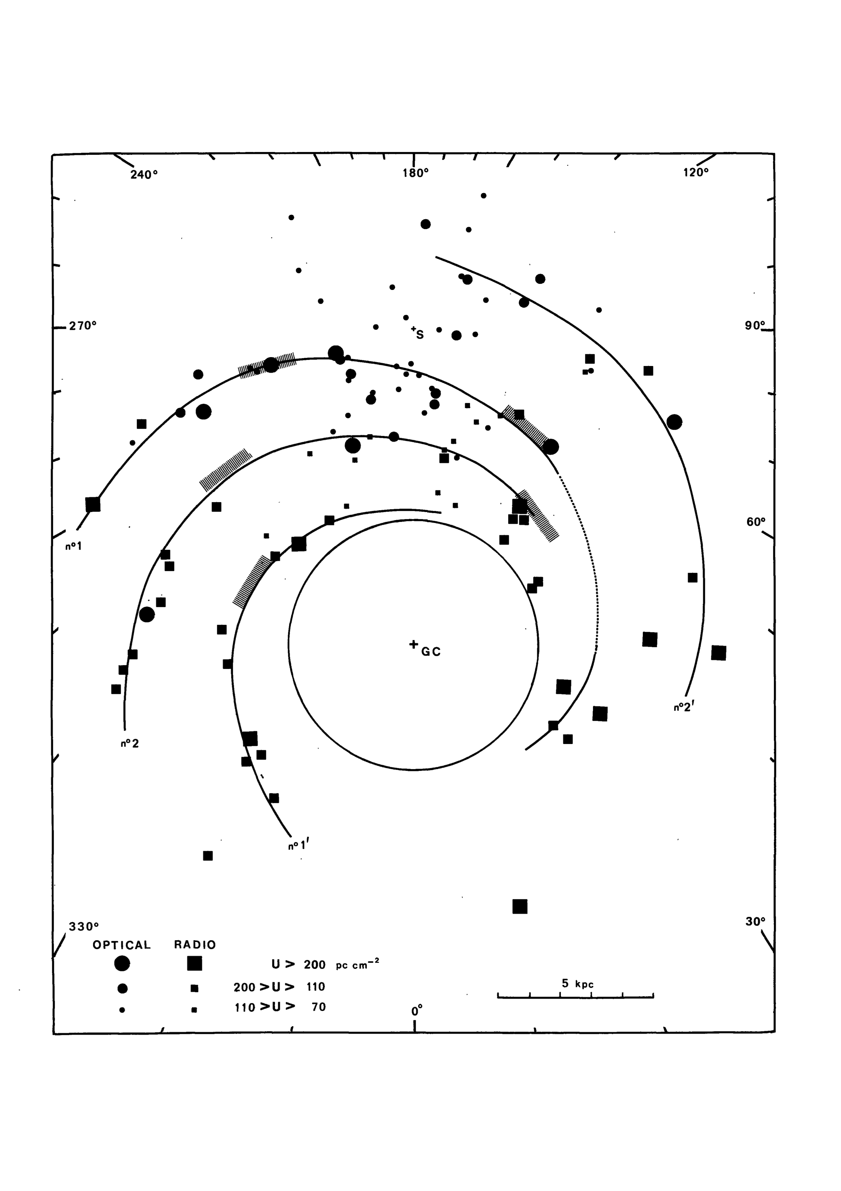
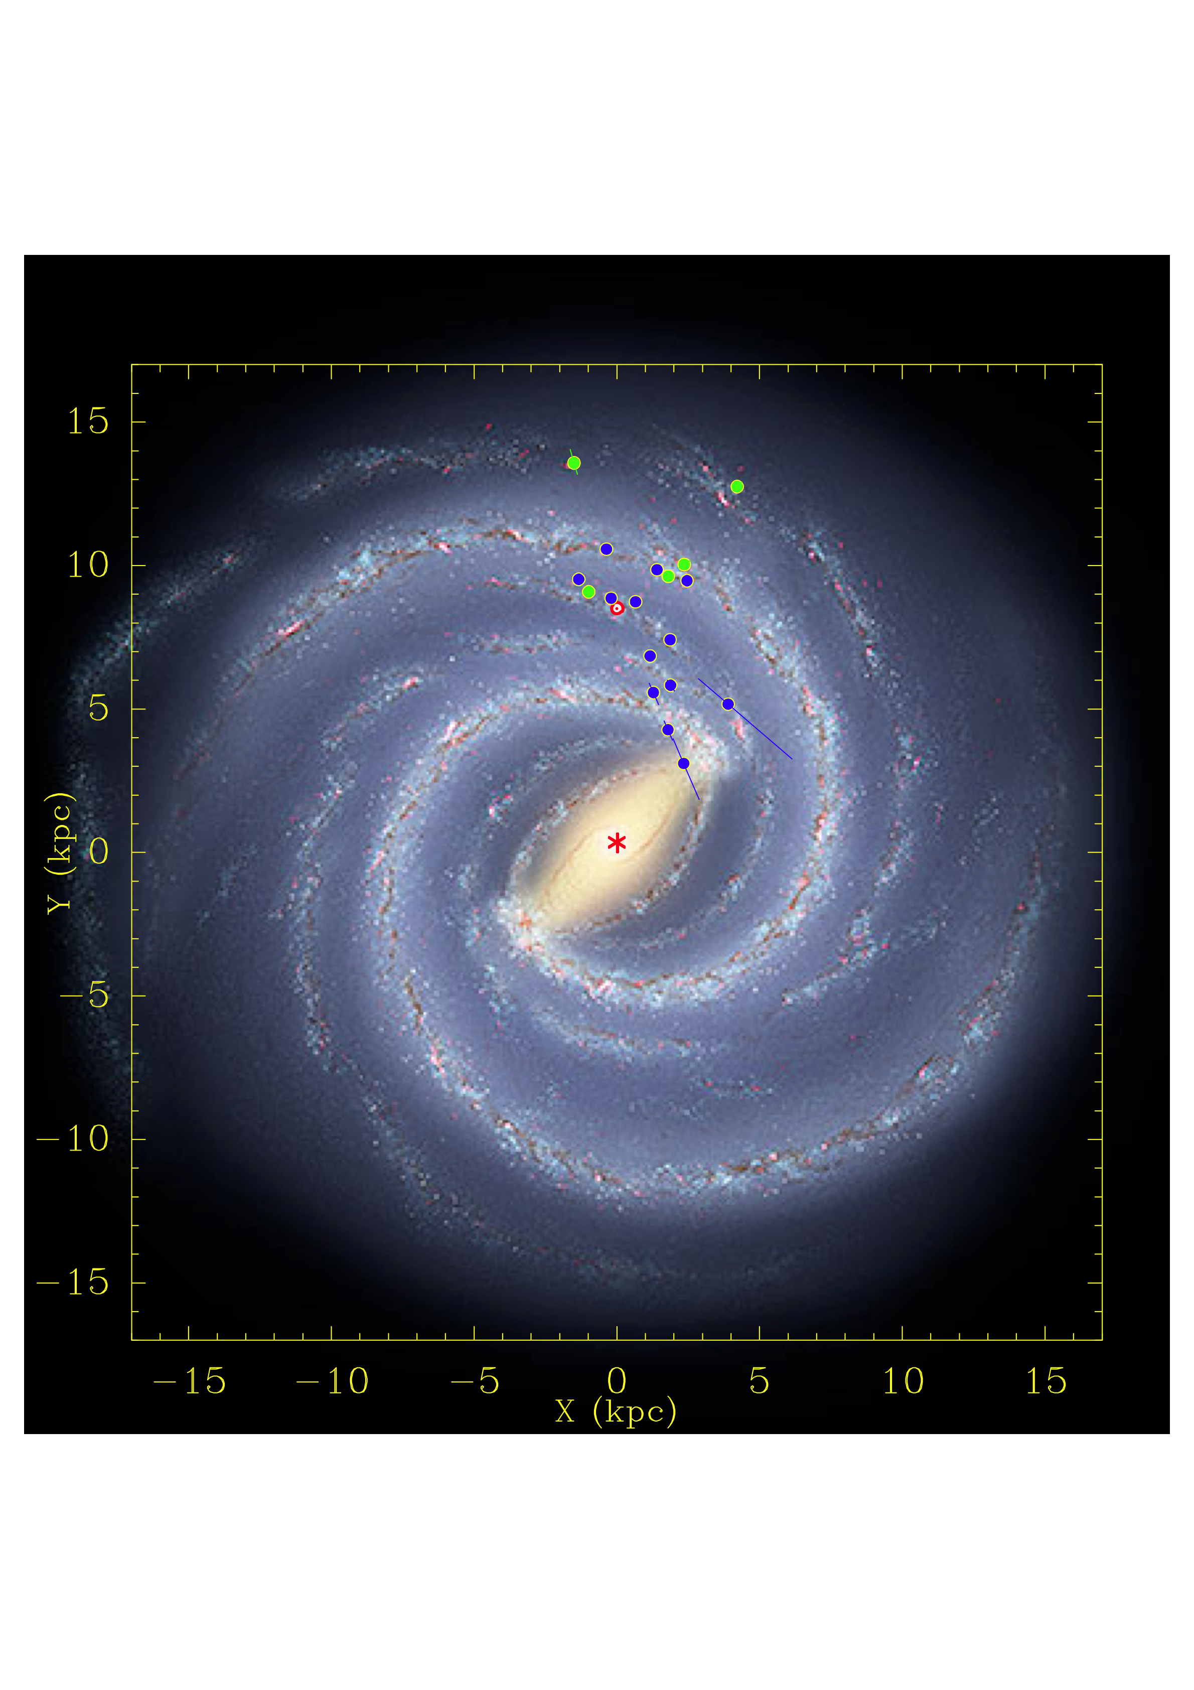
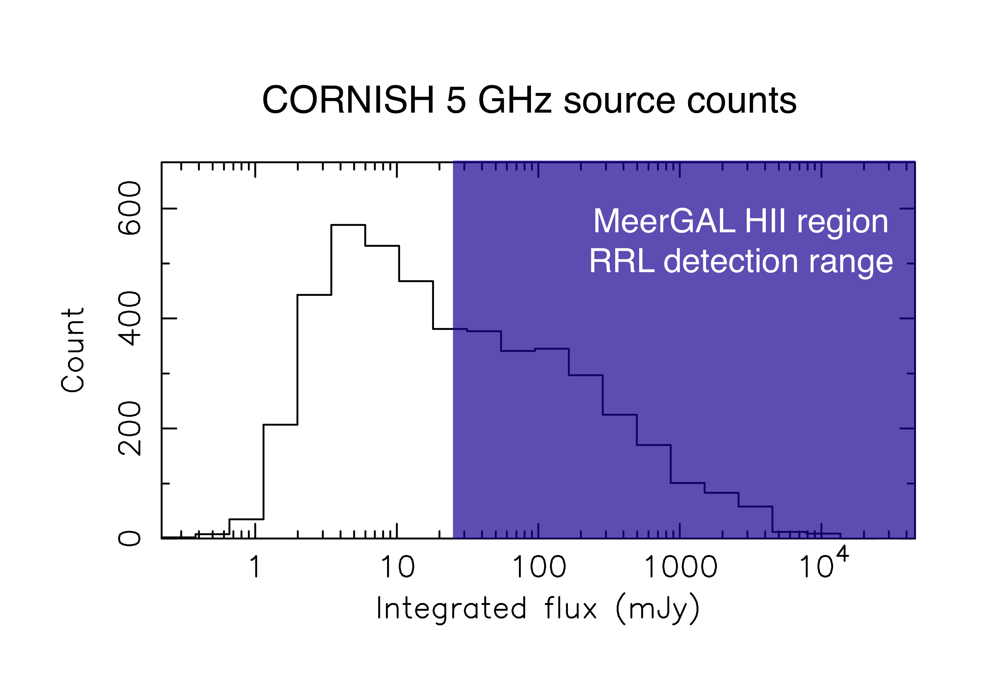
Science Goal: 21st century map of Milky Way structure
State of the art for the last 35 years is the GG76 spiral arm model based on diffuse HII region recombination line velocities
Recent VLBI parallaxes of CH₃OH & H₂O masers – but not in the South
MeerGAL will measure RRL velocities for ~2000 young HII regions (compact, ultracompact & hypercompact) – order of magnitude more than GG76
Plus velocities & proper motions for ~1000 12.2 GHz CH₃OH masers, with potential for VLBI parallax

Slide 7
Other Science Goals
Mass loss from OB stars
Census of massive binaries
Radio protostars & T Tauris
Sub-arcsec census of 12.2 GHz Class II methanol masers
Anomalous microwave emission – spinning dust
Variable optically thick PNe – alternative distance tracer
High frequency phase calibrators in the Galactic Plane

Slide 8
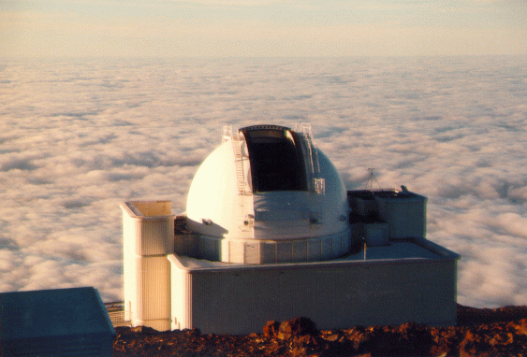
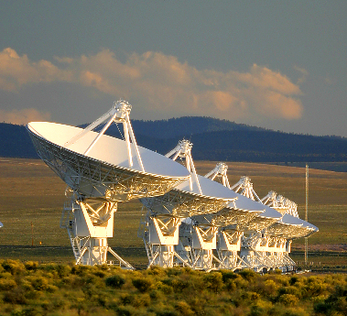
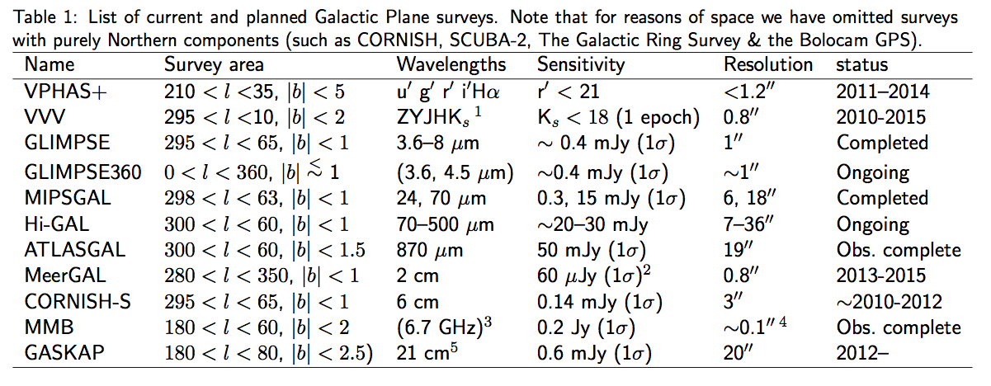
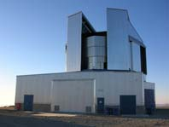
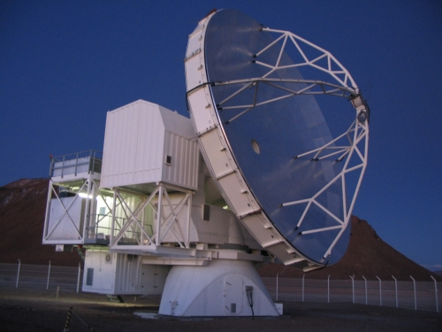
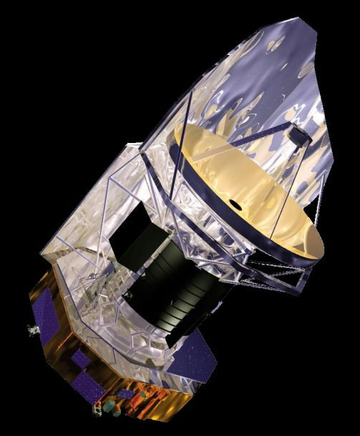
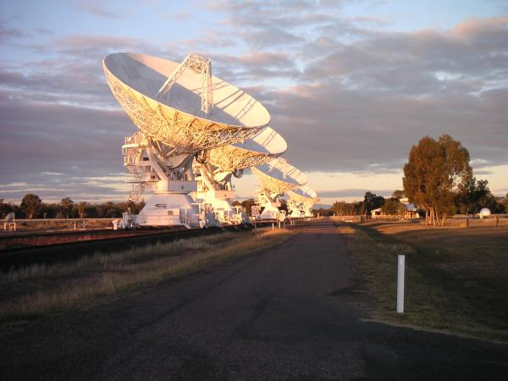
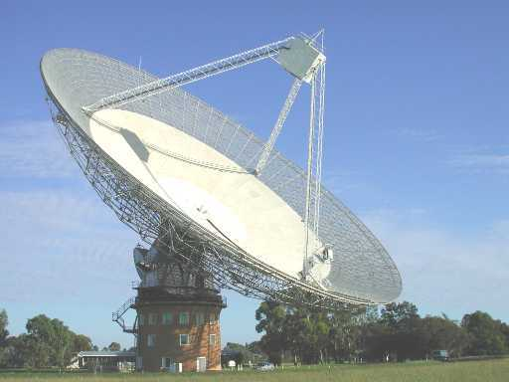
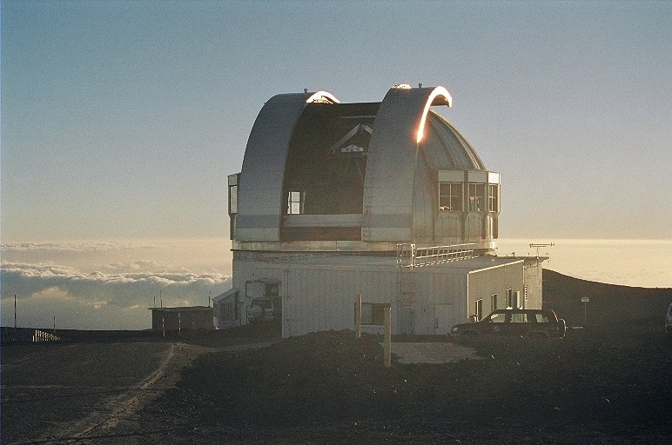
Multi-wavelength surveys of the Galaxy
MeerGAL fills the gap between existing & future multiwavelength surveys
Great opportunity for synergies between projects

Slide 9
Possible synergies with SALT
Complementary imaging surveys in optical and IR already available
Optical targets: planetary nebulae, young supernova remnants, stars with dense stellar winds: O/B stars, T Tau, interacting binaries including symbiotic stars.
Will need spectroscopy to classify these sources and detect wind lines
The goals of mapping spiral structure may require high resolution spectra to find the velocities of faint radio sources with no RRL detection

Slide 10
Timescales
Most objects for optical follow-up will be found in the first epoch of MeerGAL.
It is possible that optical variability studies may be requested, eg X-ray binary counterparts, symbiotic stars
Sample size is uncertain
Can probably use an intermediate size telescope to narrow the sample for SALT (AAT)
Possibly 250 hours of SALT time would be needed

