Slide 1

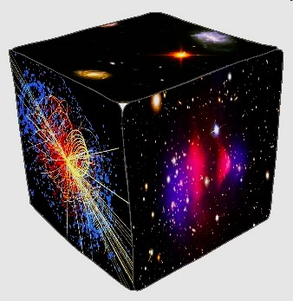
SALT-MeerKAT Workshop Nov. 5th, 2012
HESS-SALT-MeerKAT
Synergies: Extragalactic
Sergio Colafrancesco
Wits University - DST/NRF SKA Research Chair
Email: Sergio.Colafrancesco@wits.ac.za

Slide 2
Outline
Sensitivity for MeerKAT, SALT and HESS
Astrophysical synergies: Extragalactic
  Blazars
  Radiogalaxies
  Starburst galaxies (star forming galaxies)
  Galaxies (including SNRs)
  Clusters of galaxies
  Superclusters & Filaments
  Dark Matter halos
Cosmological synergies
  Non-thermal phenomena in LSS (single sources)
  Non-thermal surveys (statistics)
  Cosmology of non-thermal phenomena
    EBL, IGM B-field, Dark Matter nature
    Jets & SMBHs evolution, CRs in cosmology

Slide 3
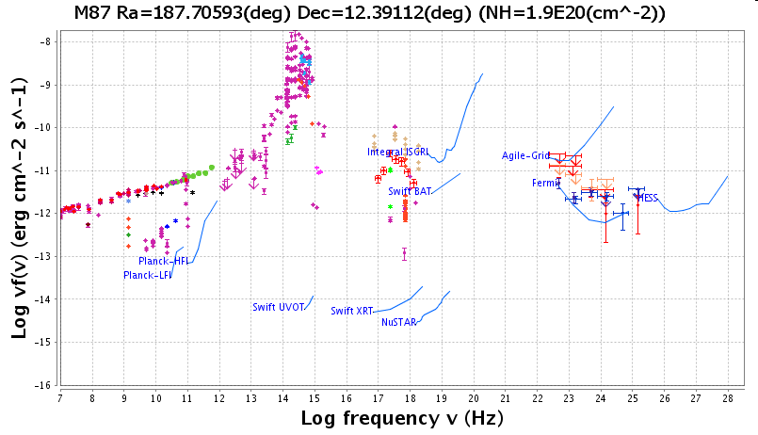
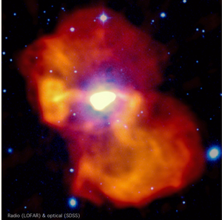
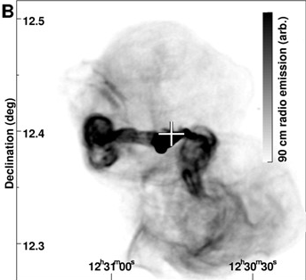
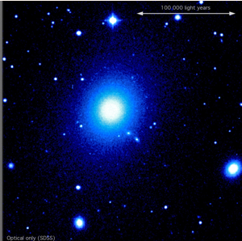
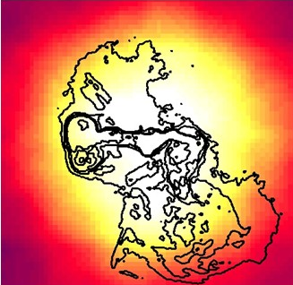
MeerKAT-SALT-HESSII
M87
non-thermal-B
dust-thermal
non-thermal-Radiation
MeerKAT
SALT
HESS-II

Slide 4
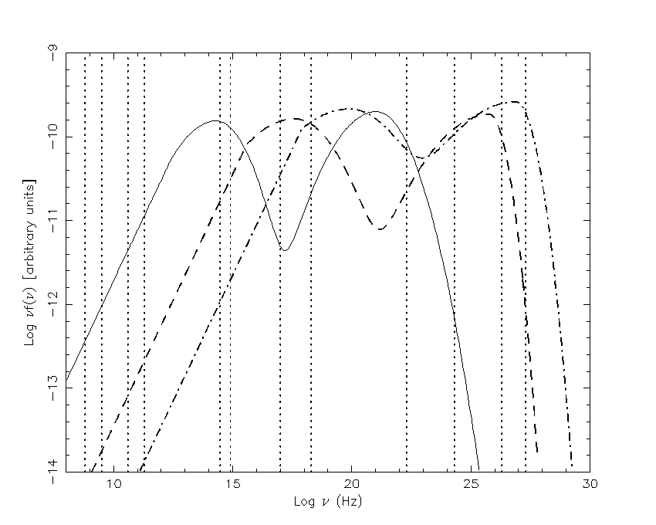
The Blazar Zoo
LSP objects with large Compton dominance in γ-ray
(flat spectra in radio, steep spectra in Fermi)
(U)HSP objects with high flux (no Compton dominance) in γ-rays
(flat spectra in radio, inverted spectra in Fermi)
RG objects with low relativistic boost and extended jets/lobes
(steep spectra in radio, steep spectra in Fermi)
(steep-spectra extended, flat-spectra core emission)
MeerKAT
HESS
MeerKAT
LSP Objects
Compton
Compton
Synch.
HSP Objects
RGs
UHSP Objects ?

Slide 5
Blazars
Detect more than 150 blazars sr⁻¹ with HESS-II at E>30GeV
- Using α_{rTeV} we compute expectations for blazars counts at Radio
- Using α_{ro} we compute expectations for blazars counts at Optical
Detect HSP blazars at z ≈ 1 with MeerKAT (if they exist)
HESS: biased to HSP
SALT: host galaxy study
MeerKAT: biased to LSP ⬇
HESS-II
HESS-II
HESS-II
HESS-II
HESS-II
[Norris etal. 2012]
[HESS Coll. 2012]

Slide 6
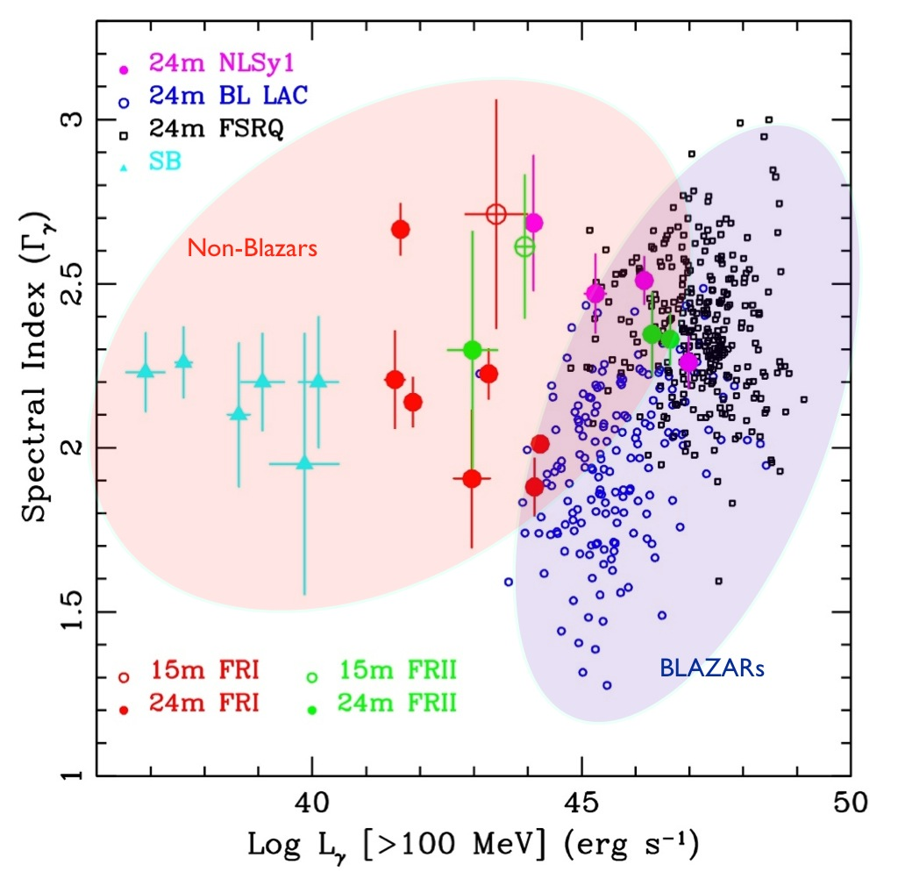
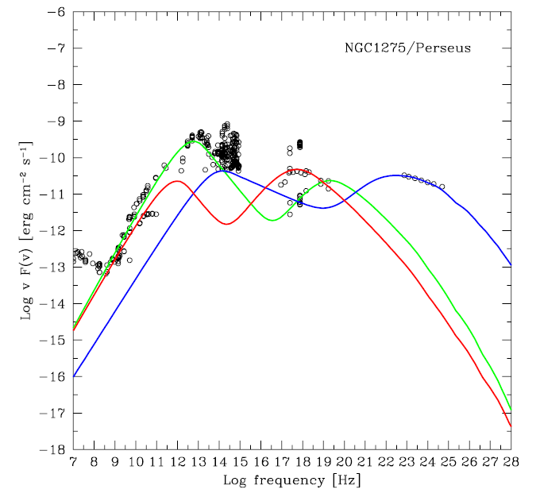
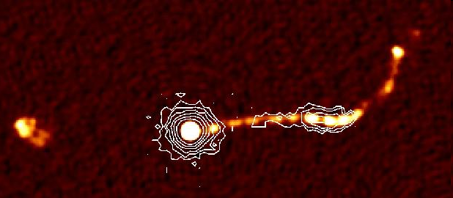
RadioGalaxies
Fermi-LAT: 3% of extragalactic
sources are non-blazars
TeV: 2 radiogalaxies/80 sources
➔Expect larger detection of RGs with HESS-II
NGC1275
Perseus
[S.C. et al. 2010]
RGs show multiple components
More dense/compact emerge at TeV and are visible at radio (high-res)
At ν > 1 GHz
NGC1275 looks
like a blazar
(variable/compact)
At ν < 1 GHz
NGC1275 looks
like a RG
(extended em.)
PKS 0637-752
A 20.1-GHz Compact Array

Slide 7
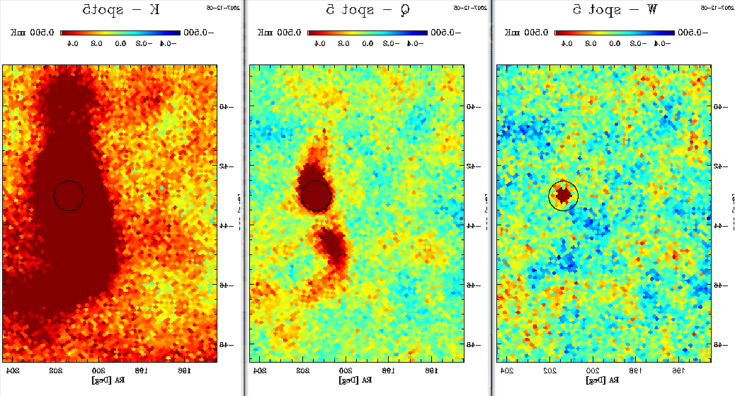
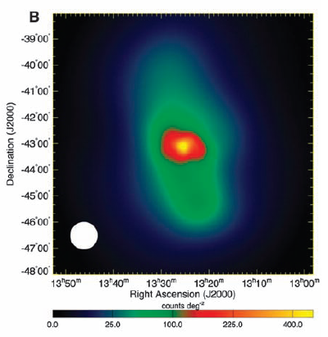
RadioGalaxies
RadioGalaxies
CenA
Fermi
(>200MeV)
23 GHz
41 GHz
70 GHz
Synch
radio
ICS
γ-rays
WMAP
Core radio flux correlates with γ-ray flux
[Norris et al. 2012]
To be
revised

Slide 8
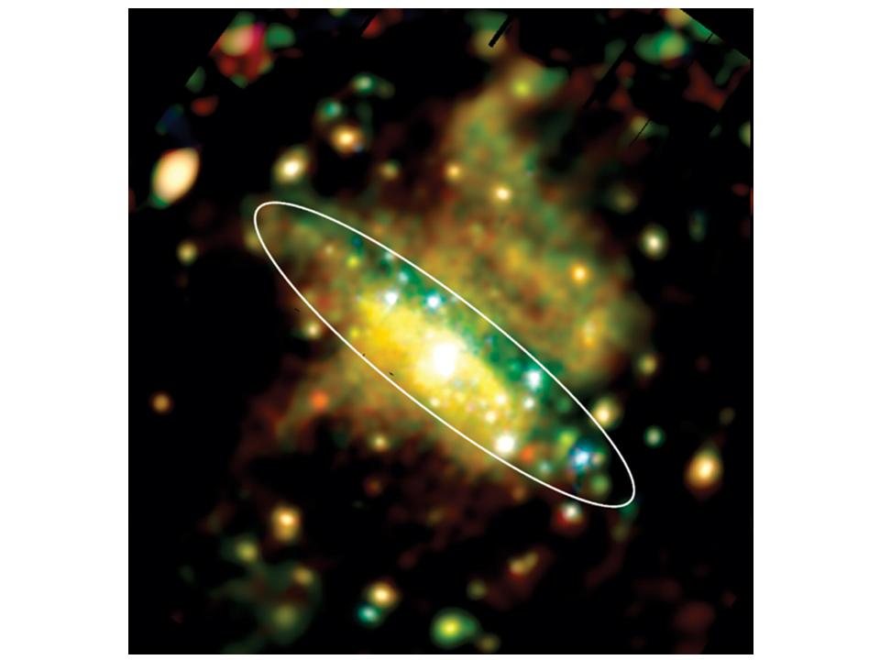
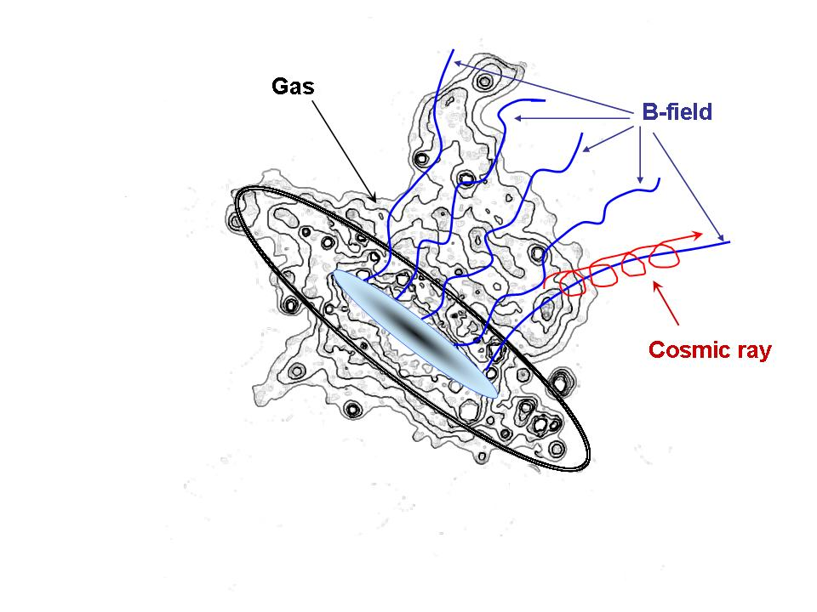
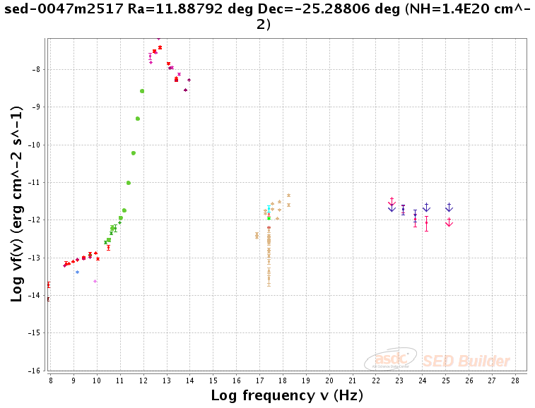
Starburst-StarForming Galaxies
Starburst-SFG: dominant galaxy population at mJy flux level (MeerKAT)
well visible at Optical (SALT)
Few Starburst-SFG seen at TeV
(mini) Jet emission
(Hyp)Wind non-thermal emission
SFR non-thermal emission
NGC253
NGC253
[HESS Coll. 2012]
➔New source pop. with HESS-II
[S.C., Shafi, Marchegiani 2012]

Slide 9
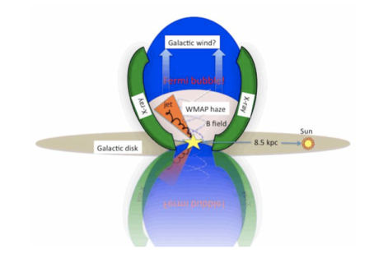
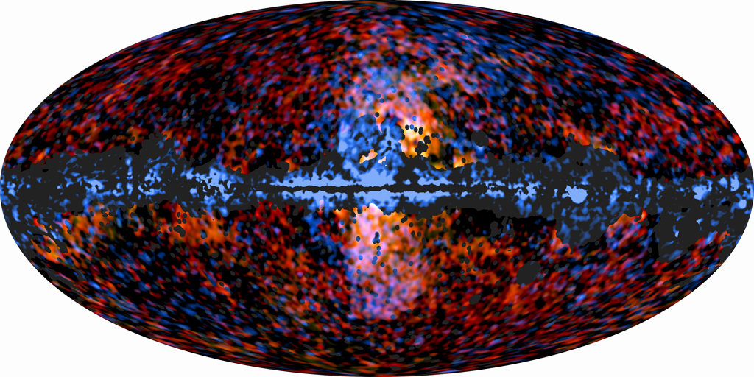
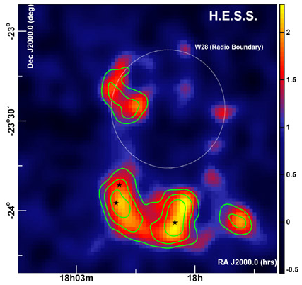
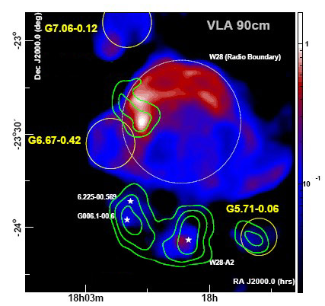
Galaxies (including SNRs)
Our Galaxy shows an outflow of non-thermal particles in the form
of two symmetric bubbles (Wind-driven outflow)
Radio-γ combined study of nearby galaxies with MeerKAT-HESS in search
for non-thermal phenomena in ‘normal’ galaxies:
Non-Thermal Winds
Unresolved SNRs
Unresolved galactic sources (J.VdW talk)
SALT study of galactic bulge structure
and activity
W28
W28

Slide 10
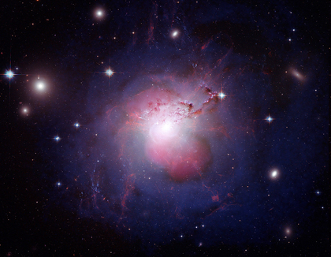
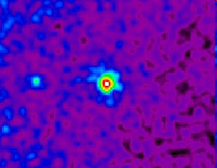
Clusters of galaxies
Perseus cluster
Radio
X-ray
(Fit by hyp.)
Gamma-ray
Optical
Th. Bremsstrahlung
π⁰ decay
Synchrotron
Bremsstrahlung
ICS
X-ray
Galaxy clusters show the presence of various non-thermal
phenomena (Radio halos, Hard X-ray & γ-rays excess)
that are not yet understood.
Fermi
Radio + γ-ray is the key strategy
Optical needed for M estimate (W.L.)
and cluster galaxy study
[S.C. et al.1998- 2012]
Magic

Slide 11
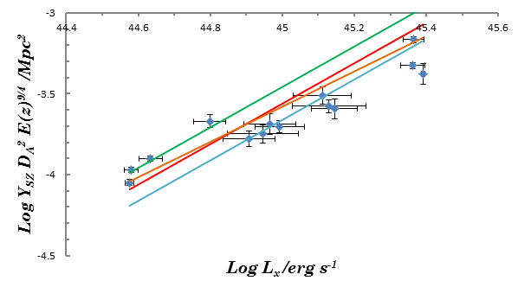
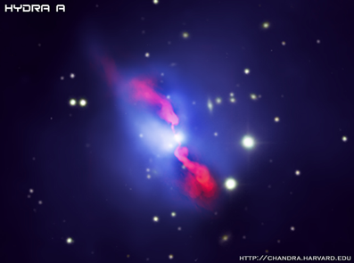
Clusters of Galaxies
≈P_{th}+ P_{nt}
Statistics of Radio halos
Additional physics of clusters
[S.C. etal 2012]
cavities
X=P_{nt}/P_{th}=(0.26±0.04)
RG lobes
SZE
X-rays
≈P_{th}
[HESS Coll. 2012]
MeerKAT
To be
revised
[Norris etal. 2012]

Slide 12
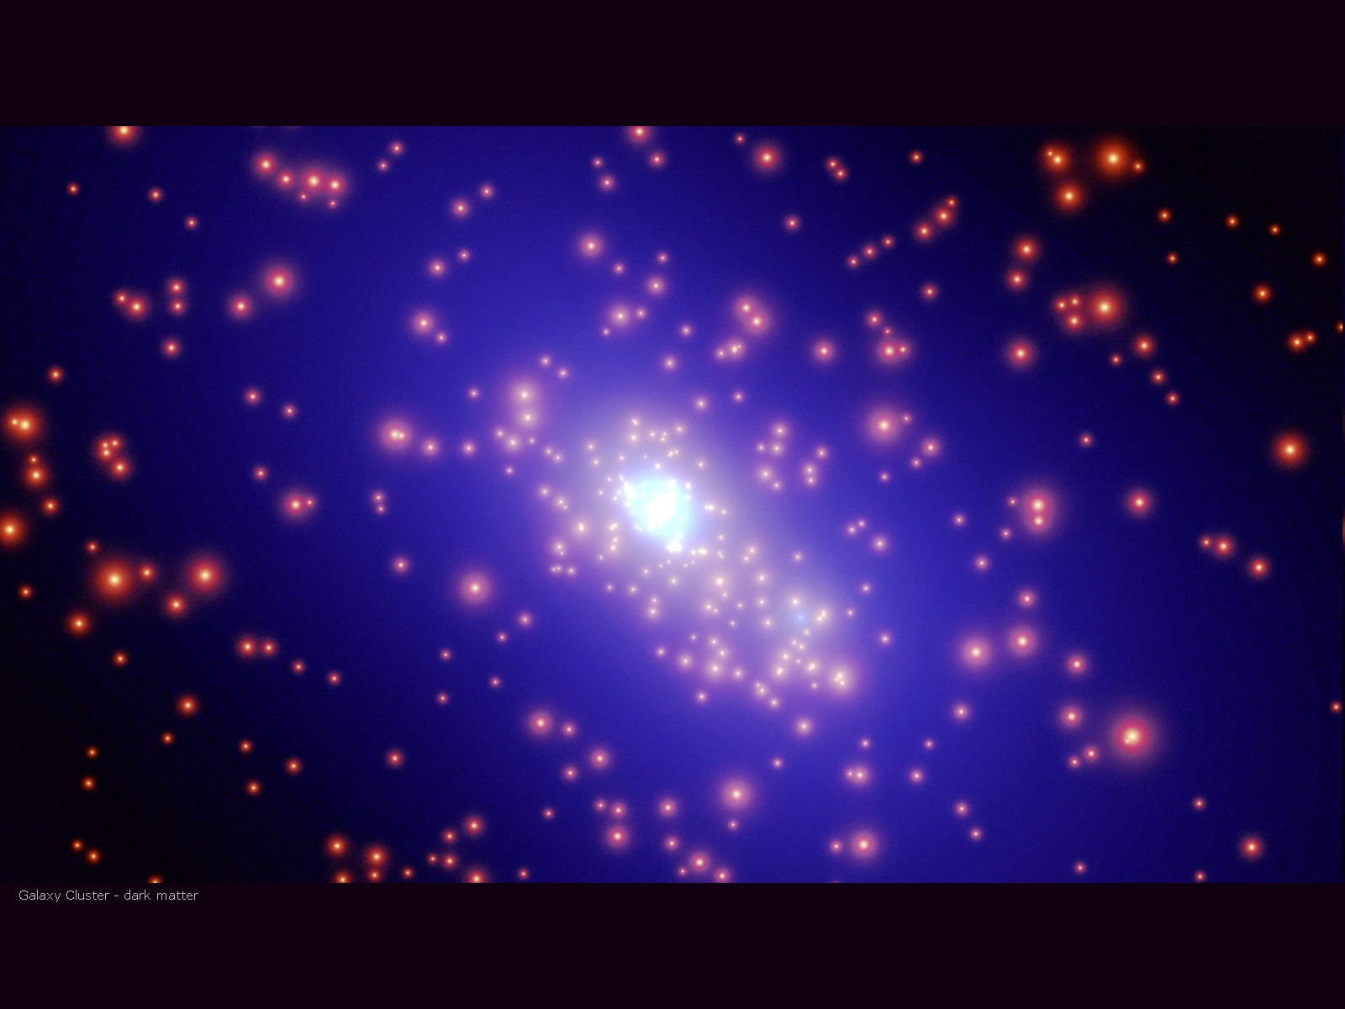
Dark Matter
It is becoming more and more evident that Radio and Gamma-ray emission
are the dominant probes for Dark Matter nature
π±
π⁰
χ
χ
χ
χ
e±
γγ
B
Continuous γ-ray emission
Continuous radio emission

Slide 13
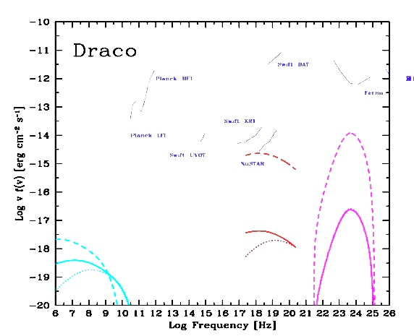
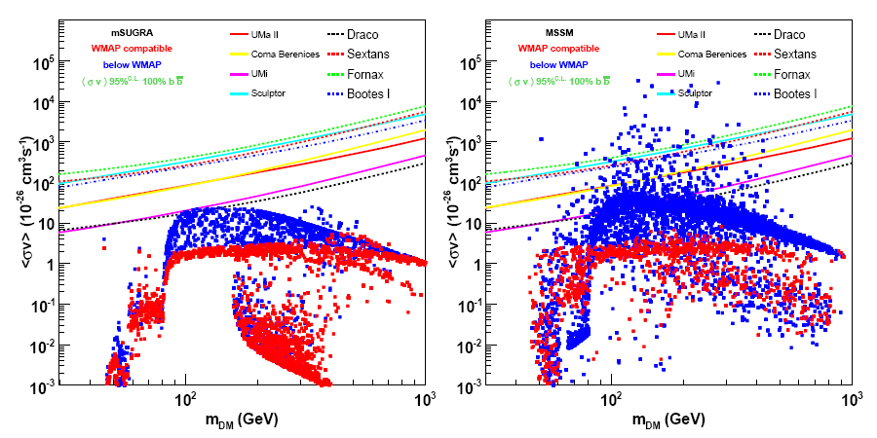
Dark Matter: Radio + γ-rays + O
Carina
DSph
0.1μG
Fermi 2yr
ATCA 121hr
MeerKAT
1μG
SKA-P1
[S.C. et al. 2001-2012]
Fornax
Coma cluster
MeerKAT
HESS-II
SKA
CTA

Slide 14
Cosmology: CRs and B in LSS
Cosmic Ray evolution
in Large Scale Structures
Cluster
region
Radio + γ-rays: crucial
Optical: galaxy id. & nature
Filament
region
Void
region
[Araya-Melo et al. 2012]

Slide 15
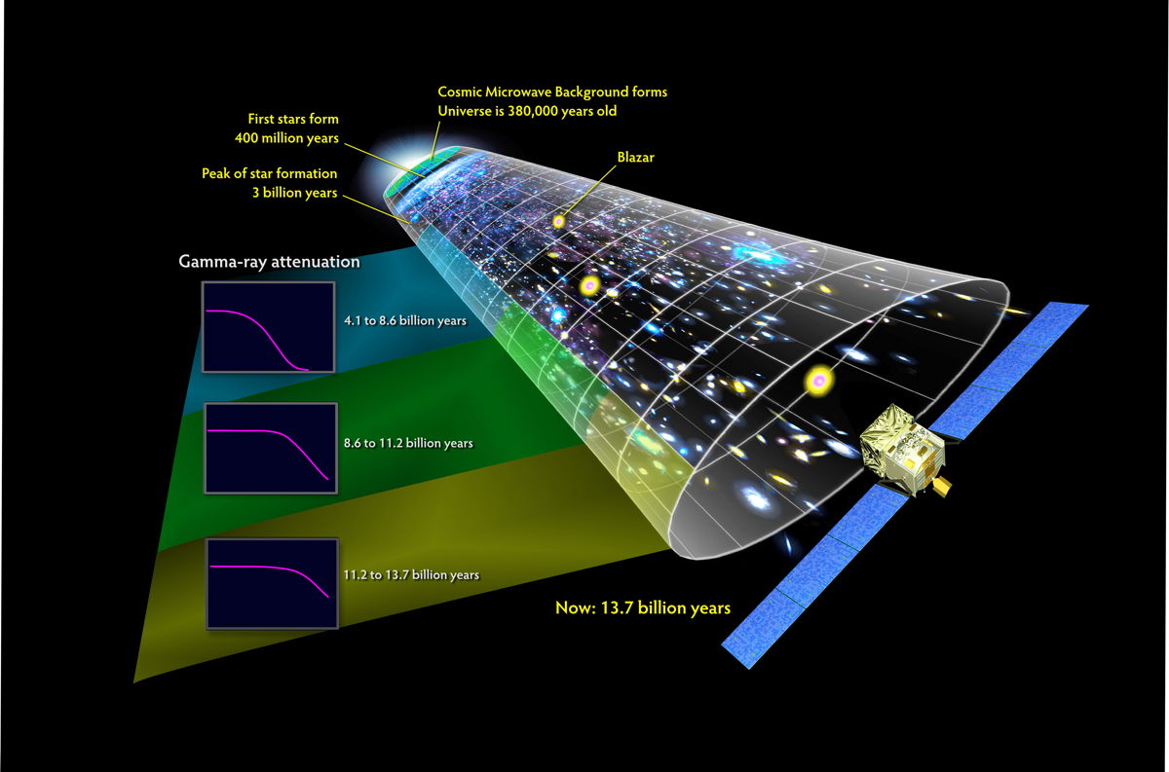
Cosmology: EBL, B, BHs, DM
EBL nature
Attenuation and spectral
distortion of distant γ-ray sources
depends on the EBL (IR,O)
Gamma: crucial signal
Radio: Blazar study
O/IR: foreground
Axion DM
Conversion of Blz γ-ray photons
into Axions in the B_{IGM}.
IGM B-field
Limits on B_{IGM} from secondary e±
ICS-on-CMB cascade emission
(t & spatial features depend on B)
MeerKAT: AGN continuum + FR study
HESS : EBL nature, Axions, B_{IGM}
SALT : AGN id + host galaxies

Slide 16
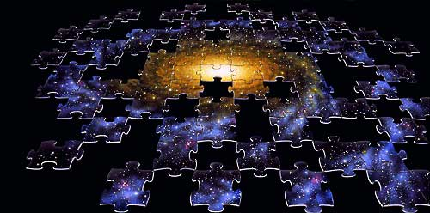
THANKS
for your attention !

