Slide 1

Herschel-SALT-MeerKAT
Study -- Lensed Submm Galaxies plus more, exploiting submm surveys –
ASTROPHYSICAL
TERAHERTZ
LARGE
AREA
SURVEY
Lerothodi Leeuw
University of South Africa
in collaboration with the H-ATLAS team
(http://www.h-atlas.org/)

Slide 2
Outline
H-ATLAS – Lensing Project
H-ATLAS first fields
Gravitational Lenses in H-ATLAS Context
SDP sources >100mJy + 5 Lens Candidates
Evidence for Lensing and Results
Deep Optical, Submm, and Radio Follow-up
Results + SALT-MeerKAT Opportunities
Some Lessons from H-ATLAS Lensing + More
On-going and Follow-up Work
** Multi-waveband Astronomy at Work **

Slide 3
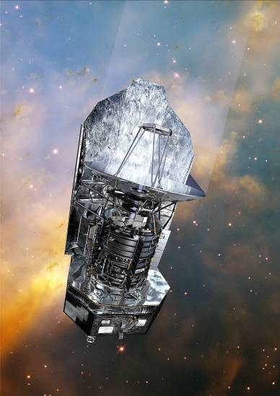
The Hershel-ATLAS
ASTROPHYSICAL
TERAHERTZ
LARGE
AREA
SURVEY
The Hershel
Space Observatory
Largest Open Time Key Project on Herschel (Eales et al. 2010)
600 hours for about 550 deg²
PACS+SPIRE: 110, 160, 250, 350, and 500μm
~9’’, ~13’’, ~20’’, ~30’’,and ~40’’
Led by Steve Eales (Cardiff) & Loretta Dunne (Nottingham + NZ ) + 150 co-­‐Is

Slide 4
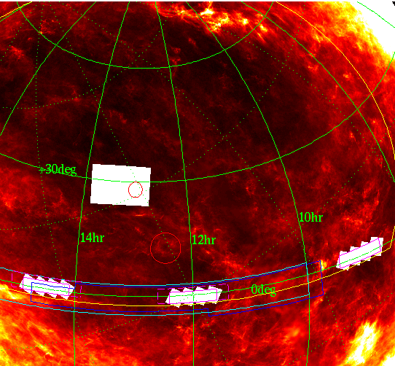
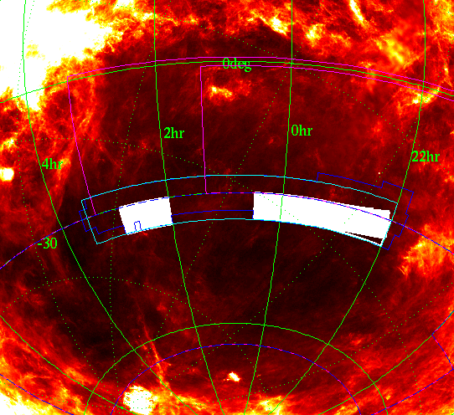
NGP and Equatorial
SGP
Fields chosen to allow maximum overlap with existing and planned surveys
2dF, SDSS, GAMA, KIDS, VIKING, PanSTARRS, DES, SPT, SASSy
and to be accessible to new facilities which will be valuable for follow-up
ALMA, SKA and prototypes, SCUBA2, LOFAR, e-MERLIN

Slide 5
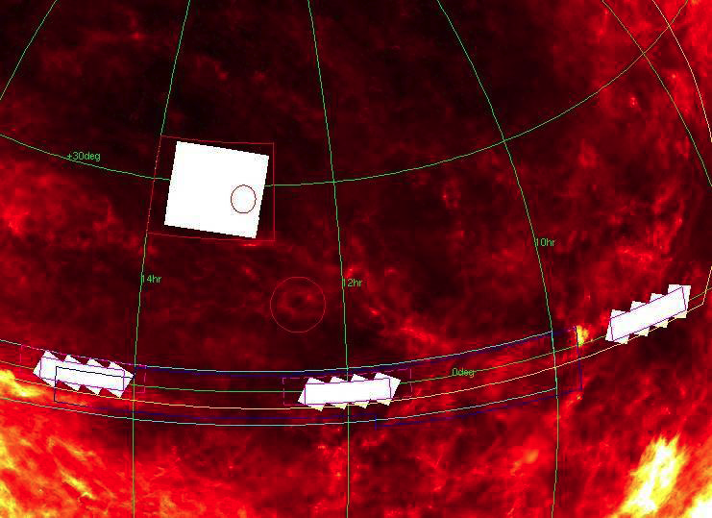
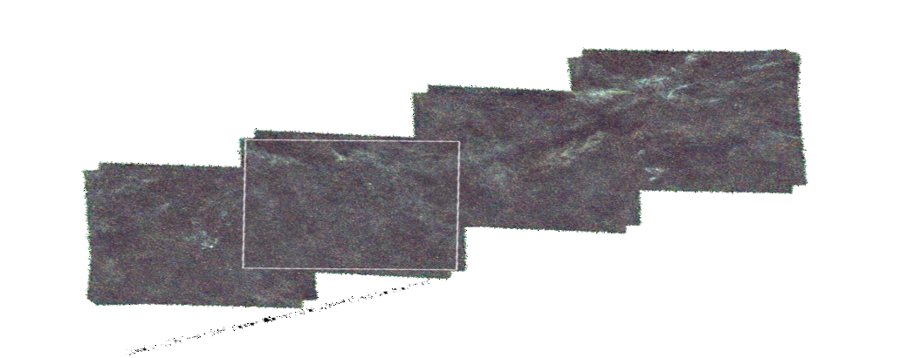
The H-ATLAS SDP-field
(~4x4 deg² )
NGP and Equatorial
SDP-field

Slide 6
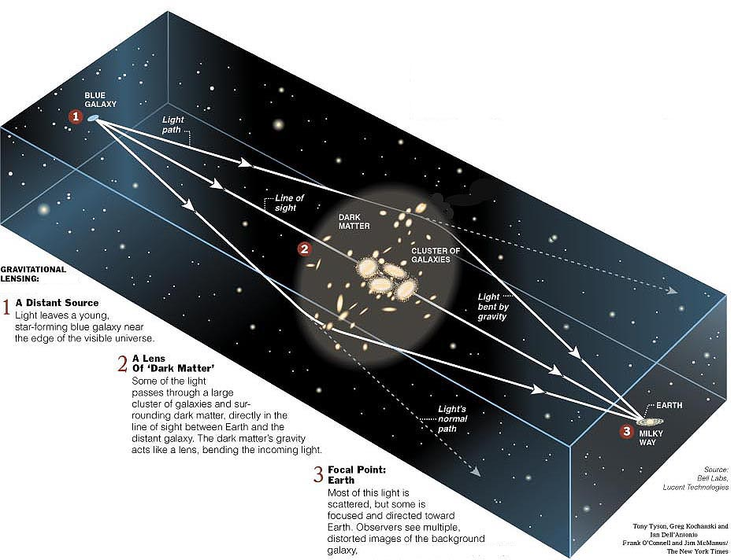

Slide 7
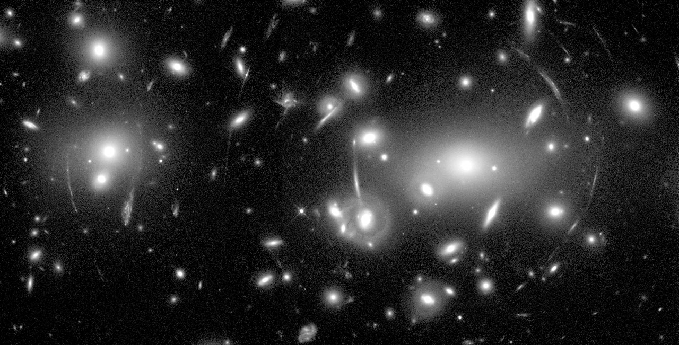
In conversation with
Hubble Space Telescope Image of Abell 2218

Slide 8

The H-ATLAS SDP-field
(~4x4 deg² )
> 6000 sources extracted
Rigby et al. 2010, Smith et al. 2010
5 Lensed SMG Galaxies
out of 11 sources with S_{500μm} > 100 mJy
Negrello et al. 2007, 2010 (Science)

Slide 9
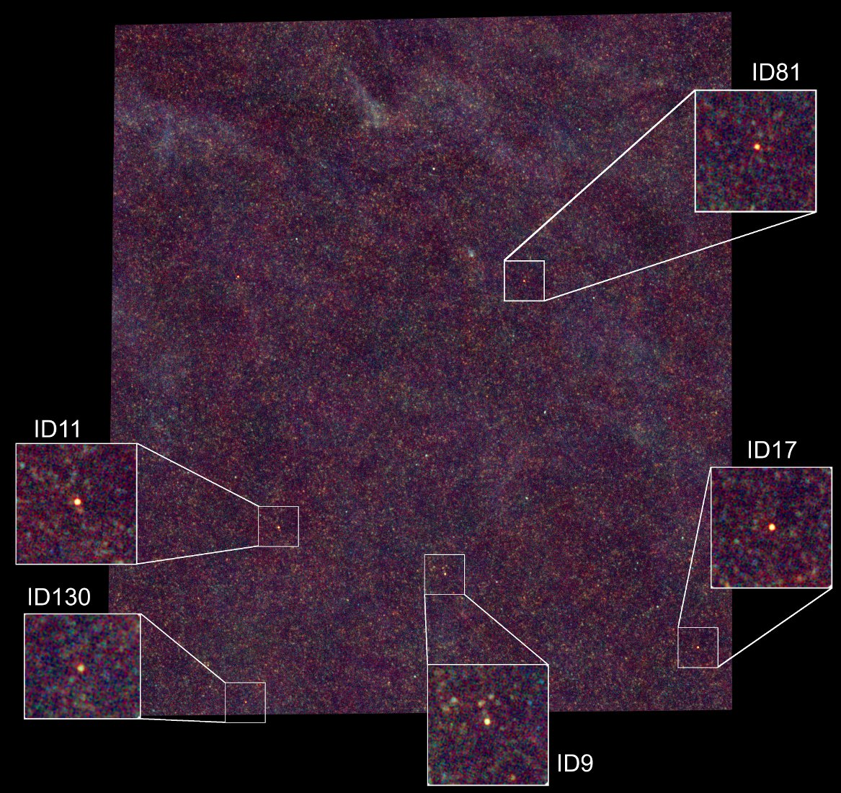
The Hershcel
Space Observatory
Herschel-ATLAS Gravitationally Lensed Galaxies

Slide 10
The H-ATLAS: Gravitational Lensing Project – lead by M. Negrello and S. Serjeant
submm surveys are ideal for finding lenses because
SMGs are at high redshifts -> high lensing efficiency
SMGs have steep number count -> strong magnification bias (Chapman et al. 2005, Coppin et al. 2006)
@ 2 & 1.2 mm radio
galaxies dominate, with
small excess due to SMGs
(Vieira et al. 2010)
@ 0.5mm, 1 to 2 Galaxy-
Galaxy Lensed SMGs
found / (degree)²
(Negrello et al. 2007, 2010)

Slide 11
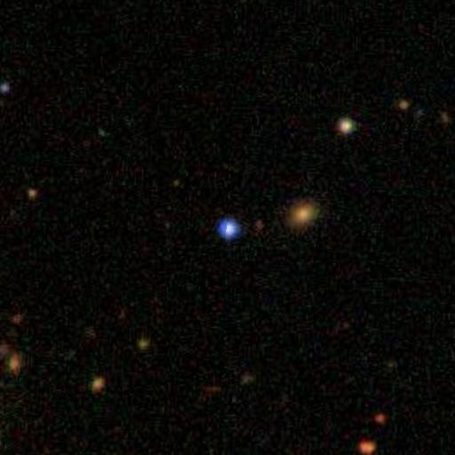
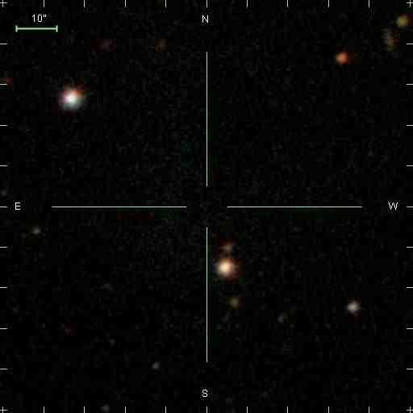
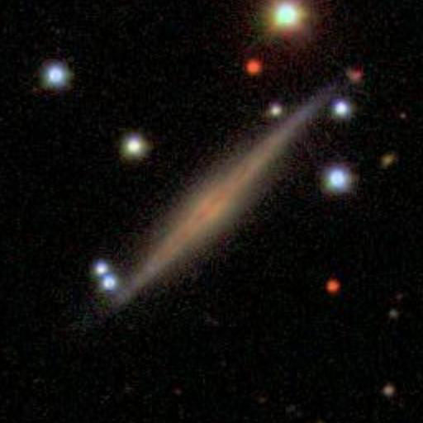
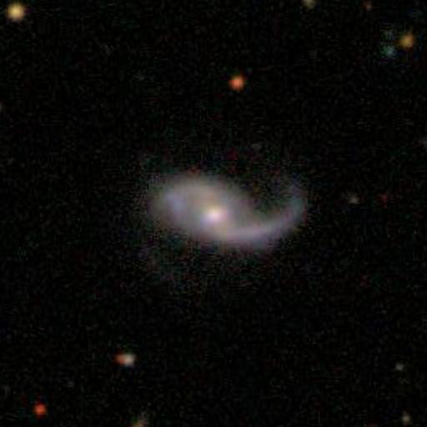
The H-ATLAS SDP-field
(~4x4 deg² )
QSO
Galactic blob
6000 sources extracted
11 sources with S_{500μm} > 100 mJy
A bright radio QSO (z=1.02)
A Galactic blob
Four local Late-type Galaxies (z<0.1)
ID 5
ID 7

Slide 12
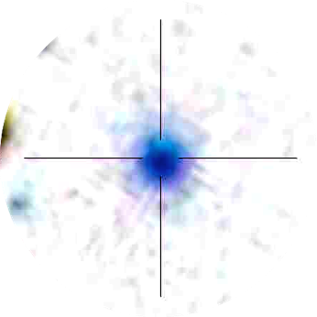
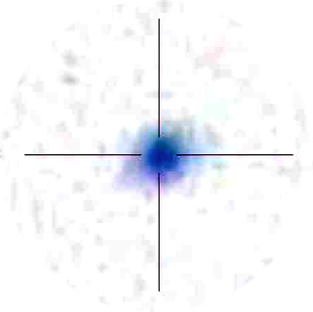
Five Lens Candidates

Slide 13
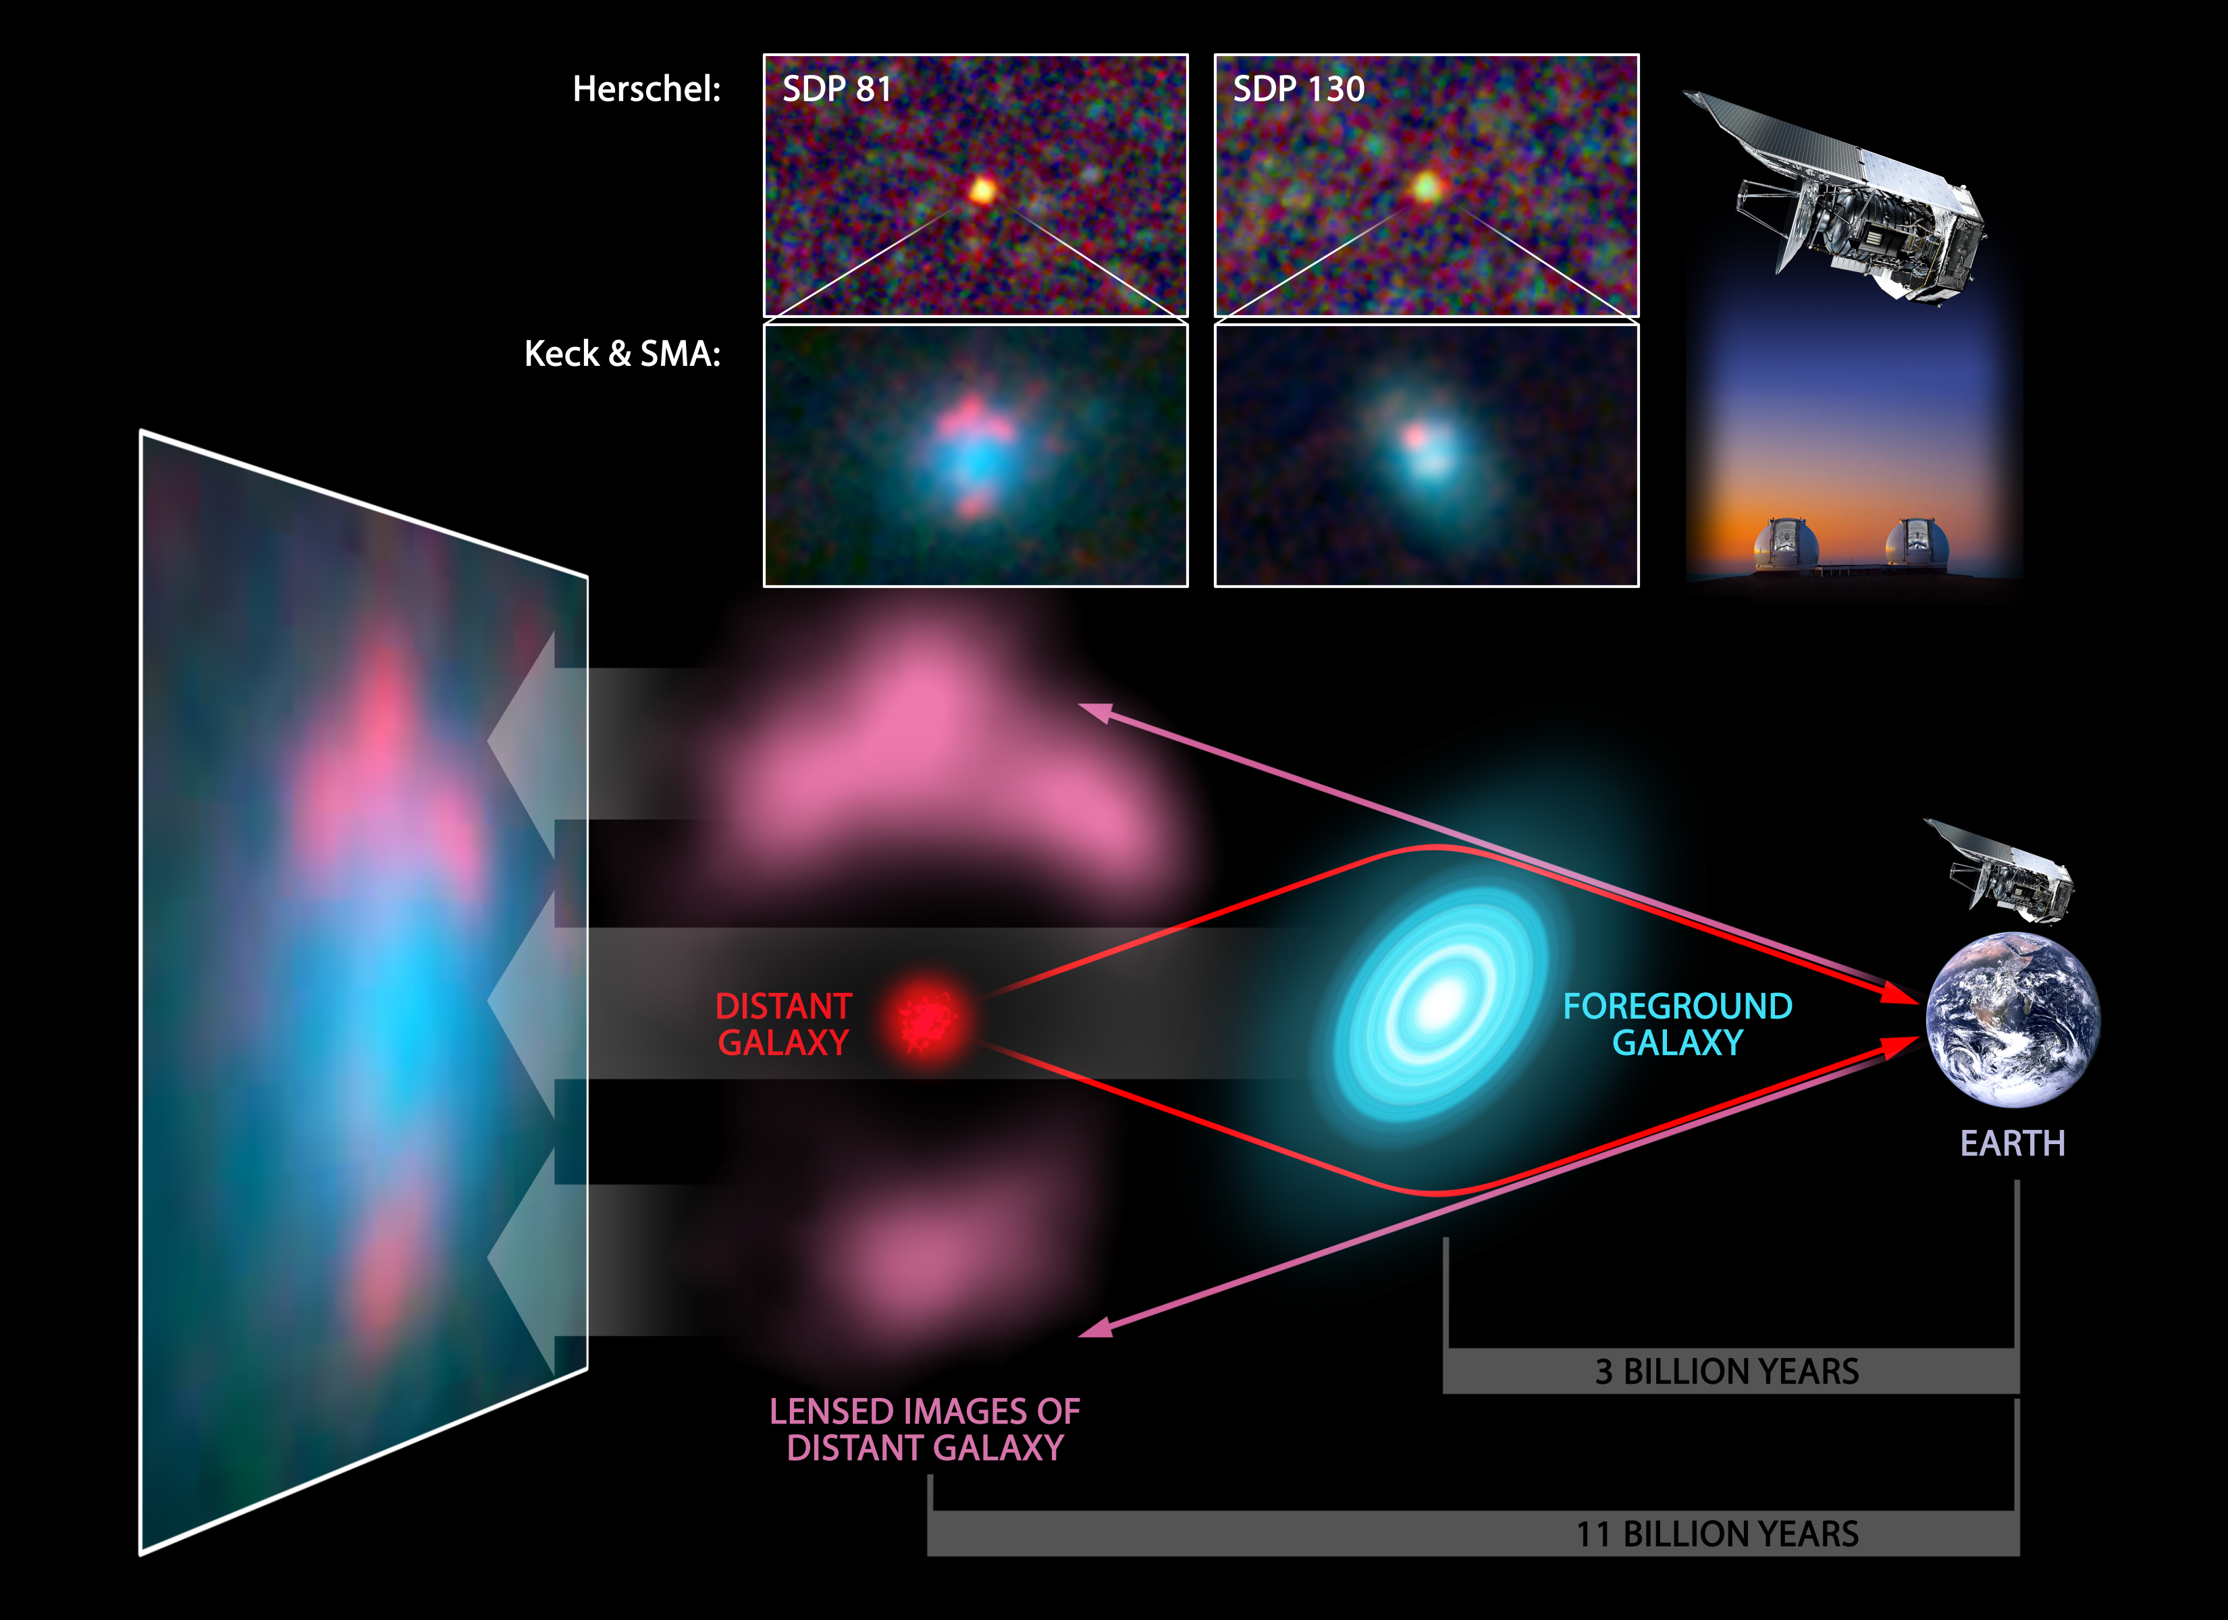
SALT & MeerKAT
SALT & MeerKAT
CREDITS: ESA/NASA/JPL--‐Caltech/Keck/SMA

Slide 14
CARMA CO(2-1) and CO(3-2) Imaging of ID9 and ID17b
Leeuw, Riechers, Carpenter, H-ATLAS
et al. (2012, in prep).

Slide 15
CARMA CO(2-1) and CO(3-2) Dynamics of ID9 and ID17b
Leeuw, Riechers, Carpenter, H-ATLAS
et al. (2012, in prep).

Slide 16
KECK Imaging and CARMA CO Maps of H-ATLAS G12H29 (z=3.259), a possible proto-Galaxy also detected with Planck
Left: Fu et al 2011. Right: Leeuw et al. in prep
SALT: Lens Redshift + MeerKAT: Masers + Conti + >> z CO

Slide 17
CARMA CO(4-3) maps of H-ATLAS G12H29 (z=3.259),
a possible proto-Galaxy also detected with Planck
Left: CARMA B-Array. Right: CARMA D-Array. Visibility Plane Lensing Fitting Models in Development, Leeuw, Riechers, Bussman, Rahman, H-ATLAS et al. in prep
SALT: Lens Redshift + MeerKAT: Masers + Conti + >> z CO

Slide 18
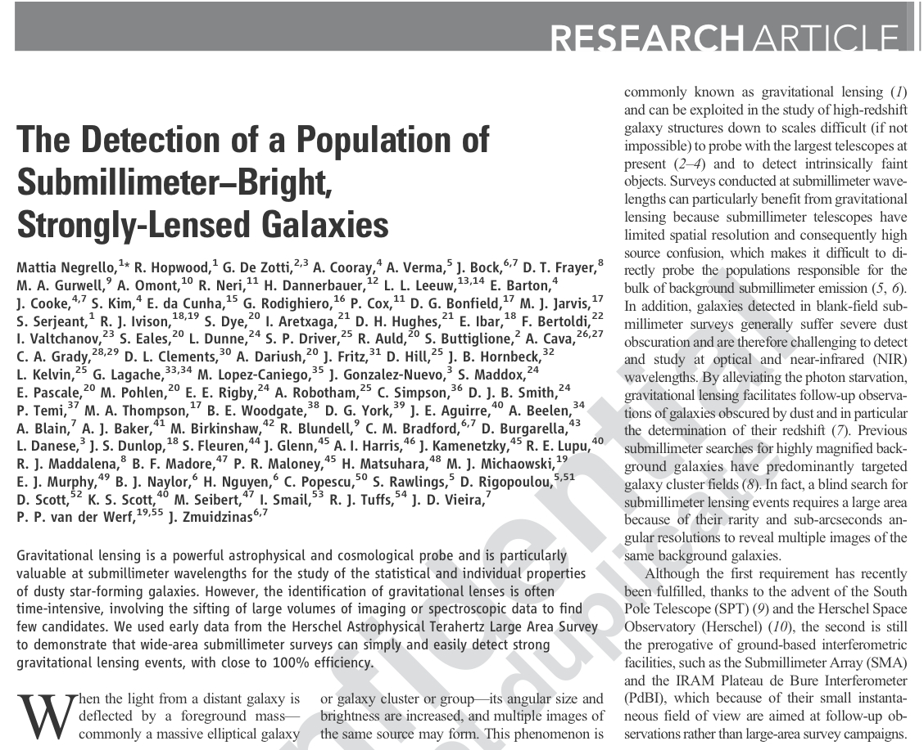
Proof of concept paper in Science, Nov 5th, 2010

Slide 19
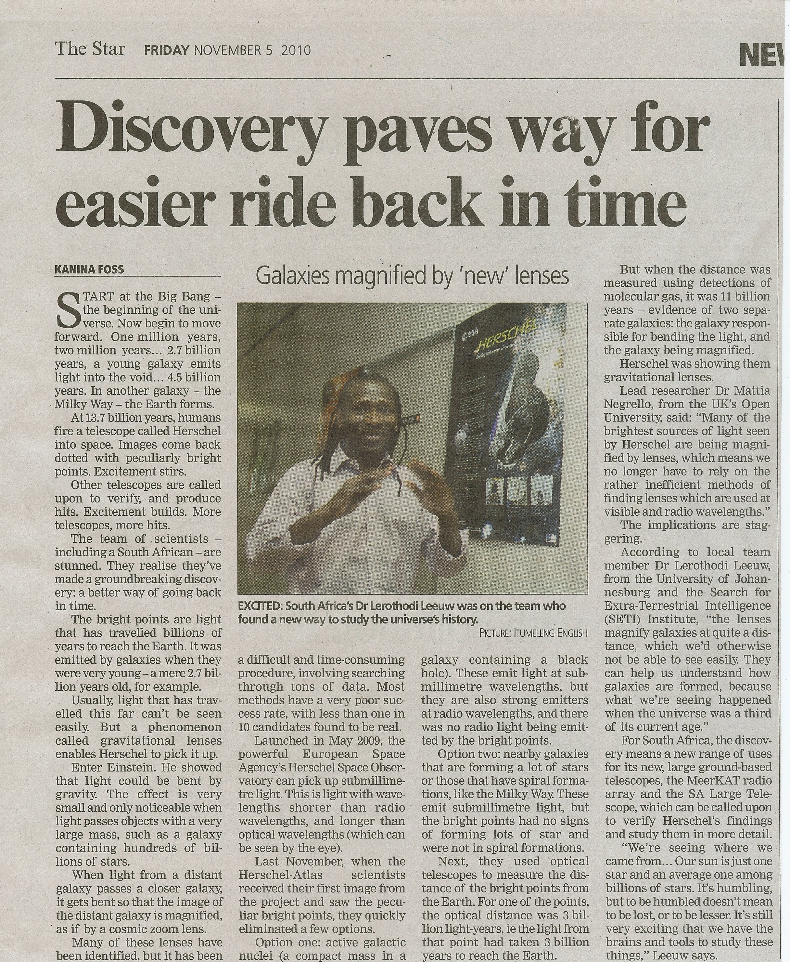

Slide 20
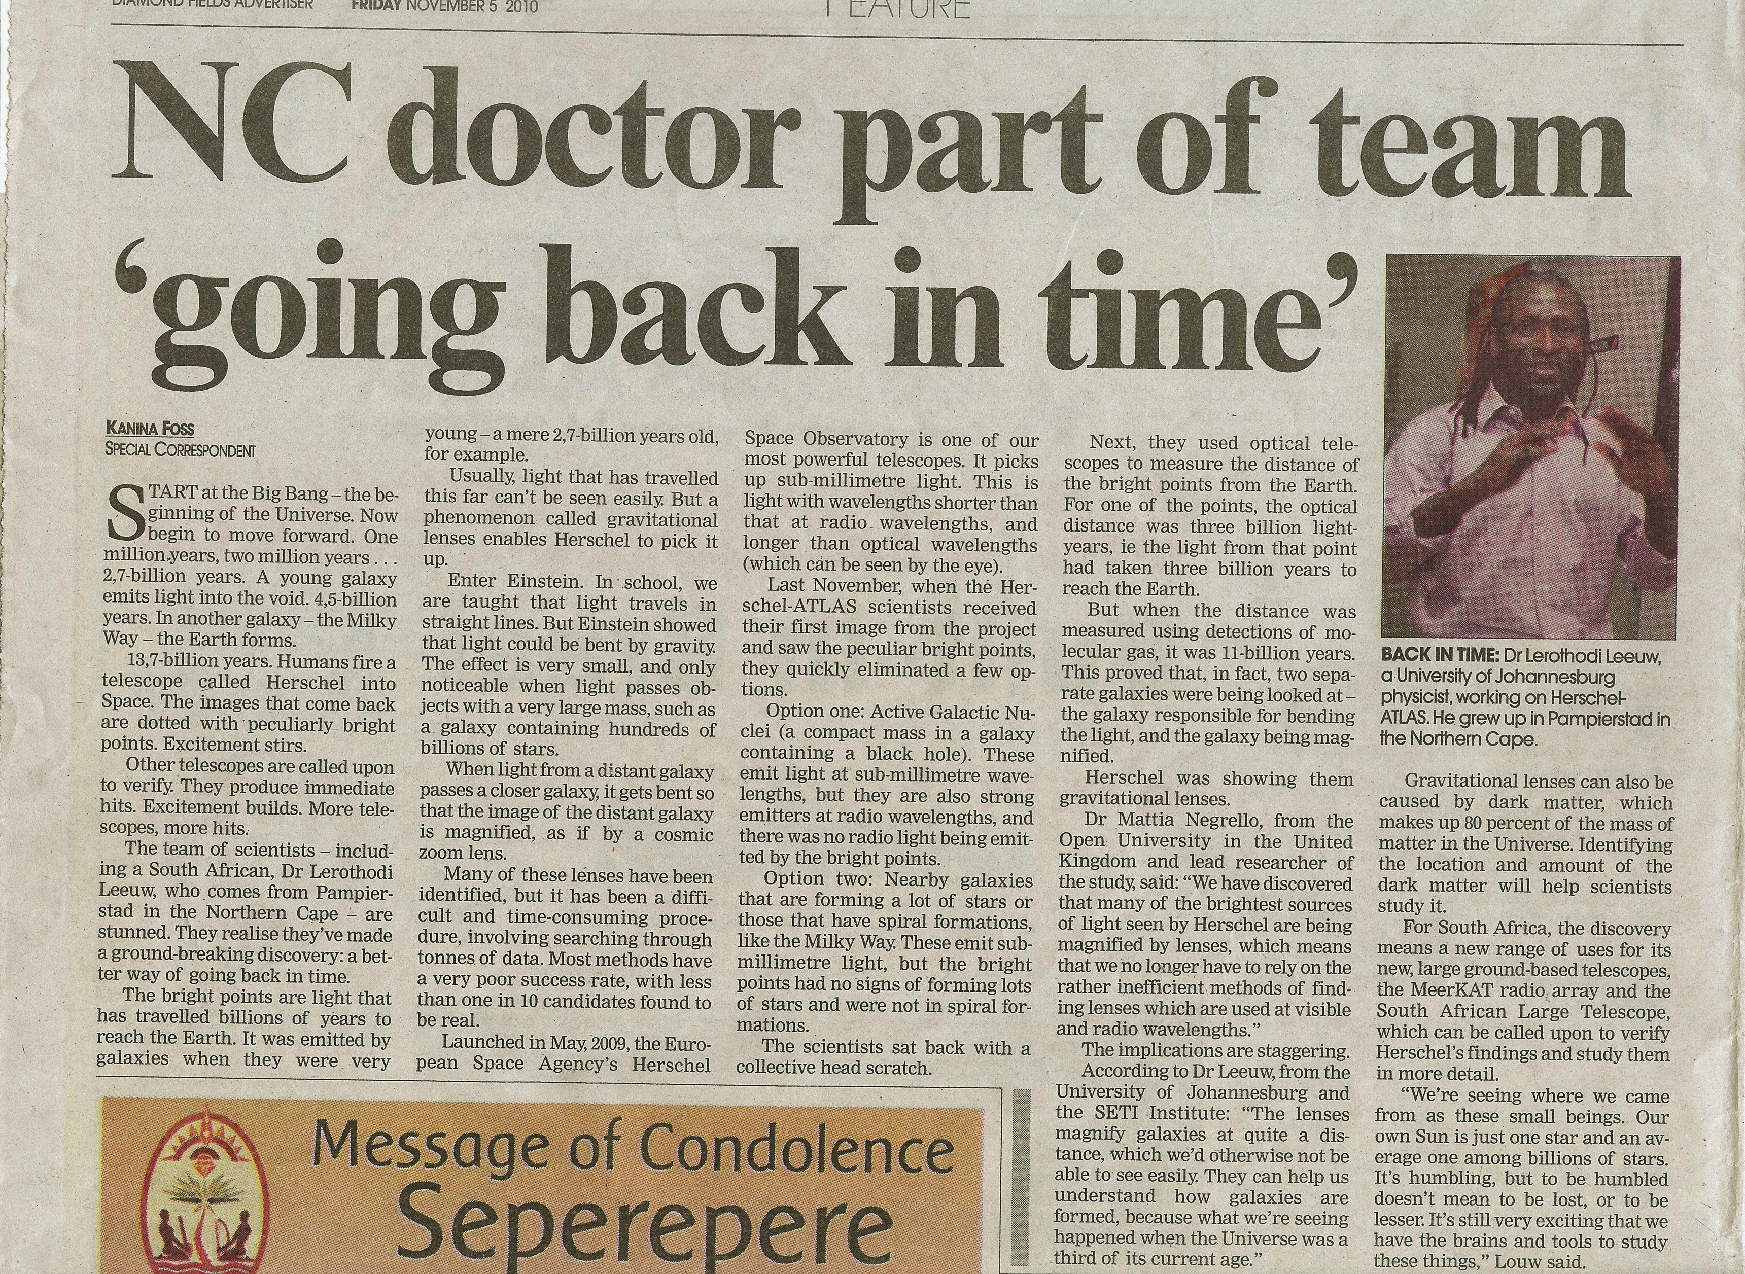

Slide 21
Key Lessons (1)
The method is working
Sample of >100 sub--‐mm bright lenses in full H-ATLAS
We can explore a wide range of lens redshift and mass
Constraints on the cosmic evolution of mass profile of
Ellipticals
The counts of un--‐lensed SMGs are steep
HLIRGs are very rare (<0.4 deg--‐2 at 99% CI)

Slide 22
Key Lessons (2)
These lensed SMGs are invisible in the optical
submm photo-z + CO redshifts are crucial
(Frayer et al. 2010, Lupu et al. 2011, Krips et al. in prep)
High-resolution at submm and radio mapping is crucial
SMA, PdBI, CARMA, VLA, ALMA, MeerKAT, SKA are key
(Krips et al. in prep, Leeuw et al. in prep, Ivan et al. in prep..)
We can detect the lensed morphology with Spitzer
HST/WFC3 NIR follow--‐up feasible (Hopwood et al. 2011)

Slide 23
Herschel + SALT + MeerKAT
Lensed SMGs and Lensing optical galaxies + HLIGS
submm & radio CO z and imaging + SALT redshifts + Lyma
(e.g. Fu et al. 2011, Bussman et al. 2011, Leeuw et al. in prep)
Masers in the Lensed SMGs + HLIGS
eVLA, MeerKAT are key
(Ivison et al. .)
Proto-clusters, Pro-planetary systems, Radio Galaxies + QSOs
SALT redshifts + MeerKAT imaging + (Thompson et al., Jarvis et al., …)

Slide 24
SALT & MeerKAT
SALT & MeerKAT
CREDITS: ESA/NASA/JPL--‐Caltech/Keck/SMA

Slide 26
Herschel – SALT - MeerKAT
These lensed SMGs are invisible in the optical
submm photo-z + CO redshifts are crucial
(Frayer et al. 2010, Lupu et al. 2011, Krips et al. in prep)
High-resolution at submm and radio mapping is crucial
SMA, PdBI, CARMA, VLA, ALMA, MeerKAT, SKA are key
(Krips et al. in prep, Leeuw et al. in prep, Ivan et al. in prep..)
We can detect the lensed morphology with Spitzer
HST/WFC3 NIR follow--‐up feasible (Hopwood et al. 2011)

Slide 27
Initial Papers

Slide 30
On-going and Follow-up Work
(not a complete list)
HERSCHEL: More H-ATLAS fields + New Approved Large programs
HST/WFC3 NIR: April 2011 (for the 5 lenses in Science)
SMA Legacy Proposal: submitted and approved (H-ATLAS+HerMES) : About 20 targets from H‐ATLAS GAMA‐9h and GAMA‐15
IRAM/MAMBO photometry (B--‐rated) ~100 targets from all the 3 GAMA fields (priority to 500 μm risers)
APEX/Z--‐spec + GBT/Zpec: Blind CO redshifts
IRAM/PdBI: (A and B‐rated)•high‐res CO (and continuum) imaging in high‐J transition•semi‐blind CO spectroscopy, with 3.5 < zphot < 5.4
CARMA: Approved imaging program of ~10 targets lead by Leeuw, L
ALMA SV: A few proposals in preparation or submitted
---- below is said NOT on behalf of H-ATLAS team
MeerKAT and SALT (programs to be proposed – efficiency + impact)
Interested students and postdocs please talk to or email me (this is hip)!

Slide 31
On-going and Follow-up Work
(not a complete list)
HERSCHEL: More H-ATLAS fields + New Approved Large programs
HST/WFC3 NIR: April 2011 (for the 5 lenses in Science)
SMA Legacy Proposal: submitted and approved (H-ATLAS+HerMES) : about 20 targets from H‐ATLAS GAMA‐9h and GAMA‐15
IRAM/MAMBO photometry (B--‐rated) ~100 targets from all the 3 GAMA fields (priority to 500 μm risers)
APEX/Z--‐spec + GBT/Zpec: Blind CO redshifts
IRAM/PdBI: (A and B‐rated)•high‐res CO (and continuum) imaging in high‐J transition•semi‐blind CO spectroscopy, with 3.5 < zphot < 5.4
CARMA: Approved imaging program of ~10 targets lead by Leeuw, L
ALMA SV: A few proposals in preparation or submitted (Leeuw, L et al.)
---- below is said NOT on behalf of H-ATLAS team
MeerKAT and SALT (programs to be proposed – efficiency + impact)
Interested students and postdocs please talk to or email me (this is hip)!

Slide 32
Proof of concept paper in Science, Nov 5th, 2010

Slide 35
Possible Lessons or Comments for ACT??
mm populations dominated by sync with some dusty galaxies or SMGs present ({H}ULIGS)
  your second (and third) band data will elucidate this
SZ cluster lens searches possible with new sensitive broadband IR to submm detectors
  also useful for SZ cluster morphology/substructure!
current SMG z follow-up easier than before
  at cm to submm single dishes and arrays!
thanks for the invitation and nice meeting
  and thanks for your interest in local (astro) research

Slide 36
The H-ATLAS SDP-field
(~4x4 deg² )
> 6000 sources extracted
Rigby et al. 2010, Smith et al. 2010
11 sources with S_{500μm} > 100 mJy

Slide 37
The H-ATLAS SDP-field
(~4x4 deg² )
From 11 sources with S_{500μm} > 100 mJy
A bright radio QSO (z=1.02)
A Galactic blob
Four local Late-type Galaxies (z<0.1)

Slide 38
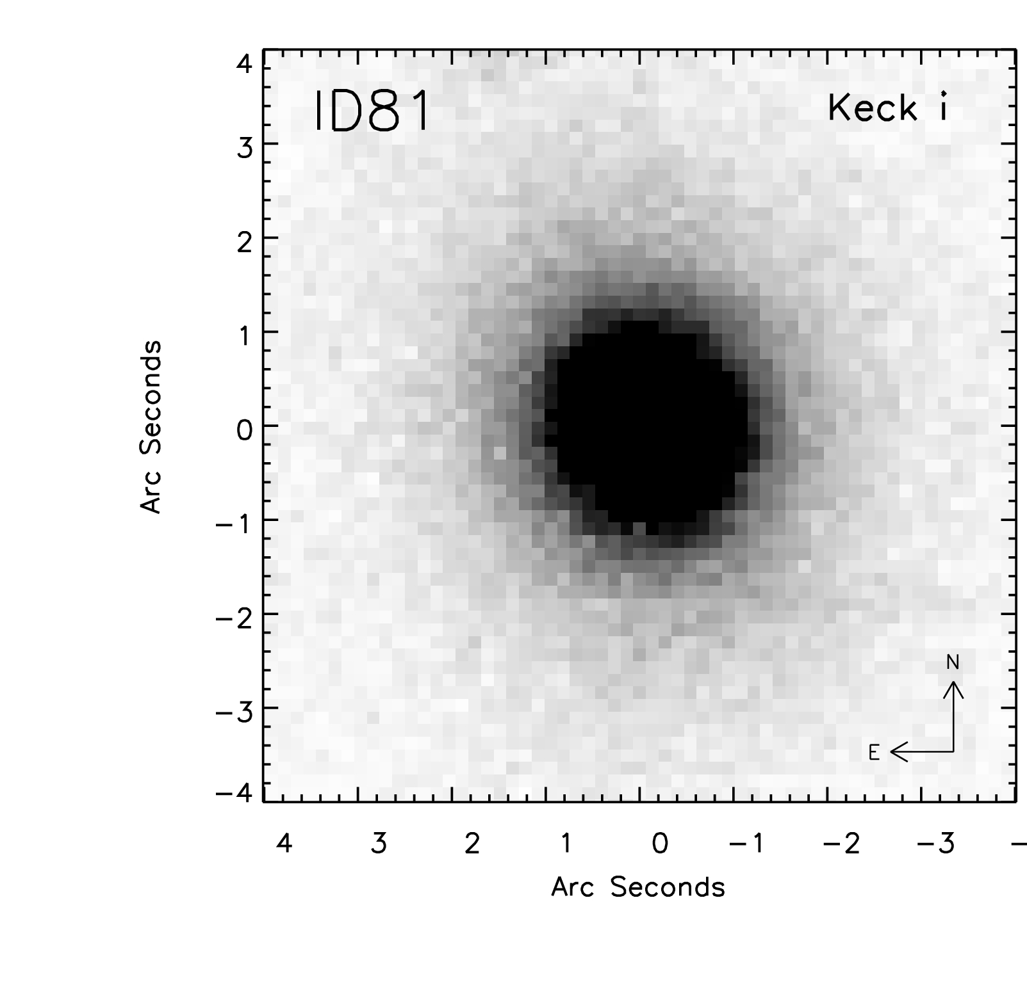
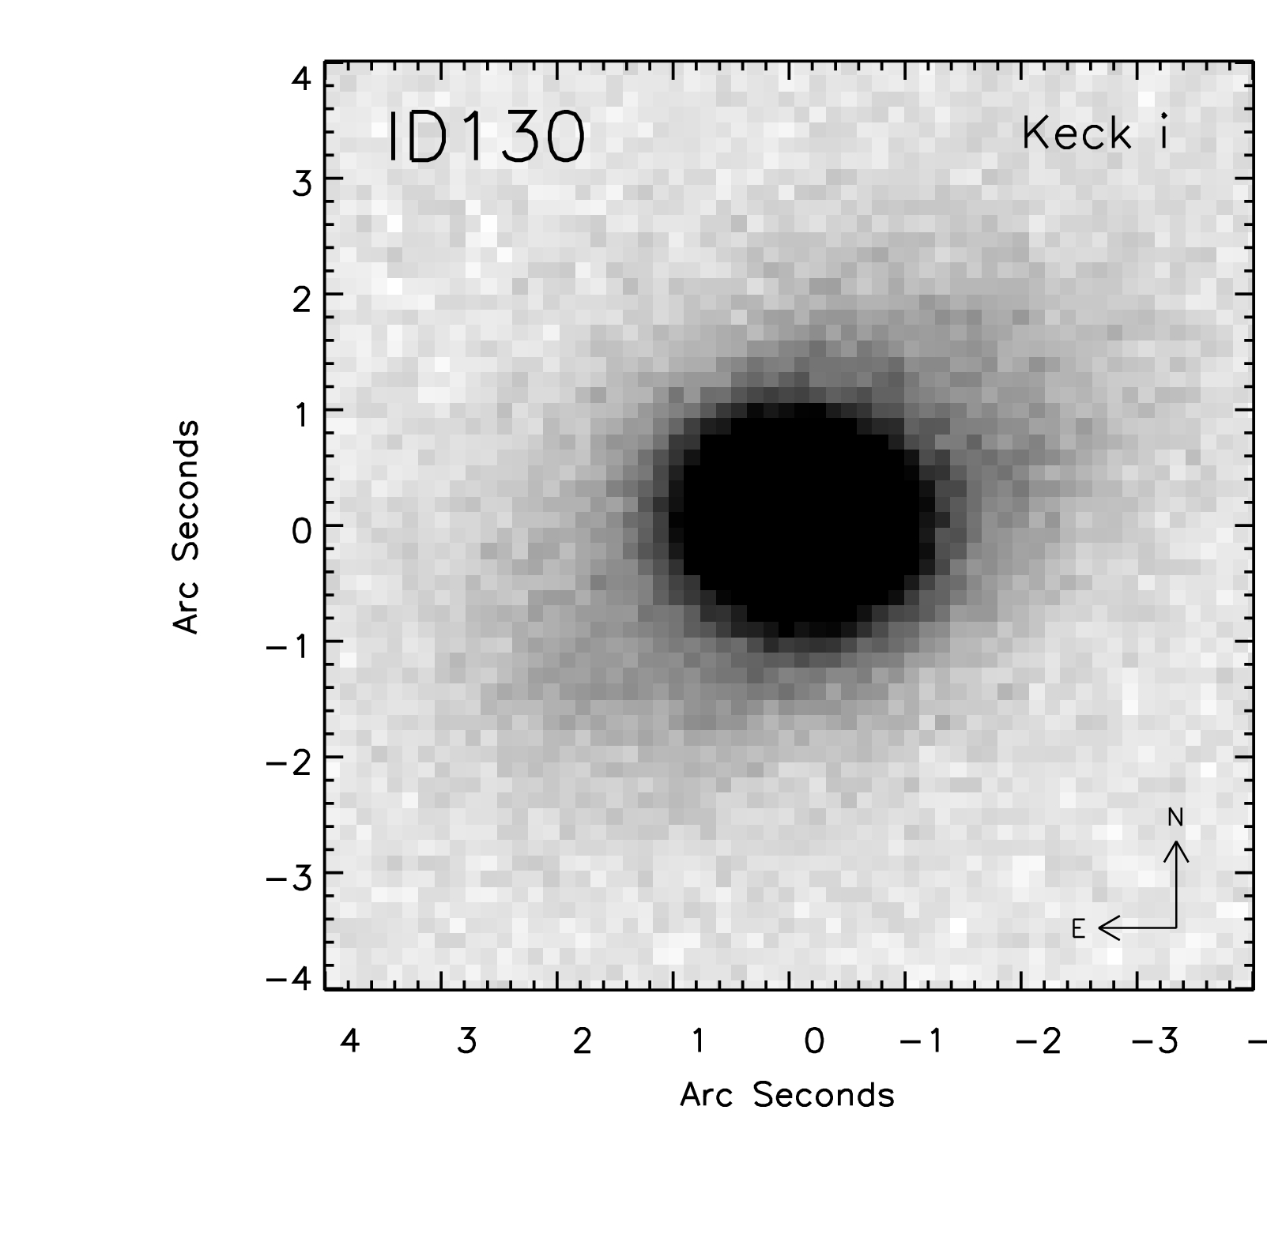
Evidence for Gravitational Lensing –
(1) Optical SDSS counterpart
  (a) Elliptical morphology (from Keck follow-up)
  (b) Highly reliable association with H-ATLAS source

Slide 39
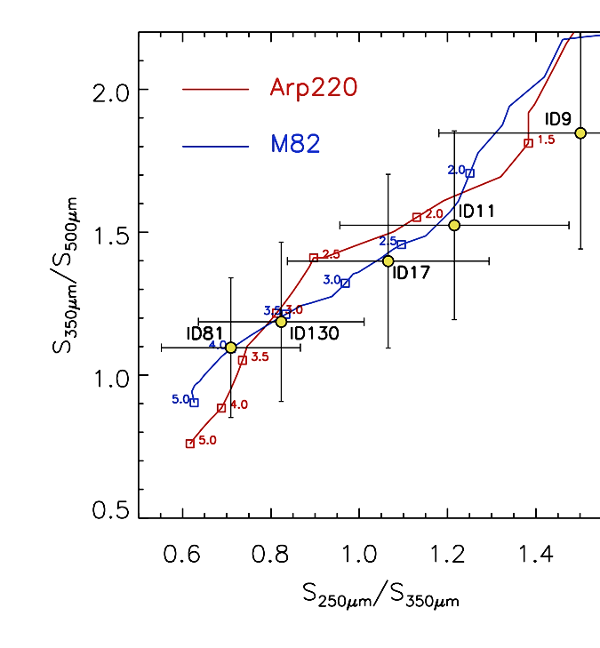
Evidence for Gravitational Lensing –
(2) Redshifts and SEDs
z_{opt} ≠ z_{submm},z_{CO}
UV/optical/near– IR SED inconsistent with the submm SED

Slide 40
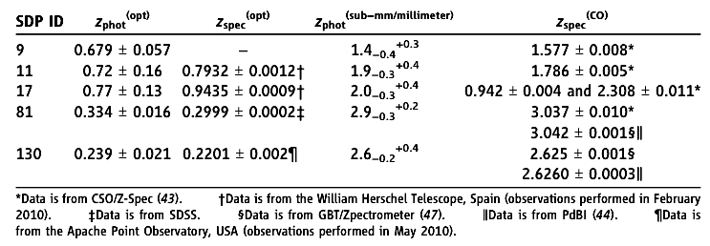
z_{opt} ≠ z_{submm},z_{CO}

Slide 41
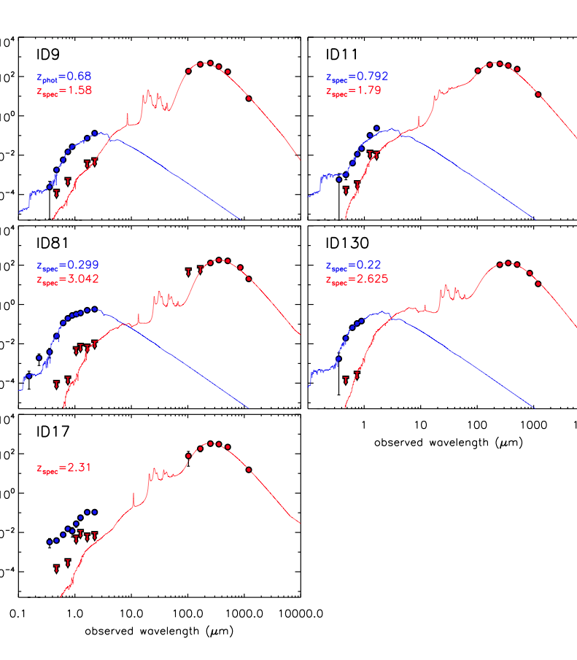
SEDs
Blue for Ellipticals
Red for Submm Galaxies
ID 17 has two CO z’s of 0.94 and 2.31

Slide 42
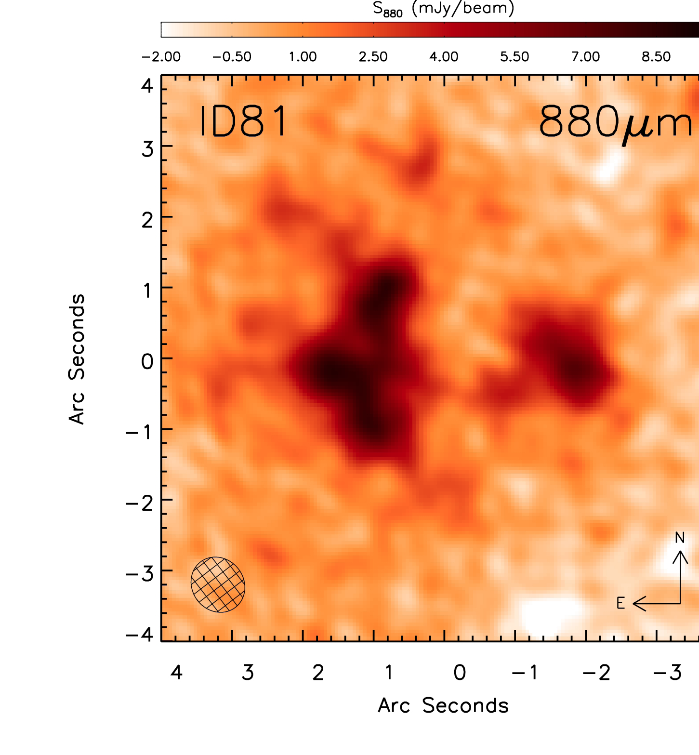
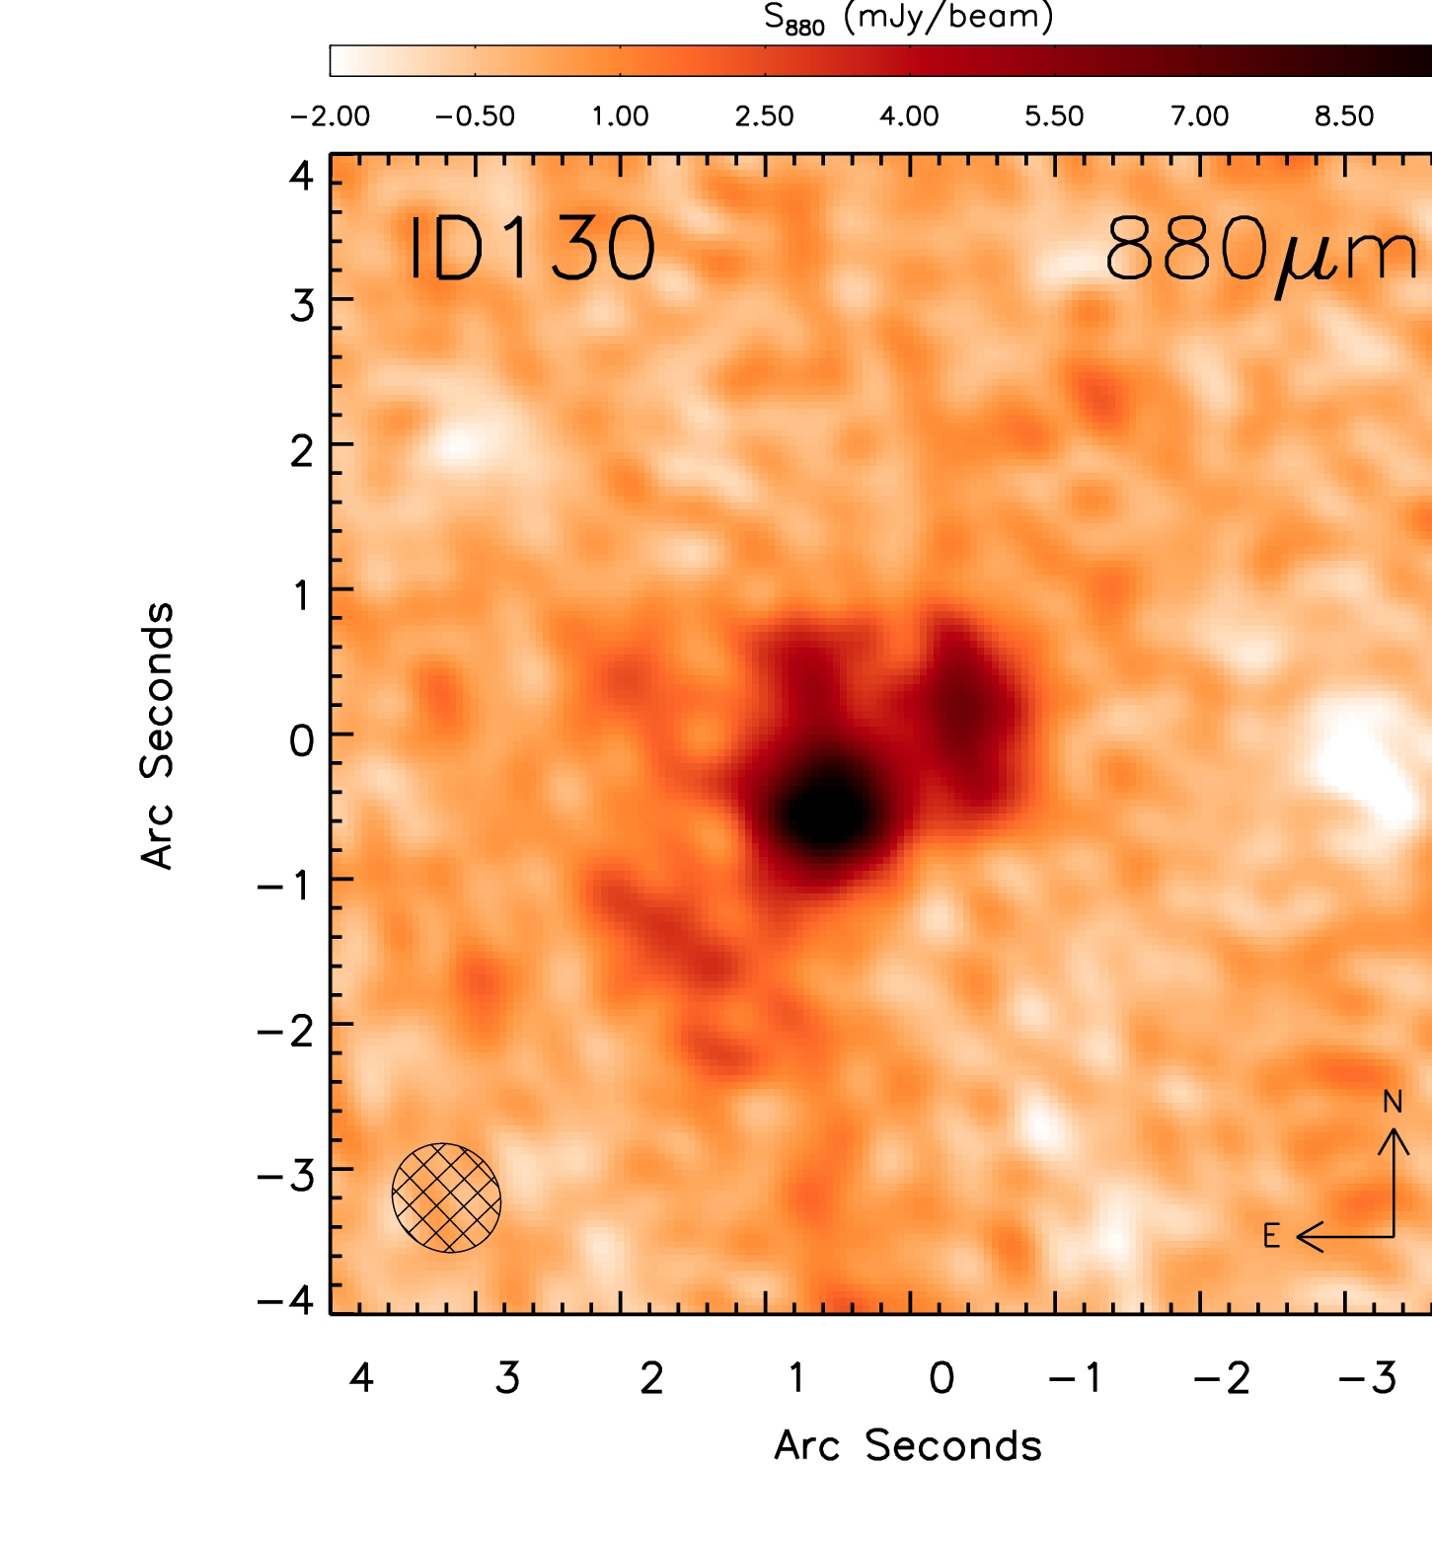
Evidence for Gravitational Lensing –
(3) Multiple Peaks in High Resolution Submm Imaging with the SMA

Slide 43
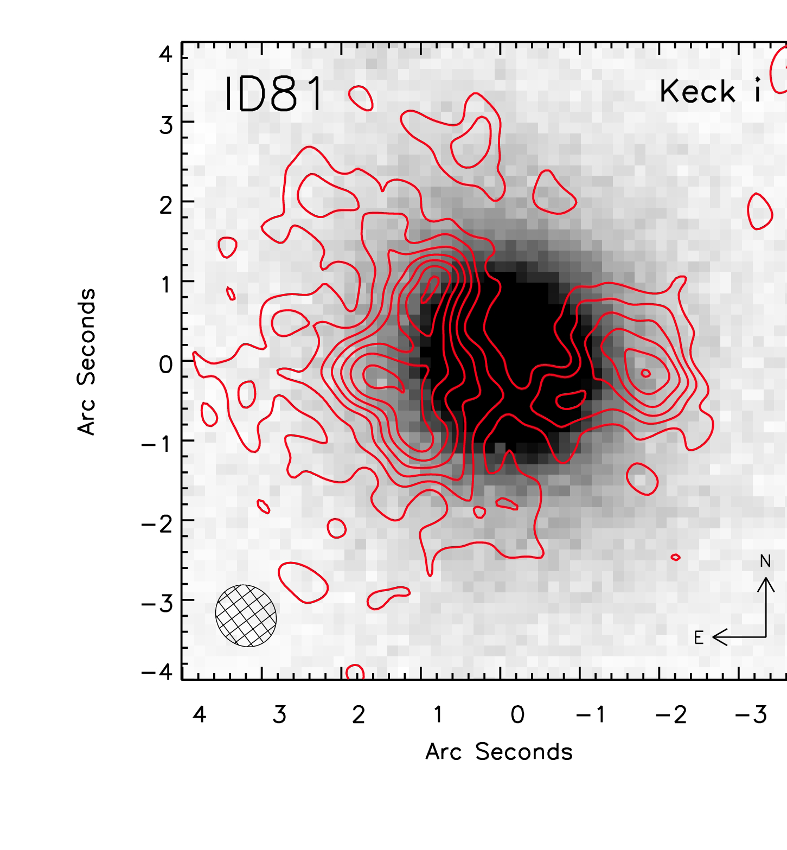
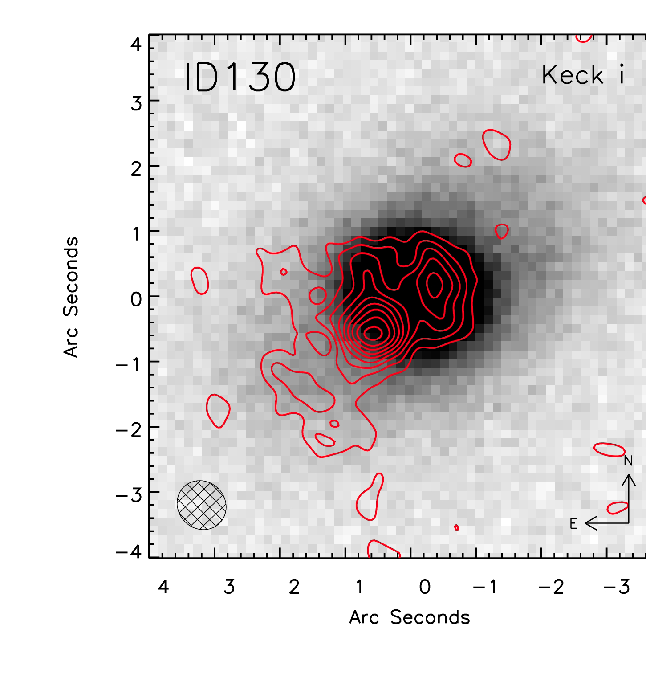
Evidence for Gravitational Lensing –
(3) Multiple Peaks in High Resolution Submm Imaging with the SMA (red contours)

Slide 44
CREDITS: ESA/NASA/JPL--‐Caltech/Keck/SMA

