Slide 1
KAT-7 Science verification 2012
SPT and Commissioning teams *
http://public.ska.ac.za/kat-7/kat-7-operations
* Bennett, T., Blose, S., Booth, R., de Villiers, M., Dikgale, A., Foley, T., Frank, B., Goedhart, S., Hess, K., Horrell, J., Lucero, D., Magnus, L., Mauch, T., Nemalili, T., Oozeer, N., Passmoor, S., Ratcliffe, S., Richter, L., Schwardt, L., Smirnov, O., Spann, R., Williams, L., Wilson, S., Wolleben, M., Zwart, J.,
Notes:
*
Thomas, Bennett, thomas@ska.ac.za
Siphelele, Blose, siphelele@ska.ac.za
Roy, Booth, rbooth@ska.ac.za
Mattieu, de Villiers, mattieu@ska.ac.za
Audrey, Dikgale, audrey@ska.ac.za
Tony, Foley, tony@ska.ac.za
Brad, Frank, frank.brad@gmail.com
Sharmila, Goedhart, sharmila@ska.ac.za
Kelley, Hess, kmhess@gmail.com
Jasper, Horrell, jasper@ska.ac.za
Danielle, Lucero, dmr2010@gmail.com
Lindsay, Magnus, lindsay@ska.ac.za
Tom, Mauch, tmauch@ska.ac.za
Tshakule, Nemalili, tnemalili@ska.ac.za
Nadeem, Oozeer, nadeem@ska.ac.za
Sean, Passmoor, sean@ska.ac.za
Simon, Ratcliffe, simonr@ska.ac.za
Laura, Richter, laura@ska.ac.za
Ludwig, Schwardt, schwardt@ska.ac.za
Oleg, Smirnov, oms@ska.ac.za
Rupert, Spann, rupert@ska.ac.za
Lance, Williams, lance@ska.ac.za
Susan, Wilson, swilson072@gmail.com
Maik, Wolleben, maik@ska.ac.za
Jonathan, Zwart, jtlz2cal@gmail.com

Slide 3
Overview
Polarization - Maik Wolleben
Confirmation of polarization calibration, Off axis polarization performance
Mosaicing - Maik Wolleben
Mosaicing observation planning and reduction confirmed, Primary beam correction
Spectral lines - Sharmila Goedhart, Brad Frank
NGC 3109 HI, HI absorption, MASERS
Continuum observations - Nadeem Oozeer
Galaxy clusters, Calibrator monitoring, AGN variability
Target of opportunity - Tony Foley (TAC)
ATEL #3694
Pulsar Observation – Simon ratcliffe
Online Flagging – Tom Mauch
VLBI – Laura Richter

Slide 4
SVP - MLS Involvements
ThunderKAT - currently in planning stage (work on Cir X-1 data underway)
Trappum - awaiting beamformer, initial discussions.
Pulsars - awaiting beamformer, have had initial discussions regarding monitoring program.
MIGHTEE - observations underway on candidate fields.
VLBI - initial eVLBI scheduled for Q4, routine observations 2013.
MHONGOOSE - Early observations with wbc8k.
MeerKAT Absorption Line Survey - early absorption observations with wbc8k
MeerGAL - Early maser observations, waiting for OH modes
Fornax - Use as target of convenience

Slide 5
Primary beam correction – (Wolleben M)
20 arcmins
Primary beam correction was performed in MIRIAD using a 1.3 degree Gaussian (at 1.4 GHz). So far primary beam correction has not been confirmed in CASA.
Notes:
KAT-7 file - 1330696924.h5, 2012-03-02 16:02:04 SAST, antennas 1,2,3,5,6,7 wbc mode

Slide 6
Confirmation of polarization calibration
Polarization calibration: verification using 3C286 and 3C138 with Miriad
12 hour observation, first 6 hours 3C138, then 3C286
Used 3C286 as gain and polarization calibrator
Bootstrapped calibration to 3C138 (both sources are not visible at the same time)
Miriad flux models for these sources at 1.4 GHz:
3c286: IQUV = 14.6, 0.56, 1.26, 0.0 (flux calibrator)
3c138: IQUV = 8.6, 0.60, -0.27, 0.0 (test source)
Observed fluxes at 1.4 GHz:
3c286: IQUV = 14.6, 0.56, 1.26, 0.0 ⇒ as expected
3c138: IQUV = 8.5, 0.58, -0.26, 0.0 ⇒ calibration confirmed! ☺
Conclusion is that Miriad works very well with linear hands of polarization and there is nothing, at this point, that prevents us from doing polarization imaging once the online system is there.
Notes:
KAT-7 file - 1330696924.h, 2012-03-02 16:02:04 SAST, antennas 1,2,3,5,6,7 wbc mode 1400 MHz

Slide 7
Polarization off axis performance
Observation:
3C286, 5x5 raster, spaced 20 arcmin, cycled through every 30 minutes
observed from source rise till set to get good parallactic angle coverage
the centre pointing was used for calibration (Miriad, full polarization)
each 3C286 pointing imaged individually and then source from each image copied into a single fits file to produce the images below
Recommendation:
The useful FOV is <30 arcmin in diameter (<15 arcmin radius from beam centre).
For now, data in the useful FOV can be calibrated in the standard way by observing a calibrator in the field centre and applying the calibration for the whole FOV.
Without primary beam correction the flux of a source can vary by approx. +/- 10% over the useful FOV (< 30 arcmin diameter).
Primary beam correction can “fix” fluxes in Stokes I but not in U, Q, and V.
If one is only interested in Stokes I the useful FOV can be larger than 30 arcmin.
Beyond the 15 arcmin radius Stokes U, Q, and V fluxes will be wrong.

Slide 8
Polarized intensity 3C286
The degree of polarization is given by
√(Q² + U² + V²)/ I²
The image (left) confirms that the Mueller matrix is position-dependent and variable across the beam.
3C286 has the following polarization parameters
I | Q | U | V
14.8 | 0.56 | 1.25 | 0

Slide 9
Q and U across the beam 3C286
Work is underway to model this variation so as to be able to use a greater portion of the beam for polarimetry

Slide 10
Amount of circular polarization 3C286
There is no circular polarization at the centre of the beam (expected) but there appears to be leakage off beam centre.
Calibration of this is ongoing together with a scheme to do L-Band holography for a measurement of beam characteristics.

Slide 11
Mosaicing
Left: KAT-7 Mosaic consisting of 49 Fields, 1.9 GHz
10 hours total observing time (including calibrators)
Right: NVSS at 1.4 GHz shown for comparison
Notes:
KAT-7 file - 1322242239.h5, observation date 2011-11-25 19:30:39 SAST all seven antennas centre freq 1822 MHz wbc mode, PKS 0407-658 as calibrator

Slide 12
Mosaicing
1225 fields
observed during 3 consecutive nights
size: 10 x 10 deg in Galactic coordinates
integration time of each field: 30 s
RMS in the final image: 35 mJy/beam in Stokes I, 20 mJy/beam in polarized intensity.
Probably due to ground radiation.
Supernova Remnant SN 1006. (Type 1A observed in 1006 AD.)
Notes:
Observed on 21, 22 and 23 March 2012 for about 12 hrs starting at about 9pm each day 1332359420.h5, 1332445695.h5, 1332530889.h5

Slide 13
Spectral modes
Mode | Band Bandwidth | Channel Bandwidth | Available
Wideband | 256 MHz 54000 km/s | 390.625 kHz 82 km/s | Yes
8k Wideband | 256 MHz 54000 km/s | 48.8 kHz 10 km/s | Yes
HI Spectral Line | 33.3 MHz 7000 km/s | 4 kHz 0.84 km/s | ~ Oct 2012
OH Spectral Line | 12.5 MHz 2600 km/s | 1.5 kHz 0.3 km/s | ~ Jun 2012
OH Spectral Line | 3.1 MHz 654 km/s | 381 Hz 80 m/s | ~ Jun 2012
Velocities are referenced to HI
Updates - http://public.ska.ac.za/kat-7

Slide 14
HI Velocity Field of NGC 3109 (Frank B et al.)
Observed using the wbc8k mode (10km/s spectral resolution for HI).
The wbc8k mode was made available to commissioning to start testing observation and reduction strategies for the narrow band modes while the other modes are being developed.
It illustrates the power of the ROACH design as the time from conception to first deployment was one day.
Notes:
NGC 3109 is a small spiral or irregular galaxy around 4.2 Mly away in the direction of the constellation of Hydra.
KAT-7 file - 1331824641.h5, 2012-03-15 17:17:21 SAST, 12:34:28 hrs observation, 1934-638, NGC3109e, 1018-317, all antennas, centre freq 1470.0 MHz, wbc8k mode

Slide 15
PKS1814-637 absorption – (Goedhart, S)
This was a short (10 min on source) observation to confirm the presence of the absorption structure
The expected absorption line is at 1334 MHz.
Notes:
KAT-7 file - 1333079135.h5, 2012-03-30 05:45:35 SAST, targets:1934-638, PKS1814-637, all antennas, centre freq 1328.0 MHz, wbc8k mode

Slide 16
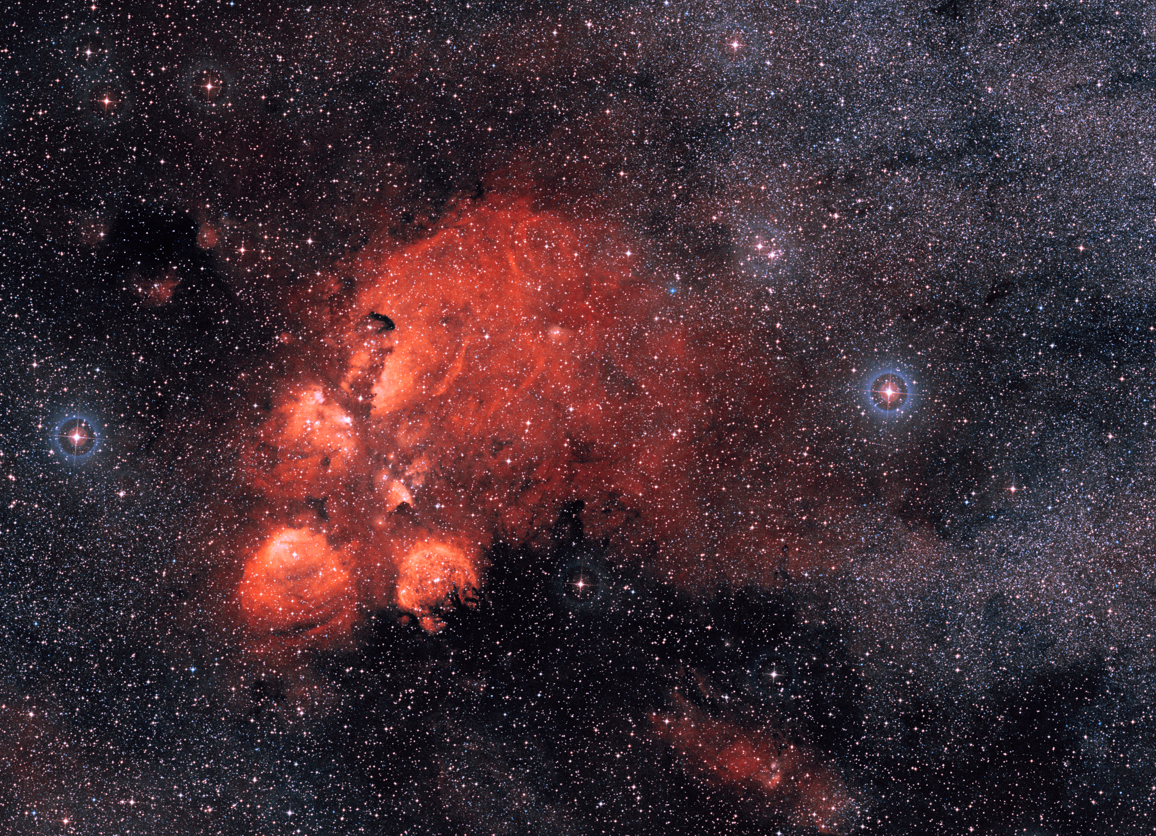
Notes:
Also known as (Cat's Paw Nebula, Bear Claw Nebula and Gum 64) is an emission nebula located in the constellation Scorpius
It was discovered by astronomer John Herschel in 1837, who observed it from the Cape of Good Hope in South Africa.
HII region/molecular cloud in the sagitarius arm

Slide 17
Single channel MASER lines for NGC6334 – (Goedhart, S)
Notes:
KAT-7 file -1329004046.h5, 2012-02-12 01:47:26 SAST, 13:05:15observing time, targets: PKS1740-517, NGC6334, 1934-638, antennas 2,3,5,6,7, centre freq 1822.0 MHz

Slide 18
Images (line maps) at 1665 and 1667 MHz respectively

Slide 19
Overlay of the narrow band contours on the continuum image
Notes:
V – peak flux of 458 mJy/beam
E – peak flux of 1636 mJy/beam
F – peak flux of 433 mJy/beam

Slide 20
Compared with ATCA at 1.6 GHz
Notes:
Brooks & Whiteoak

Slide 21
Long Continuum Integration – (Oozeer, N.)
These are the commissioning targets we want to meet
Mosaic imaging with KAT-7.
Wide field imaging testing and calibration.
Polarization calibration over wide FOV using direction dependant solutions.
Spectral line imaging mode.
Source extraction algorithm.
The Purpose (Mission)
Follow up observations of clusters of galaxies.
Understand the global view of magnetism within clusters
Understanding the correlation between radio and X-ray luminosities of clusters
Combining short-spacing data with other single dish telescope (such as the GBT) and with other interferometers.
“Possible” detection of halos and relics (halos and relics are diffuse radio emission found at the centre and periphery of clusters of galaxies.
Notes:
They have steep spectral indices α ~ 1.2 − 1.4). Cassano et al., predicted the flux limit of ~ 100 mJy at 1.4 GHz for detecting giant radio haloes at z~0.2.

Slide 22
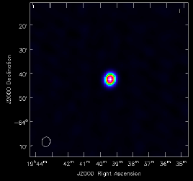
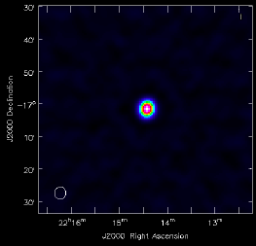
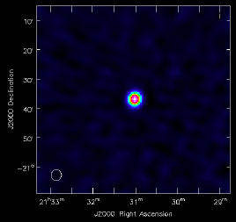
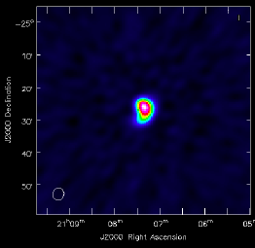
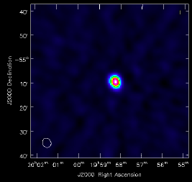
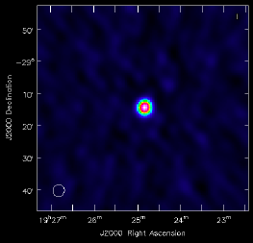
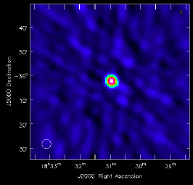
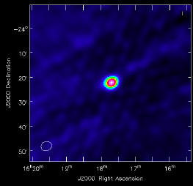
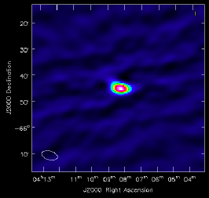
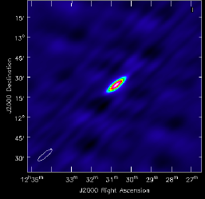
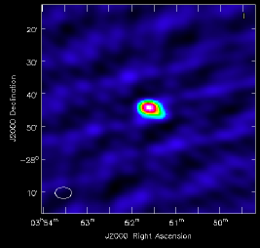
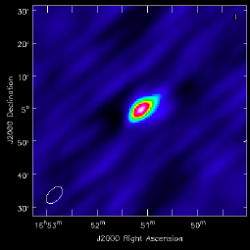
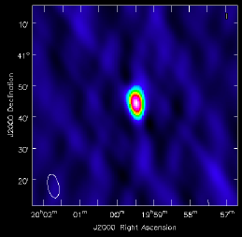
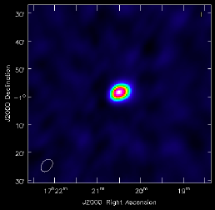
KAT-7 “calibrators”
PKS 1934-630
B2211-172
B2131-203
B2104-256
B1954-552
B1924-291
B1827-360
B1517-247
B0407-658
3C 286
B0349-278
3C 274
3C 495 - Cygnus A
3C 353
Notes:
HartRAO observations
AMI high frequency follow up of some of the calibrators – Jonathan Zwart

Slide 23
Transients:
CirX-1
Feb 2012 ~ ongoing
PKS1510-089
Oct 2011 ~ ongoing
PKS1451-375
Nov 2012 ~
Notes:
AE Aquarii PK flux from NVSS is few mJy ~4mJy which will require very long integration for KAT-7 (8 hours or more on source).
Right now the source is visible for 8hrs.
KAT-7 synthesized beam resolution is of the order of 3 arcmin at 1.8 GHz with a primary beam of 1 degree.
This field seems to be crowded and there are 2 source with pk flux above 100mJy at around 30arcmin away.
AE Aquarii will be blended in KAT-7 image, with another source 2.8 arcmin away.

Slide 26
PKS 1510-089 light curve (ATEL-3694)
Appart from monitoring the source PKS 1510-089 for the ATEL, the regular observations have been used to test the auto-delay (fringe stopping) functionality and to test interferometric pointing.
Notes:
~ 1000 hours of data available

Slide 27
PKS 1510-089 - auto_delay OFF
ra: 15:12:50.6
Dec: -09.05.56.12
Bmaj: 2.97'
Bmin: 2.86'
rms of residual image: 13 mJy
Fig: PKS1510-089 observed on 24-Feb 2012 with auto_delay OFF with 6 antennas (ant4 OUT).
Notes:
PKS 1510-089 : auto_delay_OFF
KAT-7 file 1330117630.h5, 2012-02-20 23:07:10 SAST, 16:16:11 hr duration, target: Circinus X-1, PKSJ1939-6342, PKS J1517-2422, PKS 1613-586, PKS J1510-0543, PKS 1510-089, 3C286
, antennas: 1,2,3,5,6,7, centre freq 1822.0 MHz
Ratio of peak flux and integrated fluxes = 1.03 (implies point source)

Slide 28
PKS 1510-089 - auto_delay testing
ra: 15:12:49.9
Dec: -09.06.05.10
Bmaj: 5.52'
Bmin: 2.94'
rms of residual image: 40 mJy
Fig: PKS1510-089 observed on 20-April 2012 with auto_delay ON with 5 antennas (ant2 and ant7 OUT).
Notes:
KAT-7 file 1334943650.h5, 2012-04-20 19:40:50 SAST 15:01:28, Targets: 3C286, PKSJ1939-6342, PKS J1510-0543, Circinus X-1, PKS J1517-2422, PKS 1510-089, PKS 1613-586, Antennas: 1,3,4,5,6 Centre frequency:1822.0
These are some of the experiments we can even do with 5 antennas.
This observation is ~ 15hrs of observations of both PKS 1510-089 and Cir X-1
This is the result using auto_delay ON. Position seems to coincide very well well with all previous observations without auto_delay. rms of residual image ~ 40 mJy, with an offset of around 3arcsec from the ICRF position and the various parameters are:
RA J2000 15:12:49.89 +/- 0.18 Dec(J2000) = -009.06.05.10 +/- 1.75
Bmaj/arcmin = 5.52 +/- 0.39 Bmin/arcmin = 2.94 +/- 0.75 PA/deg = 113.3 +/- 6.1
S/Jy = 2.057 +/- 0.034 S_pk/Jy = 2.247 +/- 0.037

Slide 29
Positional Offset (deg) wrt ICRF
Notes:
The International Celestial Reference Frame (ICRF)
Analysis of 5 data sets out of the MANY data sets:
Such observations are being used to commission:
System/band pass stability
noise variation in continuum imaging
the positional offset due to calibration
Plus radio light curve as mentioned earlier.

Slide 30
Future work:
Zie et al. (2008) - radio light curves of PKS 1510-089 at 37 and 22 GHz from 1990 to 2005 taken from the database of the Metsähovi Radio Observatory, and find
evidence of quasi-periodic outbursts.
They also found two periods of p1 = 0.92 ± 0.04 yr and p2 = 1.82 ± 0.12yr for the outbursts in PKS 1510-089
The results are in good agreement with the periodic deep flux minima of 1.84 ± 0.1 yr (half period ∼ 0.92 ± 0.03 yr) observed by Zie et al. and other authors in the optical band.

Slide 31
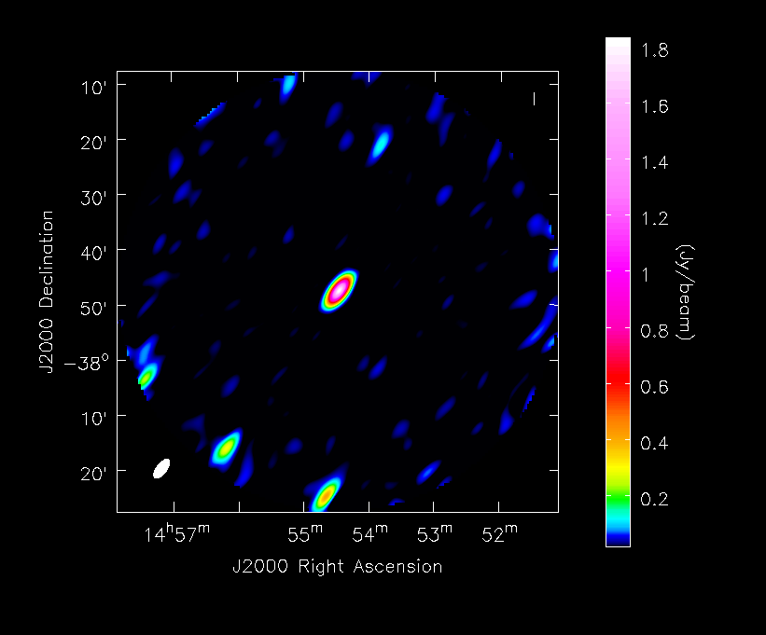
PKS 1451-375: Blazar (ATEL4536, 4537)
Notes:
Again with only 5 antennas, these sources can be monitored.
This source has been observed by Hungwe for the TANAMI project.

Slide 32
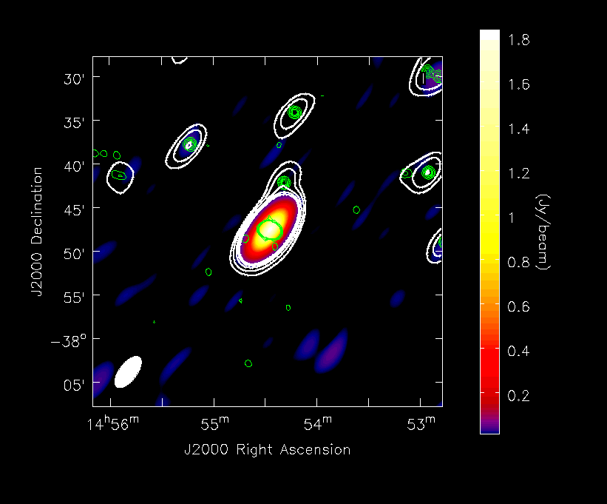

Slide 33
PKS 1451-375
Ra : 14:54:27.390 +/- 0.019 s
dec: -037.47.35.917 +/- 0.337 arcsec
Major axis FWHM: 4.1546 +/- 0.0059 arcmin
Minor axis FWHM: 1.8705 +/- 0.0133 arcmin
position angle: 142.57 +/- 0.14 deg
Spectral index ~ -0.28
Expected Flux density at 1822 = 1.644 Jy
Measured flux using KAT-7 = 1.8696 +/- 0.0060 Jy

Slide 34
El Gordo (ACT-CL J0102-4915)
Aim for observation
check for diffuse synchrotron emission
check polarization
derive spectral index and look for break in spectrum (derive/confirm physical parameters)
if no detection: may get only an upper limit
check expected rms using long integration.
Notes:
KAT-7 file - 1332041919.h5, 2012-03-18 05:38:39 SAST, 13:11:42 hr observation, targets:PKSJ0042-4414, el_gordo, PKSJ0010-4153, 3C48, all seven antennas, centre freq 1822.0
KAT-7 file - 1332581406.h5, 2012-03-24 11:30:07 SAST, 10:37:16 hr observation, targets:el_gordo, PKSJ1939-6342, PKSJ0042-4414, PKSJ0010-4153, PKS J0423-0120, 3C138, , all seven antennas, centre freq 1822.0MHz
This Galaxy cluster signature was detected from SZ using Atacama Cosmology Telescope.
Our rms is around 1sigma ~ 650 mircoJy/Beam
23 hours of observations which ~ 13 hours on source @ 1822 MHz using 7 antennas.
Data reduced in Casa - procedures are available for any continuum data reduction for KAT-7.
Polarization observation has been done using mosaicing. Reduction in under way using Miriad since casa does not support Linear pol.

Slide 35
Comparison with SUMMS
These sources are just above the detection limit of SUMSS but well detected with KAT-7
Notes:
SUMSS (catalogue of the radio sky at 843 MHz) source in green contour overlay onto the KAT-7 images
KAT-7 contours at 2.5 mJy/beam (Our rms is around 1sigma ~ 650 mircoJy/Beam), the SUMSS survey resolution of 45 arcsec and sensitivity (1-sigma noise limit 1mJy).
We have detected almost all the strong source we expected from SUMSS. However, we also detect some faint source which SUMSS did not pick up. Investigation to know what they are are in progress.

Slide 36
radio relics
Notes:
Zoomed region of interest shows the KAT-7 (Red contours) with SUMSS (green)
This is the highest redshift relic detected using SZ effect from the ACT
The low frequency image from SUMSS shows possible relics which has then been confined using ATCA observation (priv comm)
Our aim was to see if we to do detect diffuse emission from the source using KAT-7 - YES
Check for polarised emission - On-going
Derive radio luminosity at 1.4GHz and other parameters - on going.
SUMSS with a better resolution has resolved this source whereas KAT-7 provides modest resolution of around 3' allowing us to detect the diffuse feature.
However, the source is blended with a component in the NW part.
The South-East Component detected from KAT-7 has no strong detection from SUMSS.
Polarimetric observation using mosaic has been done and is being reduced - this will go about 1/3 times deeper than the total intensity.
Magnetic understanding in cluster is still not well understood. With KAT-7 we expected to get an understanding of the large scale magnetic property of this relic source.
KAT-7 is an ideal instrument for detecting large scale diffuse emission, that is provided by our short spacings.
To get a global picture of the environment of clusters of galaxies for example, we don't want to resolve all the structures.

Slide 37
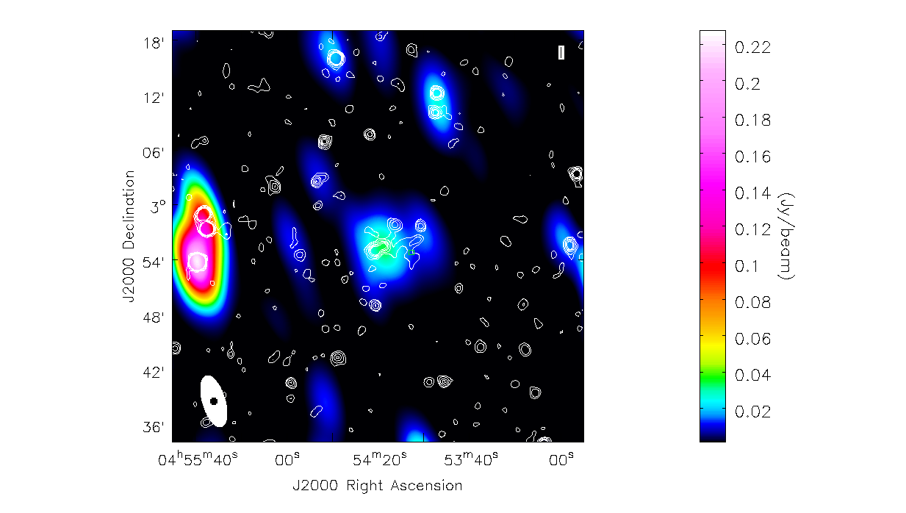
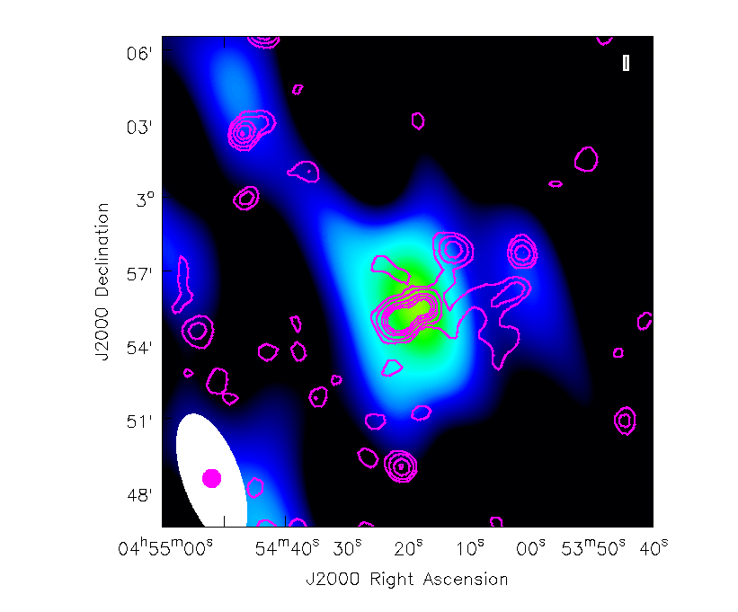
ACO 0520 – radio halo – (Zwart, J., Dean, R.)
Girardi et al, 2008, showed that ACO0520 is a cluster forming at the crossing of three filaments?
Notes:
The Abell 520 galaxy cluster is an unusual structure resulting from a major merger. It has been popularly nicknamed The Train Wreck Cluster.

Slide 38
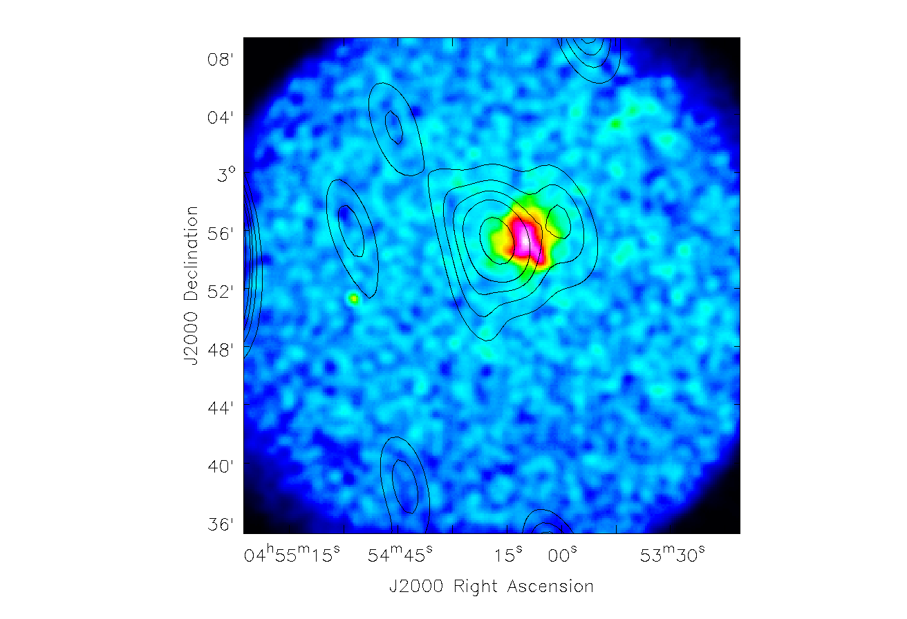

Slide 39
RXC J2003.5-2323 – ( UKZn – Knowles, Moodley)
Giancintucci et al . 2009
X-ray luminous and massive galaxy cluster at redshift z=0.317
RAJ2000 20h03m30.4s
DecJ2000 -232305
z 0.317
Lx (0.1- 2.4 KeV) 9.25x10⁴⁴ ergs s⁻¹
Mv 2.05x10¹⁵ Mo
Rv 2.75 Mpc
RXC J2003.5-2323 hosts a cluster scale radio source classified as a giant radio halo (Venturi et al. 2007)
S(1.4GHz) = 35+- 2 mJy
α = 1.27 (Typical giant radio halo , Feretti 2005)
Notes:
It belongs to the ROSAT-ESO Flux Limited X-ray cluster catalogue (REFLEX; Böhringer et al. 2004).

Slide 40
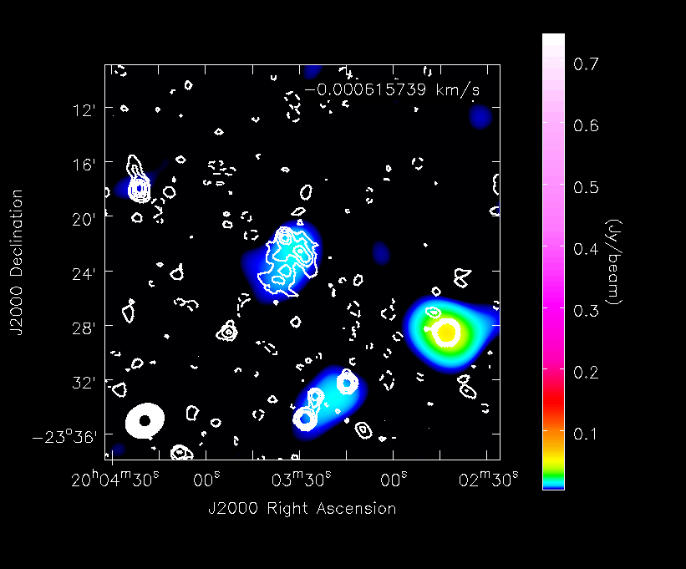
RXCJ2003-2323
Notes:
Position ---
--- ra: 20:03:33.15 +/- 0.42 s (6.28 arcsec)
--- dec: -023.23.04.16 +/- 5.69 arcsec
Flux ---
--- Integrated: 40.3 +/- 3.0 mJy
--- Peak: 16.1 +/- 1.2 mJy/beam
Rms ~ 1.1 mJy

Slide 41
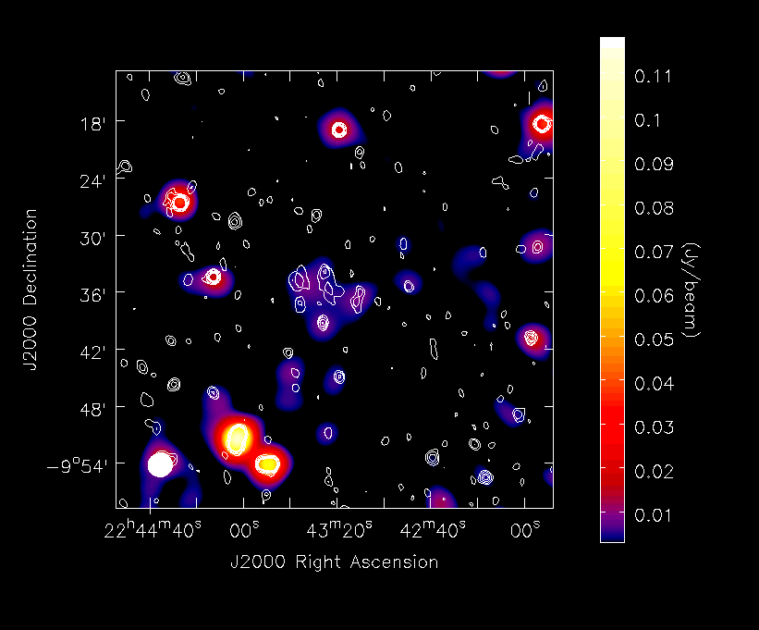
Notes:
Filename: 1347034080.h5
Date: 2012-09-07 18:08:08 SAST
Duration: 8:24:53
Targets: HAN-HALO1, PKS2243-123, PKS 1934-638
Ants: 1234567
In general, halos (both GHs and MHs) are regular, unpolarised emission
around the cluster’s centre, whereas relics are peripheral,
polarised, typically elongated, and thought to be associated
with shocks.

Slide 42
Ongoing cluster:
Planck’s cluster – Colafrancesco, S. (Wits)
RCS cluster – Gilbank, D. (SAAO)
ACT cluster – Moodley, K. (UKZn)
Scientist Involvement:
AIMS, UWC, UCT, UKZn, Wits, SAAO, …
Notes:
The connection of cluster mergers with the presence of extended, diﬀuse radio sources in galaxy clusters is still debated.
An interesting case is the rich, merging cluster Abell 520, containing a radio halo being formed at the crossing of 3 filaments (Girardi, 2008)

Slide 43
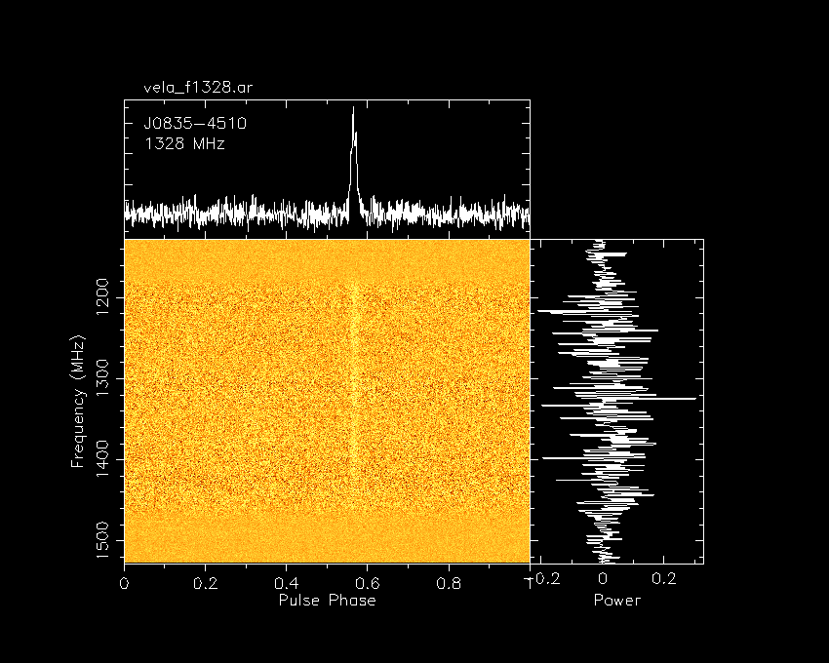
Vela pulsar – (Ratcliffe, S)

Slide 44
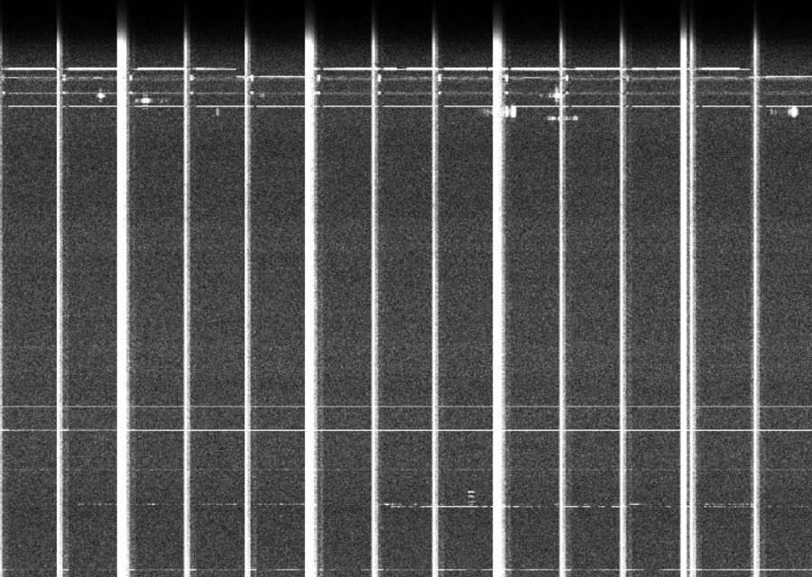
RFI Flagging – (Mauch T)

Slide 45
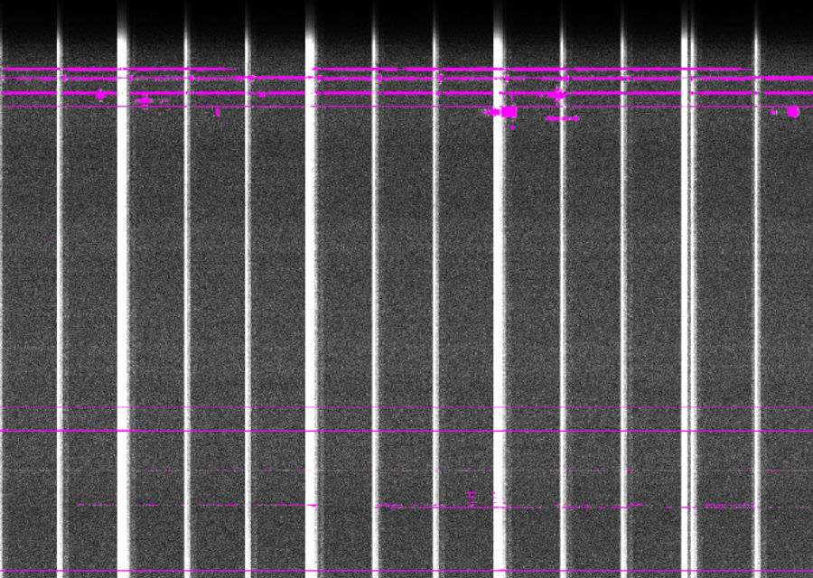

Slide 46
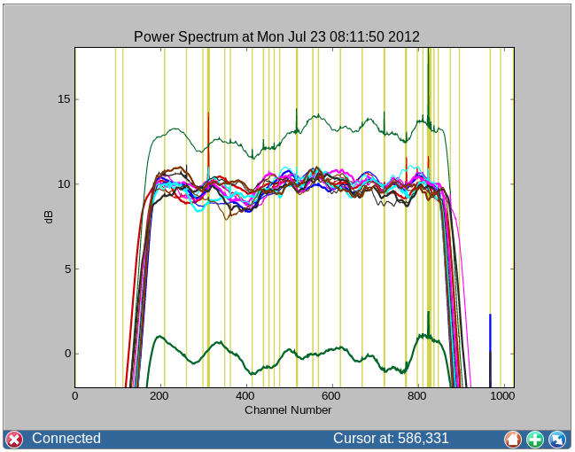

Slide 47
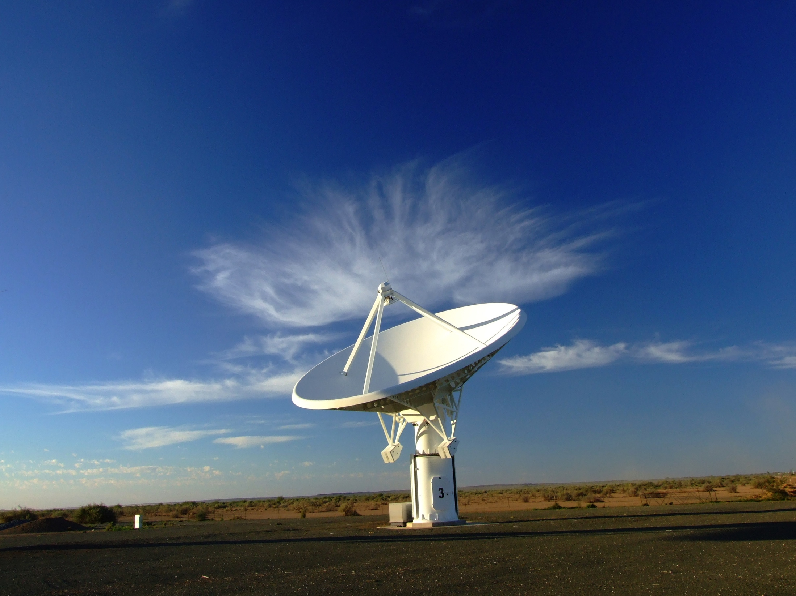
Thank you

